Slide 1
P2 Chapter 10 :: Numerical Methods
Pupil Notes
Last modified: 13th Jan 2020

Slide 2
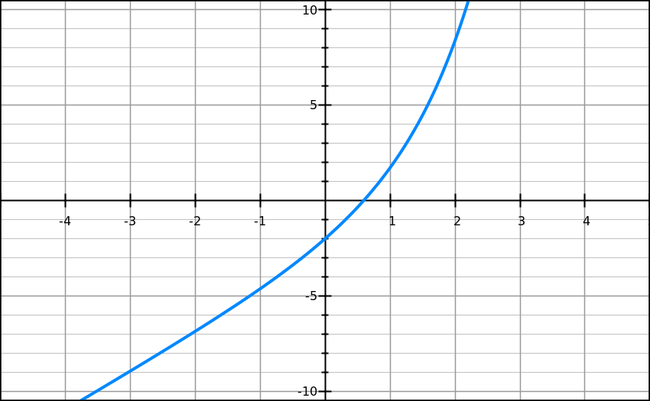
Proving a solution lies in a range
Show that ${f\left(x\right)=e}^{x}+2x−3$ has a root between $x=0.5$ and $x=0.6$
Exam Tip: In the mark scheme they’re looking for:
Finding the function output for the two values.
Referring to a ‘change in sign’.
$$\left(0.6, 0.022\right)$$
If the $y$ value goes from negative to positive or vice versa, then clearly the $y$ values must pass 0 somewhere in between.
$$\left(0.5,−0.351\right)$$

Slide 3
…but only if the function is continuous
$$y$$
A function is continuous if the line does not ‘jump’. A root is only guaranteed with a sign change if the function is continuous, as otherwise the line can skip past 0 (in this case due to a vertical asymptote.
$$(1,1)$$
$$x$$
$$(−1,−1)$$
…and no sign change doesn’t mean there isn’t a root
$$y$$
Beware! Just because there isn’t a sign change, doesn’t mean there’s no root in that interval.
root
root
$$x$$
The sign change method fails to detect a root if there were an even number of roots in that interval.

Slide 4
Proving a solution to a given accuracy
Edexcel C3 Jan 2013
Thinking back to lower school, if the root $2.307$ is correct to 3dp, what’s the smallest and greatest value it could be?
Smallest:
Greatest:
If there was a sign change between $x=2.3065$ and $x=2.3075$, then we know $2.3065<α<2.3075$. But if the value is in this range, then we know it is 2.307 to 3 decimal places!

Slide 5
Example
[Textbook] (a) Using the same axes, sketch the graphs of $y=\ln{x}$ and $y=\frac{1}{x}$. Explain how your diagrams shows that the function $y=\ln\left(x\right)−\frac{1}{x}$ has only one root.
(b) Show that this root lies in the interval $1.7<x<1.8$
(c) Given that the root of $f\left(x\right)$ is $α$, show that $α=1.763$ correct to 3 decimal places.

Slide 6
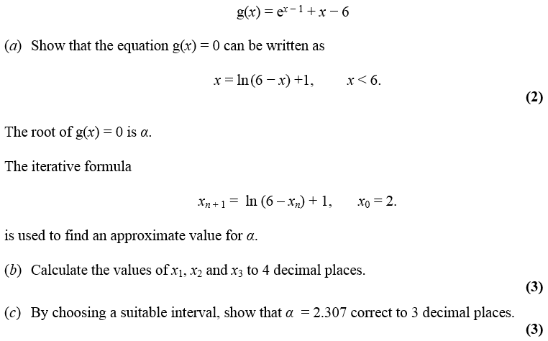
Using iteration to approximate a root
Edexcel C3 Jan 2013
! To solve $f\left(x\right)=0$ by an iterative method, rearrange into a form $x=g\left(x\right)$ and use the iterative formula $x_{n+1}=g\left(x_{n}\right)$

Slide 7
Does the starting value $x_{0}$ matter?
Yes! We’ll see why in a bit when we look at staircase and cobweb diagrams.
If there are a multiple roots, iteration might converge to (i.e. approach) a different root.
Or we may not converge to a root at all, and diverge (i.e. approach infinity).
[Textbook] $f\left(x\right)=x^{3}−3x^{2}−2x+5$
Show that the equation $f\left(x\right)=0$ has a root in the interval $3<x<4$.
Use the iterative formula $x_{n+1}=\sqrt{\frac{x_{n}^{3}−2x_{n}+5}{3}}$ to calculate the values of $x_{1}$, $x_{2}$ and $x_{3}$, giving your answers to 4 decimal places, and taking: (i) $x_{0}=1.5$ (ii) $x_{0}=4$

Slide 8
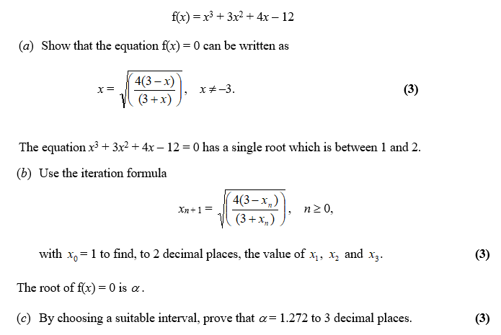
Test Your Understanding
Edexcel C3 June 2012 Q2

Slide 9
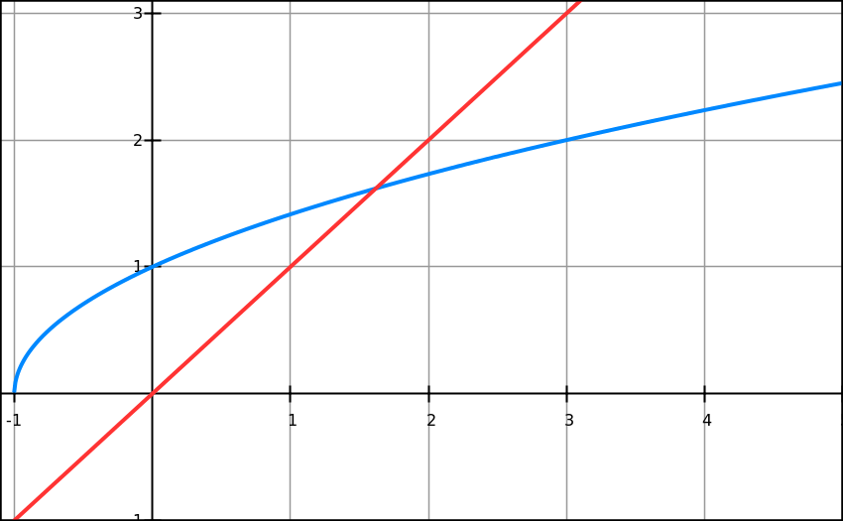
Why does this method work?
Solve $x^{2}−x−1=0$
Recall we put in the form $x=g\left(x\right)$: in this case $x=\sqrt{x+1}$ is one possible rearrangement.
We can then use the recurrence $x_{n+1}=\sqrt{x_{n}+1}$ . Why does this recurrence work?
This is called a staircase diagram due to its shape. We can see that we’re converging towards the root $α$.
$$y=x$$
$$y=\sqrt{x+1}$$
This value of $x$ is the root of the original equation.
$$x_{1}$$
$$α$$
$$x_{0}$$

Slide 10
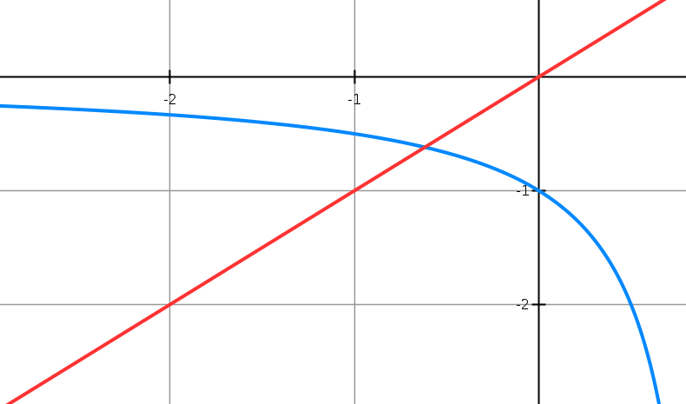
Cobweb Diagrams
Solve $x^{2}−x−1=0$
We could also have rearranged differently to $x=\frac{1}{x−1}$
Therefore we use the recurrence $x_{n+1}=\frac{1}{x_{n}−1}$ . What happens this time?
$$y=x$$
$$x_{2}$$
$$x_{0}$$
$$α$$
$$x_{1}$$
$$x_{3}$$
$$y=\frac{1}{x−1}$$
This is unsurprisingly called a cobweb diagram. Again we can see that we’re successfully converging towards the root $α$.

Slide 11
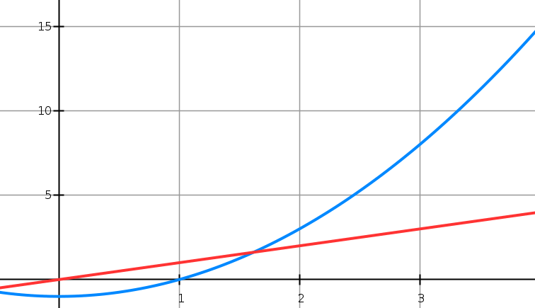
And when iteration fails…
Solve $x^{2}−x−1=0$
But again, we could have rearranged differently! $x=x^{2}−1$
Therefore we use the recurrence $x_{n+1}=x_{n}^{2}−1$ . What happens this time?
The root approximations $x_{i}$ are getting further away from the true root $α$, not closer, so our iterative method failed. ☹
$$α$$
$$x_{0}$$
$$x_{1}$$

Slide 12
Test Your Understanding
$$f\left(x\right)=x^{2}−8x+4$$
Show that the root of the equation $f\left(x\right)=0$ can be written as $x=\sqrt{8x−4}$
Using the iterative formula $x_{n+1}=\sqrt{8x_{n}−4}$, and starting with $x_{0}=1$, draw a staircase diagram, indicating $x_{0},x_{1}, x_{2}$ on your $x$-axis, as well as the root $α$.

Slide 13
The Newton-Raphson Process
y
Formula:
Using Year 1 coordinate geometry:
$$y−f\left(x_{n}\right)=f^{′}\left(x_{n}\right)\left(x−x_{n}\right)$$
But we’re interested when
$x=x_{n+1}$ and $y=0$
$$−f\left(x_{n}\right)=f^{′}\left(x_{n}\right)\left(x_{n+1}−x_{n}\right)$$
which rearranges to give:
$$y=f\left(x\right)$$
! Newton-Raphson Process:
$$x_{n+1}=x_{n}−\frac{f\left(x_{n}\right)}{f^{′}\left(x_{n}\right)}$$
$$x$$
$$x_{n+1}$$
$$xn$$
Exam Note: Pearson didn’t include the above proof in their own textbook, so I can only presume you won’t be tested on the proof.

Slide 14
Quickfire Questions
Using the Newton-Raphson process, state the recurrence relation for the following functions:
$$f\left(x\right)=x^{3}−2$$
$$f\left(x\right)=\tan{x}$$
$$f\left(x\right)=x^{2}−x−1$$

Slide 15
Example Exam Question
Edexcel FP1 June 2013(R) Q3c

Slide 16
Test Your Understanding
Edexcel FP1 Jan 2010 Q2c

Slide 17
When does Newton-Raphson fail?
$$y$$
If the starting value $x_{0}$ was the stationary point, then $f^{′}\left(x_{0}\right)=0$, resulting in a division by 0 in the above formula.
Graphically, it is because the tangent will never reach the $x$-axis.
tangent
$$x_{0}$$
$$x$$
$$y=\frac{x}{\sqrt{1+x^{2}}}$$
$$y$$
Newton-Raphson also suffers from the same drawbacks as solving by iteration, in that it’s possible for the values of $x_{i}$ to diverge.
In this example, the $x_{i}$ oscillate either side of 0, but gradually getting further away from $α=0$.
$$x_{1}$$
$$x_{0}$$
$$x$$
$$x_{2}$$

Slide 18
Application to Modelling
[Textbook] The price of a car in £s, $x$ years after purchase, is modelled by the function
$$f\left(x\right)=15 000 {\left(0.85\right)}^{x}−1000\sin{x}, x>0$$
Use the model to find the value, to the nearest hundred £s, of the car 10 years after purchase.
Show that $f\left(x\right)$ has a root between 19 and 20.
Find $f^{′}\left(x\right)$
Taking 19.5 as a first approximation, apply the Newton-Raphson method once to $f(x)$ to obtain a second approximation for the time when the value of the car is zero. Give your answer to 3 decimal places.
Criticise this model with respect to the value of the car as it gets older.

