Slide 1

P2 Chapter 11 :: Integration
Student Notes
Last modified: 3rd January 2020

Slide 2
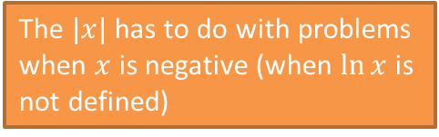
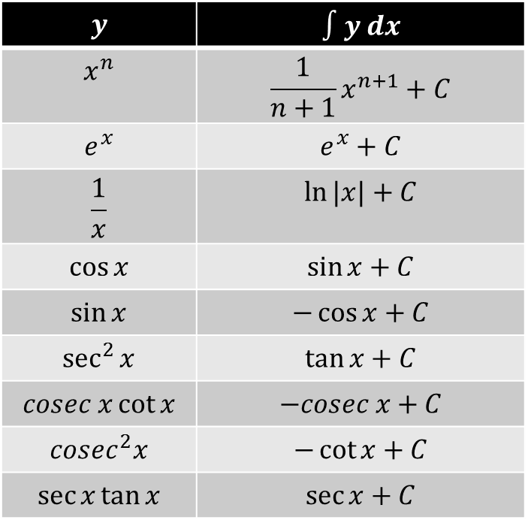
SKILL #1: Integrating Standard Functions
There’s certain results you should be able to integrate straight off, by just thinking about the opposite of differentiation.
$$y$$ | $$∫y dx$$
$$x^{n}$$ | $$\frac{1}{n+1}x^{n+1}+C$$
$$e^{x}$$ | $$e^{x}+C$$
$$\frac{1}{x}$$ | $$\ln{|x|}+C$$
$$\cos{x}$$ | $$\sin{x}+C$$
$$\sin{x}$$ | $$−\cos{x}+C$$
$$\sec^{2}{x}$$ | $$\tan{x}+C$$
$$cosec x\cot{x}$$ | $$−cosec x+C$$
$$cosec^{2}x$$ | $$−\cot{x}+C$$
$$\sec{x}\tan{x}$$ | $$\sec{x}+C$$
The $|x|$ has to do with problems when $x$ is negative (when $\ln{x}$ is not defined)

Slide 3
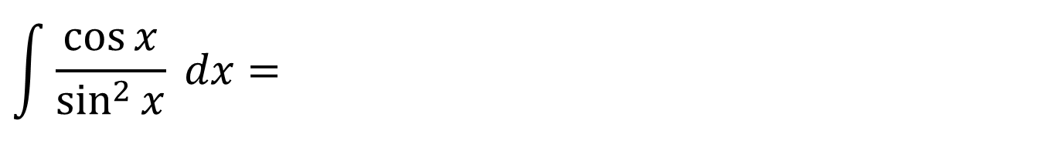
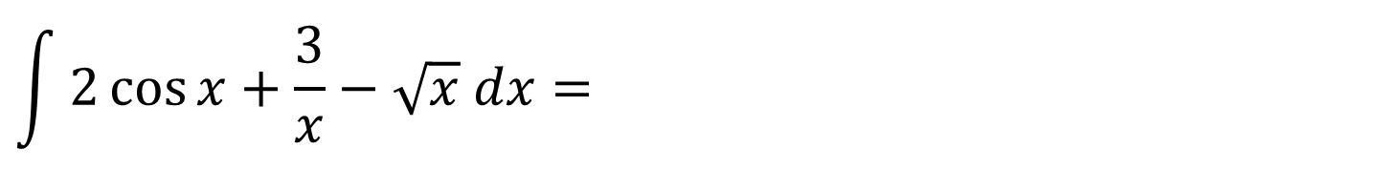
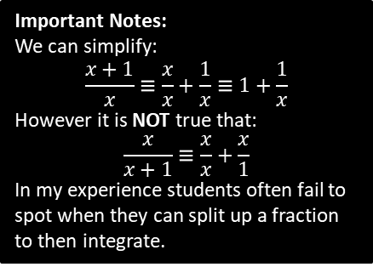
Test Your Understanding
$$\int{2\cos{x}+\frac{3}{x}−\sqrt{x} dx}=$$
$$\int{\frac{\cos{x}}{\sin^{2}{x}} dx}=$$
[Textbook] Given that $\int_{a}^{3a}{ \frac{2x+1}{x} dx}=\ln{12}$, find the exact value of $a$.
Important Notes:
We can simplify:
$$\frac{x+1}{x}≡\frac{x}{x}+\frac{1}{x}≡1+\frac{1}{x}$$
However it is NOT true that:
$$\frac{x}{x+1}≡\frac{x}{x}+\frac{x}{1}$$
In my experience students often fail to spot when they can split up a fraction to then integrate.

Slide 4
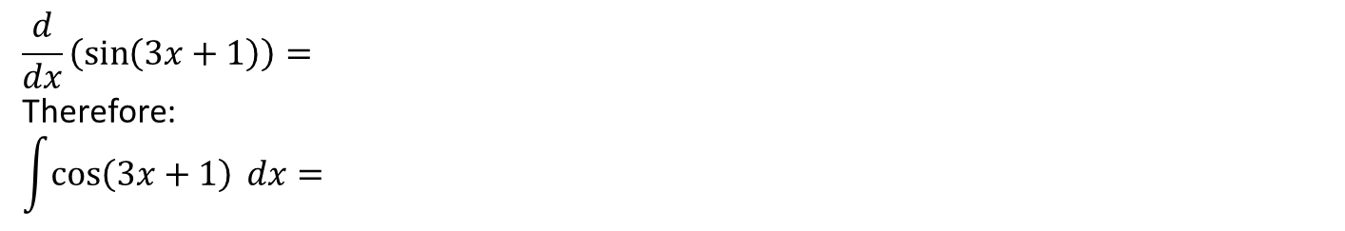


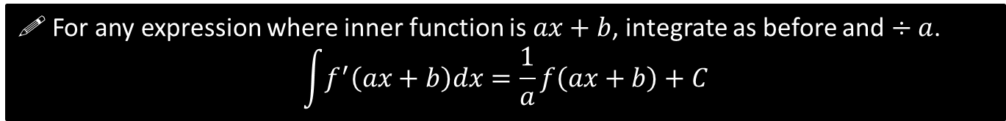
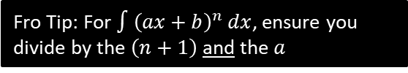
SKILL #2: Integrating $f\left(ax+b\right)$
$$\frac{d}{dx}\left(\sin\left(3x+1\right)\right)=$$
Therefore:
$$\int{\cos\left(3x+1\right) dx}=$$
! For any expression where inner function is $ax+b$, integrate as before and $÷a$.
$$\int{f^{′}\left(ax+b\right)dx}=\frac{1}{a}f\left(ax+b\right)+C$$
Quickfire:
$$\int{e^{3x} dx}=$$
$$\int{\frac{1}{5x+2}dx}=$$
$$\int{{2sec}^{2}\left(3x−2\right) dx=}$$
$$\int{{\left(3x+4\right)}^{3} dx}=$$
$$\int{\sin\left(1−5x\right)dx}=$$
$$\int{\frac{1}{3{\left(4x−2\right)}^{2}}dx=}$$
$$\int{{\left(10x+11\right)}^{12}=}$$
Fro Tip: For $∫{\left(ax+b\right)}^{n} dx$, ensure you divide by the $\left(n+1\right)$ and the $a$

Slide 5

Check Your Understanding
$$\int{e^{3x+1}dx}=$$
$$\int{\frac{1}{1−2x}dx}=$$
$$\int{{\left(4−3x\right)}^{5}dx}=$$
$$\int{\sec\left(3x\right)tan⁡(3x) dx}=$$

Slide 6
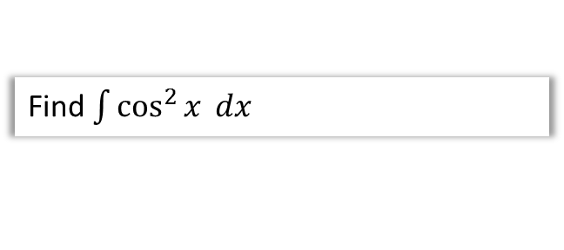


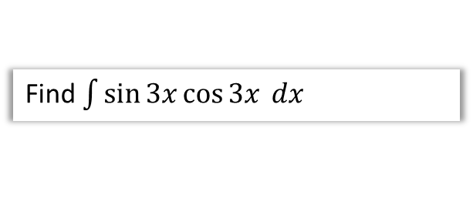
SKILL #3: Integrating using Trig Identities
Some expressions, such as $\sin^{2}{x}$ and $\sin{x}\cos{x}$ can’t be integrated directly, but we can use one of our trig identities to replace it with an expression we can easily integrate.
Q
Find $\int{\sin^{2}{x} dx}$
Q
Find $\int{\sin{3x}\cos{3x} dx}$
Q
Find $\int{\cos^{2}{x} dx}$
Q
Find $\int{\tan^{2}{x} dx}$

Slide 7

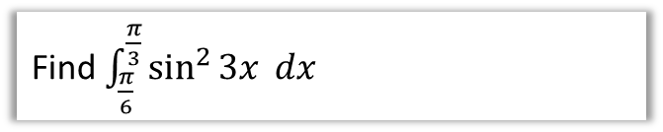
Check Your Understanding
Q
Find $\int{{\left(\sec{x}+\tan{x}\right)}^{2} dx}$
Q
Find $\int_{\frac{π}{6}}^{\frac{π}{3}}{\sin^{2}{3x}} dx$

Slide 8

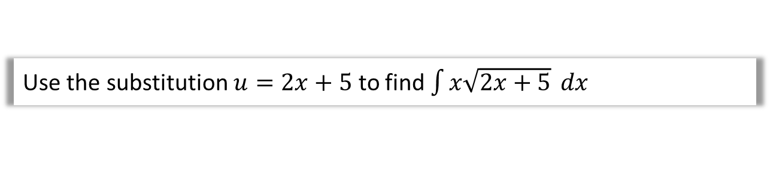
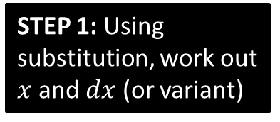
SKILL #5: Integration by Substitution
For some integrations involving a complicated expression, we can make a substitution to turn it into an equivalent integration that is simpler. We wouldn’t be able to use ‘reverse chain rule’ on the following:
Q
Use the substitution $u=2x+5$ to find $\int{x\sqrt{2x+5}} dx$
The aim is to completely remove any reference to $x$, and replace it with $u$. We’ll have to work out $x$ and $dx$ so that we can replace them.
STEP 1: Using substitution, work out $x$ and $dx$ (or variant)
STEP 2: Substitute these into expression.
STEP 3: Integrate simplified expression.
STEP 4: Write answer in terms of $x$.

Slide 9
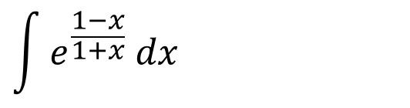


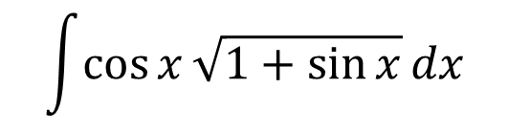
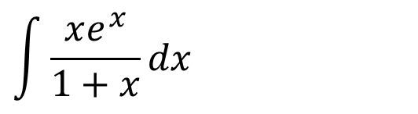

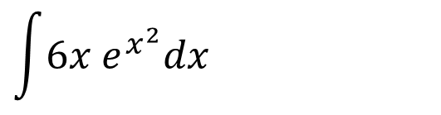

How can we tell what substitution to use?
In Edexcel you will usually be given the substitution!
However in some other exam boards, and in STEP, you often aren’t.
There’s no hard and fast rule, but it’s often helpful to replace to replace expressions inside roots, powers or the denominator of a fraction.
Sensible substitution:
$$\int{\cos{x}\sqrt{1+\sin{x}}dx}$$
$$u=$$
$$\int{6x e^{x^{2}}dx}$$
$$u=$$
$$\int{\frac{xe^{x}}{1+x}dx}$$
$$u=$$
$$\int{e^{\frac{1−x}{1+x}} dx}$$
$$u=$$

Slide 10

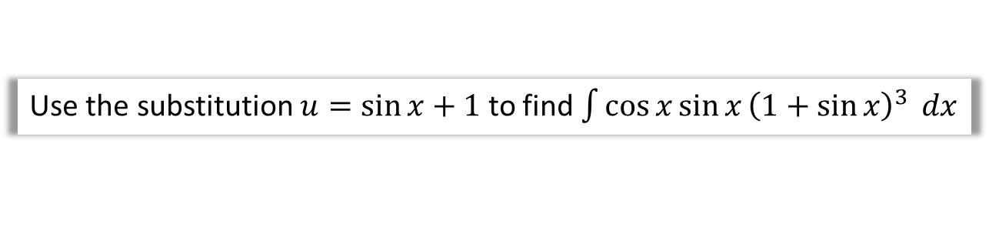
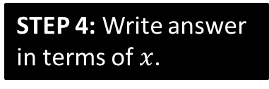
Another Example
Q
Use the substitution $u=\sin{x}+1$ to find $\int{\cos{x}\sin{x}{\left(1+\sin{x}\right)}^{3}} dx$
STEP 1: Using substitution, work out $x$ and $dx$ (or variant)
STEP 2: Substitute these into expression.
STEP 3: Integrate simplified expression.
STEP 4: Write answer in terms of $x$.

Slide 11
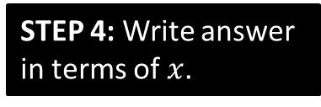


Using substitutions involving implicit differentiation
When a root is involved, it makes thing much tidier if we use $u^{2}=…$
Q
Use the substitution $u^{2}=2x+5$ to find $\int{x\sqrt{2x+5}} dx$
STEP 1: Using substitution, work out $x$ and $dx$ (or variant)
STEP 2: Substitute these into expression.
STEP 3: Integrate simplified expression.
STEP 4: Write answer in terms of $x$.

Slide 12
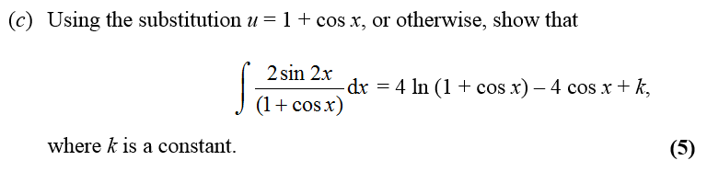
Test Your Understanding
Edexcel C4 Jan 2012 Q6c
Hint: You might want to use your double angle formula first.

Slide 13
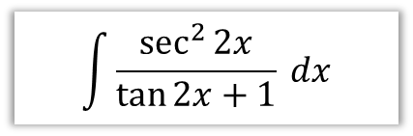
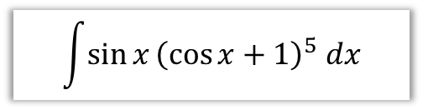

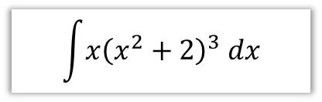

Starter
$$\int{\sin{x}{\left(\cos{x}+1\right)}^{5} dx}$$
$$\int{\frac{cosec^{2}x}{{\left(2+\cot{x}\right)}^{3}}dx}$$
$$\int{\frac{\sec^{2}{2x}}{\tan{2x}+1} dx}$$
$$\int{x{\left(x^{2}+2\right)}^{3} dx}$$
$$\int{5\tan{x}\sec^{2}{x} dx}$$

Slide 14
Definite Integration
Now consider:
Q
Calculate $\int_{0}^{\frac{π}{2}}{\cos{x}\sqrt{1+\sin{x}}} dx$
Use substitution:

Slide 15
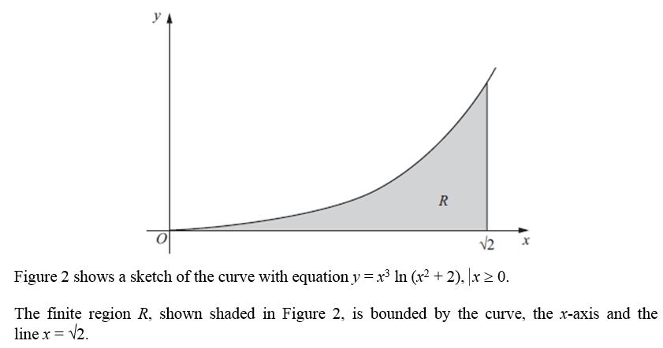
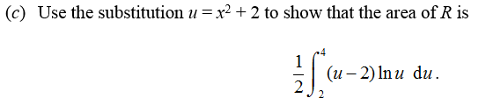
Test Your Understanding
Edexcel C4 June 2011 Q4

Slide 16
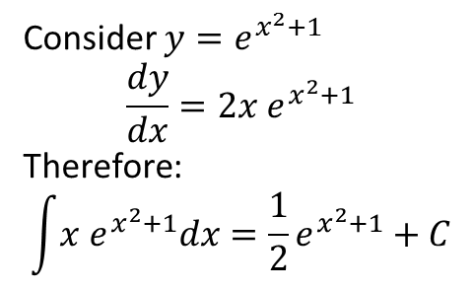
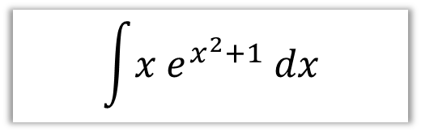
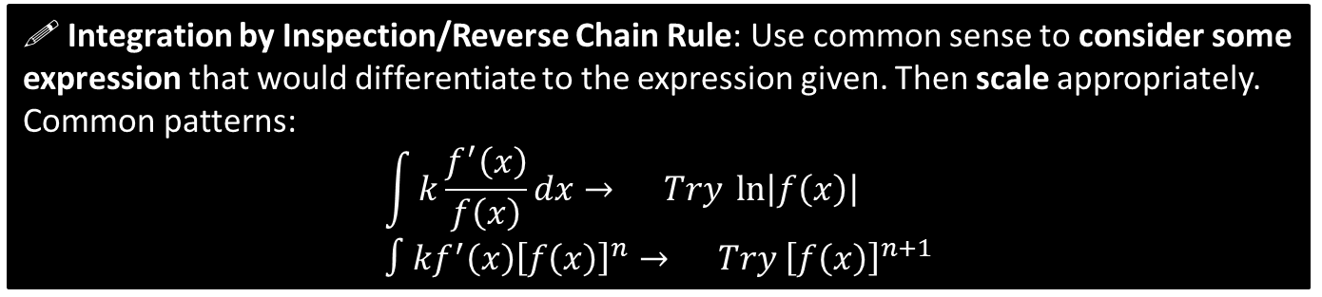
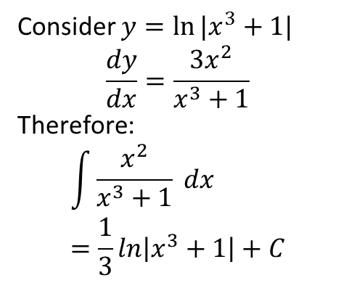
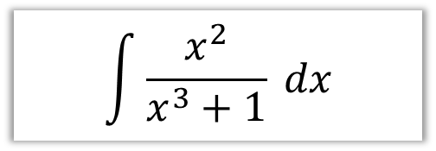
SKILL #4: Reverse Chain Rule
! Integration by Inspection/Reverse Chain Rule: Use common sense to consider some expression that would differentiate to the expression given. Then scale appropriately.
Common patterns:
$$\int{k\frac{f^{′}\left(x\right)}{f\left(x\right)}dx}→ Try \ln\left|f\left(x\right)\right| \\ ∫kf^{′}\left(x\right){\left[f\left(x\right)\right]}^{n}→ Try {\left[f\left(x\right)\right]}^{n+1}$$
In words: “If the bottom of a fraction differentiates to give the top (forgetting scaling), try ln of the bottom”.
$$\int{\frac{x^{2}}{x^{3}+1} dx}$$
$$\int{x e^{x^{2}+1} dx}$$
Consider $y=ln⁡|x^{3}+1|$
$$\frac{dy}{dx}=\frac{3x^{2}}{x^{3}+1}$$
Therefore:
$$\int{\frac{x^{2}}{x^{3}+1} dx} \\ =\frac{1}{3}ln\left|x^{3}+1\right|+C$$
Consider $y=e^{x^{2}+1}$
$$\frac{dy}{dx}=2x e^{x^{2}+1}$$
Therefore:
$$\int{x e^{x^{2}+1}dx}=\frac{1}{2}e^{x^{2}+1}+C$$

Slide 17
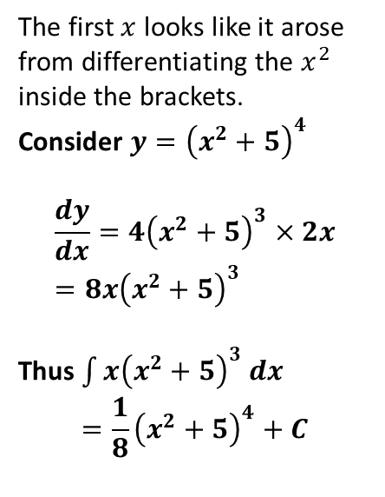
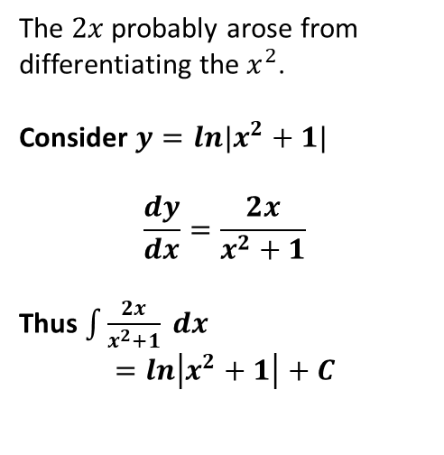
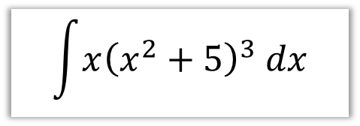
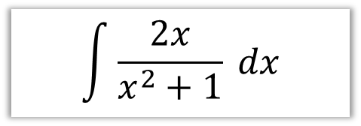
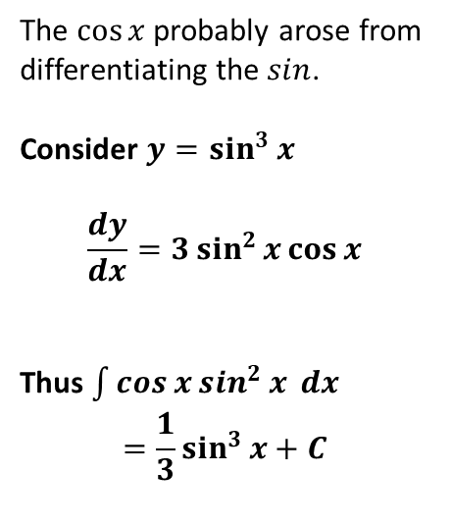
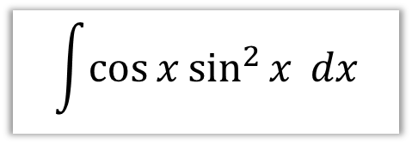
SKILL #4: Reverse Chain Rule
There’s certain more complicated expressions which look like the result of having applied the chain rule. I call this process ‘consider then scale’:
Consider some expression that will differentiate to something similar to it.
Differentiate, and adjust for any scale difference.
$$\int{x{\left(x^{2}+5\right)}^{3} dx}$$
$$\int{\cos{x}\sin^{2}{x} dx}$$
$$\int{\frac{2x}{x^{2}+1} dx}$$
The first $x$ looks like it arose from differentiating the $x^{2}$ inside the brackets.
Consider $y={\left(x^{2}+5\right)}^{4}$
$$\frac{dy}{dx}=4{\left(x^{2}+5\right)}^{3}×2x \\ =8x{\left(x^{2}+5\right)}^{3}$$
Thus $\int{x{\left(x^{2}+5\right)}^{3} dx}$
$$=\frac{1}{8}{\left(x^{2}+5\right)}^{4}+C$$
The $\cos{x}$ probably arose from differentiating the $sin$.
Consider $y=\sin^{3}{x}$
$$\frac{dy}{dx}=3\sin^{2}{x}\cos{x}$$
Thus $\int{\cos{x}\sin^{2}{x} dx}$
$$=\frac{1}{3}\sin^{3}{x+C}$$
The $2x$ probably arose from differentiating the $x^{2}$.
Consider $y=ln|x^{2}+1|$
$$\frac{dy}{dx}=\frac{2x}{x^{2}+1}$$
Thus $\int{\frac{2x}{x^{2}+1} dx}$
$$=ln\left|x^{2}+1\right|+C$$

Slide 18

$$\sec^{n}{x}\tan{x}$$
$$\int{\sec^{4}{x}\tan{x}} dx$$

Slide 19


SKILL #6: Integration by Parts
$$\int{x\cos{x} dx}=?$$
Just as the Product Rule was used to differentiate the product of two expressions, we can often use ‘Integration by Parts’ to integrate a product.
! To integrate by parts:
$$\int{u\frac{dv}{dx}}dx=uv−\int{v\frac{du}{dx} dx}$$

Slide 20

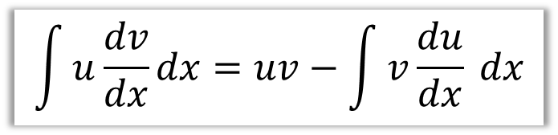
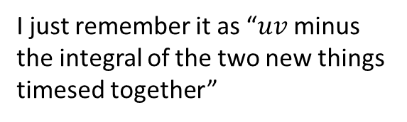
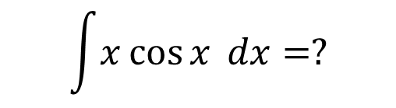
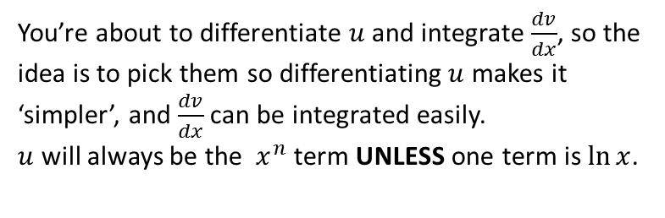
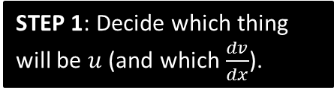
SKILL #6: Integration by Parts
$$\int{x\cos{x} dx}=?$$
$$\int{u\frac{dv}{dx}}dx=uv−\int{v\frac{du}{dx} dx}$$
STEP 1: Decide which thing will be $u$ (and which $\frac{dv}{dx}$).
You’re about to differentiate $u$ and integrate $\frac{dv}{dx}$, so the idea is to pick them so differentiating $u$ makes it ‘simpler’, and $\frac{dv}{dx}$ can be integrated easily.
$u$ will always be the $x^{n}$ term UNLESS one term is $\ln{x}$.
STEP 2: Find $\frac{du}{dx}$ and $v$.
STEP 3: Use the formula.
I just remember it as “$uv$ minus the integral of the two new things timesed together”

Slide 21
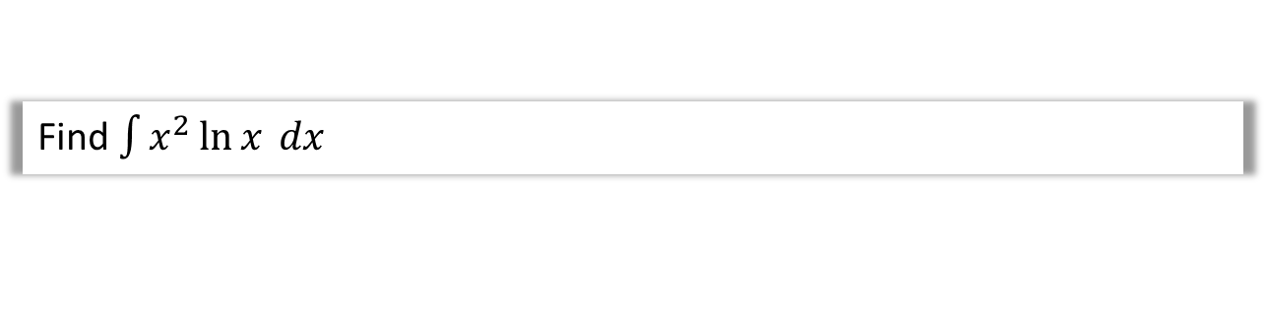

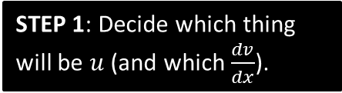
Another Example
Q
Find $\int{x^{2}\ln{x} dx}$
STEP 1: Decide which thing will be $u$ (and which $\frac{dv}{dx}$).
STEP 2: Find $\frac{du}{dx}$ and $v$.
STEP 3: Use the formula.

Slide 22

IBP twice! 😐
Q
Find $\int{x^{2}e^{x} dx}$

Slide 23

Test Your Understanding
Q
Find $\int{x^{2}\sin{x} dx}$

Slide 24
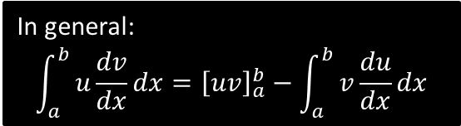
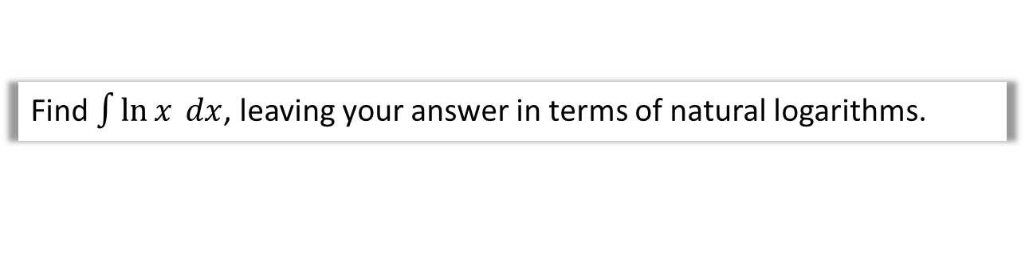
Integrating $\ln{x}$ and definite integration
Q
Find $\int{\ln{x} dx}$, leaving your answer in terms of natural logarithms.
Q
Find $\int_{1}^{2}{\ln{x}dx}$, leaving your answer in terms of natural logarithms.
In general:
$$\int_{a}^{b}{u\frac{dv}{dx}dx}={\left[uv\right]}_{a}^{b}−\int_{a}^{b}{v\frac{du}{dx}dx}$$

Slide 25
Test Your Understanding
Q
Find $\int_{0}^{\frac{π}{2}}{x\sin{x} dx}$

Slide 26
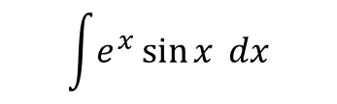
One final one… A Challenge…
$$\int{e^{x}\sin{x} dx}$$

Slide 27

SKILL #7: Using Partial Fractions
We saw earlier that we can split some expressions into partial fractions. This allows us to differentiate some expressions with more complicated denominators.
Find $\int{\frac{2}{x^{2}−1} dx}$

Slide 28


Further Examples
Find $\int{\frac{x−5}{\left(x+1\right)\left(x−2\right)} dx}$
Find $\int{\frac{8x^{2}−19x+1}{\left(2x+1\right){\left(x−2\right)}^{2}} dx}$

Slide 29

Test Your Understanding
Edexcel C4 June 2009 Q3

Slide 30

Integrating top-heavy algebraic fractions
$$\int{\frac{x^{2}}{x+1} dx= ?}$$
How would we deal with this? (the clue’s in the title)

Slide 31


Test Your Understanding
$$\int{\frac{x^{3}+2}{x+1} dx}$$
$$\int{\frac{x}{x−1} dx}$$

Slide 32







Finding Areas
You’re already familiar with the idea that definite integration gives you the (signed) area bound between the curve and the $x$-axis.
Given your expanded integration skills, you can now find the area under a greater variety of curves.
$$y$$
[Textbook] The diagram shows part of the curve $y=\frac{9}{\sqrt{4+3x}}$
The region $R$ is bounded by the curve, the $x$-axis and the lines $x=0$ and $x=4$, as shown in the diagram. Use integration to find the area of $R$.
$$\frac{9}{2}$$
$$R$$
$$4$$
$$x$$

Slide 33












Skill #9: Area between two curves
$$y$$
(This was presented in my Year 1 slides as an ‘alternative method’)
The areas under the two curves are $\int_{a}^{b}{f\left(x\right) dx}$ and $\int_{a}^{b}{g\left(x\right) dx}$. It therefore follows the area between them (provided the curves don’t overlap) is:
$$R=\int_{a}^{b}{f\left(x\right) dx}−\int_{a}^{b}{g\left(x\right) dx} \\ =\int_{a}^{b}{\left(f\left(x\right)−g\left(x\right)\right) dx}$$
$$y=f\left(x\right)$$
$$R$$
$$y=g\left(x\right)$$
$$a$$
$$x$$
$$b$$
Fro Tip: Ensure you have top curve minus bottom curve.
[Textbook] The diagram shows part of the curves $y=\sin{2x}$ and $y=\sin{x}\cos^{2}{x}$ where $0≤x≤\frac{π}{2}$. The region $R$ is bounded by the two curves. Use integration to find the area of $R$.
$$y$$
$$y=\sin{2x}$$
$$R$$
$$y=\sin{x}\cos^{2}{x}$$
$$x$$

Slide 34

Test Your Understanding
Edexcel C4 Jan 2009 Q2

Slide 35




Trapezium Rule
In general: !
width of each trapezium
$$\int_{a}^{b}{y}dx≈\frac{h}{2}\left(y_{1}+2\left(y_{2}+…+y_{n−1}\right)+y_{n}\right)$$
Area under curve
is approximately
Example
We’re approximating the region bounded between $x=1$, $x=3$, the x-axis the curve $y=x^{2}$, using 4 strips.
Dividing a gap of 2 into 4 strips means each strip will be width 0.5
$$x$$ | 1 | 1.5 | 2 | 2.5 | 3
$$y$$ | 1 | 2.25 | 4 | 6.25 | 9
$$h= \\ Area≈$$

Slide 36

Trapezium Rule
Edexcel C2 May 2013 (R) Q2
Fro Tip: You can generate table with Casio calcs . $Mode→3 (Table)$. Use ‘Alpha’ button to key in X within the function. Press =

Slide 37


Further Example
Trapezium Rule: $\int_{a}^{b}{y dx}≈\frac{1}{2}h\left[y_{0}+2\left(y_{1}+…+y_{n−1}\right)+y_{n}\right]$
Q
Given $I=\int_{0}^{\frac{π}{3}}{\sec{x} dx}$
Find the exact value of $I$.
Use the trapezium rule with two strips to estimate $I$.
Use the trapezium rule with four strips to find a second estimate of $I$.
Find the percentage error in using each estimate.

Slide 38

Test Your Understanding
Edexcel C4 June 2014(R) Q2

Slide 39





Integration with Parametric Equations
(We’re on the home straight!)
Suppose we have the following parametric equations:
$$x=t^{2} \\ y=t+1$$
To find the area under the curve, we want to determine to determine $\int{y dx}$. The problem however is that $y$ is in terms of $t$, not in terms of $x$.
Area: $\int{y dx}=\int{y\frac{dx}{dt} dt}$
Tip : No need to remember the whole new formulae. Just remember that $\frac{dx}{dt}dt=dx$ , which follows from the chain rule (and very informally, you can see holds as the $dt$’s cancel)
Determine the area bound between the curve with parametric equations $x=t^{2}$ and $y=t+1$, the $x$-axis, and the lines $x=0$ and $x=3$.
$$\frac{dx}{dt}=$$
STEP 1: Find $\frac{dx}{dt}$
STEP 2: Change limits
STEP 3: Integrate

Slide 40




Further Example
[Textbook] The curve $C$ has parametric equations
$$x=t\left(1+t\right), y=\frac{1}{1+t}, t≥0$$
Find the exact area of the region $R$, bounded by $C$, the $x$-axis and the lines $x=0$ and $x=2$.
$$R$$
$$C$$
2
$$\frac{dx}{dt}=$$
When $x=0,$
When $x=2$,

Slide 41


Test Your Understanding
Edexcel C4 Jan 2013 Q5
Helping Hand:
$$\frac{d}{dx}\left(a^{x}\right)=a^{x}\left(\ln{a}\right) \\ \int{a^{x}} dx=\frac{a^{x}}{\ln{a}}+c$$

Slide 42



Exercise ?
This exercise is not in the current version of the Pearson textbooks as the content was added later. I have temporarily included the exercise subsequently produced by Pearson.

Slide 43



Slide 44






SKILL #11: Differential Equations
Differential equations are equations involving a mix of variables and derivatives, e.g. $y$, $x$ and $\frac{dy}{dx}$. We can solve these by “separating the variables”.
‘Solving’ these equations means to get $y$ in terms of $x$ (with no $\frac{dy}{dx}$).
Q
Find the general solution to $\frac{dy}{dx}=xy+y$
STEP 1: Get $y$ to the side of $\frac{dy}{dx}$ by dividing and $x$ to the other side.
(you may need to factorise to separate out $y$ first)
STEP 2: Integrate both sides with respect to $x$. $\frac{dy}{dx} dx$ simplifies to $dy$ (recall that (implicitly) differentiating an expression in terms of $y$ with respect to $x$ introduces a $\frac{dy}{dx}$, so integrating similarly would get rid of it)
STEP 3: Make $y$ the subject, if the question asks.
Fro Tip: When you have $e^{f\left(x\right)+c}=e^{f\left(x\right)}e^{c}$, it’s typical to write $Ae^{f\left(x\right)}$ where $A=e^{c}$ (noting that $A$ is any positive constant since $e^{c}>0$)

Slide 45





Another Example
Q
Find the general solution to $\left(1+x^{2}\right)\frac{dy}{dx}=x\tan{y}$
STEP 1: Get $y$ to the side of $\frac{dy}{dx}$ by dividing and $x$ to the other side.
(you may need to factorise to separate out $y$ first)
STEP 2: Integrate both sides with respect to $x$.
STEP 2b: If possible, try to combine your constant of integration with other terms
(e.g. by letting $C=\ln{k}$ where $k$ is another constant)
STEP 3: Make $y$ the subject, if the question asks.

Slide 46

Differential Equations with Boundary Conditions
Q
[Textbook] Find the general solution to $\frac{dy}{dx}=−\frac{3\left(y−2\right)}{\left(2x+1\right)\left(x+2\right)}$
Given that $x=1$ when $y=4$. Leave your answer in the form $y=f\left(x\right)$

Slide 47

Test Your Understanding
Edexcel C4 Jan 2012 Q4

Slide 48

Key Points on Differential Equations
Get $y$ on to LHS by dividing (possibly factorising first).
If after integrating you have $ln$ on the RHS, make your constant of integration $\ln{k}$.
Be sure to combine all your $ln$’s together just as you did in C2.
E.g.:
$2\ln\left|x+1\right|−\ln\left|x\right| → \ln\left|\frac{{\left(x+1\right)}^{2}}{x}\right|$
Sub in boundary conditions to work out your constant – better to do sooner rather than later.
Exam questions ♥ partial fractions combined with differential equations.

Slide 49

Forming differential equations
Differential equations are useful because regularly in real-life, the rate of change of a variable is based on its current value. For example in Year 1, we saw a property of exponential growth is that the rate of change is proportional to the current value:
Q
The rate of increase of a rabbit population (with population $P$, where time is $t$) is proportional to the current population.
Form a differential equation, and find its general solution.

Slide 50



Further Example
[Textbook] Water in a manufacturing plant is held in a large cylindrical tank of diameter 20m. Water flows out of the bottom of the tank through a tap at a rate proportional to the cube root of the volume.
Show that $t$ minutes after the tap is opened, $\frac{dh}{dt}=−k\sqrt[3]{h}$ for some constant $k$.
Show that the general solution of this differential equation may be written $h={\left(P−Qt\right)}^{\frac{3}{2}}$, where $P$ and $Q$ are constants.
Initially the height of the water is 27m. 10 minutes later, the height is 8m.
(c) Find the values of the constants $P$ and $Q$.
(d) Find the time in minutes when the water is at a depth of 1m.
$$h$$
$$20m$$

Slide 51

Test Your Understanding
Edexcel C4 June 2005 Q8
Teachers/Students: I recommend also looking at Edexcel Jan 2008 Q8 which has a part (a) similar to the previous example.

Slide 52

Summary of Functions
$$f(x)$$ | How to deal with it | $\int{f\left(x\right)dx}$ (+constant) | Formula booklet?
$$sin x$$ | Standard result | $$−\cos{x}$$ | No
$$cos x$$ | Standard result | $$\sin{x}$$ | No
$$tan x$$ | In formula booklet, but use $\int{\frac{\sin{x}}{\cos{x}}dx}$ which is of the form $\int{\frac{kf^{′}\left(x\right)}{f\left(x\right)}}dx$ | $$\ln\left|\sec{x}\right|$$ | Yes
$$sin^{2} x$$ | For both $\sin^{2}{x}$and $\cos^{2}{x}$ use identities for $\cos{2x}$ $$\cos{2x}=1−2\sin^{2}{x} \\ \sin^{2}{x}=\frac{1}{2}−\frac{1}{2}\cos{2x}$$ | $$\frac{1}{2}x−\frac{1}{4}\sin{2x}$$ | No
$$cos^{2} x$$ | $$\cos{2x}=2\cos^{2}{x}−1 \\ \cos^{2}{x}=\frac{1}{2}+\frac{1}{2}\cos{2x}$$ | $$\frac{1}{2}x+\frac{1}{4}\sin{2x}$$ | No
$$tan^{2}x$$ | $$1+\tan^{2}{x}≡\sec^{2}{x} \\ \tan^{2}{x}≡\sec^{2}{x}−1$$ | $$\tan{x}−x$$ | No
$$cosec x$$ | Would use substitution $u=cosec x+\cot{x}$, but too hard for exam. | $$−ln\left|cosec x+\cot{x}\right|$$ | Yes
$$sec x$$ | Would use substitution $u=\sec{x}+\tan{x}$, but too hard for exam. | $$\ln\left|\sec{x}+\tan{x}\right|$$ | Yes
$$cot x$$ | $\int{\frac{\cos{x}}{\sin{x}}dx}$ which is of the form $\int{\frac{f^{′}\left(x\right)}{f\left(x\right)}}dx$ | $$\ln\left|\sin{x}\right|$$ | Yes

Slide 53

Summary of Functions
$$f(x)$$ | How to deal with it | $\int{f\left(x\right)dx}$ (+constant) | Formula booklet?
$$cosec^{2}x$$ | By observation. | $$−\cot{x}$$ | No!
$$sec^{2}x$$ | By observation. | $$\tan{x}$$ | Yes (but memorise)
$$cot^{2}x$$ | $$1+\cot^{2}{x}≡cosec^{2}x$$ | $$−\cot{x}−x$$ | No
$$sin 2x cos 2x$$ | For any product of sin and cos with same coefficient of $x$, use double angle. $$\sin{2x}\cos{2x}≡\frac{1}{2}\sin{4x}$$ | $$−\frac{1}{8}\cos{4x}$$ | No
$$\frac{1}{x}$$ |  | $$\ln{x}$$ | No
$$\ln{x}$$ | Use IBP, where $u=\ln{x},\frac{dv}{dx}=\ln{x}$ | $$x\ln{x}−x$$ | No
$$\frac{x}{x+1}$$ | Use algebraic division.$\frac{x}{x+1}≡1−\frac{1}{x+1}$ | $$x−\ln\left|x+1\right|$$
$$\frac{1}{x\left(x+1\right)}$$ | Use partial fractions. | $$\ln\left|x\right|−\ln\left|x+1\right|$$

Slide 54

Summary of Functions
$$f(x)$$ | How to deal with it | $\int{f\left(x\right)dx}$ (+constant)
$$\frac{4x}{x^{2}+1}$$ | Substitution or Reverse chain rule. Of form $\int{\frac{kf^{′}\left(x\right)}{f\left(x\right)}}$ | $$2\ln\left|x^{2}+1\right|$$
$$\frac{x}{{\left(x^{2}+1\right)}^{2}}$$ | Substitution or Reverse chain rule (i.e. “Consider $y={\left(x^{2}+1\right)}^{−1}"$ and differentiate) | $$−\frac{1}{2}{\left(x^{2}+1\right)}^{−1}$$
$$e^{2x+1} \\ \frac{1}{1−3x}$$ | For any function where ‘inner function’ is linear expression, divide by coefficient of $x$ | $$\frac{1}{2}e^{2x+1} \\ −\frac{1}{3}\ln\left|1−3x\right|$$
$$x\sqrt{2x+1}$$ | IBP or use sensible substitution. $u=2x+1$ or even better, $u^{2}=2x+1$. | $$\frac{1}{15}{\left(2x+1\right)}^{\frac{3}{2}}\left(3x−1\right)$$
$$\sin^{5}{x} cos x$$ | Substitution or Reverse chain rule. | $$\frac{1}{6}\sin^{6}{x}$$

