Slide 1
P2 Chapter 2 :: Functions & Graphs
Last modified: 6th September 2019

Slide 2
1 :: The Modulus Function
! The modulus of a number $a$, written $|a|$, is its non-negative numerical value. e.g. $\left|6\right|=6$ and $\left|−7.1\right|=7.1$
$$b$$
$$a$$
1
2
3
4
5
6
7
8
The modulus function is particularly useful in expressing a difference. We generally like to quote differences as positive values, but $b−a$ may be negative if $b$ is smaller than $a$. By using $|b−a|$, we get round this problem!
More fundamentally, the modulus of a value gives us its ‘magnitude’, i.e. size; from Mechanics, you should also be used to the notion the distances and speeds are quoted as positive values.
And in Pure Year 1 we saw the same notation used for vectors: $|a|$ gives us the magnitude/length of the vector $a$. It’s the same function!

Slide 3
Examples
If $f\left(x\right)=\left|2x−3\right|+1$, find
$f(5)$
$f(−2)$
$f(1)$
Sketch$y=|x|$

Slide 4
Modulus Graphs
Sketch $y=|2x−3|$
Hence solve $\left|2x−3\right|=5$

Slide 5
Solve $\left|3x−5\right|=2−\frac{1}{2}x$
Hence solve $\left|3x−5\right|>2−\frac{1}{2}x$

Slide 6
Test Your Understanding
Solve $\left|x+1\right|=2x+5$
(be careful – there’s only one solution!)
Solve $\left|4x−1\right|<2x$

Slide 7
Sketching $y=|f\left(x\right)|$ and $y=f\left(\left|x\right|\right)$
$$y$$
This is a sketch of $y=f(x)$ where $f\left(x\right)=(x−3)(x+1)$
$$y=f(x)$$
$$3$$
$$x$$
$$−3$$
$$−1$$
$$3$$
$$−3$$

Slide 8
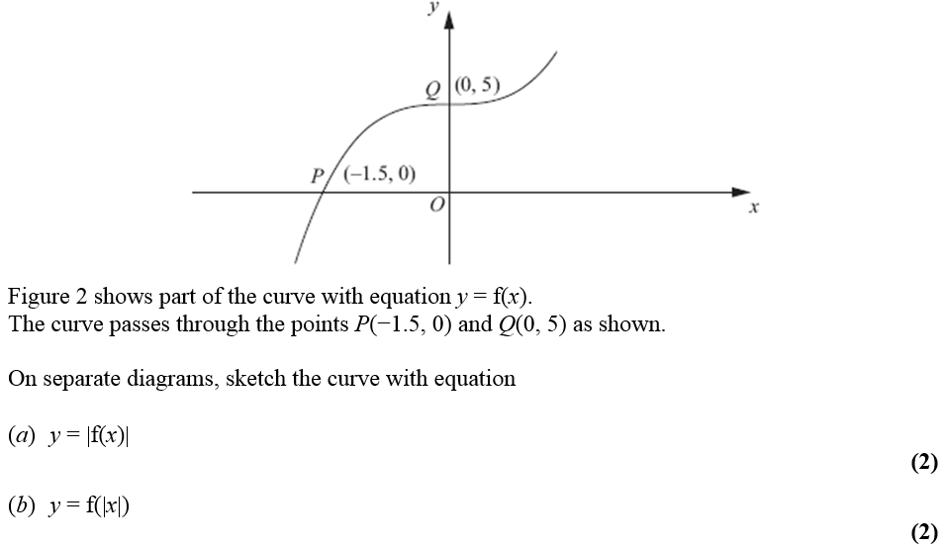
Test Your Understanding
Edexcel C4 June 2012 Q4

Slide 9
Further Test Your Understanding
[Textbook] Sketch for $−360≤x≤360$:
a) $y=\left|\sin\left(x\right)\right|$ b) $y=sin⁡(\left|x\right|)$

Slide 10
Lesson 2: Combining Transformations
RECAP:
Affects which axis?
What we expect or opposite?
Change inside $f( )$
Change outside $f( )$
There is nothing new here relative to Year 1, except that you might have to do more than one transformation…
$$y$$
Here is a graph of $y=f(x)$.
Sketch the graph of:
a) $y=2f\left(x+2\right)$
$$y=f(x)$$
$$B\left(6,4\right)$$
$$x$$
$$O$$
$$A\left(2,−1\right)$$
$$\left(0,−2\right)$$

Slide 11
Combining Transformations
$$y$$
Here is a graph of $y=f(x)$.
Sketch the graph of:
b) $y=−f\left(2x\right)$
$$y=f(x)$$
$$B\left(6,4\right)$$
$$x$$
$$O$$
$$A\left(2,−1\right)$$
c) $y=\left|f\left(−x\right)\right|$

Slide 12
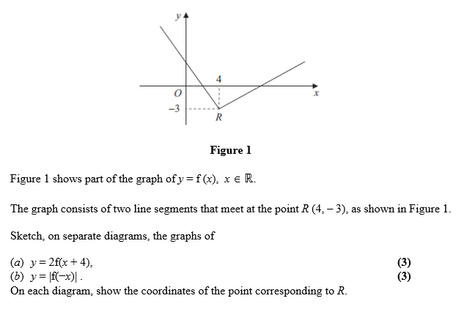
Test Your Understanding
C4 June 2011 Q3

Slide 13
Lesson 3: What is a mapping?
A mapping is something which maps one set of numbers to another.
! The domain is the set of possible inputs, usually the x-values.
! The range is the set of possible outputs, usually the y-values.
A function is: a mapping such that every element of the domain is mapped to
exactly one element of the range.
Notation:
$$f\left(x\right)=2x+1$$
$$f:x→2x+1$$
$f\left(x\right)$ refers to the output of the function.

Slide 14
One-to-one vs Many-to-one
While functions permit an input only to be mapped to one output, there’s nothing stopping multiple different inputs mapping to the same output.
Type
Description
Example
$$y$$
Many-to-one
function
Multiple inputs can map to the same output.
$$y=x^{2}$$
$$f\left(x\right)=x^{2}$$
e.g. $f\left(2\right)=4$
$$f\left(−2\right)=4$$
2
4
$$x$$
-2
You can use the ‘horizontal ray test’ to see if a function is one-to-one or many-to-one.
One-to-one
function
Each output has one input and vice versa.
$$f\left(x\right)=2x+1$$
5
2
3
7
4
9

Slide 15
Further Examples
It is often helpful to sketch the function to reason about the range.
[Textbook] Find the range of each of the following functions.
$f\left(x\right)=3x−2$, domain $\{1,2,3,4\}$
$g\left(x\right)=x^{2}$, domain $\left\{x∈ℝ, −5≤x≤5\right\}$
$h\left(x\right)=\frac{1}{x}$, domain $\{x∈ℝ, 0<x≤3$}
State if the functions are one-to-one or many-to-one.
We use $x$ to refer to the input, and $f(x)$ to refer to the output.
Thus your ranges should be in terms of $f(x)$.

Slide 16
Piecewise Functions
A ‘piecewise function’ is one which is defined in parts: we can use different rules for different intervals within the domain.
[Textbook] The function $f(x)$ is defined by
$$f:x→\left\{\begin{aligned}5−2x, x<1 \\ x^{2}+3, x≥1\end{aligned}\right.$$
Sketch $y=f\left(x\right)$, and state the range of $f\left(x\right)$.
Solve $f\left(x\right)=19$

Slide 17
Test Your Understanding
Edexcel C4 June 2012 Q6a
Edexcel C4 June 2010 Q4d
The function $f$ is defined by
$$f:x→e^{x}+2, x∈ℝ$$
State the range of $f$.
The function $g$ is defined by
$$g:x→x^{2}−4x+1, x∈ℝ, 0≤x≤5$$
Find the range of $g$.

Slide 18
Summary of Domain/Range
It is important that you can identify the range for common graphs, using a suitable sketch:
$$f\left(x\right)=\frac{1}{x}, x∈ℝ, x≠0$$
Range:
$$f\left(x\right)=x^{2}, x∈ℝ$$
Range:
$$f\left(x\right)=\ln{x}, x∈ℝ, x>0$$
Range:
$$f\left(x\right)=e^{x}, x∈ℝ,$$
Range:
$$f\left(x\right)=x^{2}+2x+9, x∈ℝ$$
Range:
Be careful in noting the domain – it may be ‘restricted’, which similarly restricts the range. Again, use a sketch!
$$f\left(x\right)=x^{2}, x∈ℝ, −1≤x≤4$$
Range:

Slide 19
Composite Functions
Sometimes we may apply multiple functions in succession to an input.
These combined functions are known as a composite function.
$$f$$
$$g$$
$$x$$
$$f\left(x\right)$$
$$gf\left(x\right)$$
$$gf$$
! $gf(x)$ means $g(f\left(x\right))$, i.e. $f$ is applied first, then $g$.
Let $f\left(x\right)=x^{2}+1$, and $g\left(x\right)=4x−2$.
What is…
$fg(2)$?
$fg(x)$?
$gf(x)$?
$f^{2}\left(x\right)$?
Solve $gf\left(x\right)=38$

Slide 20
Further Examples
The functions $f$ and $g$ are defined by
$$f:x→\left|2x−8\right| \\ g:x→\frac{x+1}{2}$$
a) Find $fg\left(3\right)$ b) Solve $fg\left(x\right)=x$

Slide 21
Test Your Understanding
Edexcel C4 June 2013(R) Q4
Edexcel C4 June 2012 Q6
The functions and $f$ and $g$ are defined by
$$f:x→2\left|x\right|+3, x∈ℝ$$
$$g:x→3−4x, x∈ℝ$$
b) Find $fg\left(1\right)$
d) Solve the equation
$$gg\left(x\right)+{\left[g\left(x\right)\right]}^{2}=0$$
The functions $f$ and $g$ are defined by
$$f:x→e^{x}+2, x∈ℝ \\ g:x→\ln{x}, x>0$$
b) Find $fg\left(x\right)$, giving your answer in its simplest form.

Slide 22
Inverse Functions
$$f$$
An inverse function $f^{−1}$ does the opposite of the original function. For example, if $f\left(4\right)=2$, then $f^{−1}\left(2\right)=4$.
If $f\left(x\right)=2x+1$, we could do the opposite operations within the function in reverse order to get back to the original input:
$$x$$
$$y$$
$$f^{−1}$$
Notation: Just like $f^{2}$ means “apply $f$ twice”, $f^{−1}$ means “apply $f$ -1 times”, i.e. once backwards!
This is why we write $\sin^{−1}{(x)}$ to mean “inverse sin”.
$$×2$$
$$+1$$
$$x$$
$$2x$$
$$2x+1$$
$$−1$$
$$÷2$$
Thus $f^{−1}\left(x\right)=\frac{x−1}{2}$
This has appeared in exams before.
Explain why the function must be one-to-one for an inverse function to exist:

Slide 23
More on Inverse Functions
$$f$$
In the original function, we have the output $y$ in terms of the input $x$, e.g. $y=2x+1$
Therefore if we change the subject to get $x$ in terms of $y$, then we have the input in terms of the output, i.e. the inverse function!
$$x=\frac{y−1}{2}$$
However, we tend to write a function in terms of $x$, so would write;
$$f^{−1}\left(x\right)=\frac{x−1}{2}$$
$$x$$
$$y$$
$$f^{−1}$$
If $f\left(x\right)=3−4x$, find $f^{−1}(x)$
If $f\left(x\right)=\frac{x+2}{2x−1}$, $x≠\frac{1}{2}$, determine $f^{−1}\left(x\right)$

Slide 24
Graphing an Inverse Function
Notice that $x$-intercepts become $y$-intercepts, and vertical asymptotes become horizontal ones.
We saw that the inverse function effectively swaps the input $x$ and output $y$. Thus the $x$ and $y$ axis are swapped when sketching the original function and its inverse.
And since the set of inputs and set of outputs is swapped…
$$y$$
$$x=1$$
$$y=f^{−1}(x)$$
$$y=f(x)$$
$$2$$
$$y=1$$
! The domain of $f\left(x\right)$ is the range of $f^{−1}\left(x\right)$ and vice versa.
$$x$$
$$2$$
$$y=x$$
$y=f(x)$ and $y=f^{−1}\left(x\right)$ have the line $y=x$ as a line of symmetry.
Domain of $f$:
Range of $f^{−1}$:
The domain of the function is the same as the range of the inverse, but remember that we write a domain in terms of $x$, but a range in terms of $f\left(x\right)$ or $f^{−1}\left(x\right)$.

Slide 25
Example
[Textbook] If $g(x)$ is defined as $g\left(x\right)=\sqrt{x−2} \left\{x∈ℝ,x≥2\right\}$
Find the range of $g\left(x\right)$.
Calculate $g^{−1}\left(x\right)$
Sketch the graphs of both functions.
State the domain and range of $g^{−1}\left(x\right)$.

Slide 26
Further Example
[Textbook] The function is defined by $f\left(x\right)=x^{2}−3$, $x∈ℝ$, $x≥0$.
Find $f^{−1}\left(x\right)$
Sketch $y=f(x)$ and $y=f^{−1}\left(x\right)$ and state the domain of $f^{−1}$.
Solve the equation $f\left(x\right)=f^{−1}\left(x\right)$.

Slide 27
Test Your Understanding
Edexcel C4 June 2012 Q6
The function $f$ is defined by
$f:x→e^{x}+2$, $x∈ℝ$
(d) Find $f^{−1}$, the inverse function of $f$, stating its domain.
(e) On the same axe sketch the curves with equation $y=f\left(x\right)$ and $y=f^{−1}\left(x\right)$, giving the coordinates of all the points where the curves cross the axes.

Slide 28
Solving Modulus Problems
[Textbook] Given the function $f\left(x\right)=3\left|x−1\right|−2, x∈ℝ$,
Sketch the graph of $y=f\left(x\right)$
State the range of $f$.
It is often helpful to sketch the graph in stages as we apply more transformations:

Slide 29
Solving Modulus Problems
[Textbook] Given the function $f\left(x\right)=3\left|x−1\right|−2, x∈ℝ$,
Sketch the graph of $y=f\left(x\right)$
State the range of $f$.
Solve the equation $f\left(x\right)=\frac{1}{2}x+3$

Slide 30
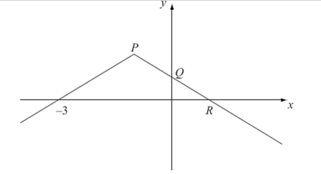
Test Your Understanding
You can sketch this function by starting with $y=|x|$ and gradually transform it as per the previous example.
C4 June 2008 Q3

