Slide 1
P2 Chapter 4 :: Binomial Expansion
jfrost@tiffin.kingston.sch.uk
www.drfrostmaths.com @DrFrostMaths
Last modified: 6th September 2018

Slide 2
Pure Year 1 Recap
Remember that for small integer $n$ you could use a row of Pascal Triangle for the Binomial coefficients, descending powers of the first term and ascending powers of the second.
If the first term is 1, we can ignore the powers of 1.
$${\left(1+x\right)}^{5} =$$
$${\left(1+2x\right)}^{4}=$$
$${\left(1−3x\right)}^{3}=$$
Do you remember the simple way to find your Binomial coefficients?
$$\left(\begin{matrix}n \\ 1\end{matrix}\right)=$$
$$\left(\begin{matrix}n \\ 2\end{matrix}\right)=$$
$$\left(\begin{matrix}n \\ 3\end{matrix}\right)=$$
$$\left(\begin{matrix}n \\ 4\end{matrix}\right)=$$
$$\left(\begin{matrix}10 \\ 3\end{matrix}\right)=$$
$$\left(\begin{matrix}−1 \\ 2\end{matrix}\right)=$$
$$\left(\begin{matrix}−2 \\ 3\end{matrix}\right)=$$
$$\left(\begin{matrix}0.5 \\ 2\end{matrix}\right)=$$

Slide 3
Binomial Expansion
! ${\left(1+x\right)}^{n}=1+nx+\frac{n\left(n−1\right)}{2!}x^{2}+\frac{n\left(n−1\right)\left(n−2\right)}{3!}x^{3}+…+nCr x^{n}$
Binomial expansions, when $n$ is either negative or fractions, are infinitely long.
Use the binomial expansion to find the first four terms of $\frac{1}{1+x}$
And the first four terms of $\sqrt{1−3x}$

Slide 4
When are infinite expansions valid?
Our expansion might be an infinite number of terms. If so, the result must converge
$$\frac{1}{1+x}={\left(1+x\right)}^{−1} \\ =1+\left(−1\right)x+\frac{−1×−2}{2!}x^{2}+\frac{−1×−2×−3}{3!}x^{3}+… \\ =1−x+x^{2}−x^{3}+…$$
What would happen in the expansion if:
a) $x>1$ :
b) $0<x<1$:
c) $−1<x<0$:
d) $x=$

Slide 5
When are infinite expansions valid?
Expansions are allowed to infinite. However, the result must converge
$$\sqrt{1−3x}={\left(1−3x\right)}^{\frac{1}{2}} \\ =1+\frac{1}{2}\left(−3x\right)+\frac{\frac{1}{2}×−\frac{1}{2}}{2!}{\left(−3x\right)}^{2}+\frac{\frac{1}{2}×−\frac{1}{2}×−\frac{3}{2}}{3!}{\left(−3x\right)}^{3}+… \\ =1−\frac{3}{2}x−\frac{9}{8}x^{2}−\frac{27}{16}x^{3}−…$$
This time, what do you think needs to be between -1 and 1 for the expansion to be valid?
! An infinite expansion ${\left(1+x\right)}^{n}$ is valid if $\left|x\right|<1$
Quickfire Examples:
Expansion of ${\left(1−\frac{2}{3}x\right)}^{−1}$ valid if:
Expansion of ${\left(1+2x\right)}^{−1}$ valid if:
Expansion of ${\left(1−x\right)}^{−2}$ valid if:
Expansion of ${\left(1+\frac{1}{4}x\right)}^{\frac{1}{2}}$ valid if:

Slide 6
Combining Expansions
Edexcel C4 June 2013 Q2

Slide 7
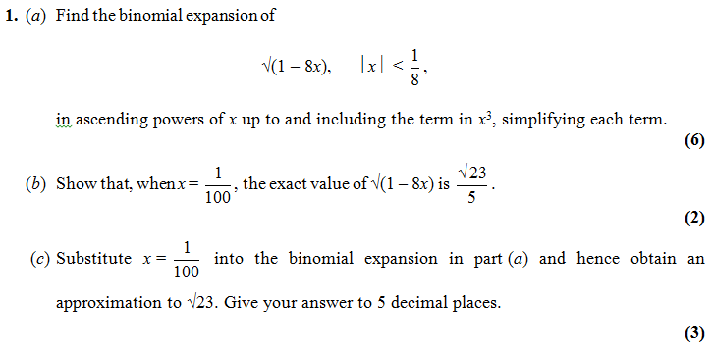
Test Your Understanding
Find the binomial expansion of $\frac{1}{{\left(1+4x\right)}^{2}}$ up to an including the term in $x^{3}$. State the values of $x$ for which the expansion is valid.
C4 Edexcel Jan 2010

Slide 8
Accuracy of an approximation
$$\frac{1}{1+x}=1−x+x^{2}−x^{3}+x^{4}−…$$
If $x=0.01$, how accurate would the approximation $1−x+x^{2}$ by for the value of $\frac{1}{1+x}$?
Common Errors
$$\sqrt{1−3x}={\left(1−3x\right)}^{\frac{1}{2}} \\ =1+\frac{1}{2}\left(−3x\right)+\frac{\frac{1}{2}×−\frac{1}{2}}{2!}{\left(−3x\right)}^{2}+\frac{\frac{1}{2}×−\frac{1}{2}×−\frac{3}{2}}{3!}{\left(−3x\right)}^{3}+… \\ =1−\frac{3}{2}x−\frac{9}{8}x^{2}−\frac{27}{16}x^{3}−…$$
What errors do you think are easy to make?
Sign errors, e.g. ${\left(−3x\right)}^{2}=−9x^{2}$
Not putting brackets around the $−3x$, e.g. $−3x^{2}$ instead of ${\left(−3x\right)}^{2}$
Dividing by say 3 instead of $3!$

Slide 9
Dealing with ${\left(a+bx\right)}^{n}$
Find first four terms in the binomial expansion of $\sqrt{4+x}$
State the values of $x$ for which the expansion is valid.
$${\left(4+x\right)}^{\frac{1}{2}}$$

Slide 10
Quickfire First Step
What would be the first step in finding the Binomial expansion of each of these?
Binomial expansion valid if:
$${\left(2+x\right)}^{−3}$$
$${\left(9+2x\right)}^{\frac{1}{2}}$$
$${\left(8−x\right)}^{\frac{1}{3}}$$
$${\left(5−2x\right)}^{−3}$$
$${\left(16+3x\right)}^{−\frac{1}{2}}$$

Slide 11
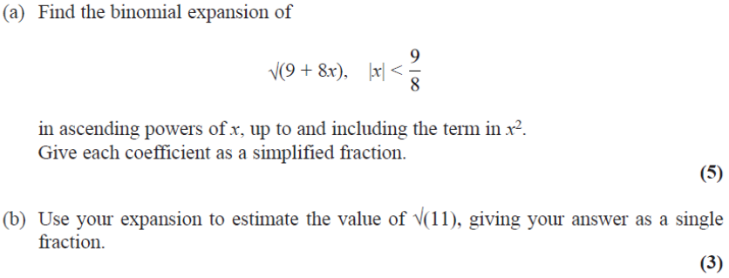
Test Your Understanding
Edexcel C4 June 2013 (Withdrawn) Q1

Slide 12
Using Partial Fractions
Partial fractions allows us to split up a fraction into ones we can then find the binomial expansion of.
[Textbook]
Express $\frac{4−5x}{\left(1+x\right)\left(2−x\right)}$ as partial fractions.
Hence show that the cubic approximation of $\frac{4−5x}{\left(1+x\right)\left(2−x\right)}$ is $2−\frac{7}{2}x+\frac{11}{4}x^{2}−\frac{25}{8}x^{3}$
c) State the range of values of $x$ for which the expansion is valid.

Slide 13
Test Your Understanding

