Slide 1

P2 Chapter 5 :: Radians
jfrost@tiffin.kingston.sch.uk
www.drfrostmaths.com
@DrFrostMaths
Last modified: 6th September 2018

Slide 2
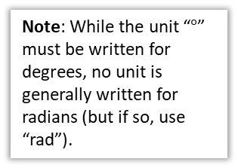
Radians
So far you’ve used degrees as the unit to measure angles.
But outside geometry, mathematicians pretty much always use radians.
r
Note: While the unit “$°$” must be written for degrees, no unit is generally written for radians (but if so, use “rad”).
1°
r
1 rad
A degree is a 360th of a rotation around a full circle. This is a somewhat arbitrary definition!
One radian however is the movement of one radius’ worth around the circumference of the circle.
Thinking about how many radii around the circumference we can go:

Slide 3
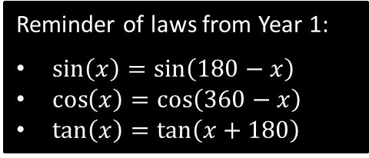
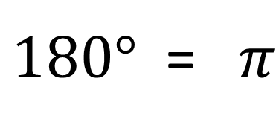




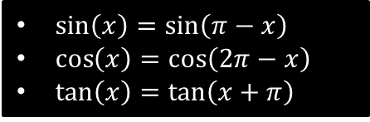
Converting between radians and degrees
$$45°=$$
$$60°=$$
$$270°=$$
$$120°=$$
$$30°=$$
$$135°=$$
$$90°=$$
$180°$ = $π$
$$\frac{π}{3}=$$
$$\frac{π}{6}=$$
$$\frac{3}{2}π=$$
$$\frac{5π}{6}=$$
Reminder of laws from Year 1:
$\sin\left(x\right)=\sin\left(180−x\right)$
$\cos\left(x\right)=\cos\left(360−x\right)$
$\tan\left(x\right)=\tan\left(x+180\right)$
$\sin\left(x\right)=\sin\left(π−x\right)$
$\cos\left(x\right)=\cos\left(2π−x\right)$
$\tan\left(x\right)=\tan\left(x+π\right)$

Slide 4

Graph Sketching with Radians
We can replace the values $90°, 180°, 270°, 360°$ on the $x$-axis with their equivalent value in radians.

Slide 5
Test Your Understanding
Sketch the graph of $y=\cos\left(x+\frac{π}{2}\right)$ for $0≤x<2π$.

Slide 6





Arc length Sector Area
$$l$$
$$r$$
$$r$$
$$θ$$
$$θ$$

Slide 7
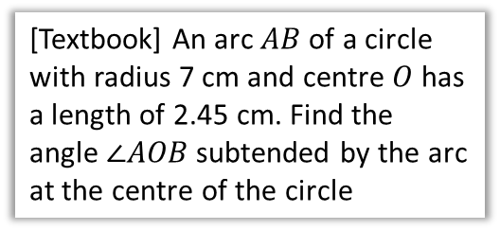
Examples
[Textbook] Find the length of the arc of a circle of radius 5.2 cm, given that the arc subtends an angle of 0.8 radians at the centre of the circle.
[Textbook] An arc $AB$ of a circle with radius 7 cm and centre $O$ has a length of 2.45 cm. Find the angle $∠AOB$ subtended by the arc at the centre of the circle

Slide 8


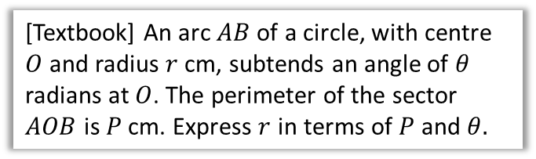






Further Examples
[Textbook] An arc $AB$ of a circle, with centre $O$ and radius $r$ cm, subtends an angle of $θ$ radians at $O$. The perimeter of the sector $AOB$ is $P$ cm. Express $r$ in terms of $P$ and $θ.$
[Textbook] The border of a garden pond consists of a straight edge $AB$ of length 2.4m, and a curved part $C$, as shown in the diagram. The curve part is an arc of a circle, centre $O$ and radius 2m.
Find the length of $C$.
$$C$$
$$θ$$
$$2 cm$$
$$2 cm$$
$$A$$
$$2.4 cm$$
$$B$$

Slide 9
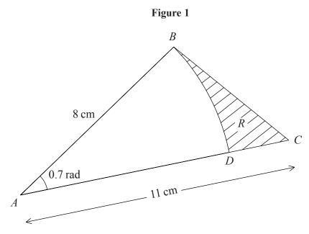
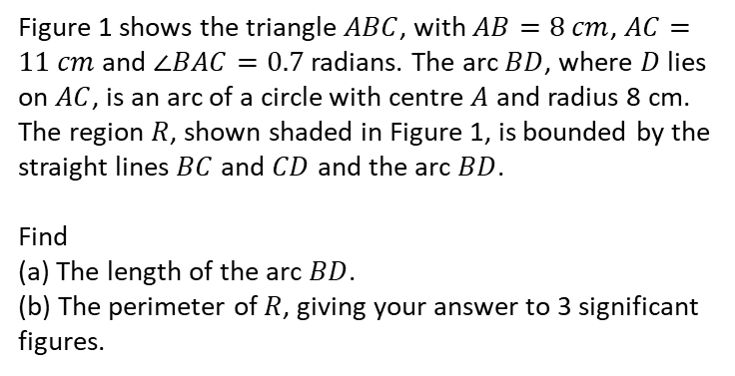
Test Your Understanding
Edexcel C2 Jan 2005 Q7
Figure 1 shows the triangle $ABC$, with $AB=8 cm$, $AC=11 cm$ and $∠BAC=0.7$ radians. The arc $BD$, where $D$ lies on $AC$, is an arc of a circle with centre $A$ and radius 8 cm. The region $R$, shown shaded in Figure 1, is bounded by the straight lines $BC$ and $CD$ and the arc $BD$.
Find
(a) The length of the arc $BD$.
(b) The perimeter of $R$, giving your answer to 3 significant figures.

Slide 10











Examples
[Textbook] In the diagram, the area of the minor sector $AOB$ is 28.9 cm². Given that $∠AOB=0.8$ radians, calculate the value of $r$.
[Textbook] A plot of land is in the shape of a sector of a circle of radius 55 m. The length of fencing that is erected along the edge of the plot to enclose the land is 176 m. Calculate the area of the plot of land.
$$A$$
$$A$$
$$55 m$$
$r$cm
$$0.8$$
$$O$$
$$θ$$
$r$cm
$$55 m$$
$$B$$
$$B$$

Slide 11

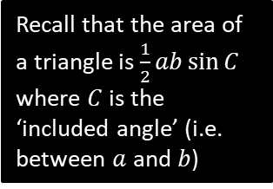


Segment Area
A segment is the region bound between a chord and the circumference.
This is just a sector with a triangle cut out.
$$r$$
$$θ$$
$$r$$
Area using radians:
Recall that the area of a triangle is $\frac{1}{2}ab\sin{C}$ where $C$ is the ‘included angle’ (i.e. between $a$ and $b$)

Slide 12















Segment Examples
[Textbook] In the diagram above, $OAB$ is a sector of a circle, radius 4m. The chord $AB$ is 5m long. Find the area of the shaded segment.
[Textbook] In the diagram, $AB$ is the diameter of a circle of radius $r$cm, and $∠BOC=θ$ radians. Given that the area of $ΔAOC$ is three times that of the shaded segment, show that
$3θ−4\sin{θ}=0$.
$$A$$
$$4 m$$
$$C$$
$$O$$
$$θ$$
$$5m$$
$$4 m$$
$$θ$$
$$B$$
$$B$$
$$A$$
$$r$$
$$O$$
$$r$$

Slide 13
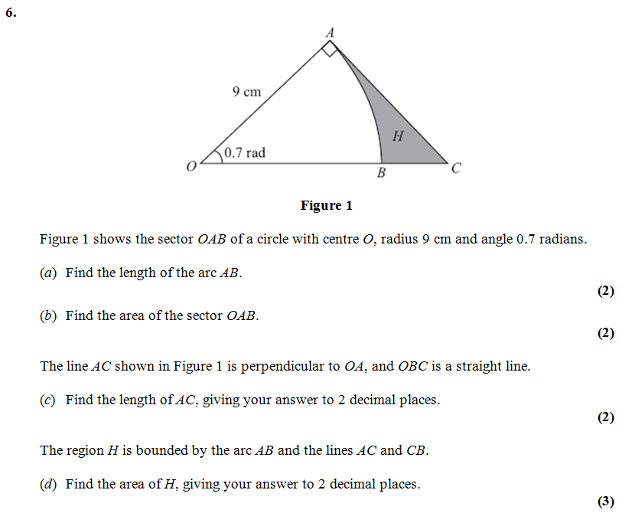
Test Your Understanding
Edexcel C2

Slide 14
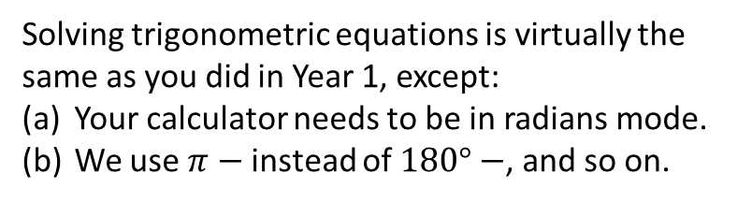

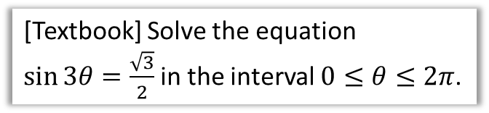
Solving Trigonometric Equations
$\sin\left(x\right)=\sin\left(π−x\right)$
$\cos\left(x\right)=\cos\left(2π−x\right)$
$\tan\left(x\right)=\tan\left(x+π\right)$
Solving trigonometric equations is virtually the same as you did in Year 1, except:
Your calculator needs to be in radians mode.
We use $π−$ instead of $180°−$, and so on.
[Textbook] Solve the equation
$\sin{3θ}=\frac{\sqrt{3}}{2}$ in the interval $0≤θ≤2π$.
[Jan 07 Q6] Find all the solutions, in the interval 0 ≤ x < 2π, of the equation
2 cos² x + 1 = 5 sin x,
giving each solution in terms of π. (6)

Slide 15
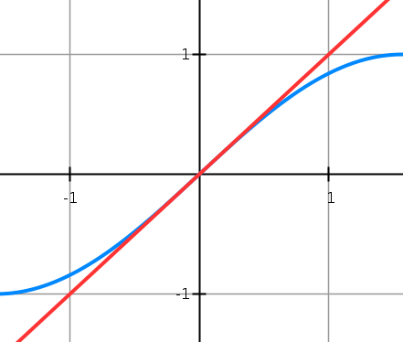
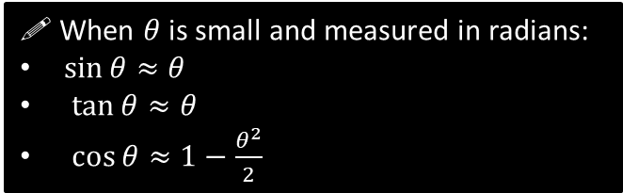


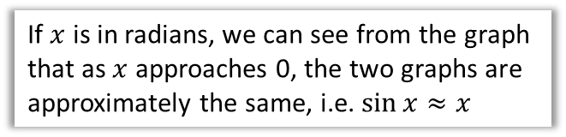
Small Angle Approximations
$$y=x$$
$$y=\sin{x}$$
! When $θ$ is small and measured in radians:
$\sin{θ}≈θ$
$\tan{θ}≈θ$
$\cos{θ}≈1−\frac{θ^{2}}{2}$
If $x$ is in radians, we can see from the graph that as $x$ approaches 0, the two graphs are approximately the same, i.e. $\sin{x}≈x$

Slide 16
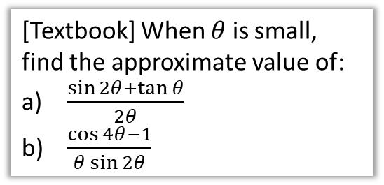
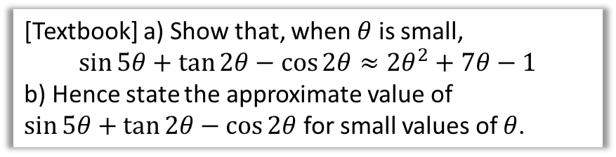
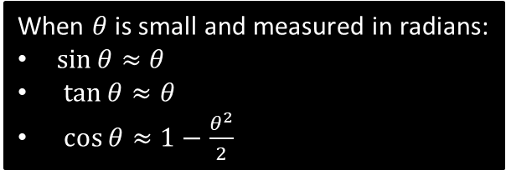
Examples
When $θ$ is small and measured in radians:
$\sin{θ}≈θ$
$\tan{θ}≈θ$
$\cos{θ}≈1−\frac{θ^{2}}{2}$
[Textbook] When $θ$ is small, find the approximate value of:
$\frac{\sin{2θ}+\tan{θ}}{2θ}$
$\frac{\cos{4θ}−1}{θ\sin{2θ}}$
[Textbook] a) Show that, when $θ$ is small,
$$\sin{5θ}+\tan{2θ}−\cos{2θ}≈2θ^{2}+7θ−1$$
b) Hence state the approximate value of
$\sin{5θ}+\tan{2θ}−\cos{2θ}$ for small values of $θ$.

