Slide 1
P2 Chapter 6 :: Trigonometry
Student Version
Last modified: 12th September 2019

Slide 2
Reciprocal Trigonometric Functions
$$\sec\left(x\right)=\frac{1}{\cos\left(x\right)}$$
$$\operatorname{cosec}\left(x\right)=\frac{1}{\sin\left(x\right)}$$
$$\cot\left(x\right)=\frac{1}{\tan\left(x\right)} or \frac{\cos\left(x\right)}{\sin\left(x\right)}$$
$$\cot{\frac{π}{4}}=$$
$$\sec{\frac{π}{4}=}$$
$$\operatorname{cosec}{\frac{π}{3}}=$$
$$\cot{\frac{π}{6}}=$$
$$\operatorname{cosec}{\frac{5π}{6}}=$$
$$\cot{\frac{π}{3}}=$$
$$\sec{\frac{π}{6}}=$$
$$\operatorname{cosec}{\frac{π}{2}}=$$
$$\sec{\frac{5π}{3}}=$$

Slide 3
Sketches
To draw a graph of $y=cosec x$, start with a graph of $y=\sin{x}$, then consider what happens when we reciprocate each $y$ value.
$$y$$
$$1$$
$$y=\sin{x}$$
$$x$$
$$\frac{1}{2}π$$
$$π$$
$$\frac{3}{2}π$$
$$2π$$
$$−1$$
Domain:
Range:

Slide 4
Sketches:
$$y$$
Domain:
Range:
$$1$$
$$y=\cos{x}$$
$$x$$
$$\frac{1}{2}π$$
$$π$$
$$\frac{3}{2}π$$
$$2π$$
$$−1$$
$$y$$
Domain:
Range:
$$y=\tan{x}$$
$$\frac{1}{2}π$$
$$π$$
$$2π$$
$$x$$

Slide 5
Example
[Textbook]
a) Sketch the graph of $y=4cosec x, −π≤x≤π$.
b) On the same axes, sketch the line $y=x$.
c) State the number of solutions to the equation $4cosec x−x=0, −π≤x≤π$

Slide 6
Test Your Understanding
Sketch $y=−1+\sec{2x}$ in the interval $0≤x<360°$.
$$−1$$

Slide 7
Using $sec,cosec,cot$
Questions in the exam usually come in two flavours: (a) ‘provey’ questions requiring to prove some identity and (b) ‘solvey’ questions.
[Textbook]
Simplify $\sin{θ}\cot{θ}\sec{θ}$
Simplify $\sin{θ}\cos{θ} \left(\sec{θ}+cosec θ\right)$
Prove that $\frac{\cot{θ} cosec θ}{\sec^{2}{θ}+cosec^{2} θ}≡\cos^{3}{θ}$

Slide 8
Test Your Understanding
$$\sec{x}−\cos{x}≡\sin{x}\tan{x}$$
1
2
$$\left(1+\cos{x}\right)\left(\operatorname{cosec}{x}−\cot{x}\right)≡\sin{x}$$

Slide 9
Solvey Questions
[Textbook] Solve the following equations in the interval $0≤θ≤360°$:
$\sec{θ}=−2.5$
$\cot{2θ}=0.6$
Solve $\cot{θ}=0$ in the interval $0≤θ≤2π$.

Slide 10
Test Your Understanding
Solve in the interval $0≤θ<360°$:
$$cosec 3θ=2$$

Slide 11
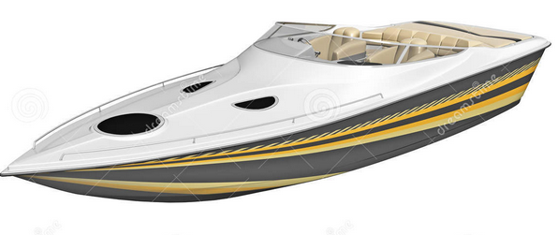
New Identities
From C2 you knew:
$$\sin^{2}{x}+\cos^{2}{x}=1$$

Slide 12
Examples
[Textbook] Prove that ${cosec}^{4}{θ}−\cot^{4}{θ}=\frac{1+\cos^{2}{θ}}{1−\cos^{2}{x}}$
Solve the equation $4 cosec^{2}θ−9=\cot{θ}$ in the interval $0≤θ≤360°$

Slide 13
Test Your Understanding
Edexcel C3 June 2013 (R)
Q
Solve, for $0≤x<2π$, the equation
$$2cosec^{2}x+\cot{x}=5$$
giving your solutions to 3sf.

Slide 14
Inverse Trig Functions
You need to know how to sketch $y=\arcsin{x}, y=\arccos{x}$, $y=\arctan{x}$.
(Yes, you could be asked in an exam!)
$$y$$
We have to restrict the domain of $\sin{x}$ to $−\frac{π}{2}≤x<\frac{π}{2}$ before we can find the inverse. Why?
$$1$$
$$x$$
$$−\frac{π}{2}$$
$$\frac{π}{2}$$
$$y=\sin{x}$$
$$−1$$

Slide 15
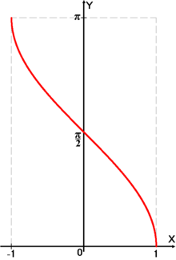
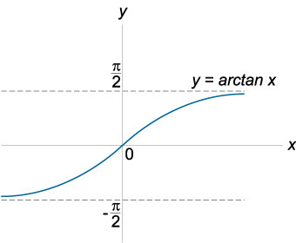
Inverse Trig Functions
$$y=\arccos{x}$$
$$y=\arctan{x}$$
Note that this graph has asymptotes.

Slide 16
Evaluating inverse trig functions
[Textbook] Work out, in radians, the values of:
$\arcsin\left(−\frac{\sqrt{2}}{2}\right)$
$\arccos\left(−1\right)$
$\arctan\left(\sqrt{3}\right)$
You can simply use the $\sin^{−1}{x}$, $\cos^{−1}{x}$ and $\tan^{−1}{x}$ buttons on your calculator.
If you don’t have a calculator, just use the $sin,cos,tan$ graphs backwards.

Slide 17
One Final Problem…
Edexcel C3 Jan 2007

