Slide 1
P2 Chapter 7 :: Trigonometry And Modelling
jfrost@tiffin.kingston.sch.uk
www.drfrostmaths.com @DrFrostMaths
Last modified: 6th September 2018

Slide 2
Addition Formulae
Addition Formulae allow us to deal with a sum or difference of angles.
$$\sin\left(A+B\right)=\sin{A}\cos{B}+\cos{A}\sin{B} \\ \sin\left(A−B\right)=\sin{A}\cos{B}−\cos{A}\sin{B} \\ \cos\left(A+B\right)=\cos{A}\cos{B}−\sin{A}\sin{B} \\ \cos\left(A−B\right)=\cos{A}\cos{B}+\sin{A}\sin{B} \\ \tan\left(A+B\right)=\frac{\tan{A}+\tan{B}}{1−\tan{A}\tan{B}} \\ \tan\left(A−B\right)=\frac{\tan{A}−\tan{B}}{1+\tan{A}\tan{B}}$$
How to memorise:
First notice that for all of these the first thing on the RHS is the same as the first thing on the LHS!
For sin, the operator in the middle is the same as on the LHS.
For cos, it’s the opposite.
For tan, it’s the same in the numerator, opposite in the denominator.
Do I need to memorise these?
They’re all technically in the formula booklet, but you REALLY want to eventually memorise these (particularly the $sin$ and $cos$ ones).
For sin, we mix sin and cos.
For cos, we keep the cos’s and sin’s together.

Slide 3
Proof of other identities
Edexcel C3 Jan 2012 Q8

Slide 4
Examples
Q
Given that $2\sin{(x+y)}=3\cos\left(x−y\right)$ express $\tan{x}$ in terms of $\tan{y}$.

Slide 5
Uses of Addition Formulae
Q
[Textbook] Using a suitable angle formulae, show that $\sin{15°}=\frac{\sqrt{6}−\sqrt{2}}{4}$.
Q
[Textbook] Given that $\sin{A}=−\frac{3}{5}$ and $180°<A<270°$, and that $\cos{B}=−\frac{12}{13}$, find the value of: (a) $\cos\left(A−B\right)$

Slide 6
Continued…
Q
Given that $\sin{A}=−\frac{3}{5}$ and $180°<A<270°$, and that $\cos{B}=−\frac{12}{13}$, find the value of: (b) $\tan\left(A+B\right)$

Slide 7
Test Your Understanding
Without using a calculator, determine the exact value of:
$\cos\left(75°\right)$
$\tan\left(75°\right)$

Slide 8
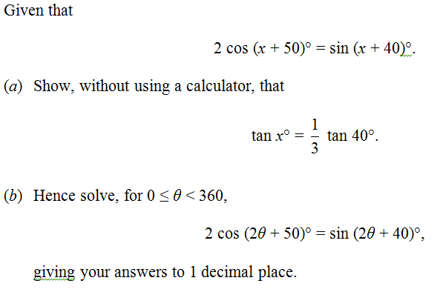
Challenging question
Edexcel June 2013 Q3

Slide 9
Double Angle Formulae
Double-angle formula allow you to halve the angle within a trig function.
!
This first form is relatively rare.
$$\sin\left(2A\right)≡2\sin{A}\cos{A} \\ \cos\left(2A\right)≡\cos^{2}{A}−\sin^{2}{A}$$ $≡2\cos^{2}{A}−1$ $$≡1−2\sin^{2}{A}$$
$$\tan\left(2A\right)=\frac{2\tan{A}}{1−\tan^{2}{A}}$$
Fro Tip: The way I remember what way round these go is that the cos on the RHS is ‘attracted’ to the cos on the LHS, whereas the sin is pushed away.
These are all easily derivable by just setting $A=B$ in the compound angle formulae. e.g. $$\sin\left(2A\right)=\sin\left(A+A\right) \\ =\sin{A}\cos{A}+\cos{A}\sin{A} \\ =2\sin{A}\cos{A}$$

Slide 10
Examples
[Textbook] Use the double-angle formulae to write each of the following as a single trigonometric ratio.
$\cos^{2}{50°}−\sin^{2}{50° }$
$\frac{2\tan\left(\frac{π}{6}\right)}{1−\tan^{2}\left(\frac{π}{6}\right)}$
$\frac{4\sin{70°}}{\sec{70°}}$
$$\sin{2x}=2\sin{x}\cos{x} \\ \cos{2x}=\cos^{2}{x}−\sin^{2}{x} \\ =2\cos^{2}{x}−1 \\ =1−2\sin^{2}{x} \\ \tan{2x}=\frac{2\tan{x}}{1−\tan^{2}{x}}$$

Slide 11
Examples
[Textbook] Given that $x=3\sin{θ}$ and $y=3−4cos2θ$, eliminate $θ$ and express $y$ in terms of $x$.
$$\sin{2x}=2\sin{x}\cos{x} \\ \cos{2x}=\cos^{2}{x}−\sin^{2}{x} \\ =2\cos^{2}{x}−1 \\ =1−2\sin^{2}{x} \\ \tan{2x}=\frac{2\tan{x}}{1−\tan^{2}{x}}$$
Fro Note: This question is an example of turning a set of parametric equations into a single Cartesian one. You will cover this in the next chapter.
Given that $\cos{x}=\frac{3}{4}$ and $x$ is acute, find the exact value of
(a) $\sin{2x}$ (b) $\tan{2x}$

Slide 12
Solving Trigonometric Equations
This is effectively the same type of question you encountered in Chapter 6 and in Year 1, except you may need to use either the addition formulae or double angle formulae.
[Textbook] Solve $3\cos{2x}−\cos{x}+2=0$ for $0≤x≤360°$.

Slide 13
Further Examples
[Textbook] By noting that $3A=2A+A$, :
Show that $\sin\left(3A\right)=3\sin{A}−4\sin^{3}{A}$.
Hence or otherwise, solve, for $0<θ<2π$, the equation $16\sin^{3}{θ}−12\sin{θ}−2\sqrt{3}=0$
[Textbook] Solve $4\cos\left(θ−30°\right)=8\sqrt{2}\sin{θ}$ in the range $0≤θ<360°$.

Slide 14
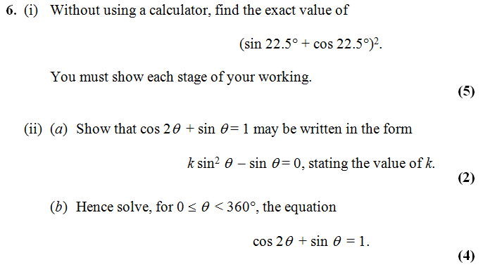
Test Your Understanding
Edexcel C3 Jan 2013 Q6
If you finish that quickly…
[Textbook] Solve $2\tan{2y}\tan{y}=3$ for $0≤y<2π$, giving your answer to 2dp.

Slide 15
Proving Trigonometric Identities
Just like Chapter 6 had ‘provey’ and ‘solvey’ questions, we also get the ‘provey’ questions in Chapter 7. Just use the appropriate double angle or addition formula.
Prove that $\tan{2θ}≡\frac{2}{\cot{θ}−\tan{θ}}$
Prove that $\frac{1−\cos{2θ}}{\sin{2θ}}≡\tan{θ}$

Slide 16
Test Your Understanding
Prove that $\cot{2x}+cosec 2x≡\cot{x}$

Slide 17
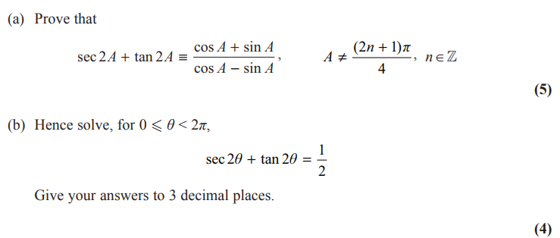
Very Challenging Exam Example
Edexcel C3 June 2015 Q8

Slide 18
$$a\sin{θ}+b\cos{θ}$$
Q
Put $3\sin{x}+4\cos{x}$ in the form $R\sin\left(x+α\right)$ giving $α$ in degrees to 1dp.
STEP 1: Expanding:
STEP 2: Comparing coefficients:
STEP 3: Using the fact that $R^{2}\sin^{2}{α}+R^{2}\cos^{2}{α}=R^{2}$:
STEP 4: Using the fact that $\frac{R\sin{α}}{R\cos{α}}=\tan{α}$:
STEP 5: Put values back into original expression.

Slide 19
Test Your Understanding
Q
Put $\sin{x}+\cos{x}$ in the form $R\sin\left(x+α\right)$ giving $α$ in terms of $π$.
Q
Put $\sin{x}−\sqrt{3}\cos{x}$ in the form $R\sin\left(x−α\right)$ giving $α$ in terms of $π$.

Slide 20
Further Examples
Q
Put $2\cos{θ}+5\sin{θ}$ in the form $R\cos\left(θ−α\right)$ where $0<α<90°$
Hence solve, for $0<θ<360$, the equation $2\cos{θ}+5\sin{θ}=3$
Fro Tip: This is an exam favourite!
Q
(Without using calculus), find the maximum value of $12\cos{θ}+5\sin{θ}$, and give the smallest positive value of $θ$ at which it arises.

Slide 21
Quickfire Maxima
What is the maximum value of the expression and determine the smallest positive value of $θ$ (in degrees) at which it occurs.
Expression | Maximum | (Smallest) $θ$ at max
$$20\sin{θ}$$
$$5−10\sin{θ}$$
$$3\cos\left(θ+20°\right)$$
$$\frac{2}{10+3\sin\left(θ−30\right)}$$

Slide 22
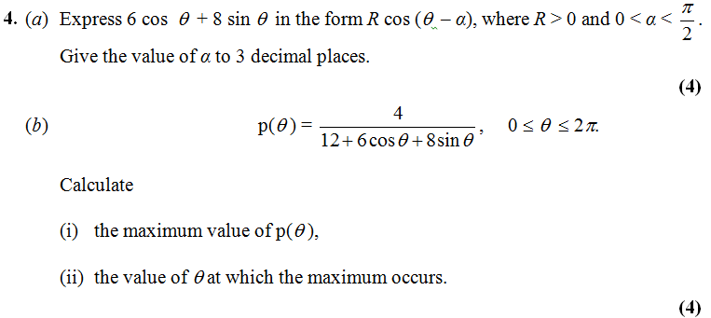
Further Test Your Understanding
Edexcel C3 Jan 2013 Q4

Slide 23
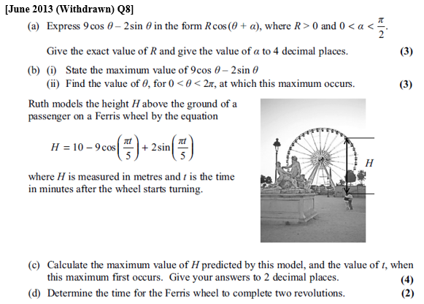
Modelling
When trigonometric equations are in the form $Rsin\left(ax±b\right)$ or $Rcos\left(ax±b\right)$, they can be used to model various things which have an oscillating behaviour, e.g. tides, the swing of a pendulum and sound waves.

Slide 24
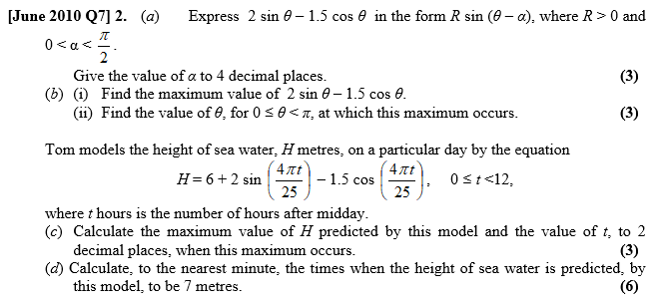
Test Your Understanding

