Slide 1
P2 Chapter 8 :: Parametric Equations
jfrost@tiffin.kingston.sch.uk
www.drfrostmaths.com @DrFrostMaths
Last modified: 6th September 2018

Slide 2
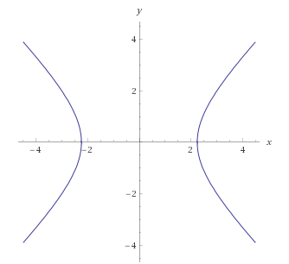
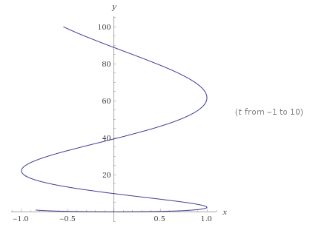
What are they and what is the point?
$$x^{2}−y^{2}=5$$
Typically, with two variables $x$ and $y$, we can relate the two by a single equation involving just $x$ and $y$.
This is known as a Cartesian equation.
The line shows all points $\left(x,y\right)$ which satisfy the Cartesian equation.
$$x=\sin\left(t\right) \\ y=t^{2}$$
However, in Mechanics for example, we might want each of the $x$ and $y$ values to be some function of time $t$, as per this example.
This would allow us to express the position of a particle at time $t$ as the vector:
$$\left(\begin{matrix}\sin{t} \\ t^{2}\end{matrix}\right)$$
These are known as parametric equations, because each of $x$ and $y$ are defined in terms of some other variable, known as the parameter (in this case $t$).

Slide 3
Converting parametric to Cartesian
How could we convert these parametric equations into a single Cartesian one?
$$x=2t, y=t^{2}, −3<t<3$$
What is the domain of the function?
! If $x=p(t)$ and $y=q(t)$ can be written as $y=f\left(x\right)$, then the domain of $f$ is the range of $p$...
! and the range of $f$ is the range of $q$.

Slide 4
Further Example
[Textbook] A curve has the parameter equations
$$x=\ln\left(t+3\right), y=\frac{1}{t+5}, t>−2$$
a) Find a Cartesian equation of the curve of the form $y=f\left(x\right)$, $x>k$, where $k$ is a constant to be found.
b) Write down the range of $f\left(x\right)$.

Slide 5
Test Your Understanding
Edexcel C4 Jan 2008 Q7
Edexcel C4 Jan 2011

Slide 6
…when you have trig identities
It’s often helpful to use $\sin^{2}{t}+\cos^{2}{t}≡1$ or $1+\tan^{2}{t}≡\sec^{2}{t}$ to turn parametric equations into a single Cartesian one.
[Textbook] A curve has the parametric sequences $x=\sin{t}+2$, $y=\cos{t}−3$, $t∈ℝ$.
Find a Cartesian equation for the curve.
Hence sketch the curve.
[Textbook] A curve is defined by the parametric equations
$$x=\sin{t}, y=\sin{2t}, −\frac{π}{2}≤t≤\frac{π}{2}$$
Find a Cartesian equation of the curve in the form $y=f\left(x\right), −k≤x≤k$, stating the value of the constant $k$.
Write down the range of $f(x)$.

Slide 7
Test Your Understanding
C4 June 2013
which double angle formula would be best here?
[Textbook] A curve $C$ has parametric equations
$$x=\cot{t}+2, y=cosec^{2} t−2, 0<t<π$$
Find the equation of the curve in the form $y=f\left(x\right)$ and state the domain of $x$ for which the curve is defined.
Hence, sketch the curve.

Slide 8
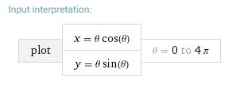
Sketching Parametric Curves
We can try different values of $t$ and determine the point $\left(x,y\right)$ for each value to get a sequence of points…
2π
$$θ$$ | $$0$$ | $$\frac{π}{4}$$ | $$\frac{π}{2}$$ | $$\frac{3}{4}π$$ | $$π$$ | $$\frac{5}{4}π$$ | $$\frac{3}{2}π$$ | $$\frac{7}{4}π$$ | $$2π$$
$$x$$
$$y$$

Slide 9
Test Your Understanding
[Textbook] Draw the curve given by the parametric equations $x=2t,$
$y=t^{2}$, for $−1≤t≤5$.
$$t$$ | $$−1$$ | $$0$$ | $$1$$ | $$2$$ | $$3$$ | $$4$$ | $$5$$
$$x$$
$$y$$
$$y$$

Slide 10
Points of Intersection
We can find where a parametric curve crosses a particular axis or where curves cross each other.
The key is to first find the value of the parameter $t$.
$$y$$
[Textbook] The diagram shows a curve $C$ with parametric equations $x=at^{2}+t$, $y=a\left(t^{3}+8\right)$, $t∈ℝ$, where $a$ is a non-zero constant. Given that $C$ passes through the point $\left(−4,0\right)$,
a) find the value of $a$.
b) find the coordinates of the points $A$ and $B$ where the curve crosses the $y$-axis.
$$C$$
$$−4$$
$$x$$
$$O$$
$$A$$
$$B$$

Slide 11
Points of Intersection
[Textbook] A curve is given parametrically by the equations $x=t^{2}, y=4t$. The line $x+y+4=0$ meets the curve at $A$. Find the coordinates of $A$.
Whenever you want to solve a Cartesian equation and pair of parametric equations simultaneously, substitute the parametric equations into the Cartesian one.
[Textbook] The diagram shows a curve $C$ with parametric equations
$$x=\cos{t}+\sin{t}, y={\left(t−\frac{π}{6}\right)}^{2}, −\frac{π}{2}<t<\frac{4π}{3}$$
a) Find the point where the curve intersects the line $y=π^{2}$.
b) Find the coordinates of the points $A$ and $B$ where the curve cuts the $y$-axis.

Slide 12
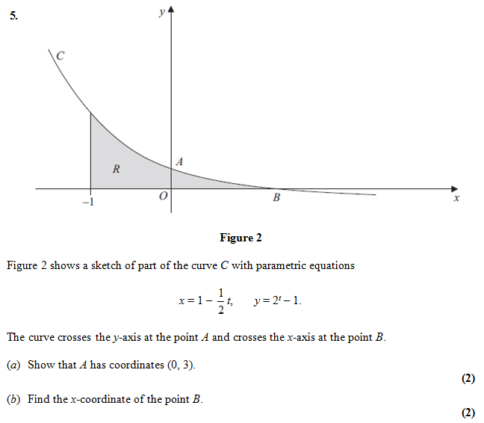
Test Your Understanding
C4 Jan 2013

Slide 13
Modelling
As we saw at the start of this chapter, parametric equations are frequently used in mechanics, particularly where the $\left(x,y\right)$ position (the Cartesian variables) depends on time $t$ (the parameter).
[Textbook] A plane’s position at time $t$ seconds after take-off can be modelled with the following parametric equations:
$$x=\left(v\cos{θ}\right)t m, y=\left(v\sin{θ}\right)t m, t>0$$
where $v$ is the speed of the plane, $θ$ is the angle of elevation of its path, $x$ is the horizontal distance travelled and $y$ is the vertical distance travelled, relative to a fixed origin.
When the plane has travelled 600m horizontally, it has climbed 120m.
a. find the angle of elevation, $θ$.
Given that the plane’s speed is 50 m s⁻¹,
b. find the parametric equations for the plane’s motion.
c. find the vertical height of the plane after 10 seconds.
d. show that the plane’s motion is a straight line.
e. explain why the domain of $t$, $t>0$, is not realistic.
DFM
$$θ$$

Slide 14
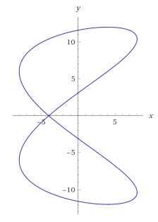
Further Example
[Textbook] The motion of a figure skater relative to a fixed origin, $O$, at time $t$ minutes is modelled using the parametric equations
$$x=8\cos{20t}, y=12\sin\left(10t−\frac{π}{3}\right), t≥0$$
where $x$ and $y$ are measured in metres.
Find the coordinates of the figure skater at the beginning of his motion.
Find the coordinates of the point where the figure skater intersects his own path.
Find the coordinates of the points where the path of the figure skater crosses the $y$-axis.
Determine how long it takes the figure skater to complete one complete figure-of-eight motion.

