Slide 1
P2 Chapter 9 :: Differentiation
Student notes
Last modified: 6th September 2018

Slide 2
Differentiating trigonometric functions
$$\frac{d}{dx}\left(\sin{x}\right)=$$
Things of helpfulness:
As $x→0, \sin{x}≈x$ and $\cos{x}≈1−\frac{1}{2}x^{2}$
$\sin\left(a+b\right)=\sin{a}\cos{b}+\cos{a}\sin{b}$
Proof
Yes, you could be tested on this!
Use addition formula.
Collect $\sin{x}$ terms and $\cos{x}$ terms together.
Use small angle approximations to consider what the expressions in terms of $h$ will become.

Slide 3
Differentiating trigonometric functions
$$\frac{d}{dx}\left(\cos{x}\right)=$$
$$\sin{x}$$
$$\cos{x}$$

Slide 4
Differentiating $\sin{kx}$ and $\cos{kx}$
$$\frac{d}{dx}\left(\sin{kx}\right)=$$
$$\frac{d}{dx}\left(\cos{kx}\right)=$$
This makes sense when you think that, for example, sin2x is repeating twice as fast and is therefore twice as steep!
Quickfire Questions:
$$\frac{d}{dx}\left(\sin{3x}\right)= \\ \frac{d}{dx}\left(\cos{5x}\right)= \\ \frac{d}{dx}\left(3\sin{5x}\right)=$$
$$\frac{d}{dx}\left(4\cos{3x}\right)=$$
$$\frac{d}{dx}\left(−\frac{1}{2}\sin{x}\right)= \\ \frac{d}{dx}\left(−\frac{2}{3}\cos{\frac{1}{2}x}\right)=$$

Slide 5
Example
[Textbook] A curve has equation $y=\frac{1}{2}x−\cos{2x}$. Find the stationary points on the curve in the interval $0≤x≤π$.

Slide 6
Test Your Understanding
A curve has equation $y=\sin{3x}+2x$. Find the stationary points on the curve in the interval $0≤x≤\frac{2}{3}π$.

Slide 7
Differentiation exponential and log functions
$$\frac{d}{dx}\left(e^{x}\right)=$$
$$\frac{d}{dx}\left(e^{kx}\right)=$$
$$\frac{d}{dx}\left(\ln{x}\right)=$$
$$\frac{d}{dx}\left(a^{x}\right)=$$
$$\frac{d}{dx}\left(a^{kx}\right)=$$

Slide 8
Quickfire Questions
$$\frac{d}{dx}\left(3^{x}\right)= \\ \frac{d}{dx}\left(x^{3}\right)= \\ \frac{d}{dx}\left(\ln\left(3x\right)\right)= \\ \frac{d}{dx}\left(3^{2x}\right)=$$
$$\frac{d}{dx}\left(2^{3x}\right)= \\ \frac{d}{dx}\left(5\ln{x}\right)= \\ \frac{d}{dx}\left(e^{\frac{1}{2}x}\right)= \\ \frac{d}{dx}\left(5\ln\left(2x\right)\right)= \\ \frac{d}{dt}\left(9^{t}\right)= \\ \frac{d}{dx}\left(5\left(4^{x}\right)\right)= \\ \frac{d}{dx}\left(x^{4}\right)=$$
$$\frac{d}{dx}\left(\ln{6x}\right)= \\ \frac{d}{dx}\left(6\ln{x}\right)=$$
$$\frac{d}{dx}\left(3e^{2x}\right)= \\ \frac{d}{dx}\left(e^{−x}\right)=$$
Wordy Example:
A rabbit population $P$ after $t$ years can be modelled using $P=1000(2^{t})$. Determine after how many years the rate of population increase will reach 20,000 rabbits per year.

Slide 9
Test Your Understanding
Differentiate ${y=\left(e^{x}+2\right)}^{2}$
A child has headlice and his parents treat it using a special shampoo. The population $P$ of headlice after $t$ days can be modelled using $P=460\left(3^{−2t}\right)$
a) Determine how many days have elapsed before the child has 20 headlice left.
b) Determine the rate of change of headlice after 3 days.

Slide 10
The Chain Rule
The chain rule allows us to differentiate a composite function, i.e. a function within a function.
$$y={\left(3x^{4}+x\right)}^{5}$$
The Chain Rule:
$$\frac{dy}{dx}=\frac{dy}{du}×\frac{du}{dx}$$
Fro Note: Notice how the $du$’s sort of ‘cancel’ top and bottom on the RHS. This is not a valid proof of the chain rule, but the $d$’s sort of behave as quantities which can often be manipulated in this way.
Doing it mentally in one go:
(aka the ‘coverup method’)
Full Method:
The chain rule boils down to:
$\frac{dy}{dx}=$outer function differentiated
$×$ inner function differentiated
$\frac{dy}{dx}$=

Slide 11
Further Practice
$$\frac{dy}{dx}=$$
$$y={\left(x^{2}+1\right)}^{3}$$
$$\frac{dy}{dx}=$$
$$y={\left(\ln{x}\right)}^{3}$$
$$\frac{dy}{dx}=$$
$$y=e^{x^{2}+x}$$
$$\frac{dy}{dx}=$$
$$y={\left(2^{x}+1\right)}^{2}$$
$$\frac{dy}{dx}=$$
$$y=\ln\left(\sin{x}\right)$$

Slide 12
Yet Further Practice
$$\frac{dy}{dx}=$$
$$y=\sin{5x}$$
$$y=\sin^{2}{x}=$$
$$\frac{dy}{dx}=$$
$$y=\sqrt{x+1}=$$
$$\frac{dy}{dx}=$$
$$\frac{dy}{dx}=$$
$$y=\cos^{3}{2x}=$$
$$y=e^{e^{x}}$$
$$\frac{dy}{dx}=$$

Slide 13
Test Your Understanding
C3 June 2011 Q1a
In general:
$$\frac{d}{dx}(\ln\left(f\left(x\right)\right)=\frac{f^{′}\left(x\right)}{f\left(x\right)}$$
[Textbook] Given that $y=\sqrt{5x^{2}+1}$, find $\frac{dy}{dx}$ at $\left(4,9\right)$

Slide 14
$$dx/dy$$
Proof: By the chain rule:
$$\frac{dy}{dy}=\frac{dy}{dx}×\frac{dx}{dy}$$
But $\frac{dy}{dy}=\frac{d}{dy}\left(y\right)=1$. $∴\frac{dy}{dx}=1÷\frac{dx}{dy}$
! $\frac{dy}{dx}=\frac{1}{\left(\frac{dx}{dy}\right)}$
Sometimes we might have $x$ in terms of $y$, but we want to find $\frac{dy}{dx}$.
Find $\frac{dy}{dx}$ when $x=2y^{2}+y$
Find the gradient of $x={\left(1+2y\right)}^{3}$ when $y=1$

Slide 15
The Product Rule
The product rule is used, unsurprisingly, when we have a product of two functions.
! The product rule:
If $y=uv$ then $\frac{dy}{dx}=u\frac{dv}{dx}+v\frac{du}{dx}$
This is quite easy to remember. Differentiate one of the things but leave the other. Then do the other way round. Then add!
Since addition is commutative, it doesn’t matter which way round we do it.
If $y=x^{2}\sin{x}$, determine $\frac{dy}{dx}$
$$u= v= \\ \frac{du}{dx}= \frac{dv}{dx}=$$
Write out $u=…, v=…$ then differentiate each.
Sub into product rule.
If $y=xe^{2x}$, determine the coordinates of the turning point.
$$u= v= \\ \frac{du}{dx}= \frac{dv}{dx}= \\ \frac{dy}{dx}=$$

Slide 16
Product + Chain Rule Examples
[Textbook] If $y=e^{4x}\sin^{2}{3x}$, show that $\frac{dy}{dx}=e^{4x}\sin{3x}\left(A\cos{3x}+B\sin{3x}\right)$, where $A$ and $B$ are constants to be determined.
[Textbook] Given that $f\left(x\right)=x^{2}\sqrt{3x−1}$, find $f′(x)$

Slide 17
Test Your Understanding
Edexcel C3 Jan 2012 Q1a
Edexcel C3 June 2013 Q5(c) – very difficult question!!
$$\frac{dy}{dx}=\frac{1}{6x{\left(x−1\right)}^{\frac{1}{2}}}$$
Find $\frac{d^{2}y}{dx^{2}}$, simplifying your answer.

Slide 18
The Quotient Rule
Just as we use the ‘product rule’ to differentiate a ‘product’, we use the ‘quotient rule’ to differentiate a ‘quotient’ (i.e. division).
$$y=\frac{u}{v} \\ \frac{dy}{dx}=\frac{v\frac{du}{dx}−u\frac{dv}{dx}}{v^{2}}$$
[Textbook] If $y=\frac{x}{2x+5}$, find $\frac{dy}{dx}$

Slide 19
Examples
[Textbook] Find the stationary point of $y=\frac{\sin{x}}{e^{2x}}$ , $0<x<π$

Slide 20
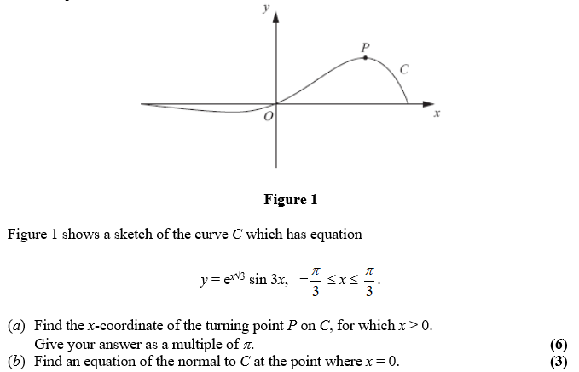
Test Your Understanding
Edexcel C3 Jan 2012 Q1a
Edexcel C3 June 2012 Q3

Slide 21
Differentiating combinations of functions
Functions can interact in different ways…
How to differentiate
1
Composite Function
i.e. of form $y=f\left(g\left(x\right)\right)$
$$y=\sqrt{1+3x}$$
The Chain Rule
The ‘outer’ function here is the $√$ and the inner function the $1+3x$.
i.e. $f\left(x\right)=\sqrt{x}$ and $g\left(x\right)=1+3x$
2
Product of Two Functions
The Product Rule
i.e. of form $y=f\left(x\right)g\left(x\right)$
$$y=x\sin{2x}$$
3
Division (i.e. “Quotient”) of Two Functions
i.e. of form $y=\frac{f\left(x\right)}{g\left(x\right)}$
The Quotient Rule
$$y=\frac{\ln{x}}{x}$$

Slide 22
Differentiating other trigonometric functions
Differentiate $y=\tan{x}$
! More generally: $\frac{d}{dx}\left(\tan{kx}\right)=k\sec^{2}{kx}$

Slide 23
Differentiating other trigonometric functions
$$\frac{d}{dx}\left(\tan{x}\right)=\sec^{2}{x} \\ \frac{d}{dx}\left(\sec{x}\right)=\sec{x}\tan{x}$$
$$\frac{d}{dx}\left(\cot{x}\right)={−cosec}^{2}{x} \\ \frac{d}{dx}\left(\operatorname{cosec}{x}\right)=−\operatorname{cosec}{x}\cot{x}$$
Differentiate
$y=\frac{cosec 2x}{x^{2}}$
$y=\sec^{3}{x}$

Slide 24
Test Your Understanding So Far
Edexcel C3 June 2013(R) Q5b

Slide 25
Making use of $1÷dx/dy$
Often in exam questions, you will be given $x$ in terms of $y$, but want to find $\frac{dy}{dx}$ in terms of $x$.
The key is to make use of an appropriate trig identity, e.g:
$$\sin^{2}{x}+\cos^{2}{x}≡1 1+\tan^{2}{x}≡\sec^{2}{x}$$
Given that $x=\tan{y}$, express $\frac{dy}{dx}$ in terms of $x$.

Slide 26
Further Examples
a) Show that if $y=\arcsin{x}$, then $\frac{dy}{dx}=\frac{1}{\sqrt{1−x^{2}}}$
!
$$\frac{d}{dx}\left(\arcsin{x}\right)=\frac{1}{\sqrt{1−x^{2}}} \\ \frac{d}{dx}\left(\arccos{x}\right)=−\frac{1}{\sqrt{1−x^{2}}} \\ \frac{d}{dx}\left(\arctan{x}\right)=\frac{1}{1+x^{2}}$$
b) Hence find $\frac{dy}{dx}$ when $y=\arcsin{x^{2}}$

Slide 27
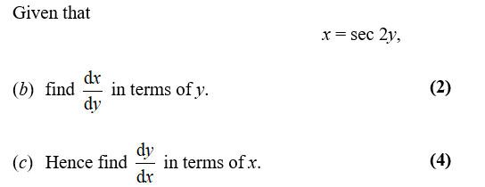
Test Your Understanding
Edexcel C3 Jan 2011 Q8b,c
[Textbook] Given that
$y=\arctan\left(\frac{1−x}{1+x}\right)$, find $\frac{dy}{dx}$

Slide 28
Parametric Differentiation
Recall from the previous chapter that parametric equations are when we define each of $x$ and $y$ (and possibly $z$) in terms of some separate parameter, e.g. $t$.
! If $x$ and $y$ are given as functions of a parameter $t$, then
$$\frac{dy}{dx}=\frac{dy/dt}{dx/dt}$$
[Textbook] Find the gradient at the point $P$ where $t=2$, on the curve given parametrically by
$$x=t^{3}+t, y=t^{2}+1, t∈ℝ$$
[Textbook] Find the equation of the normal at the point $P$ where $θ=\frac{π}{6}$, to the curve with parametric equations $x=3\sin{θ}, y=5\cos{θ}$

Slide 29
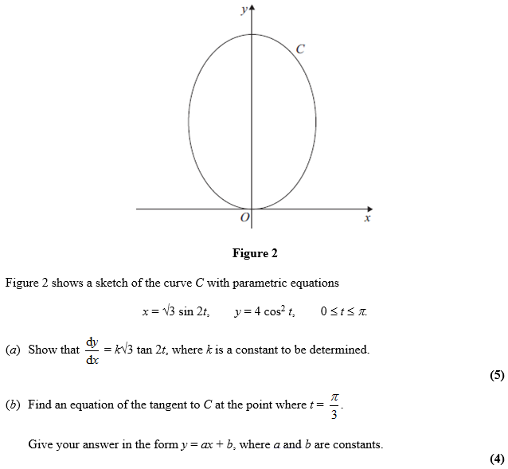
Test Your Understanding
C4 June 2012 Q6

Slide 30
Implicit Differentiation - Examples
To differentiate implicitly you only need to know 2 things:
Differentiate any y terms as normal and pop dy/dx on the end – CHAIN RULE!
$$\frac{d}{dx}\left(y^{2}\right)=$$
$$\frac{d}{dx}\left(\sin{y}\right)=$$
In general, when differentiating a function of $y$, but with respect to $x$, slap a $\frac{dy}{dx}$ on the end. i.e.
$$\frac{d}{dx}\left(f\left(y\right)\right)=f^{′}\left(y\right)\frac{dy}{dx}$$
$$\frac{d}{dx}\left(\tan\left(y\right)\right)=$$
$$\frac{d}{dx}\left(e^{y}\right)=$$
$$\frac{d}{dx}\left(e^{x^{2}y}\right)=$$
$$\frac{d}{dx}\left(x^{2}+\cos{y}\right)=$$
$$\frac{d}{dx}\left(xy\right)=$$

Slide 31
Meatier Examples
[Textbook] Find $\frac{dy}{dx}$ in terms of $x$ and $y$ where $x^{3}+x+y^{3}+3y=6$
[Textbook] Find the value of $\frac{dy}{dx}$ at the point $(1,1)$, where $e^{2x}\ln{y}=x+y−2$

Slide 32
Test Your Understanding
C4 Jan 2008 Q5
Hint for (b): Solve simultaneously with original equation.
C4 June 2014(R) Q3

Slide 33
Using the second derivative
You may remember that a point of inflection was where the concavity of a curve changes, i.e. concave to convex or vice versa, or informally, ‘swerving one way to swerving the other’.
In this region the gradient, although initially negative, is still also increasing.
We say the curve is concave when the gradient is always decreasing, i.e. the change in the gradient is negative.
! $f(x)$ convex when $f^{′′}\left(x\right)≥0$
At point of inflection, the gradient is not changing, i.e. the gradient of the gradient is 0. Note that points of inflection (as with this example) are not necessarily stationary points.
! $f(x)$ concave when $f^{′′}\left(x\right)≤0$
Point of inflection when $f^{′′}\left(x\right)=0$
The sign of $f^{′′}\left(x\right)$ should change sign either side of the x value

Slide 34
Examples
[Textbook] Find the interval on which the function $f\left(x\right)=x^{3}+4x+3$ is concave.
[Textbook] Show that $f\left(x\right)=e^{2x}+x^{2}$ is convex for all real values of $x$.
[Textbook] The curve $C$ has equation $y=x^{3}−2x^{2}−4x+5$
Find the coordinates of the point of inflection.

Slide 35
Relating Rates of Change
Q
Determine the rate of change of the area $A$ of a circle when the radius $r=3$cm, given that the radius is changing at a rate of $5 cm s^{−1}$.
Firstly, how would we represent…
Fro Tip: Whenever you see the word ‘rate’, think $/dt$
“the rate of change of the area $A$”
“the rate of change of the radius $r$ is 5”
“the area $A$ of a circle”

Slide 36
Relating Rates of Change - Example
You can relate one rate of change to another. This is useful when a situation involves more than two variables.
Given that the area of a circle A, is related to its radius r by the formula A = πr², and the rate of change of its radius in cm is given by ^{dr}/_{dt} = 5, find ^{dA}/_{dt} when r = 3

Slide 37
Relating Rates of Change - Example
The volume of a hemisphere is related to its radius by the formula:
$$V=\frac{2}{3}πr^{3}$$
The total surface area is given by the formula:
$$S=3πr^{2}$$
Find the rate of increase of surface area when the rate of increase of volume:
$$\frac{dV}{dt}=6$$
4D

Slide 38
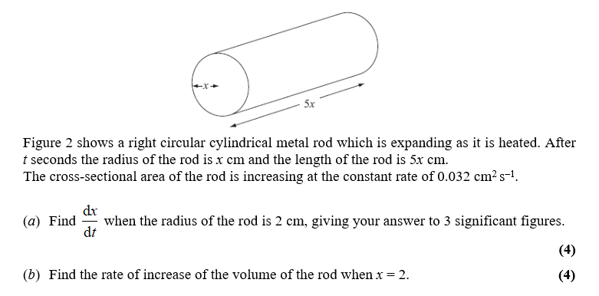
Further Example
Edexcel C4 June 2008 Q3
It’s common to have a second part of the question where you have to connect further rates.

Slide 39
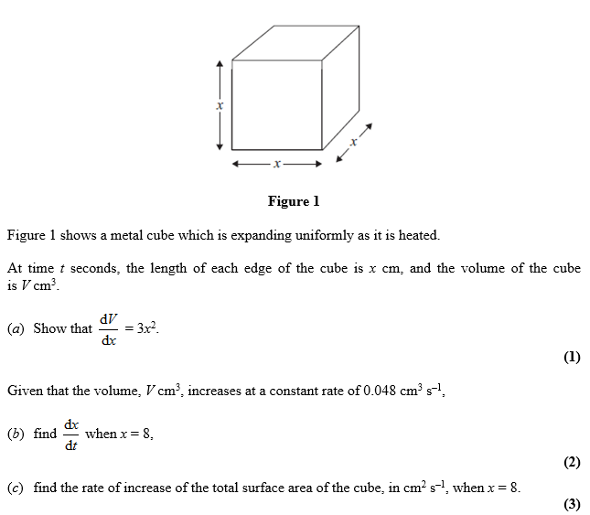
Test Your Understanding
June 2012 Q2
Tip: Don’t forget that if you know $\frac{dV}{dx}$ then $\frac{dx}{dV}=\frac{1}{dV/dx}$

