Slide 1
Stats Yr2 Chapter 1 :: Regression, Correlation & Hypothesis Tests
Student Pack
Last modified: 22nd January 2018

Slide 2
Exponential Regression
Linear regression line not a good fit for the data.
$$y=a+bx$$
Rabbit population $(y)$
Exponential line much better fit.
$$y=ab^{x}$$
Time$(x)$
For some variables, e.g. population with time, it may be more appropriate to use an exponential equation, i.e. $y=ab^{x}$, where $a$ and $b$ are constants we need to fix to best match the data.
$$y=ab^{x}$$
! If $y=kb^{x}$ for constants $k$ and $b$ then $\log{y}=\log{k}+x\log{b}$

Slide 3
Example
[Textbook] The table shows some data collected on the temperature, in $°$C, of a colony of bacteria ($t$) and its growth rate ($g$).
The data are coded using the changes of variable $x=t$ and $y=\log{g}$. The regression line of $y$ on $x$ is found to be $y=−0.2215+0.0792x$.
a. Mika says that the constant -0.2215 in the regression line means that the colony is shrinking when the temperature is $0°$C. Explain why Mika is wrong
b. Given that the data can be modelled by an equation of the form $g=kb^{t}$ where $k$ and $b$ are constants, find the values of $k$ and $b$.
Temperature, $t$ ($°$C) | 3 | 5 | 6 | 8 | 9 | 11
Growth rate, $g$ | 1.04 | 1.49 | 1.79 | 2.58 | 3.1 | 4.46

Slide 4
Test Your Understanding
Robert wants to model a rabbit population $P$ with respect to time in years $t$. He proposes that the population can be modelled using an exponential model: $P=kb^{t}$
The data is coded using $x=t$ and $y=\log{P}$. The regression line of $y$ on $x$ is found to be $y=2+0.3x$. Determine the values of $k$ and $b$.

Slide 5
Measuring Correlation
You’re used to use qualitative terms such as “positive correlation” and “negative correlation” and “no correlation” to describe the type of correlation, and terms such as “perfect”, “strong” and “weak” to describe the strength.
The Product Moment Correlation Coefficient is one way to quantify this:
! The product moment correlation coefficient (PMCC), denoted by $r$, describes the linear correlation between two variables. It can take values between -1 and 1.
$$r=−1$$
$$0$$
$$1$$
Perfect negative
Strong negative
No correlation
Weak positive
Perfect positive
Rule of thumb: $r<−0.7$ or $r>0.7$ is considered to be ‘strong’ correlation.
Note that PMCC is only applicable for a linear correlation, i.e. closeness of fit to a linear regression line (i.e. a straight ‘line of best fit’). It may be the data exhibits strong correlation with respect to a different model (e.g. exponential) even when the PMCC is low.

Slide 6
Example
[Textbook] From the large data set, the daily mean windspeed, $w$ knots, and the daily maximum gust, $g$ knots, were recorded for the first 10 days in September in Hurn in 1987.
State the meaning of n/a in the table above.
Calculate the product moment correlation coefficient for the remaining 8 days.
With reference to your answer to part b, comment on the suitability of a linear regression model for these data.
Day of month | 1 | 2 | 3 | 4 | 5 | 6 | 7 | 8 | 9 | 10
$$w$$ | 4 | 4 | 8 | 7 | 12 | 12 | 3 | 4 | 7 | 10
$$g$$ | 13 | 12 | 19 | 23 | 33 | 37 | 10 | n/a | n/a | 23

Slide 7
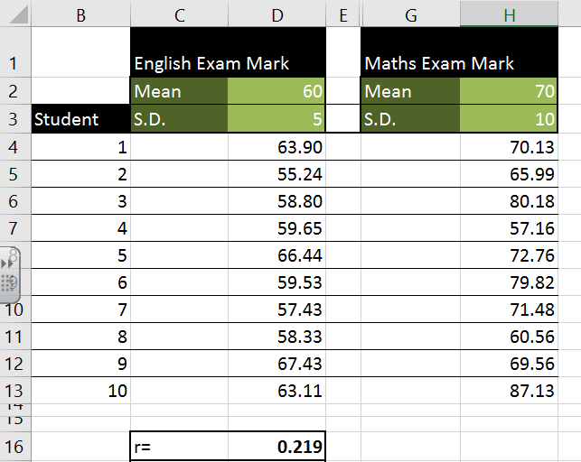
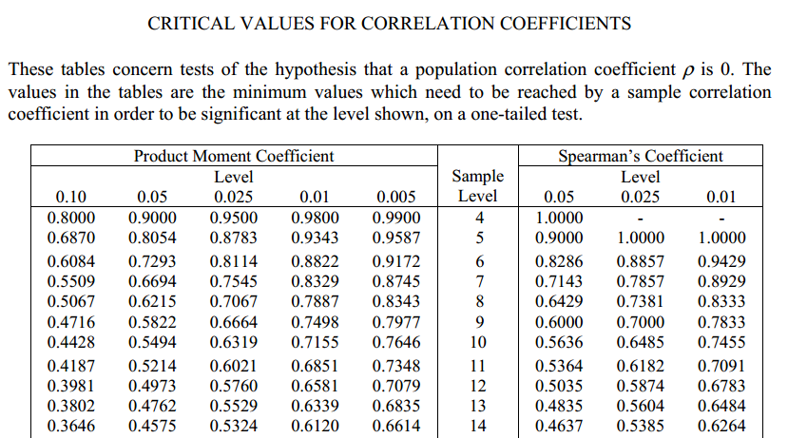
How to carry out the hypothesis test
Let’s carry out a hypothesis test on whether there is positive correlation between English and Maths marks, at 10% significance level:
There is no underlying correlation between English and maths marks.
$$H_{0}:$$
$$H_{1}:$$
Sample size
There is an underlying positive correlation between English and maths marks.
Critical value for 10% significance level:
Look up value in table.
As with Year 1, a 2 mark conclusion: (a) Compare values; do we reject $H_{0}$? (b) put in context of original problem.
These values give the minimum value of $r$ required to reject the null hypothesis, i.e. the amount of correlation that would be considered significant.

Slide 8
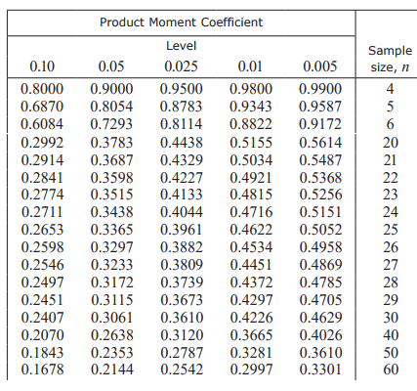
Two-tailed test
In the previous example we hypothesised that English/Maths marks were positively correlated. But we could also test whether there was any correlation, i.e. positive or negative.
[Textbook] A scientist takes 30 observations of the masses of two reactants in an experiment. She calculates a product moment correlation coefficient of $r=−0.45$.
The scientist believes there is no correlation between the masses of the two reactants. Test at the 10% level of significance, the scientist’s claim, stating your hypotheses clearly.
$$H_{0}: \\ H_{1}:$$
Sample size $=$
Critical value at significance:
Two-tailed, so 5% at each tail.

Slide 9
Test Your Understanding
[Textbook] The table from the large data set shows the daily maximum gust, $x$ kn, and the daily maximum relative humidity, $y$%, in Leeming for a sample of eight days in May 2015.
Find the product moment correlation coefficient for this data.
Test, at the 10% level of significance, whether there is evidence of a positive correlation between daily maximum gust and daily maximum relative humidity. State your hypotheses clearly.
$$x$$ | 31 | 28 | 38 | 37 | 18 | 17 | 21 | 29
$$y$$ | 99 | 94 | 87 | 80 | 80 | 89 | 84 | 86

