Slide 1
Stats Yr2 Chapter 2 :
Conditional Probability

Slide 2









Conditional Probability
Think about how we formed a probability tree at GCSE:
$$P\left(A∩B\right) \\ =$$
$$B$$
$$P\left(A\right)$$
$$A$$
Read the ‘|’ symbol as “given that”. i.e. “B occurred given that A occurred”.
$$B′$$
$$B$$
$$A′$$
$$B′$$
Alternatively (and more commonly):
Memory Tip: You’re dividing by the event you’re conditioning on.
! $P\left(B | A\right)=$

Slide 3

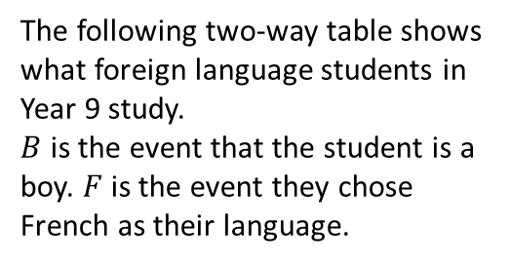

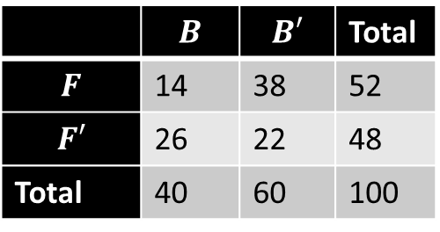



Examples
a
Determine the probability of:
$P\left(F | B^{′}\right)$
$$P\left(B | F^{′}\right)=$$
1
The following two-way table shows what foreign language students in Year 9 study.
$B$ is the event that the student is a boy. $F$ is the event they chose French as their language.
 | $$B$$ | $$B′$$ | Total
$$F$$ | 14 | 38 | 52
$$F′$$ | 26 | 22 | 48
Total | 40 | 60 | 100
b
2
Using the Venn Diagram, determine:
a
$P\left(A | B\right)$
$$ξ$$
$$A$$
$$B$$
2
3
6
4
$$P\left(A′ | B′\right)= P\left(B | A∪B\right)=$$
b
c

Slide 4
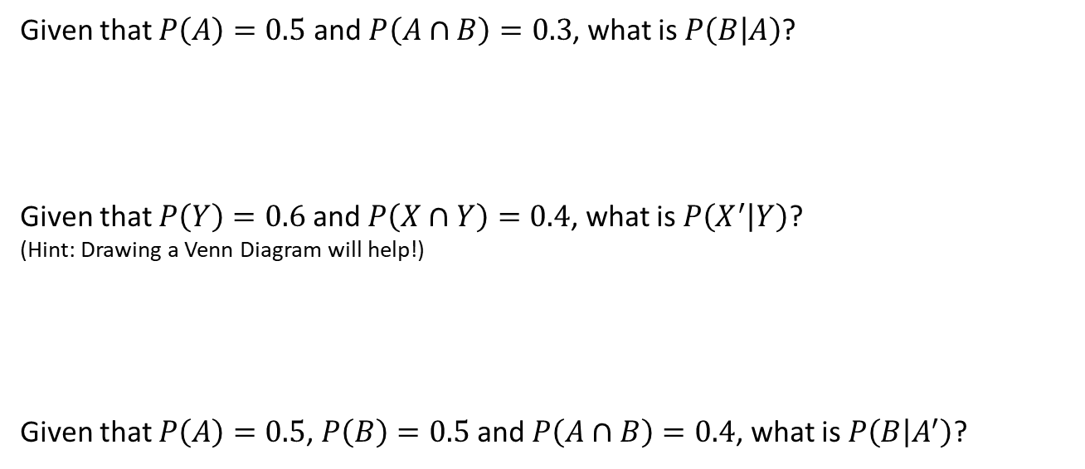
Further Examples
Given that $P\left(A\right)=0.5$ and $P\left(A∩B\right)=0.3$, what is $P\left(B | A\right)$?
Given that $P\left(Y\right)=0.6$ and $P\left(X∩Y\right)=0.4$, what is $P\left(X^{′} | Y\right)$?
(Hint: Drawing a Venn Diagram will help!)
Given that $P\left(A\right)=0.5$, $P\left(B\right)=0.5$ and $P\left(A∩B\right)=0.4$, what is $P\left(B | A^{′}\right)$?
a
Fro Tip: The ‘restricted sample space’ method also works for Venn Diagrams with probabilities.
b
c

Slide 5
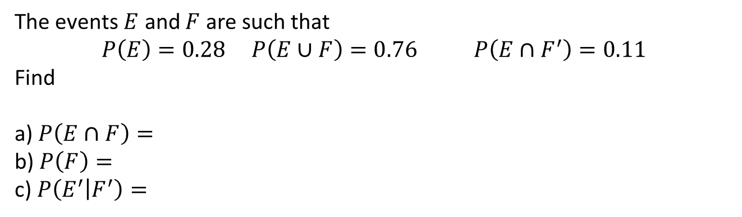
Check your understanding
The events $E$ and $F$ are such that
$$P\left(E\right)=0.28 P\left(E∪F\right)=0.76 P\left(E∩F^{′}\right)=0.11$$
Find
a) $P\left(E∩F\right)=$
b) $P\left(F\right)=$
c) $P\left(E^{′} | F^{′}\right)=$

Slide 6
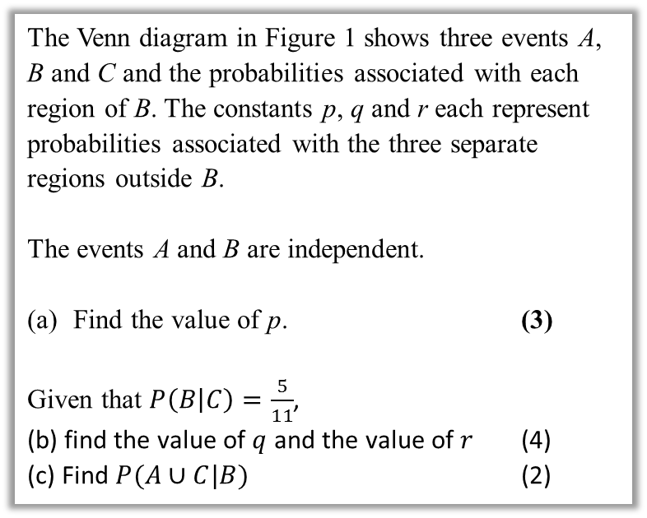

Further Test Your Understanding
May 2013 (R) Q6
(From earlier)
$0.1=\left(p+0.1\right)×0.4$
$p+0.1=0.25$
$p=0.15$
The Venn diagram in Figure 1 shows three events A, B and C and the probabilities associated with each region of B. The constants p, q and r each represent probabilities associated with the three separate regions outside B.
The events A and B are independent.
Find the value of p. (3)
Given that $P\left(B | C\right)=\frac{5}{11}$,
(b) find the value of $q$ and the value of $r$ (4)
(c) Find $P(A∪C|B)$ (2)

Slide 7

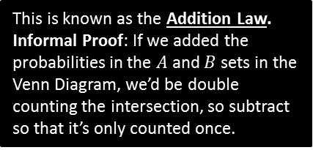
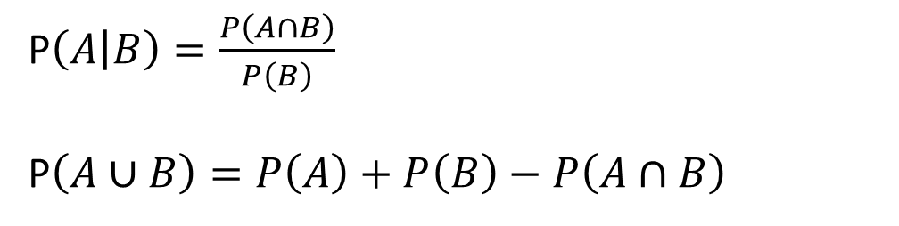

Full Laws of Probability
!
If events $A$ and $B$ are independent.
P$\left(A∩B\right)=P\left(A\right)×P\left(B\right)$
$P\left(A | B\right)=P\left(A\right)$
If events $A$ and $B$ are mutually exclusive:
$P\left(A∩B\right)=0$
$P\left(A∪B\right)=P\left(A\right)+P\left(B\right)$
In general:
We first encountered this in the previous section.
P$\left(A | B\right)=\frac{P\left(A∩B\right)}{P\left(B\right)}$
P$\left(A∪B\right)=P\left(A\right)+P\left(B\right)−P\left(A∩B\right)$
This is known as the Addition Law.
Informal Proof: If we added the probabilities in the $A$ and $B$ sets in the Venn Diagram, we’d be double counting the intersection, so subtract so that it’s only counted once.

Slide 8
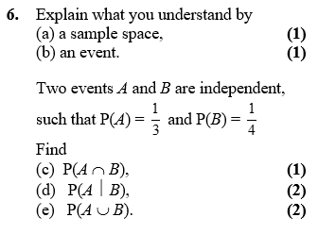
Example
Edexcel S1

Slide 9
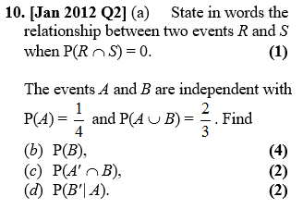
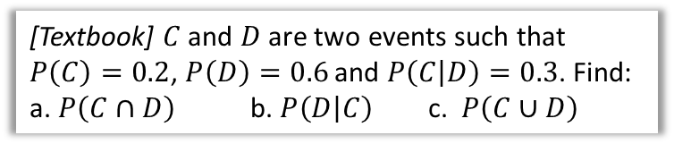
Further Examples
[Textbook] $C$ and $D$ are two events such that $P\left(C\right)=0.2$, $P\left(D\right)=0.6$ and $P\left(C | D\right)=0.3$. Find:
a. $P\left(C∩D\right)$ b. $P\left(D | C\right)$ c. $P\left(C∪D\right)$

Slide 10
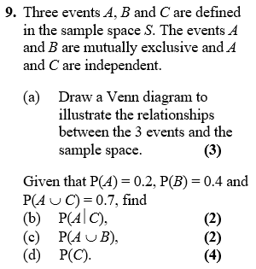
Test Your Understanding
Edexcel S1

Slide 11
SUPER IMPORTANT TIPS
If I were to identify two tips that will possible help you the most in probability questions:
If you see the words ‘given that’, Immediately write out the law for conditional probability.
Example: “Given Bob walks to school, find the probability that he’s not late…”
First thing you should write:
If you see the words ‘are independent’, Immediately write out the laws for independence.
(Even before you’ve finished reading the question!)
Example: “$A$ is independent from $B$…”
First thing you should write:

Slide 12






Probability Trees
We saw probability trees in Year 1. The only difference here is determining a conditional probability using your tree.
Example: You have two bags, the first with 5 red balls and 5 blue balls, and the second with 3 red balls and 6 blue balls. You first pick a ball from the first bag, and place it in the second. You then pick a ball from the second bag. Complete the tree diagram.
Hence find the probability that:
You pick a red ball on your second pick.
Given that your second pick was red, the first pick was also red.
$$R_{2}$$
$$R_{1}$$
$$B_{2}$$
$$R_{2}$$
$$B_{1}$$
$$B_{2}$$

Slide 13
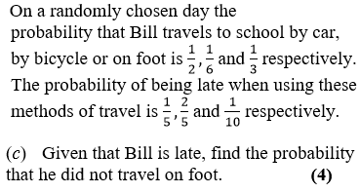
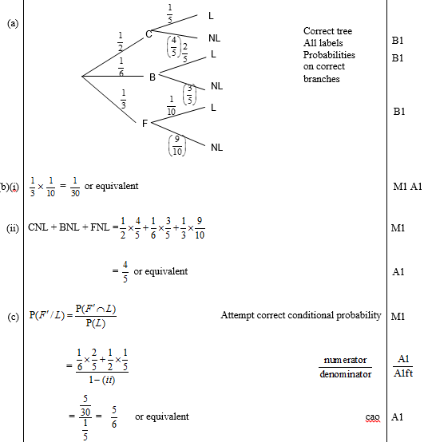
Further Example
Edexcel S1 May 2009 Q2
(Part (a) asks for a tree diagram, which may help with this question)

Slide 14
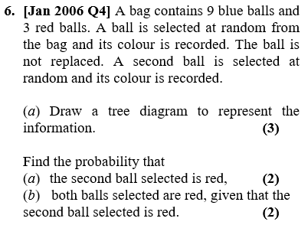
Testing Your Understanding
Edexcel S1

