Slide 1
Normal Distribution Q & A
Q1
For a Normal Distribution to be used, the variable has to be:
With a discrete variable, all the probabilities had to add up to 1.
For a continuous variable, similarly:
To find $P\left(170<X<190\right)$, we could:
Would we ever want to find $P\left(X=200\right)$ say?
Q2
$$f\left(x\right)$$
Q3
Q4
170cm
180cm
190cm
Height in cm ($x$)

Slide 2
Further Facts
$$f\left(x\right)$$
The curve has points of inflection one standard deviation from the mean, i.e. $μ±σ$
(recall from Pure Year 2 that this is where the curve changes concavity, and where the gradient is not changing)
The Normal Distribution is symmetrical, i.e. mean = mode = median
$$μ−σ$$
$$μ+σ$$
Height in cm ($x$)

Slide 3
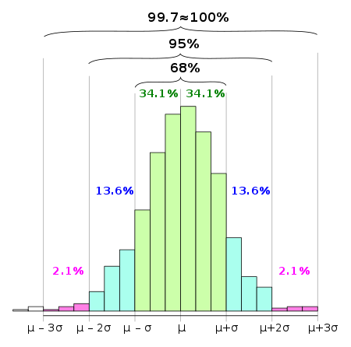
The 68-95-99.7 rule
The 68-95-99.7 rule is a shorthand used to remember the percentage of data that is within 1, 2 and 3 standard deviations from the mean respectively.
You need to memorise this!
!
$≈68\%$ of data is within one standard deviation of the mean. $≈95\%$ of data is within two standard deviations of the mean.
$≈99.7\%$ of data is within three standard deviations of the mean.
For practical purposes we consider all data to lie within $μ±5σ$
The histogram above is for a quantity which is approximately normally distributed.
Source: Wikipedia
Only one in 1.7 million values fall outside $μ±5σ$. CERN used a “5 sigma level of significance” to ensure the data suggesting existence of the Higgs Boson wasn’t by chance: this is a 1 in 3.5 million chance (if we consider just one tail).

Slide 4
Examples
[Textbook] The diameters of a rivet produced by a particular machine, $X$ mm, is modelled as $X\sim N\left({8,0.2}^{2}\right)$. Find:
$P\left(X>8\right)$
$P\left(7.8<X<8.2\right)$
Tip: Draw a diagram!

Slide 5
Test Your Understanding
IQ (“Intelligence Quotient”) for a given population is, by definition, distributed using $X\sim N\left({100,15}^{2}\right)$. Find:
$P\left(70<X<130\right)$
$P\left(X>115\right)$
Fro Tip: Draw a diagram!

Slide 6
Getting normal values from your calculator
IQ is distributed using $X\sim N\left({100,15}^{2}\right)$. Find
$P\left(X<109\right)$
$P\left(X≥93\right)$
$P\left(110<X<120\right)$
$P\left(X<80 or X>106\right)$

Slide 7
Test Your Understanding
The criteria for joining Mensa is an IQ of at least 131.
Assuming that IQ has the distribution $X\sim N\left({100,15}^{2}\right)$ for a population, determine:
What percentage of people are eligible to join Mensa.
If 30 adults are randomly chosen, the probability that at least 3 of them will be eligible to join. (Hint: Binomial distribution?)

Slide 8
Inverse Normal Distribution
We now know how to use a calculator to value of the variable to obtain a probability. But we might want to do the reverse: given a probability of being in a region, how do we find the value of the boundary?
[Textbook] $X\sim N\left({20,3}^{2}\right)$. Find, correct to two decimal places, the values of $a$ such that:
$P\left(X<a\right)=0.75$
$P\left(X>a\right)=0.4$
$P\left(16<X<a\right)=0.3$

Slide 9
Further Example
If the IQ of a population is distributed using $X\sim N\left({100,15}^{2}\right)$.
Determine the IQ corresponding to the top 30% of the population.
Determine the interquartile range of IQs.

Slide 10
Test Your Understanding
$X\sim N\left({80,7}^{2}\right)$. Using your calculator,
determine the $a$ such that $P\left(X>a\right)=0.65$
determine the $b$ such that $P\left(75<X<b\right)=0.4$
determine the $c$ such that $P\left(c<X<76\right)=0.2$
determine the interquartile range of $X$.

Slide 11
Standard Normal Distribution
! $Z$ is the number of standard deviations above the mean.
If again we use IQ distributed as $X\sim N\left({100,15}^{2}\right)$ then: (in your head!)
This formula makes sense if you think about the definition above. For an IQ of 130:
$Z=\frac{130−100}{15}=2$ as expected.
IQ | Z
100
130
85
165
62.5
$Z$ represents the coding:
$$Z=\frac{X−μ}{σ}$$ and $Z\sim N\left({0,1}^{2}\right)$. $Z$ is known as a standard normal distribution.
The 0 and 1 of $Z\sim N\left({0,1}^{2}\right)$ are the result of the coding. If we’ve subtracted $μ$ from each value the mean of the normal distribution is now 0. If we’ve divided all the values by $σ$ the standard deviation is now $\frac{σ}{σ}=1$

Slide 12
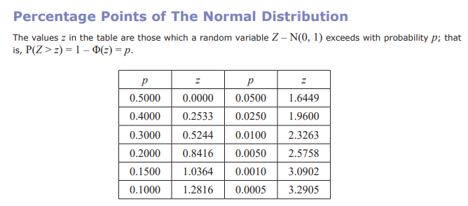
Standard Normal Distribution
The point of coding in this context is that all different possible normal distributions become a single unified distribution where we no longer have to worry about the mean and standard deviation.
It means for example when we calculate $P\left(Z<3\right)$, this will always give the same probability regardless of the original distribution.
It also means we can look up probabilities in a $z$-table:
$$φ\left(a\right)=P\left(Z<a\right)$$
! $Φ\left(a\right)=P\left(Z<a\right)$ is the cumulative distribution for the standard normal distribution. The values of $Φ(a)$ can be found in a $z$-table.
This is sometimes known as a ‘reverse z-table’, because you’re looking up the z-value for a probability. Beware: $p$ here it the probability of exceeding $z$ rather than being up to $z$. Let’s use it…
$$a$$
0

Slide 13
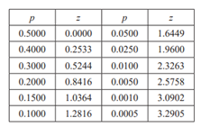
Examples
[Textbook] The random variable $X\sim N\left({50,4}^{2}\right)$. Write in terms of $Φ\left(z\right)$ for some value of $z$.
(a) $P\left(X<53\right)$ (b) $P\left(X≥55\right)$
[Textbook] The systolic blood pressure of an adult population, $S$ mmHg, is modelled as a normal distribution with mean 127 and standard deviation 16. A medical research wants to study adults with blood pressures higher than the 95th percentile. Find the minimum blood pressure for an adult included in her study.

Slide 14
Further Examples
Determine $P(Z>−1.3)$
Determine $P\left(−2<Z<1\right)$
Determine the $a$ such that $P\left(Z>a\right)=0.7$
Determine the $a$ such that $P\left(−a<Z<a\right)=0.6$

Slide 15
Test Your Understanding
1
IQ is distributed with mean 100 and standard deviation 15. Using an appropriate table, determine the IQ corresponding to the
top 10% of people.
bottom 20% of people.
2
If $X\sim N\left({100,15}^{2}\right)$, determine, in terms of $Φ$:
$P(X>115)$
$P\left(77.5<X<112\right)$
3
Find the $a$ such that:
$P\left(−a<Z<a\right)=0.2$
$P\left(0<Z<a\right)=0.35$

Slide 16
Missing $μ$ and $σ$
In the last section, you may have thought, “what’s the point of standardising to $Z$ when I can just use the DISTRIBUTION mode on my calculator?”
Fair point, but both forward and reverse normal lookups on the calculator required you to specify $μ$ and $σ$.
[Textbook] $X\sim N\left(μ,3^{2}\right)$. Given that $P\left(X>20\right)=0.2$, find the value of $μ$.
The method here is exactly the same as before:
1. Using a sketch, determine whether you’re expecting a positive or negative $z$ value.
2. Look up $z$ value, using tables if you can (otherwise your calculator). Make negative if in bottom half.
3. Use $Z=\frac{X−μ}{σ}$
[Textbook] A machine makes metal sheets with width, $X$ cm, modelled as a normal distribution such that $X\sim N\left(50,σ^{2}\right)$.
Given that $P\left(X<46\right)=0.2119$, find the value of $σ$.
Find the 90th percentile of the widths.

Slide 17
When both are missing
If both $μ$ and $σ$ are missing, we end up with simultaneous equations which we must solve.
Edexcel S1 Jan 2011

Slide 18
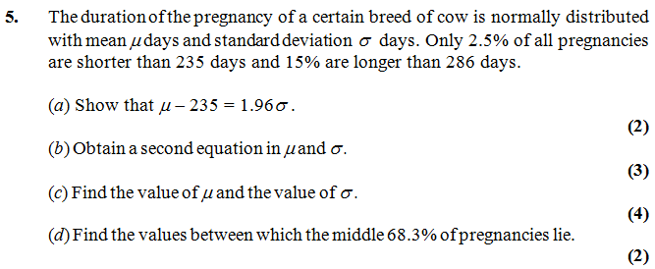
Test Your Understanding
Edexcel S1 May 2013 (R)
Edexcel S1 Jan 2002

Slide 19
Approximating a Binomial Distribution
If we’re going to use a normal distribution to approximate a Binomial distribution, it makes sense that we set the mean and standard deviation of the normal distribution to match that of the original binomial distribution:
$$μ=np \\ σ=\sqrt{np\left(1−p\right)}$$
! If $n$ is large and $p$ close to 0.5, then the binomial distribution $X\sim B\left(n,p\right)$ can be approximated by the normal distribution $N\left(μ,σ^{2}\right)$ where
$$μ=np \\ σ=\sqrt{np\left(1−p\right)}$$
Quickfire Questions:
We tend to use the letter $Y$ to represent the normal distribution approximation of the distribution $X$.
$$X\sim B\left(10,0.2\right) →$$
$$X\sim B\left(20,0.5\right) →$$
Why use a normal approximation?
Tables for the binomial distribution only goes up to $n=50$ and your calculator will reject large values of $n$.
The formula for $P\left(X=x\right)$ makes use a factorials. Factorials of large numbers cannot be computed efficiently. Type in 65! for example; your calculator will hesitate! Now imagine how many factorials would be required if you wanted to find $P\left(X≤65\right)$. 😐
$$X\sim B\left(6, 0.3\right) →$$

Slide 20
Continuity Corrections
One problem is that the outcomes of a binomial distribution (i.e. number of successes) are discrete whereas the Normal distribution is continuous.
We apply something called a continuity correction to approximate a discrete distribution using a continuous one.
The random variable $X$ represents the time to finish a race in hours. We’re interested in knowing the probability Alice took 6 hours to the nearest hour.
How would you represent this time on a number line given hours is discrete? And what about if hours was now considered to be continuous (as $Y$)?
Discrete:
$$X=6$$
Continuous:
3 4 5 6 7 8 9 10

Slide 21
Continuity Corrections
If $X$ is a discrete variable, and $Y$ is its continuous equivalent, how would you represent $P\left(X≥5\right)$ for $Y$?
Discrete:
$$X≥5$$
Continuous:
3 4 5 6 7 8 9 10
How would represent $P\left(X<9\right)$ for $Y$?
Discrete:
$$X<9→X≤8$$
Continuous:
3 4 5 6 7 8 9 10
! A continuity correction is approximating a discrete range using a continuous one.
Think “It MUST include” or “it MUST NOT include.

Slide 22
Examples
Discrete
Continuous
$$P\left(X≤7\right) \\ P\left(X<10\right) \\ P\left(X>9\right) \\ P\left(1≤X≤10\right) \\ P\left(3<X<6\right) \\ P\left(3≤X<6\right)$$
$$P\left(3<X≤6\right)$$
$$P(X=3)$$
! A continuity correction is approximating a discrete range using a continuous one.
Enlarge the range (at each end) by 0.5.

Slide 23
Full Example
[Textbook - Edited] For a particular type of flower bulbs, 55% will produce yellow flowers. A random sample of 80 bulbs is planted.
Calculate the actual probability that there are exactly 50 flowers.
Use a normal approximation to find a estimate that there are exactly 50 flowers.
Hence determine the percentage error of the normal approximation for 50 flowers.

Slide 24
Test Your Understanding
Edexcel S2 Jan 2004 Q3

Slide 25
Hypothesis Testing on the Sample Mean
0
1
2
3
4
5
6
7
8
9
Imagine we have 10 children, one of each age between 0 and 9.
This is our population. There is a known population mean of $μ=4.5$
$$\overline{x}$$
Suppose we took a sample of 4 children.
Sample 1:
1
3
7
8
4.75
Sample 2:
6
2
0
9
4.25
Sample mean $\overline{x}$ | Tally
4.00
4.25
4.50
4.75
5.00
…
The mean of this sample is $\overline{x}=4.75$. This sample mean $\overline{x}$ is close the true population mean $μ$, but is naturally going to vary as we consider different samples.
$$\overline{X}$$
For a different sample of 4, we might obtain a different sample mean. What would happen if we took lots of different samples of 4, and found the mean $\overline{x}$ of each? How would these means be distributed?
I took 1000 random samples.
In this histogram, 5 actually means $4.5≤\overline{x}<5$

Slide 26
Hypothesis Testing on the Sample Mean
$\overline{X}$ is our distribution across different sample means as we consider different samples.
1000 samples.
Size of each sample: 4 children.
Question 1: What type of distribution is $\overline{X}$?
Question 2: On average, what sample mean do we see? (i.e. the mean of the means!)
Question 3: Is the variance of $\overline{X}$ (i.e. how spread out the sample means are) the same as that of the variance of the population of children?
1000 samples.
Size of each sample: 10 children.
! For a random sample of size $n$ taken from a random variable $X$, the sample mean $\overline{X}$ is normally distributed with $\overline{X}\sim N\left(μ,\frac{σ^{2}}{n}\right)$

Slide 27
Hypothesis testing on the Sample Mean: Examples
[Textbook] A certain company sells fruit juice in cartons. The amount of juice in a carton has a normal distribution with a standard deviation of 3ml.
The company claims that the mean amount of juice per carton, $μ$, is 60ml. A trading inspector has received complaints that the company is overstating the mean amount of juice per carton and wishes to investigate this complaint. The trading inspector takes a random sample of 16 cartons and finds that the mean amount of juice per carton is 59.1ml.
Using a 5% level of significance, and stating your hypotheses clearly, test whether or not there is evidence to uphold this complaint.

Slide 28
Finding the critical region
[Textbook] A machine products bolts of diameter $D$ where $D$ has a normal distribution with mean 0.580 cm and standard deviation 0.015 cm. The machine is serviced and after the service a random sample of 50 bolts from the next production run is taken to see if the mean diameter of the bolts has changed from 0.580 cm. The distribution of the diameters of bolts after the service is still normal with a standard deviation of 0.015 cm.
Find, at the 1% level, the critical region for this test, stating your hypotheses clearly.
The mean diameter of the sample of 50 bolts is calculated to be 0.587 cm.
(b) Comment on this observation in light of the critical region.

Slide 29
Test Your Understanding
Edexcel S3 June 2011 Q7a

Slide 30
Conditional Probabilities
This is not in the textbook. But given the recent Chapter 2 on Conditional Probabilities and the fact that the type of question below occurred frequently in S1 papers, it seems worthwhile to cover!
Edexcel S1 May 2014(R) Q4

Slide 31
Test Your Understanding
Edexcel S1 Jan 2013 Q4a,c

Slide 32
One Last Toughie…
IQ is distributed as $X\sim N\left({100,15}^{2}\right)$.
A person is considered to be ‘pretty smart’ if their IQ is at least 130.
Determine the median IQ of ‘pretty smart’ people.

