Slide 1
MechYr2 Chapter 4 :: Moments
Student Notes

Slide 2
Lesson 1: Moments
!
The ‘moment’ of a force:
… measures the turning effect of the force on the body on which it is acting.
$$moment of force=force×distance$$
about a point
perpendicular distance
Notice that the measured distance is perpendicular to the force being considered.
Tom has a mass of 75kg.
10m
8m
700 N
$$A$$
$$75g$$
Moment about $A$
$$=700×10=7000 Nm$$
Moment about $A$
$$=75g×8=5880 Nm$$
The anticlockwise moment is greater, so the seesaw will tilt in an anticlockwise direction.

Slide 3
Quickfire Examples
1
$$F=20N$$
2
3
$$10N$$
$$F=20N$$
$$10m$$
$$5m$$
$$60°$$
$$P$$
$$P$$
$$P$$
Moment of force F about point P
$=200Nm$ clockwise
Moment of force F about point P
$$=0Nm$$
There is no ‘turning’ effect.
Moment of force F about point P
$$=50sin60 Nm$$
clockwise
4
5
$$10N$$
$$5N$$
$$30°$$
$$2m$$
$$3m$$
$$65°$$
$$P$$
$$P$$
Moment:
$20sin30 Nm$anticlockwise
Moment:
$15cos65 Nm$anticlockwise

Slide 4
Test Your Understanding
[Textbook] The diagram shows two forces acting on a lamina. Find the moment of each of the forces about the point $P$.
$$5N$$
$2$m
$$P$$
$$8N$$
$2$m
$$50°$$
Terminology: A lamina is a 2D object whose thickness can be ignored.
Moment of 5N force:
$=5×2=10$Nm clockwise
Moment of 8N force:
$=8×2\sin{50°}=12.3$Nm anticlockwise (3sf)

Slide 5
Resultant moments
If we have multiple coplanar forces, we can also find the overall moment by adding them – just treat one of the directions (clockwise or anticlockwise) as negative. This is similar in Year 1 to finding the resultant force.
$$5N$$
$$3N$$
$$20N$$
2
1
$$P$$
$$2m$$
$$1m$$
$$1m$$
$$10m$$
Resultant moment (about $P$):
$$10N$$
$$15m$$
$$4N$$
$$P$$
Resultant moment (about $P$)
3
$$1m$$
$$3m$$
(Rod is light)
$$m=50kg$$
$$m=30kg$$
$$P$$
Resultant moment (about $P$):
4
$$x$$
$$4m$$
$$m=30kg$$
$$P$$

Slide 6
Angled examples
[Textbook] The diagram shows a set of forces acting on a light rod. Calculate the resultant moment about the point $P$.
$$5N$$
$$4N$$
$$80°$$
$$40°$$
$1$m
$3$m
$$P$$
$3$m
$$6N$$

Slide 7
Test Your Understanding
[Textbook] The diagram shows two forces acting on a lamina.
Calculate the resultant moment about the point $P$.
$7$ N
$$25°$$
$8$ m
$$P$$
$$35°$$
$4$ N
$$20N$$
$$10N$$
$$10m$$
$$15m$$
$$P$$

Slide 8
Lesson 2: This whole chapter in a nutshell…
10m
8m
70kg
! If a rigid body is in equilibrium then:
The resultant force in any direction is 0.
The resultant moment about any point is 0.
i.e. Forces up = forces down, as per Year 1
a
b
In other words, clockwise moments = anticlockwise moments
You will typically use both these properties to solve exam questions.

Slide 9
Example
Lewis and Tom are having fun on a uniform seesaw of mass 20kg. Lewis weighs 70kg and is 10m from the pivot. Tom is 8m from the pivot. The seesaw remains horizontal.
a) Determine the reaction force at the pivot of the seesaw.
b) Determine Tom’s mass.
If a rod is uniform its centre of mass is at its centre, so we model its weight as acting at that point.
10m
8m
$m$ = ?
9m
$$R$$
70kg
Tom
Lewis
$$70g$$
$$20g$$
$$mg$$
Hint: Choose a suitable point to take moments about.

Slide 10
Two Pivots
[Textbook] A uniform beam $AB$, of mass 40 kg and length 5m, rests horizontally on support at $C$ and $D$, where $AC=DB=1$ m. When a man of mass 80kg stands on the beam at $E$ the magnitude of the reaction at $D$ is twice the magnitude of the reaction at $C$.
By modelling the beam as a rod and the man as a particle, find the distance $AE$.
$x$m
$$R$$
Note: A rod has no mass, so there is no reaction force of the rod on the man, only reaction forces from the pivots.
$$2R$$
$$A$$
$$C$$
$$D$$
$$B$$
$1$m
$1.5$m
$$E$$
$1$m
$$40g$$
$$80g$$

Slide 11
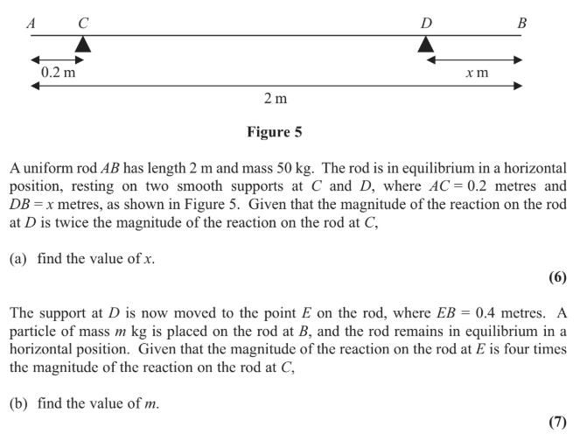
Test Your Understanding
Edexcel M1(Old) May 2013(R) Q8

Slide 12
Lesson 2/3: Centres of Mass
So far we have assumed that the rod is uniform, that is, its mass is equally distributed across the rod, such that the centre of mass is the centre.
But this may not be the case, and for non-uniform rods we may wish to find where the centre of mass lies, or we will be told where it lies.
[Textbook] Sam and Tamsin are sitting on a non-uniform plank $AB$ of mass 25kg and length 4m. The plank is pivoted at $M$, the midpoint of $AB$. The centre of mass of $AB$ is at $C$ where $AC$ is 1.8m. Sam has mass 35 kg. Tamsin has mass 25 kg and sits at $A$.
Where must Sam sit for the plank to be horizontal?

Slide 13
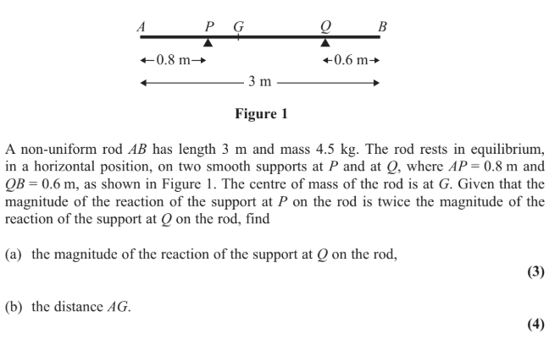
Test Your Understanding
Edexcel M1(Old) May 2012 Q2

Slide 15
Lesson 3: Tilting
Lewis
$$A$$
$$B$$
Lewis gradually increases the weight he is applying at one end of a beam, until the rod is on the verge of tilting about the support $A$. What can we say about the forces at $B$?
The rod is about to lift off pivot $B$, so there must be no reaction force from this support being exerted on the rod.
! When a rigid body is on the point of tilting about a pivot, the reaction at any other support (or tension in any other wire/string) is zero.

Slide 16
Example
Lewis
$$R N$$
No reaction force here as on point of tiling about $C$.
3m
5m
9m
2m
$$mg$$
$$C$$
$$45g N$$
$$D$$
A uniform beam beam $AB$, of mass 45kg and length 16m, rests horizontally on supports $C$ and $D$ where $AC=5$ m and $CD=9$ m.
When Lewis stands at $A$, the beam is on the point of tilting about $C$.
Determine Lewis’ mass.
Best to take moments about $C$ as we don’t require the value of $R$. In general, take moments about points that avoids variables you don’t want.

Slide 17
Suspended System Example
[Textbook] A non-uniform rod $AB$, of length 10 m and weight 40 N, is suspended from a pair of light cables attached to $C$ and $D$ where $AC=3$ m and $BD=2$ m.
When a weight of 25 N is hung from $A$ the rod is on the point of rotating.
Find the distance of the centre of mass of the rod from $A$.

Slide 18
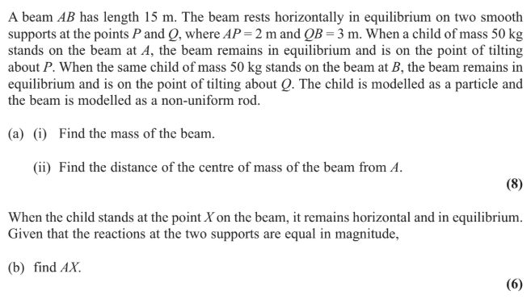
Test Your Understanding
Edexcel M1(Old) May 2013 Q6

