Slide 1
Forces
Lesson 1: Applied Example
[Textbook] A box of mass 8kg lies on a smooth horizontal floor. A force of 10N is applied at an angle of $30°$ causing the box to accelerate horizontally along the floor.
Work out the acceleration of the box.
Calculate the normal reaction between the box and the floor.
$$10N$$
8 kg
$$30°$$

Slide 2
Combining Forces
$$P$$
[Textbook] Two forces $P$ and $Q$ act on a particle as shown. $P$ has a magnitude of $10$N and $Q$ has a magnitude of 8N. Work out the magnitude and direction of the resultant force.
$$45°$$
$$30°$$
Finding total $x$ and $y$ components of force.
$$Q$$

Slide 3
Test Your Understanding
A particle has forces acting on it as indicated in the diagram. Determine the magnitude and direction (anticlockwise from the positive $x$ direction) of the resultant force.
$3$N
$$25°$$
$$32°$$
$4$N

Slide 5
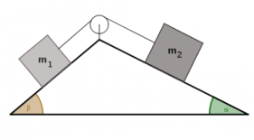
Lesson 2: Dynamics of a Particle moving in a Straight Line
R
You can extend this process to particles on an inclined plane, by considering forces parallel and perpendicular to the plane
When an object is on an inclined plane, we consider the forces acting parallel to the plane and perpendicular to the plane (instead of vertically and horizontally)
This is because any movement will be parallel to the plane (and we always then consider the direction which is perpendicular to any movement)
However, gravity will always work in a vertical direction so must be split into parallel and perpendicular directions…
3kg
60°
30°
3gCos30
3g
30°
90°
3gSin30
Above is a box resting on a plane inclined at an angle of 30° to the horizontal
→ Label gravity, which always acts vertically downwards
→ Gravity must then be split into the parallel and perpendicular components
→ The angle in the triangle created is the same as the angle the plane is inclined at (if you work out angles you can see why!)
→ Make sure you think carefully about which is Sine and which is Cosine!
→ Don’t forget the normal reaction, and any other forces which are involved in the question!
3E

Slide 6
Inclined Planes
! For problems involving inclined planes, resolve forces parallel and perpendicular to the plane.
[Textbook] A block of mass 10kg slides down a smooth slope angled at $15°$ to the horizontal.
Draw a force diagram to show all the forces acting on the block.
Calculate the magnitude of the normal reaction of the slope on the block.
Find the acceleration of the block.

Slide 7
Dynamics of a Particle moving in a Straight Line
R
2N
You can extend this process to particles on an inclined plane, by considering forces parallel and perpendicular to the plane
A box of mass 2kg is resting on a smooth plane inclined at an angle of 20° to the horizontal. It meets resistance of 2N as it travels down the slope
a) Calculate the acceleration of the box down the slope
b) If the box starts 10m up the plane, calculate the velocity of the box at the bottom of the plane
2kg
2gCos20
2g
20°
20°
2gSin20
As the plane is ‘smooth’, there is no need to consider friction or the normal reaction
3E

Slide 8
Inclined Plane with an additional force
[Textbook] A particle of mass $m$ is pushed up a smooth slope, inclined at $30°$ by a force of magnitude $5g$ N acting at angle of $60°$ to the slope, causing the particle to accelerate up the slope at 0.5 ms⁻². Show that the mass of the particle is $\left(\frac{5g}{1+g}\right)$ kg

Slide 9
Test Your Understanding
[Textbook] A particle $P$ of mass 2kg is moving on a smooth slope and is being acted on by a force of 4N that acts parallel to the slow, as shown.
The slop is inclined at an angle $α$ to the horizontal, where $\tan{α}=\frac{3}{4}$. Work out the acceleration of the particle.
$$a$$
$$P$$
$2$ kg
$$4N$$
$$α$$

Slide 10
Lesson 3: Friction
Scenario 1: A block is on a horizontal rough surface with no forces (other than gravity) acting on it.
$$R$$
Comment regarding friction:
$$mg$$
Scenario 2: A cable is attached to the block and a force applied. The block doesn’t move.
Comment regarding friction:
! The maximum friction between two surfaces:
$$F_{max}=μR$$
where $μ$ is the coefficient of friction and $R$ is the normal reaction between two surfaces.
$$R$$
$$T$$
$$F$$
$$mg$$
Scenario 3: The tension is increased until the block starts to move.
Comment regarding friction:
$$R$$
$$T$$
$$F$$
$$mg$$
This ‘maximum friction’ depends on two things:
How rough the surface is (i.e. the rougher the surface, the more force required before the block starts moving).
How hard the block is pressing against the surface (and more formally, by application of Newton’s 3rd Law, how large the reaction force $R$ is).

Slide 11
Example
[Textbook] A particle of mass 5kg is pulled along a rough horizontal surface by a horizontal force of magnitude 20N. The coefficient of friction between the particle and the floor is 0.2. Calculate:
the magnitude of frictional force
the acceleration of the particle.

Slide 12
Inclined Plane with Friction Example
[Textbook] A particle of mass 2kg is sliding down a rough slope that is inclined at $30°$ to the horizontal. Given that the acceleration of the particle is 1ms⁻², find the coefficient of friction $μ$ between the particle and the slope.

Slide 13
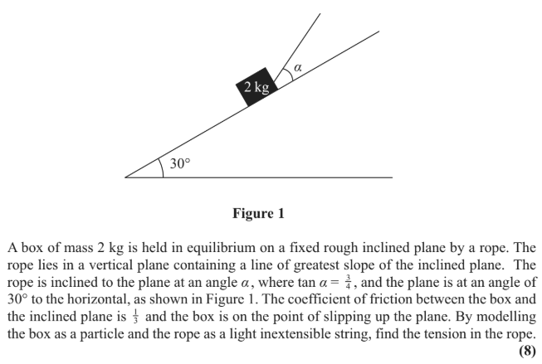
Test Your Understanding
Edexcel M1(Old) May 2013 Q3

