Slide 1
MechYr2 Chapter 6 :: Projectiles
jfrost@tiffin.kingston.sch.uk
www.drfrostmaths.com @DrFrostMaths
Last modified: 1st August 2018

Slide 2
Lesson 1: Acceleration in each direction.
The key is separately considering the motion in the vertical and horizontal directions:
! In vertical direction, acceleration downwards is $g$ ms⁻². Use suvat equations as before.
In horizontal direction, acceleration is 0 ms⁻². Constant velocity, so can use bog standard $speed=\frac{distance}{time}$
[Textbook] A particle is project horizontally at 25 ms⁻¹ from a point 78.4 metres above a horizontal surface. Find:
the time taken by the particle to reach the surface
the horizontal distance travelled in that time.
the distance of the impact point from the original point.
$25$ms⁻¹
78.4m
$x$ m

Slide 3
Further Example
[Textbook] A particle is projected horizontally with a speed of $U$ ms⁻¹ from a point 122.5m above a horizontal plane. The particle hits the plane at a point which is at a horizontal distance of 90m away from the starting point. Find the initial speed of the particle.
$U$ ms⁻¹
122.5m
90 m

Slide 4
Test Your Understanding
[Textbook] A particle is projected horizontally with a speed of $20$ ms⁻¹ from a point $h$ m above a horizontal plane. The particle hits the plane at a point which is at a horizontal distance of 100m away from the starting point. Determine the value of $h$.
$20$ ms⁻¹
$$h$$
100 m

Slide 8
Lesson 2: Components of velocity
Just as we split forces into its horizontal and vertical components, in order to consider forces in the horizontal and vertical directions respectively, we can do exactly the same with velocity!
When the object is at its highest point:
The vertical velocity is 0.
$20$ ms⁻¹
$20\sin{70°}$ ms⁻¹
$$70°$$
$20\cos{70°}$ ms⁻¹

Slide 9
Simple Example
[Textbook] A particle $P$ is projected from a point $O$ on a horizontal plane with speed 28 ms⁻¹ and with angle of elevation $30°$. After projection, the particle moves freely under gravity until it strikes the plane at a point $A$. Find:
the greatest height above the plane reached by $P$
the time of flight of $P$
the distance $OA$
$28$ ms⁻¹
$28\sin{30°}$ ms⁻¹
$$30°$$
$28\cos{30°}$ ms⁻¹

Slide 10
Projected from above ground
[Textbook] A particle is projected from a point $O$ with speed $V$ ms⁻¹ and at an angle of elevation of $θ$, where $\tan{θ=\frac{4}{3}}$. The point $O$ is 42.5m above a horizontal plane. The particle strikes the plane at a point $A$, 5 s after it is projected.
(a) Show that $V=20$. (b) Find the distance between $O$ and $A$.

Slide 11
Time above a given point
[Textbook] A particle is projected from a point $O$ with speed $35$ ms⁻¹ and at an angle of elevation of $30°$. The particle moves freely under gravity. Find the length of time for which the particle is 15 m or more above $O$.
The key is to find the two times at which the particle is 15m above ground. The time above 15m will then be the difference between these times.

Slide 12
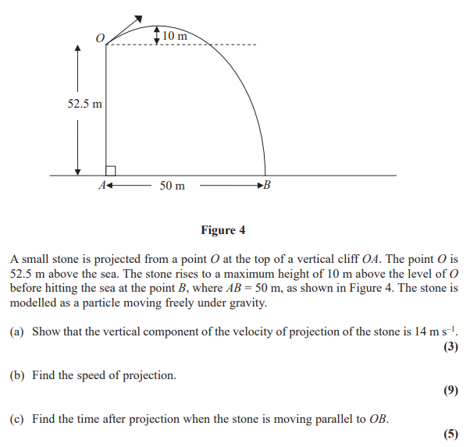
Test Your Understanding
Edexcel M2(Old) May 2012 Q7

Slide 13
Projectile Formulae
There’s nothing new here, but you may be asked to prove more general results regarding projectile motion.
[Textbook] A particle is projected from a point on a horizontal plane with an initial velocity $U$ at an angle $α$ above the horizontal and moves freely under gravity until it hits the plane at point $B$.
Given that that acceleration due to gravity is $g$, find expressions for:
the time of flight, $T$
the range, $R$, on the horizontal plane.

Slide 14
Projectile Formulae
There’s nothing new here, but you may be asked to prove more general results regarding projectile motion.
[Textbook] A particle is projected from a point on a horizontal plane with an initial velocity $U$ at an angle $α$ above the horizontal and moves freely under gravity until it hits the plane at point $B$.
Given that that acceleration due to gravity is $g$, find expressions for:
the time of flight, $T$
the range, $R$, on the horizontal plane.

Slide 15
Projectile Formulae
[Textbook] A particle is projected from a point with speed $U$ at an angle of elevation $α$ and moves freely under gravity. When the particle has moved a horizontal distance $x$, its height above the point of projection is $y$.
Show that $y=x\tan{α −\frac{gx^{2}}{2u^{2}}\left(1+\tan^{2}{α}\right)}$
A particle is projected from a point $O$ on a horizontal plane, with speed 28 ms⁻¹ at an angle of elevation $α$. The particle passes through a point $B$, which is at a horizontal distance of 32m from $O$ and at a height of 8m above the plane.
(b) Find the two possible values of $α$, giving your answers to the nearest degree.
Don’t be intimidated by the lack of numerical values. Just do what you’d usually do and resolve both vertically and horizontally!

Slide 16
General Results
Exam Note: You may be asked to derive these. But don’t attempt to memorise them or actually use them to solve exam problems – instead use the techniques used earlier in the chapter.
! For a particle projected with initial velocity $U$ at angle $α$ above horizontal and moving freely under gravity:
Time of flight $=\frac{2U\sin{α}}{g}$
Time to reach greatest height $=\frac{U\sin{α}}{g}$
Range on horizontal plane $=\frac{U^{2}\sin{2α}}{g}$
Equation of trajectory: $y=x\tan{α −\frac{gx^{2}}{2U^{2}}\left(1+\tan^{2}{α}\right)}$ where $y$ is vertical height of particle and $x$ horizontal distance.

