Slide 1
MechYr2 Chapter 7 :: Applications of Forces

Slide 2
Finding unknown forces by resolving forces
$$4 N$$
[Textbook] The diagram shows a particle in equilibrium under the forces shown. By resolving horizontally and vertically find the magnitudes of the forces $P$ and $Q$.
$$P N$$
$$45°$$
$$30°$$
Just resolve separately in the horizontal and vertical directions, as before.
$$Q N$$

Slide 3
Unknown forces on inclined planes
[Textbook] The diagram shows a particle in equilibrium on an inclined plane under the forces shown. Find the magnitude of the force $P$ and the size of the angle $α$.
$$2 N$$
$$P N$$
$$α$$
$$8 N$$
$$5 N$$
$$30°$$
Recall that I recommend using dotted labelled arrow for the components of forces in diagrams.

Slide 4
Test Your Understanding
The diagram shows a particle in equilibrium on an inclined plane under the forces shown. Find the magnitude of the force $Q$ and the size of the angle $β$.
$$14 N$$
$$Q N$$
$$β$$
$$5 N$$
$$6 N$$
$$30°$$

Slide 5
Modelling with Statics
We can apply this to problems involving tension, weight and pulleys.
[Textbook] A smooth bead $Y$ is threaded on a light inextensible string. The ends of the string are attached to two fixed points, $X$ and $Y$, on the same horizontal level. The bead is held in equilibrium by a horizontal force of magnitude 8 N acting parallel to $ZX$. The bead $Y$ is vertically below $X$ and $∠XZY=30°$ as shown in the diagram.
Find the tension in the string and the weight of the bead.
$$X$$
$$Z$$
$$30°$$
$$8 N$$
$$Y$$
$$T N$$
$$T N$$
$$8 N$$
$$30°$$
$$W N$$

Slide 6
Further Example
[Textbook] A mass of 3kg rests on the surface of a smooth plane which is inclined at an angle of $45°$ to the horizontal. The mass is attached to a cable which passes up the plane along the line of greatest slope and then passes over a smooth pulley at the top of the plane. The cable carries a mass of 1kg freely suspended at the other end. The masses are modelled as particles, and the cable as a light inextensible string. There is a force of $P$ N acting horizontally on the 3kg mass and the system is in equilibrium.
Calculate (a) the magnitude of $P$ (b) the normal reaction between the mass and the plane (c) State how you have used the assumption that the pulley is smooth in your calculations.

Slide 7
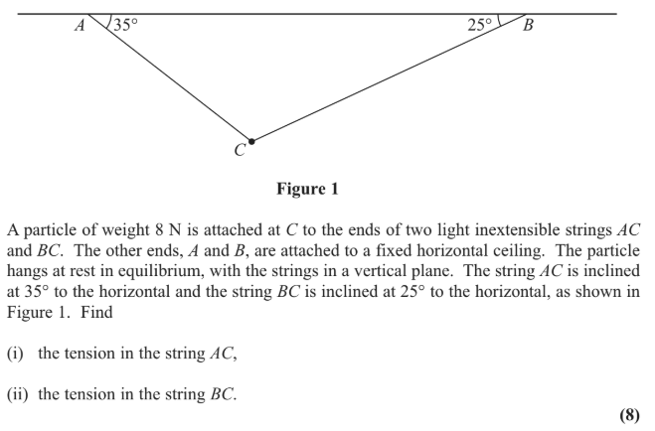
Test Your Understanding
Edexcel M1(Old) May 2013(R) Q2

Slide 8
Friction
Earlier in the module we saw that the frictional force $F≤μR$, where $F=μR$ if the object on the plane is moving. Were the object is not moving, we saw that the force of friction acts in a direction opposite to that which it would be moving if the frictional force wasn’t there.
[Textbook] A box of mass 10kg rests in limiting equilibrium on a rough plane inclined at $20°$ above the horizontal.
Find the coefficient of friction between the box and the plane.
A horizontal force of magnitude $P$ N is applied to the box. Given that the box remains in equilibrium,
(b) find the maximum possible value of $P$.

Slide 9
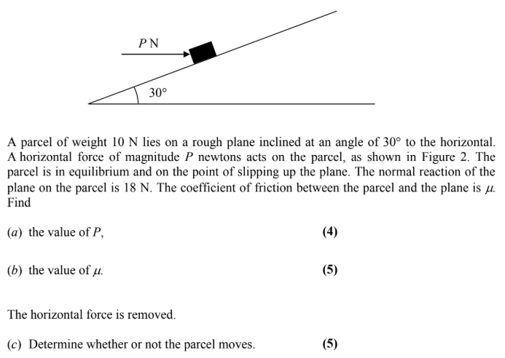
Test Your Understanding
Edexcel M1(Old) Jan 2006 Q5

Slide 10
Static rigid bodies
Recall from the chapter on moments that for a stationary rigid body:
The resultant force is 0.
The resultant moment is 0.
The problems are the same as in the moments chapter, except now we may need to consider frictional forces.
[Textbook] A uniform rod $AB$ of mass 40kg and length 10m rests with the end $A$ on rough horizontal ground. The rod rests against a smooth peg $C$ where $AC=8$ m. The rod is in limiting equilibrium at an angle of $15°$ to the horizontal. Find:
the magnitude of the reaction of $C$
the coefficient of friction between the rod and the ground.
a
Taking moments about A:
$$R\left(→\right):$$
$$R\left(↑\right)$$
$$N$$
$$15°$$
$$2 m$$
$$B$$
$$R$$
$$C$$
$$5 m$$
$$3 m$$
b
$$40g$$
This frictional force prevents the rod slides against the ground.
$$A$$
$$15°$$
$$μR$$
$$5\cos{15° m}$$

Slide 11
Further Example
[Textbook] A ladder $AB$, of mass $m$ and length $3a$, has one end $A$ resting on rough horizontal ground. The other end $B$ rests against a smooth vertical wall. A load of mass $2m$ is fixed on the ladder at the point $C$, where $AC=a$. The ladder is modelled as a uniform rod in a vertical plane perpendicular to the wall and the load is modelled as a particle. The ladder rests in limiting equilibrium at an angle of $60°$ at an angle of $60°$ with the ground.
Find the coefficient of friction between the ladder and the ground.
State how you have used the assumption that the ladder is uniform in your calculations.
$$P$$
$$B$$
$$R\left(→\right): \\ R\left(↑\right):$$
Taking moments about $B$:
$$1.5a$$
$$0.5a$$
$$C$$
$$mg$$
$$R$$
$$a$$
$$2mg$$
$$60°$$
$$A$$
$$F$$

Slide 12
Particles moving on a rough plane
We’ve previously considered particles moving on smooth planes.
And particles in equilibrium (and not moving) on rough planes.
So let’s consider particles moving on rough planes!
[Textbook] A particle is held at rest on a rough plane which is inclined to the horizontal at an angle $α$, where $\tan{α}=\frac{3}{4}$. The coefficient of friction between the particle and the plane is 0.5. The particle is released and slides down the plane. Find:
the acceleration of the particle.
the distance it slides in the first 2 seconds.
$$a$$
$$R$$
$$μR$$
$$mg\cos{α}$$
$$mg$$
$$α$$
$$α$$
$$mg\sin{α}$$

Slide 13
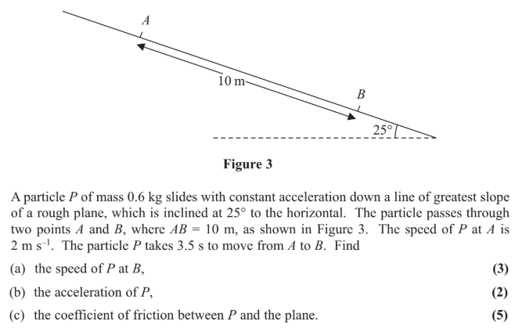
Test Your Understanding
Edexcel M1(Old) May 2013(R) Q5

Slide 14
Connected particles involving friction
We have already encountered problems involving connected particles in Mechanics Year 1. We just now throw friction into the mix.
[Textbook] Two particles $P$ and $Q$ of masses 5kg and 10kg respectively are connected by a light inextensible string. The string passes over a small smooth pulley which is fixed at the top of a rough inclined plane. $P$ rests on the inclined plane and $Q$ hangs on the edge of the plane with the string vertical and taut. The plane is inclined to the horizontal at an angle $α$ where $\tan{α}=0.75$, as shown in the diagram. The coefficient of friction between $P$ and the plane is 0.2. The system is released from rest.
Find the acceleration of the system.
Find the tension in the string.
$$P$$
5kg
$$Q$$
10kg
$$α$$

Slide 15
Further Example
[Textbook] One end of a light inextensible string is attached to a block $A$ of mass 2kg. The block $A$ is held at rest on a smooth fixed plane which is inclined to the horizontal at an angle of $30°$. The string lies along the line of greatest slope of the plane and passes over a smooth light pulley which is fixed at the top of the plane. The other end of the string is attached to a block $B$ of mass 5kg. The system is released from rest. By modelling the blocks as particles and ignoring air resistance,
(a)(i) show that the acceleration of block $B$ is $\frac{4}{7}g$
(ii) find the tension in the string.
(b) State how you have used the fact that the string is inextensible in your calculations.
(c) Calculate the magnitude of the force exerted on the pulley by the string.
$$A$$
2kg
$$B$$
5kg
$$30°$$
$$a$$
$$R$$
$$T$$
$$a$$
$$A$$
2kg
$$T$$
$$mg\cos{30}$$
5kg
$$B$$
$$mg$$
$$α$$
$$30$$
$$5g$$
$$mg\sin{30}$$

Slide 16
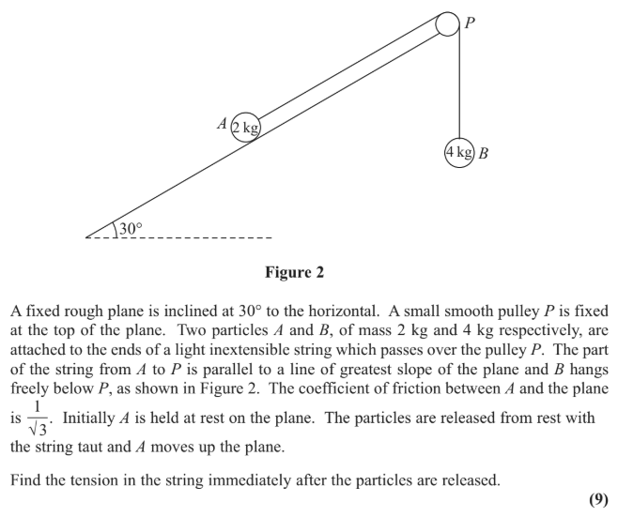
Test Your Understanding
Edexcel M1(Old) May 2013(R) Q3

