Slide 1
MechYr2 Chapter 8 :: Further Kinematics

Slide 2
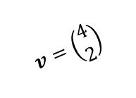
Lesson 1: Vector motion
Initially, Lewis is at the position vector $\left(\begin{matrix}3 \\ 1\end{matrix}\right)$. Each second, he moves $\left(\begin{matrix}4 \\ 2\end{matrix}\right)$, i.e. his velocity.
Where will he be after 1 second?
$$t=2$$
$$t=1$$
$$\left(\begin{matrix}11 \\ 5\end{matrix}\right)$$
$$t=0$$
$$v=\left(\begin{matrix}4 \\ 2\end{matrix}\right)$$
$$\left(\begin{matrix}7 \\ 3\end{matrix}\right)$$
After after 2 seconds?
$$\left(\begin{matrix}3 \\ 1\end{matrix}\right)$$
So in general, where would Lewis be after $t$ seconds, in terms of $t$?
! Position vector $r$ of particle:
$$r=r_{0}+vt$$
where $r_{0}$ is initial position and $v$ is velocity.

Slide 3
Example
[Textbook] A particle starts from the position vector $(3i+7j)$ m and moves with constant velocity $(2i−j)$ ms⁻¹.
Find the position vector of the particle 4 seconds later.
Find the time at which the particle is due east of the origin.

Slide 4
$suvat$… but with vectors!
Some $suvat$ equations work with vectors. By convention, we use $r$ instead of $s$ for displacement in 2D/3D (as we did in the previous exercise). In 2D, which of the quantities are vectors and which are scalars?
$$r=ut+\frac{1}{2}at^{2} \\ v=u+at$$
$r=$ vector
$u=$ vector
$v=$ vector
$a=$ vector
$t=$ scalar
Note that as $u$ and $v$ are vectors, we can’t for example use $v^{2}=u^{2}+2as$, as you can’t square a vector.
[Textbook] A particle $P$ has velocity $\left(−3i+j\right)$ ms⁻¹. The particle moves with constant acceleration $a=\left(2i+3j\right)$ ms⁻². Find (a) the speed of the particle and (b) the bearing on which it is travelling at time $t=3$ seconds.

Slide 5
Further Example
[Textbook] An ice skater is skating on a large flat ice rink. At time $t=0$ the skater is at a fixed point $O$ and is travelling with velocity $\left(2.4i−0.6j\right)$ ms⁻¹.
At time $t=20$ s the skater is travelling with velocity $\left(−5.6i+3.4j\right)$ ms⁻¹.
Relative to $O$, the skater has position vector $s$ at time $t$ seconds.
Modelling the ice skater as a particle with constant acceleration, find:
The acceleration of the ice skater
An expression for $s$ in terms of $t$
The time at which the skater is directly north-east of $O$.
A second skater travels so that she has position vector $r=\left(1.1t−6\right)j$ m relative to $O$ at time $t$.
(d) Show that the two skaters will meet.
$$s$$

Slide 6
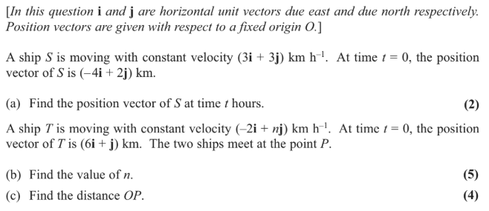
Test Your Understanding
Edexcel M1(Old) May 2013(R) Q6

Slide 7
Vector methods for projectiles
Previously we considered the initial speed of the projectile and the angle of projection. But we could also use a velocity vector to represent the initial projection (vectors have both direction and magnitude) and subsequent motion.
[Textbook] A ball is struck by a racket from a point $A$ which has position vector $20j$ m relative to a fixed origin $O$. Immediately after being struck, the ball has velocity $\left(5i+8j\right)$ ms⁻¹, where $i$ and $j$ are unit vectors horizontally and vertically respectively. After being struck, the ball travels freely under gravity until it strikes the ground at point $B$.
Find the speed of the ball 1.5 seconds after being struck.
Find an expression for the position vector, $r$, of the ball relative to $O$ at time $t$ seconds.
Hence determine the distance $OB$.
$$\left(5i+8j\right) ms^{−1}$$
$$A$$
$$20m$$
$$O$$
$$B$$

Slide 8
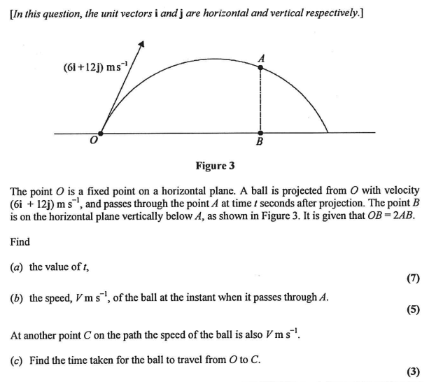
Test Your Understanding
Edexcel M2(Old) Jan 2012 Q7

Slide 9
Variable Acceleration in One Dimension
In Mechanics Yr1 we saw that velocity was the rate of change of displacement, and thus $v=\frac{ds}{dt}$. Similarly acceleration is the rate of change of velocity, and thus $a=\frac{dv}{dt}$
Let’s stick to one-dimension for the moment, but you may need to differentiate more complex functions of $t$ that use Pure Year 2 techniques.
$$s$$
$$∫v dt$$
$$\frac{d}{dt}$$
$$v$$
$$∫a dt$$
$$\frac{d}{dt}$$
$$a$$
[Textbook] A particle is moving in a straight line with acceleration at time $t$ seconds given by
$$a=\cos{2πt ms^{−2}, t≥0}$$
The velocity of the particle at time $t=0$ is $\frac{1}{2π}$ ms⁻¹. Find:
an expression for the velocity at time $t$ seconds
the maximum speed
the distance travelled in the first 3 seconds.

Slide 10
Test Your Understanding
[Textbook] A particle of mass 6kg is moving on the positive $x$-axis. At time $t$ seconds the displacement, $s$, of the particle from the origin is given by
$$s=2t^{\frac{3}{2}}+\frac{e^{−2t}}{3} m, t≥0$$
(a) Find the velocity of the particle when $t=1.5$.
Given that the particle is acted on by a single force of variable magnitude $F$ N which acts in the direction of the positive $x$-axis,
(b) Find the value of $F$ when $t=2$

Slide 11
Differentiating Vectors
Suppose that $v=\left(\begin{matrix}t^{2} \\ \sin{t}\end{matrix}\right)$. What would be the acceleration?
! If $r=xi+yj$ then $v=\frac{dr}{dt}=\dot{r}=\dot{x}i+\dot{y}j$ and $a=\frac{dv}{dt}=\frac{d^{2}r}{dt}=\ddot{r}=\ddot{x}i+\ddot{y}j$
Notational note: Dot notation is a short-hand for differentiation with respect to time: $\dot{x}=\frac{dx}{dt}$
Its use is common in Physics.
[Textbook] A particle $P$ of mass 0.8kg is acted on by a single force $F$ N. Relative to a fixed origin $O$, the position vector of $P$ at time $t$ seconds is $r$ metres, where
$$r=2t^{3}i+50t^{−\frac{1}{2}}j, t≥0$$
Find:
the speed of $P$ when $t=4$
the acceleration of $P$ as a vector when $t=2$
$F$ when $t=2$.

Slide 12
Integrating Vectors
We can similarly integrate the $i$ and $j$ components to get from acceleration to velocity and velocity to displacement.
[Textbook] A particle $P$ is moving in a plane. At time $t$ seconds, its velocity $v$ ms⁻¹ is given by
$$v=3ti+\frac{1}{2}t^{2}j, t≥0$$
When $t=0$, the position vector of $P$ with respect to a fixed $O$ is $(2i−3j)$ m. Find the position vector of $P$ at time $t$ seconds.

Slide 13
Further Example
[Textbook] A particle $P$ is moving in a plane so that, at time $t$ seconds, its acceleration is $(4i−2tj)$ ms⁻². When $t=3$, the velocity of $P$ is $6i$ ms⁻¹ and the position vector of $P$ is $(20i+3j)$ m with respect to a fixed origin $O$. Find:
the angle between the direction of motion of $P$ and $i$ when $t=2$
the distance of $P$ from $O$ when $t=0$.

Slide 14
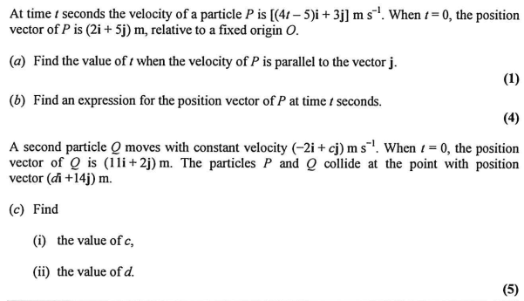
Test Your Understanding
Edexcel M2(Old) Jan 2013 Q4

