Slide 1
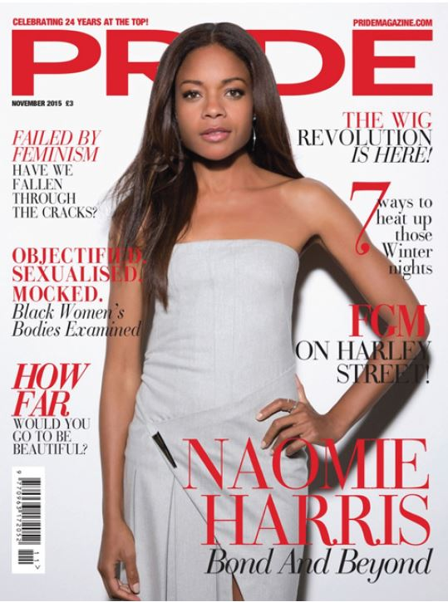
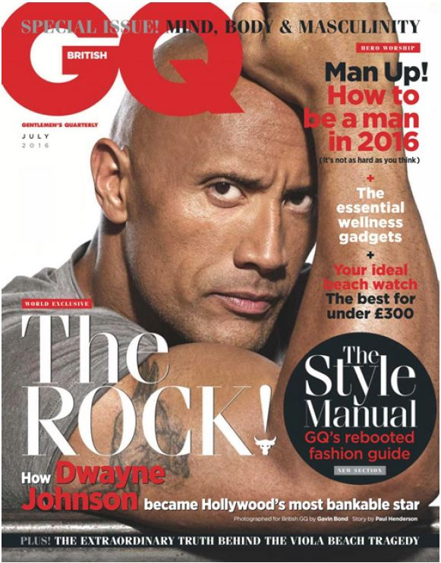
Magazines

Slide 2
Component 1
Focus Areas:
Media language
Representation
Media contexts

Slide 3
Task:
Look at the Magazine Cover Design sheet
Annotate the covers for GQ and Pride using the same key terms.
On Computers!

Slide 4
Set texts
Pride is a monthly women’s magazine targeting a specialised audience of women of colour
GQ is a monthly men’s magazine targeting a large audience of men
Both produced by the publisher Conde Nast

Slide 5
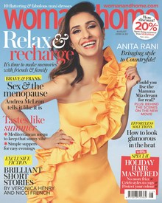
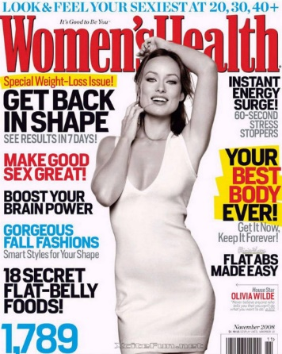
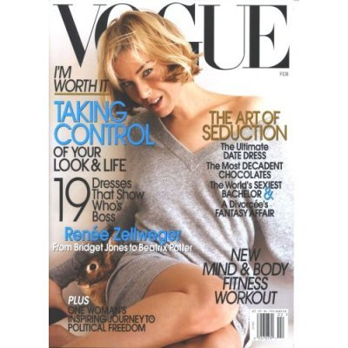
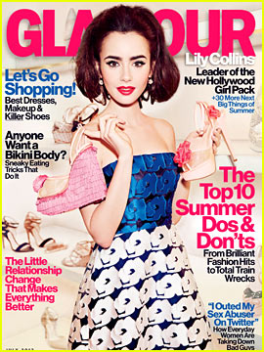
Women’s lifestyle magazines
Women’s magazines have been in existence for many years and cover a range of different sub genres including:
- ‘glossy’ monthlies such as Cosmopolitan and Marie Claire; fashion magazines such as Vogue
- weekly magazines such as Woman and Grazia
- home-focused publications such as Good Housekeeping and Woman and Home

Slide 6
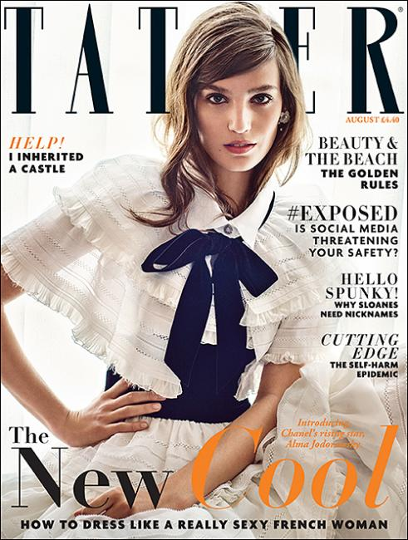
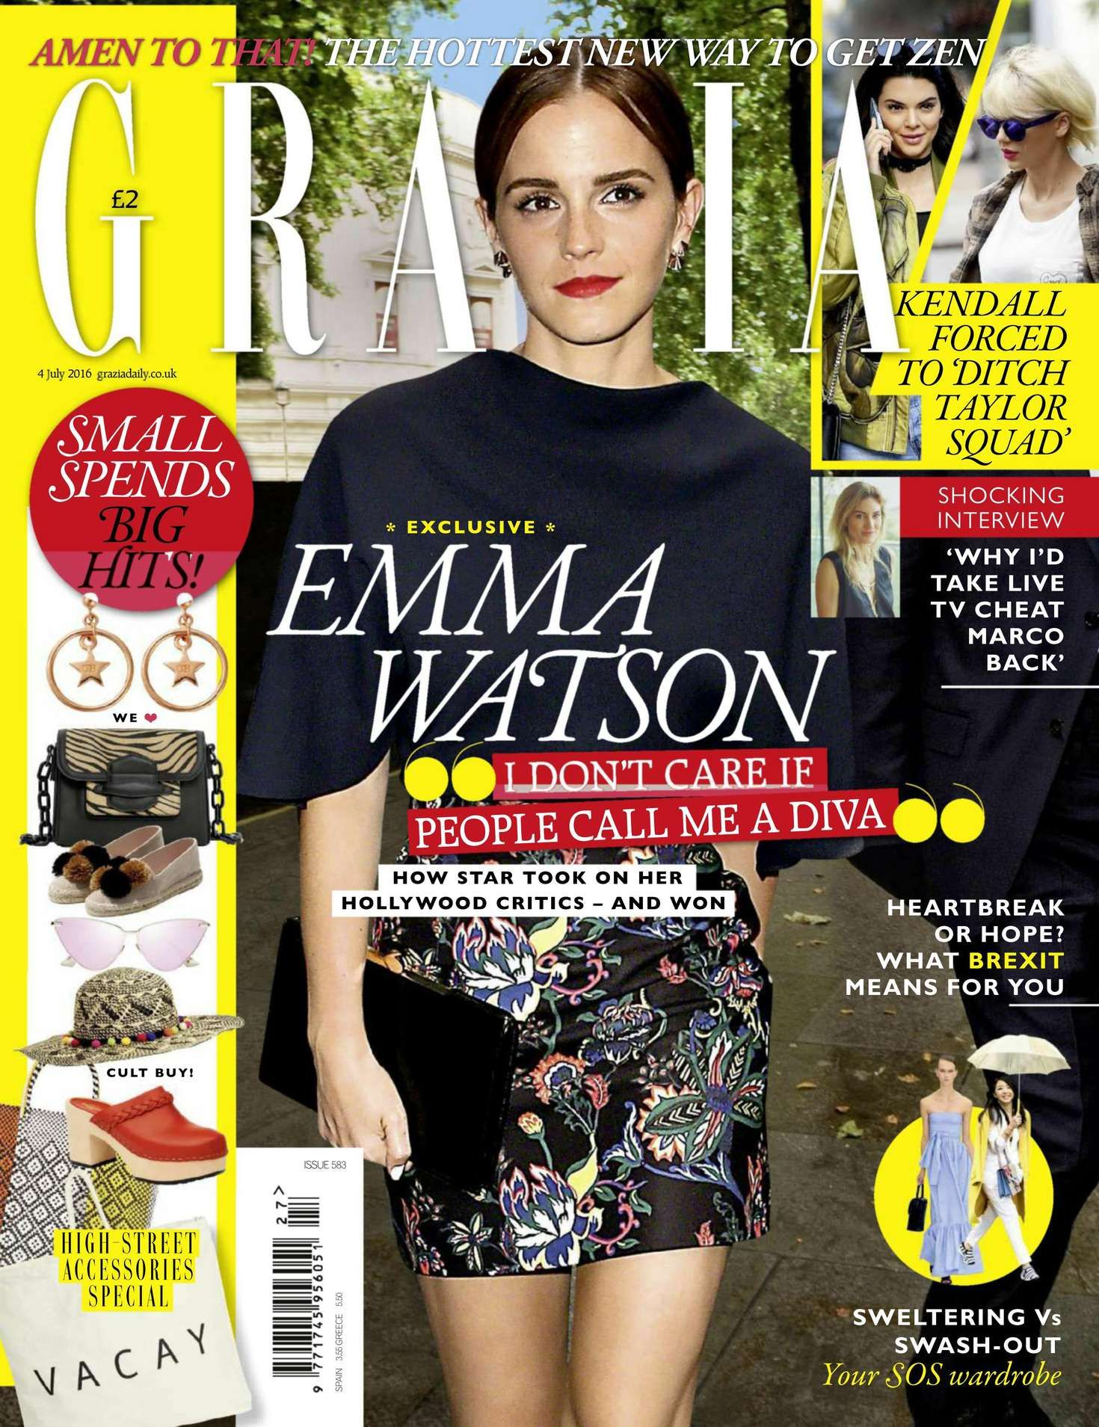
Women’s lifestyle magazines
Each magazine will target a specific audience. Some magazines are aimed at an older or younger audience, for example, and each will have a clear sense of the socio-economic background of the reader, which will be reflected in elements such as the price and the advertising as well as the content.

Slide 7
Codes and Conventions of Women’s lifestyle magazines
There is often a focus on stereotypically female interests such as fashion, beauty, relationships, health, travel, cookery and home features.
Advice columns feature in many publications and women’s magazines are often described as being a ‘friend’ to the reader, offering positive support and guidance about contemporary life.
These magazines are aspirational, especially the ‘glossies’, and can be seen to create an ‘ideal’ lifestyle that women might desire to have.
The inclusion of celebrities and features on desirable fashion items, for example, supports the idea of aspiration, and the advertising might reinforce consumerist messages – that readers can buy aspects of an ideal life

Slide 8
Does Pride follow these stereotypical conventions?
Discuss with a partner and remember to use examples and evidence!
How does Pride reflect it’s contemporary context?

Slide 9
Task:
Research the Pride media pack in detail and think about how the magazine appeals to its audience. Answer the question:
“How does Pride appeal to audiences?”
Remember to use theory, Uses and Gratifications
- Escapism/entertainment
- Personal Relationships
- Personal Identity
- Surveillance
Record your findings in a word document (250 words)

Slide 10
The ‘Uses and Gratifications Model’ suggests that audiences interact with texts for different reasons:
information,
personal identity,
social interaction and
entertainment.
Although all of these reasons could be argued for why Pride has such high readership figures, arguably the personal identity aspect is probably the main one.
In fact, its unique selling point (USP) is that it is the only black media company that still remains in black British ownership.

Slide 11
Task:
Analyse the Cover of PRIDE using the Publisher Document on GOL
Write your analysis notes on the computer
Classwork / Homework: Answer the following question:
Explore how the front cover for Pride uses the following elements of media language to create meanings:
Imagery [5]
Text [5]
Colour [5]
Use the P.E.E technique
Point
Example
Explain
250 words

Slide 12
Task:
Analyse the Cover of GQ using the PPT Document on GOL
Write your analysis notes on the computer

Slide 13
Codes and Conventions – language / content
Content reflecting social/cultural/historical context
Representation: How is Gender represented? Male/Female

Slide 14
Homework Due Today!
Email me
Explore how the front cover for Pride uses the following elements of media language to create meanings:
Imagery [5]
Text [5]
Colour [5]
Use the P.E.E technique
Point
Example
Explain
250 words

Slide 15
Task:
Research the GQ media pack in detail and think about how the magazine appeals to its audience. Answer the question:
“How does GQ appeal to audiences?”
Remember to use theory, Uses and Gratifications
- Escapism/entertainment
- Personal Relationships
- Personal Identity
- Surveillance
Record your findings in the same word document as Pride (250 words)

Slide 16
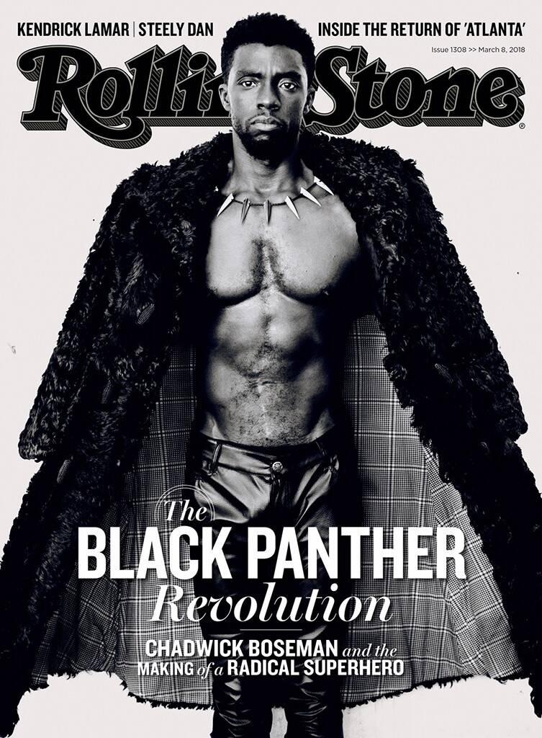
Compare the representation of ethnic groups in the GQ front cover and the Rolling Stone front cover. [25]
In your answer, you must consider:
The choices that producers have made about how to represent ethnic groups
How far the representation of ethnic groups is similar in the two front covers
How far the representation of ethnic groups is different in the two front covers

Slide 17
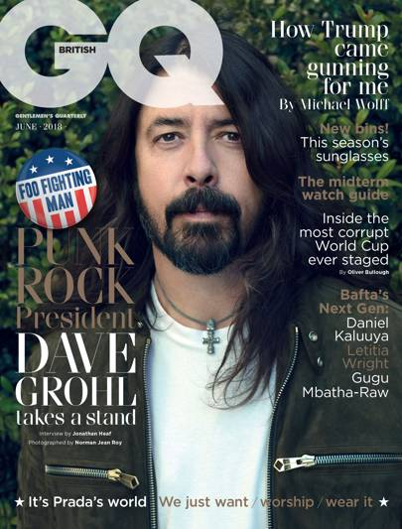
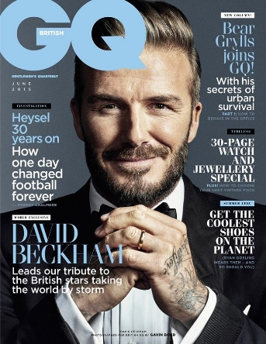
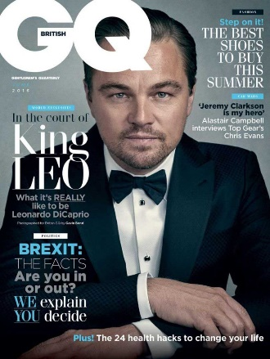
Men’s lifestyle magazines
Magazines for men have also been in existence for many years, but the men’s lifestyle magazine came into popularity in the 1980s. At this time there were several new publications in the UK, including FHM and GQ.
This can be linked to social changes as, at this time, the notion of the new man arose and there was a growth in the market for male fashion, style and grooming products.
These new magazines began by offering fashion and style advice to men in the way that magazines such as Cosmopolitan did for women.

Slide 18
Men’s lifestyle magazines
In the 90s many men’s magazines gained a reputation for sexually objectifying women.
Some argued that ‘lads mags’ like Loaded and FHM were a reaction against the feminist movement and reflected the crisis of masculinity as men’s role in society was no longer secure.
The idea of masculinity in crisis was also represented in other media products at the time. The film The Full Monty explored the issue of unemployment as a group of male steel workers are made redundant and struggle to find new identities and make ends meet. They eventually form a striptease act, in extreme opposition to their former roles

Slide 19
The overarching theme for this issue appears to surround ideas of masculinity:
If we consider the selection process that takes place when creating a magazine cover, there was clearly a conscious decision to associate ideas of masculinity with physical strength.

