Slide 1
CW | Moment of Inertia | November 5th 2014
Objective | To understand the concept of moment of inertia
From my learning today I will be able to:
Key: | State the definition of moment of inertia
Boost: | Calculate the moment of inertia for a rigid body
Aspire: | Explain physical phenomena using the concept of moment of inertia
Starter activity (5 minutes):
What do you know about the term inertia? How do you think this might apply when objects rotate?

Slide 2
CW | Moment of Inertia | November 5th 2014
Objective | To understand the concept of moment of inertia
Notes (5 minutes):
The moment of inertia is the mass property of a rigid body that determines the torque needed for a desired angular acceleration about a rotational axis. Moment of inertia, I = mr² The units of inertia are kgm² If a mass is added to an already spinning object then the total inertia is the original inertia plus the inertia due to the added mass.
From my learning today I will be able to:
Key: | State the definition of moment of inertia
Boost: | Calculate the moment of inertia for a rigid body
Aspire: | Explain physical phenomena using the concept of moment of inertia

Slide 3
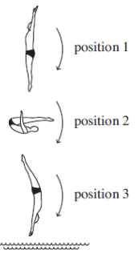
CW | Moment of Inertia | November 5th 2014
Objective | To understand the concept of moment of inertia
Question 1 (5 minutes):
From my learning today I will be able to:
Key: | State the definition of moment of inertia
Boost: | Calculate the moment of inertia for a rigid body
Aspire: | Explain physical phenomena using the concept of moment of inertia

Slide 4
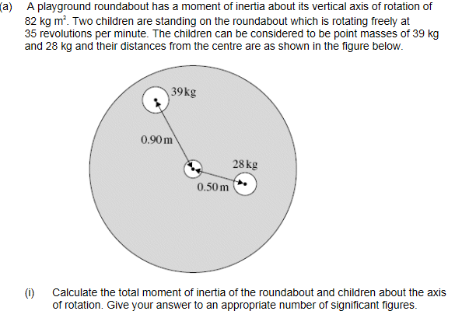
CW | Moment of Inertia | November 5th 2014
Objective | To understand the concept of moment of inertia
Question 2 (10 minutes):
From my learning today I will be able to:
Key: | State the definition of moment of inertia
Boost: | Calculate the moment of inertia for a rigid body
Aspire: | Explain physical phenomena using the concept of moment of inertia

Slide 5
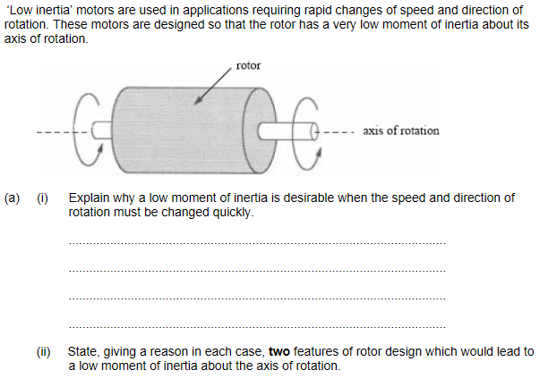
CW | Moment of Inertia | November 5th 2014
Objective | To understand the concept of moment of inertia
Question 3 (5 minutes):
From my learning today I will be able to:
Key: | State the definition of moment of inertia
Boost: | Calculate the moment of inertia for a rigid body
Aspire: | Explain physical phenomena using the concept of moment of inertia

Slide 6
CW | Moment of Inertia | November 5th 2014
Objective | To understand the concept of moment of inertia
From my learning today I will be able to:
Key: | State the definition of moment of inertia
Boost: | Calculate the moment of inertia for a rigid body
Aspire: | Explain physical phenomena using the concept of moment of inertia

