Slide 1
CW | Rotational Kinetic Energy | November 7th 2014
Objective | To understand the concept of rotational kinetic energy
From my learning today I will be able to:
Key: | Describe how we calculate the total kinetic energy of a number of rotating objects
Boost: | Convert rev min⁻¹ to rad s⁻¹
Aspire: | Calculate the rotational kinetic energy
Starter activity (5 minutes):
How do we calculate linear kinetic energy? Why can’t we use this calculate kinetic energy for a rotating object?

Slide 2
CW | Rotational Kinetic Energy | November 7th 2014
Objective | To understand the concept of rotational kinetic energy
Notes (5 minutes):
The total kinetic energy of an object rotating about an axis can be found by summing the kinetic energies of all the individual particles that make up the object. The rotational kinetic energy E_{k} for a body of moment of inertia I rotating at ω rad s⁻¹ is given by E_{k} = ½ I ω². It is important that the rotational speed (often given in rev min⁻¹) is changed to rad s⁻¹.
From my learning today I will be able to:
Key: | Describe how we calculate the total kinetic energy of a number of rotating objects
Boost: | Convert rev min⁻¹ to rad s⁻¹
Aspire: | Calculate the rotational kinetic energy

Slide 3
CW | Rotational Kinetic Energy | November 7th 2014
Objective | To understand the concept of rotational kinetic energy
Notes (5 minutes):
How do you go from revolutions per minute to radians per second?
From my learning today I will be able to:
Key: | Describe how we calculate the total kinetic energy of a number of rotating objects
Boost: | Convert rev min⁻¹ to rad s⁻¹
Aspire: | Calculate the rotational kinetic energy

Slide 4
CW | Rotational Kinetic Energy | November 7th 2014
Objective | To understand the concept of rotational kinetic energy
Task (10 minutes):
Convert these from revolutions per minute to radians per second. 40 568 2.1
From my learning today I will be able to:
Key: | Describe how we calculate the total kinetic energy of a number of rotating objects
Boost: | Convert rev min⁻¹ to rad s⁻¹
Aspire: | Calculate the rotational kinetic energy

Slide 5
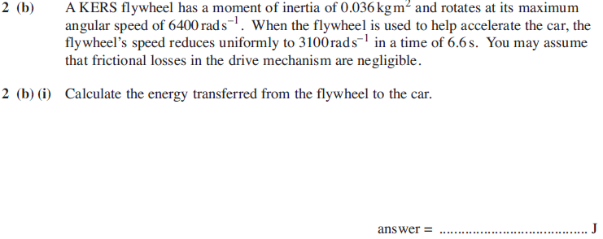
CW | Rotational Kinetic Energy | November 7th 2014
Objective | To understand the concept of rotational kinetic energy
Task (10 minutes):
From my learning today I will be able to:
Key: | Describe how we calculate the total kinetic energy of a number of rotating objects
Boost: | Convert rev min⁻¹ to rad s⁻¹
Aspire: | Calculate the rotational kinetic energy

Slide 6
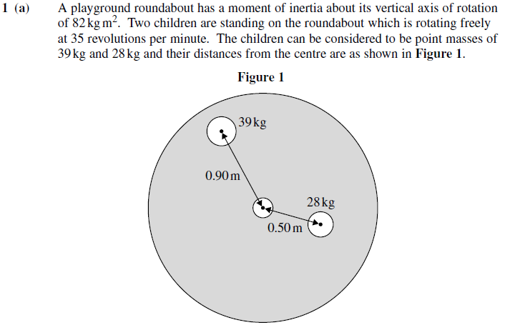
CW | Rotational Kinetic Energy | November 7th 2014
Objective | To understand the concept of rotational kinetic energy
Task (10 minutes):
From my learning today I will be able to:
Key: | Describe how we calculate the total kinetic energy of a number of rotating objects
Boost: | Convert rev min⁻¹ to rad s⁻¹
Aspire: | Calculate the rotational kinetic energy

