Slide 1
CW | Rotational Dynamics | 11 November 2014
Objective | To understand and use the rotational equivalent of SUVAT
From my learning today I will be able to:
Key: | State the rotational equivalent of SUVAT equations
Boost: | Calculate rotational displacement, velocity and acceleration
Aspire: | Explain how you can convert between rotational and linear quantities
Starter activity (5 minutes):
How many degrees does the Earth rotate through every minute? Every second? What are these in radians?

Slide 2
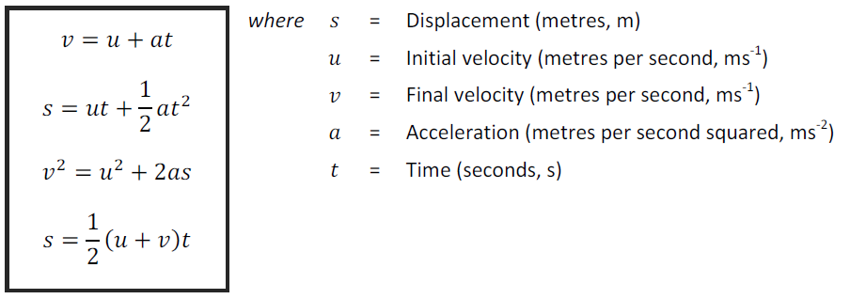
CW | Rotational Dynamics | 11 November 2014
Objective | To understand and use the rotational equivalent of SUVAT
Notes
From my learning today I will be able to:
Key: | State the rotational equivalent of SUVAT equations
Boost: | Calculate rotational displacement, velocity and acceleration
Aspire: | Explain how you can convert between rotational and linear quantities

Slide 3
CW | Rotational Dynamics | 11 November 2014
Objective | To understand and use the rotational equivalent of SUVAT
Notes
What will the equivalent equations for rotational mechanics be?
From my learning today I will be able to:
Key: | State the rotational equivalent of SUVAT equations
Boost: | Calculate rotational displacement, velocity and acceleration
Aspire: | Explain how you can convert between rotational and linear quantities

Slide 4
CW | Rotational Dynamics | 11 November 2014
Objective | To understand and use the rotational equivalent of SUVAT
Notes
From my learning today I will be able to:
Key: | State the rotational equivalent of SUVAT equations
Boost: | Calculate rotational displacement, velocity and acceleration
Aspire: | Explain how you can convert between rotational and linear quantities

