Slide 1
CW | Angular Acceleration and Momentum | 17 November 2014
Objective | To define the terms angular acceleration and angular momentum
From my learning today I will be able to:
Key: | State the linear equivalent of these terms
Boost: | Define angular acceleration and momentum
Aspire: | Explain how they are calculated in real-life situations
Starter activity (5 minutes):
Write down the definitions, formulae and units for acceleration, torque and momentum in linear mechanics.

Slide 2
CW | Angular Acceleration and Momentum | 17 November 2014
Objective | To define the terms angular acceleration and angular momentum
Notes
Acceleration (ms⁻²) – rate of change of velocity Momentum (kgms⁻¹) – product of mass and velocity Torque (Nm) – turning force How do you think you might get the angular equivalents of these and what would their units be?
From my learning today I will be able to:
Key: | State the linear equivalent of these terms
Boost: | Define angular acceleration and momentum
Aspire: | Explain how they are calculated in real-life situations

Slide 3
CW | Angular Acceleration and Momentum | 17 November 2014
Objective | To define the terms angular acceleration and angular momentum
Notes
Acceleration (rad s⁻²) – α = dω/dt Momentum (Nms) – product of I and ω Torque (Nm) – product of I and α (T=Iα) You do not have to explain where the units come from but can hopefully see they are a more correct form than if you just took the multiplied ones and put them together.
From my learning today I will be able to:
Key: | State the linear equivalent of these terms
Boost: | Define angular acceleration and momentum
Aspire: | Explain how they are calculated in real-life situations

Slide 4
CW | Angular Acceleration and Momentum | 17 November 2014
Objective | To define the terms angular acceleration and angular momentum
Notes
How do you think you might determine the torque and the momentum? How could you calculate the frictional torque? Where might we apply the law of conservation of momentum?
From my learning today I will be able to:
Key: | State the linear equivalent of these terms
Boost: | Define angular acceleration and momentum
Aspire: | Explain how they are calculated in real-life situations

Slide 5
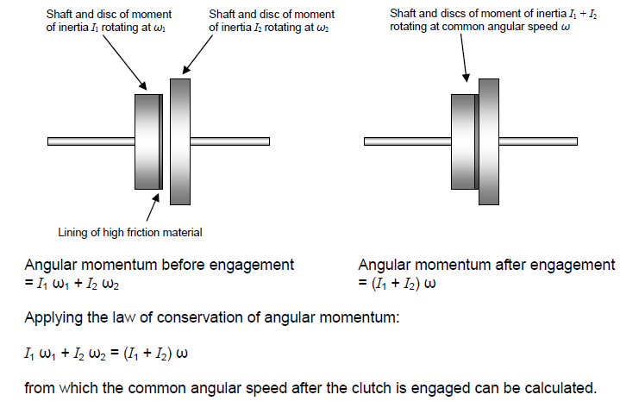
CW | Angular Acceleration and Momentum | 17 November 2014
Objective | To define the terms angular acceleration and angular momentum
Notes
From my learning today I will be able to:
Key: | State the linear equivalent of these terms
Boost: | Define angular acceleration and momentum
Aspire: | Explain how they are calculated in real-life situations

