Slide 1
CW | The p-V diagram | 01 December 2014
Objective | To explain the four changes in terms of the p-V diagram
From my learning today I will be able to:
Key: | Describe the shape of the p-V diagram for the four changes
Boost: | Explain how the first law applies to these four changes
Aspire: | Analyse the p-V graphs using the algebraic expression for the first law
Starter activity (15 minutes):
Review independent learning from the previous lesson What did you learn about the four changes?

Slide 2
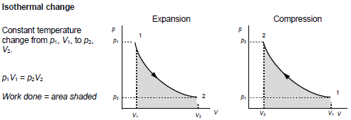
CW | The p-V diagram | 01 December 2014
Objective | To explain the four changes in terms of the p-V diagram
From my learning today I will be able to:
Key: | Describe the shape of the p-V diagram for the four changes
Boost: | Explain how the first law applies to these four changes
Aspire: | Analyse the p-V graphs using the algebraic expression for the first law

Slide 4
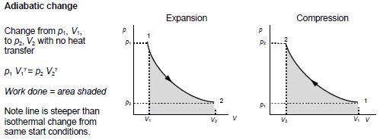

Slide 5
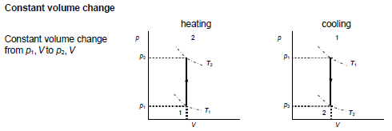

Slide 6
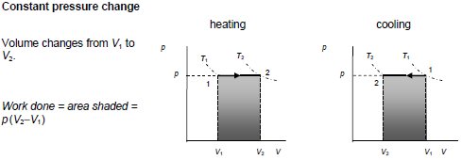

Slide 7
CW | The p-V diagram | 01 December 2014
Objective | To explain the four changes in terms of the p-V diagram
From my learning today I will be able to:
Key: | Describe the shape of the p-V diagram for the four changes
Boost: | Explain how the first law applies to these four changes
Aspire: | Analyse the p-V graphs using the algebraic expression for the first law

Slide 8
CW | The p-V diagram | 01 December 2014
Objective | To explain the four changes in terms of the p-V diagram
From my learning today I will be able to:
Key: | Describe the shape of the p-V diagram for the four changes
Boost: | Explain how the first law applies to these four changes
Aspire: | Analyse the p-V graphs using the algebraic expression for the first law

Slide 9
CW | The p-V diagram | 01 December 2014
Objective | To explain the four changes in terms of the p-V diagram
From my learning today I will be able to:
Key: | Describe the shape of the p-V diagram for the four changes
Boost: | Explain how the first law applies to these four changes
Aspire: | Analyse the p-V graphs using the algebraic expression for the first law

