Slide 1
The Second Law of Thermodynamics
Monday, 29 December 2014
From my learning today I will be able to:
Key: | State the second law of thermodynamics
Boost: | Describe how the second law applies to heat engines
Aspire: | Explain the reason for the lower efficiencies of engines

Slide 2
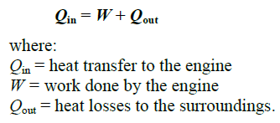
From my learning today I will be able to:
Key: | State the second law of thermodynamics
Boost: | Describe how the second law applies to heat engines
Aspire: | Explain the reason for the lower efficiencies of engines

Slide 3
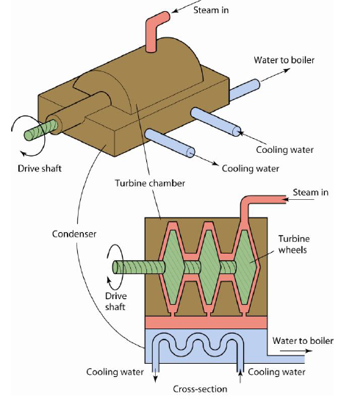
Is it possible to make an engine where no energy is wasted?
What would happen if we bypassed the condenser?
From my learning today I will be able to:
Key: | State the second law of thermodynamics
Boost: | Describe how the second law applies to heat engines
Aspire: | Explain the reason for the lower efficiencies of engines

Slide 4
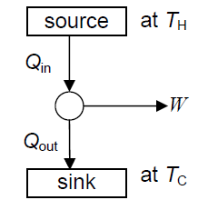
From my learning today I will be able to:
Key: | State the second law of thermodynamics
Boost: | Describe how the second law applies to heat engines
Aspire: | Explain the reason for the lower efficiencies of engines

Slide 5
From my learning today I will be able to:
Key: | State the second law of thermodynamics
Boost: | Describe how the second law applies to heat engines
Aspire: | Explain the reason for the lower efficiencies of engines

Slide 6
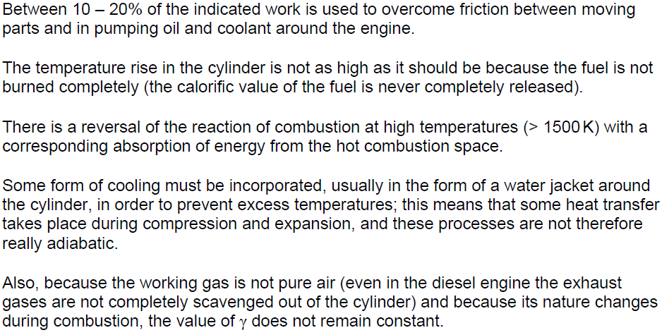
From my learning today I will be able to:
Key: | State the second law of thermodynamics
Boost: | Describe how the second law applies to heat engines
Aspire: | Explain the reason for the lower efficiencies of engines

