Slide 1
Reverse Heat Engines
Wednesday, 07 January 2015
From my learning today I will be able to:
Key: | State the function of a refrigerator and a heat pump
Boost: | Describe the coefficient of performance of these devices
Aspire: | Explain the operation of these devices in terms of the laws of thermodynamics

Slide 2
What is the function of a heat pump?
What is the function of a refrigerator?
Why are they called a reverse heat engine?
From my learning today I will be able to:
Key: | State the function of a refrigerator and a heat pump
Boost: | Describe the coefficient of performance of these devices
Aspire: | Explain the operation of these devices in terms of the laws of thermodynamics

Slide 3
From my learning today I will be able to:
Key: | State the function of a refrigerator and a heat pump
Boost: | Describe the coefficient of performance of these devices
Aspire: | Explain the operation of these devices in terms of the laws of thermodynamics

Slide 4
For example if a heat pump has a power of 150W and takes in 900W of heat from outside to inside what would the co-efficient of performance be?
What does this value mean?

Slide 5
How big can the co-efficient of performance be?

Slide 6
In a heat pump we are interested with how much energy is transferred to the surroundings (hot space) for the work done.
In a refrigerator we are interested in how much energy is removed from the food and drink (cold space) for the work done.
We are not really concerned with how good the fridge is at heatig the kitchen.

Slide 7
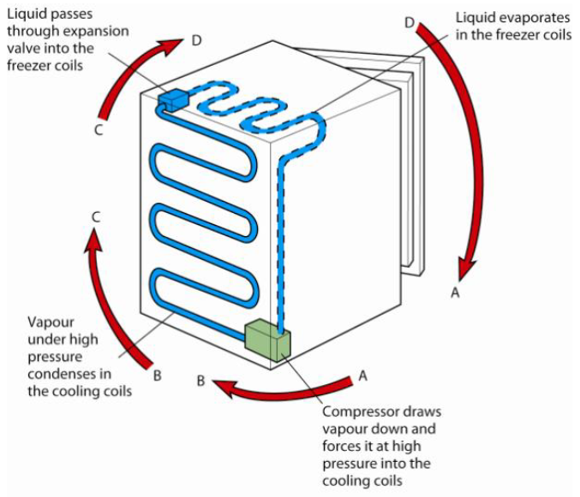

Slide 9
If a fridge has an 18W motor and a co-efficient of performance of 6 how much energy does it transfer to the hot space each second?

Slide 10
From my learning today I will be able to:
Key: | State the function of a refrigerator and a heat pump
Boost: | Describe the coefficient of performance of these devices
Aspire: | Explain the operation of these devices in terms of the laws of thermodynamics
Homework
Complete summary questions at end of book. Hand in on Friday 10th January.

