Slide 1
Starter – reflect on your previous learning to answer the following

Slide 2
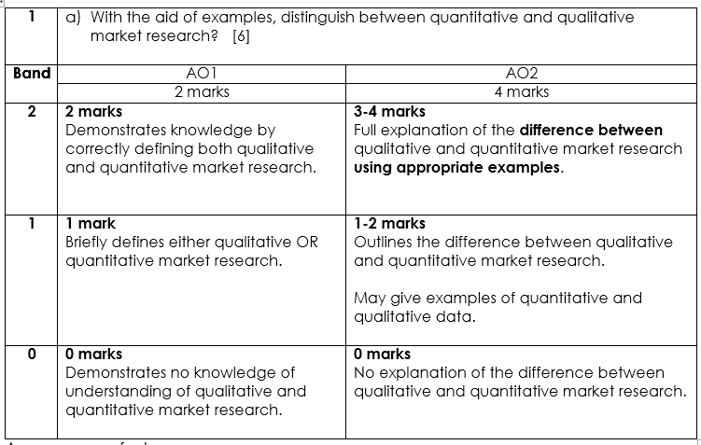

Slide 3
Sampling

Slide 4
Starter
True or False
When a firm is releasing a completely new product they are likely to use primary research
20% of the target market would like the packaging to be silver is an example of qualitative data
Government statistics would be an example of external secondary research
Secondary research always presents the most up to date facts and figures
The bigger the sample the better

Slide 5
Learning Objectives
Explain what is meant by sampling?
Explain the differences between random and quota sampling.
Understand the need to avoid bias in market research.
Evaluate the usefulness of sampling for a business and its stakeholders.

Slide 6
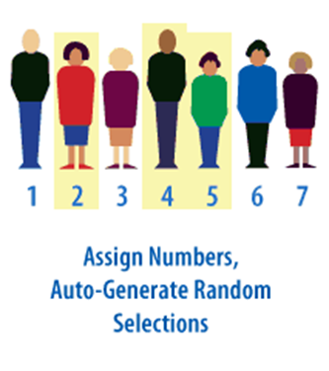
What is a sample?
Write a definition of ‘Sample’
A selection of part of the population, which must be representative of the population to be effective.
Notes:
The alternative to sampling is to conduct a census

Slide 7
Key Terms
Population: all those people whose views a business wants to find out.
Sample size: the number of people chosen for the sample from the whole population.

Slide 8
Why Do Firms Sample?
Cost – Market Research can be expensive
Time – Businesses often need information gathered from market research quickly

Slide 9
Sample size
The larger the sample size, the more reliable it is likely to be. However, larger samples incur greater costs:
Expense
Time
Sample size should relate closely to the size of the specific population.
If the sample size is very large it will take a long time and my prove to be expensive.
If the sample size is too small then there is greater chance that random factors will make results inaccurate.

Slide 10
Random Sampling
Quota Sampling
Every member of the population has an equal chance of being interviewed
Drawn from local electoral registers (interviewers must call 3 times before giving up)
Advantage:
Bias cannot be introduced
Disadvantage:
Can be expensive and time consuming
Assumes all members of the group are the same
The population is segmented into a number of groups which share specific characteristics
Often segmented based on demographics
Interviewers work to targets
Advantage:
Can be cheaper
Disadvantage:
Results are not statistically representative of the population and are not randomly chosen
Notes:
Random sampling: A small sample chosen in this way may not have all of the characteristics of the population, so a very large sample would be needed to make sure it was representative. Costly and time consuming

Slide 11
Random Sampling
Where everyone in the population has an equal chance of being included in the survey
What is your favourite flavour of ice?
Do you like marshmallows on your ice cream?
What is your favourite brand of ice cream?

Slide 12
Quota Sampling
Quota Sampling – attempts to select the individuals in the survey in relation to the characteristics of the overall market or population
Quota sampling is often used in market research. Interviewers are required to find cases with particular characteristics.
They are given quota of particular types of people to interview and the quota are organised so that final sample should be representative of population.
Have you ever been ambling along your local High Street, noticed a Market Researcher with a clipboard and thought "I don't mind being asked some questions - it might be interesting", only to find that the researcher looks straight through you?

Slide 13
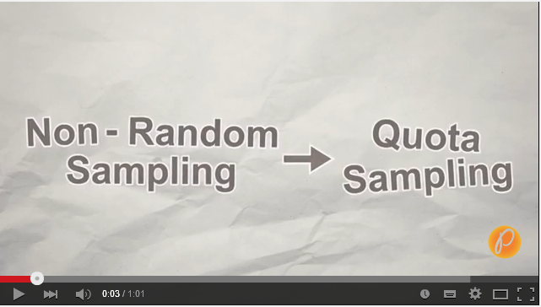
Quota Sampling
Notes:
1 minute
https://www.youtube.com/watch?v=NLzSz9VK2jY

Slide 14
Bias
Can cause data within a sample to be weighted towards one side.
For example, too many teenagers between the ages of 16-19 within a research sample.
It is possible, that results from a sample may be different from those that would have been obtained if the who population had been questioned. This is known as sampling discrepancy. This greater the discrepancy the less reliable the data obtained.

Slide 15
Confidence Level
The degree to which the statistics are a reliable predictor of actual events is known as the confidence level.
95% confidence level normally means that the prediction will be correct 19 times of 20.

Slide 16
Activities
Read pages 61 and 62 of HJR.
Complete Question 1.
Read the case study and answer questions 1, 3 and 4
Extension: test your knowledge and understanding of Market Research using the tasks on GOL

Slide 17
Past paper question
Two arguments in favour of carrying out Market Research (analysed and evaluated)
Two arguments against carrying out Market Research (analysed and evaluated)
Conclusion -

Slide 18
