Slide 1
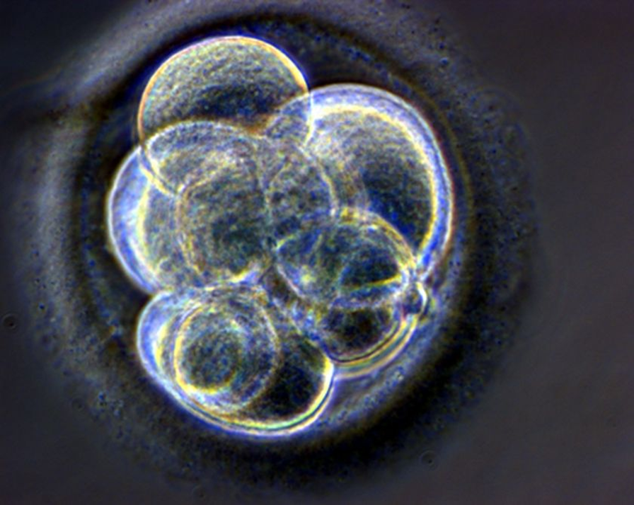
Never Let Me Go
Scientific Discourse
Chapters 11, 12 and 13
Notes:
Introduction. Aims and objectives: building on the views that the students have about the interaction between science and society, leading to the idea that science is being used as a metaphor – application of this to the text 5 mins

Slide 2
Chapter 11 … In one sentence, what is there to say about…?
I should explain why… p 124
sort of hangover … p 124
Anyway, the thing was… p 124
… what might even say what made the whole friendship possible during that time.. p 124
Okay. this had never been spelt out exactly p 124
As you'd expect.. p 124
A boy would… p 125
Anyway, the point is… p 125
Like I say…. as I say p 125
really…. really … really, really … really p 126
want to do it… I just do it … had to do it p 126
two quite separate Ruths p 127
But when I think about it now… (see also "thinking about this now…" p 128) p 127
and my role, as her closest friend p 128
You put your collection out with the rubbish? p 129
it's pointless now p 129
hardly mentioned, didn't mention p 130
We'd never come across anything like that before and didn't know what to think p 130
barging into people's rooms p 131
grimy window p 132
somebody standing outside the barn, just beside the doorway p133
I wasn't trying to spy on you …p 133 I wasn't trying to spy on you… p 134
Kath, what are you looking for? p 134
I felt comforted, protected almost p 134
I did tell him eventually, but that wasn't until a few months later… p 135

Slide 3
Chapter 11 … In one sentence, what is there to say about…?
I should explain why… p 124
Sense of duty is evident in the use of the deontic modal "should", suggest an expected, recommended behaviour
sort of hangover … p 124
Connection with Hailsham, but a hangover suggest unpleasant after effects
Anyway, the thing was… p 124
Sense of control and awareness of audience
… what might even say what made the whole friendship possible during that time.. p 124
beginning of evaluation from the adult Kathy
Okay. this had never been spelt out exactly p 124
spoken discourse, repeated use of cliché might suggest emotional immaturity
As you'd expect.. p 124
Reading against the grain, as Kathy anticipates our response
A boy would… p 125
The use of the epistemic modal suggests a pattern of behaviour
Anyway, the point is… p 125
Kathy controlling and focusing the narrative
Like I say…. as I say p 125
A feature of Kathy's idiolect – sense of spoken discourse

Slide 4
really…. really … really, really … really p 126
Childish lexis is used to describe more adult activity and emotions
want to do it… I just do it … had to do it p 126
euphemisms used - again, a sense of approximation of language – she can't find the language to express how she feels
two quite separate Ruths p 127
Repetition of the idea that the clones mimic, rather than fully understand behaviour from the wider society (they copy the elbow slap from the television)
But when I think about it now… (see also "thinking about this now…" p 128) p 127
Reminder of the retrospective narrative
and my role, as her closest friend p 128
Kathy now recognises her role – compare to the opening of the novel
You put your collection out with the rubbish? p 129
They take things that have been rejected by others, and then return them to the rubbish (rubbish motif)
it's pointless now p 129
Reflection of Ruth's death and Kathy's future

Slide 5
hardly mentioned, didn't mention p 130
Secrecy endures from Hailsham – learned behaviour
We'd never come across anything like that before and didn't know what to think p 130
Inability to think for themselves
barging into people's rooms p 131
Repetition of Hailsham's lack of privacy
grimy window p 132
symbolic/analogical function of setting – Kathy is not sure that she is doing the right thing
somebody standing outside the barn, just beside the doorway p133
repetition of surveillance and watching – often from doorways
I wasn't trying to spy on you …p 133 I wasn't trying to spy on you… p 134
Repeated phrase – it transpires that he was watching … he is keen to distinguish between the two
Kath, what are you looking for? p 134
the question the reader wants to ask
I felt comforted, protected almost p 134
Kathy's connection to Tommy
I did tell him eventually, but that wasn't until a few months later… p 135
Creation of tension and lack of resolution – characteristic ending of chapters

Slide 6
Order these from “most” to “least” agree
Science allows technologies to be built, impacting upon society.
Science informs public policies, such as personal decisions on energy, for example.
Science responds to the needs of society (in terms of health or farming, for example)
Society shapes the path of science in terms of society’s values, and the ethical decisions made
Society shapes scientists’ expectations, values, beliefs and goals.
Notes:
In pairs: five minutes to order these. 5 mins Ask for volunteers – to be ordered into a continuum, opening up a discussion about the role of science in society. 15 mins

Slide 7
The basic idea behind the possibles theory was simple …. For you and your friends.” P 137 How do the statements below affect your reading of this extract?
Presentation of an England that might have existed by the late twentieth century if the post-war scientific breakthroughs were in biotechnology rather than in nuclear physics.
Ishiguro presents an interest in universal humanist themes such individual agency and fate, and the individual’s social responsibility: “I was interested in the human capacity to accept what must seem like a limited and cruel fate.”
While Never Let Me Go cannot be read as an explicit commentary on the ethics of biotechnology – it contains virtually no scientific details – the norms and discourse of science form a powerful undercurrent that shapes both the characters and the narrative. Ishiguro does not demonise scientific creation; rather, the text’s critical focus emphasises the naturalisation of instrumentalist ways of seeing the world, its impact on social relations and on the very conceptions of what it means to be human.
Notes:
Each group has an extract: their task is to look at the way in which Ishiguro uses science in this novel. 30 mins. Feedback to the class with reference to the relevant slide. 30 mins.

Slide 8
Then there were those questions about why we wanted to track down our models at all … your life held in store.” Pp 137-138 How do the statements below affect your reading of this extract?
The use of understatement might be seen as a coping mechanism, but other events in the novel suggest that for clones there is a disconnection between the self and the body. There is a dehumanised and instrumentalised view they have of their bodies.
There is a conflict between the instrumental value of the clones as the hosts of healthy organs and the basic moral value of each individual as singular and irreplaceable.

Slide 9
We probably knew they couldn’t be serious … our plans for the future. P 140 How do the statements below affect your reading of this extract?
The clones see the purpose they have been created for as their fate; that is, they misrecognise their conditions of existence as a natural order. They are unable to see a self-determined future.
There is a submission to what Hailsham taught them to be their purpose. Within the limits of their predetermined futures, the clones therefore try to give some meaning to their lives by fulfilling what appears to be a very abstract conception of duty. Kathy’s power of identity as a Hailsham student is such that she cannot envision a different future.

Slide 10
So that was the background to Chrissie and Rodney’s claim … Tommy and me.” P 143 How do the statements below affect your reading of this extract?
The clones see the purpose they have been created for as their fate; that is, they misrecognise their conditions of existence as a natural order. They are unable to see a self-determined future.
There is a submission to what Hailsham taught them to be their purpose. Within the limits of their predetermined futures, the clones therefore try to give some meaning to their lives by fulfilling what appears to be a very abstract conception of duty. Kathy’s power of identity as a Hailsham student is such that she cannot envision a different future.

Slide 11
“When we were in Wales… properly in love.” P151 How do the statements below affect your reading of this extract?
While Never Let Me Go cannot be read as an explicit commentary on the ethics of biotechnology – it contains virtually no scientific details – the norms and discourse of science form a powerful undercurrent that shapes both the characters and the narrative. Ishiguro does not demonise scientific creation; rather, the text’s critical focus emphasises the naturalisation of instrumentalist ways of seeing the world, its impact on social relations and on the very conceptions of what it means to be human.
The mechanistic and materialistic determinism of the scientific universe which reduces the human to the body and its part is contrasted with human values of love, friendship, family and community.

Slide 12
To be honest .. this person Rodney saw. Pp152-153 How do the statements below affect your reading of this extract?
The world actively constructs them as members of a genetic underclass – through their isolation, by calling them clones – in order to continue with the donations programme. They are confined to a shadowy existence.
The mechanistic and materialistic determinism of the scientific universe which reduces the human to the body and its part is contrasted with human values of love, friendship, family and community.
Notes:
If time: hide and seek. The students have an annotated extract. They should find the extract. 10 mins

Slide 14
Pick One:
Science is used in Never Let Me Go as a metaphor for…
universal humanist themes such individual agency and fate, and the individual’s social responsibility
the human capacity to accept what must seem like a limited and cruel fate
what it means to be human.
the conflict between the mechanistic (reducing the human to the body and its parts) and human values of love, friendship, family and community.
the disconnection between the self and the body.
the conflict between the instrumental value of the clones as the hosts of healthy organs and the basic moral value of each individual as singular and irreplaceable.
the arbitrary restriction on individuality, and consequent violation of autonomy, freedom and dignity.

Slide 15
Your Homework: Decide on the three points that most interest you about this article
Kazuo Ishiguro: “We’re coming close to the point where we can create people who area superior to others” The Guardian, 3 December, 2016
Social changes unleashed by new technologies could undermine core human values unless we engage with science, warns author Kazuo Ishiguro at the Science Museum in London ahead of the opening of a new permanent mathematics gallery, which features a machine to predict coastal storm surges built by his oceanographer father.
Imagine a two-tiered society with elite citizens, genetically engineered to be smarter, healthier and to live longer, and an underclass of biologically run-of-the-mill humans. It sounds like the plot of a dystopian novel, but the world could be sleepwalking towards this scenario, according to one of Britain’s most celebrated writers.
Kazuo Ishiguro argues that the social changes unleashed by gene editing technologies, such as Crispr, could undermine core human values.
“We’re going into a territory where a lot of the ways in which we have organised our societies will suddenly look a bit redundant,” he said. “In liberal democracies, we have this idea that human beings are basically equal in some very fundamental way. We’re coming close to the point where we can, objectively in some sense, create people who are superior to others.”
“Despite the atom bomb and things like this, we’re still in the habit of compartmentalising scientific endeavour,” he said. “It’s important that we, as a society, get much more interested in science and maths, that we don’t silo it off in our minds ... until there’s some breakthrough product that turns up.”
Ishiguro cites three areas - gene editing, robotics and Artificial Intelligence - that he believes could transform the way we live and interact with each other over the next 30 years.
“We are on the brink of all kinds of discoveries that will completely alter the way we run our lives,” said the author, whose 2005 book, Never Let Me Go, imagines a dark future in which humans clones are raised to be organ donors.
The gene editing tool, Crispr, allows scientists to cut, paste and delete single letters of the genome with unprecedented precision, meaning aberrant genes can be overwritten with working copies, and, potentially, functional genes replaced with enhanced versions. Chinese scientists are already trialling the technology in patients to treat lung cancer.
“When you get to the point where you can say that person is actually intellectually or physically superior to another person because you have removed certain possibilities for that person getting ill… or because they’re enhanced in other ways, that has enormous implications for very basic values that we have,” said Ishiguro.
He also has concerns that in AI and robotics the bulk of intellectual capital lies with “the Silicon Valley masters of the universe” rather than universities or government-funded labs.
“There are some very powerful and rich people who want to do enormous research in this area,” he said. “Some of them might want to come out with things that are very beneficial, but it’s probably outside of regulation and so, yes, I think society as a whole needs to be more engaged.”
Ishiguro’s father, an oceanographer originally based in Nagasaki, moved with the family to Guildford, Surrey, to work at the National Institute of Oceanography in 1957, when Ishiguro was five.
Dr Shizuo Ishiguro with his electronic analogue machine, which converted meteorological and ocean data into electrical signals on a series of wire meshes. This allowed the height of storm surges, and where and when they would make coastal impact, to be predicted. Photograph: Image courtesy of NOC Archive.
Despite the two countries having been at war just a decade previously, the family were made welcome, he said. “The British people of that era had a very sophisticated sense of the international community because they had come through the war,” he said. “They knew the difference between serious things and less serious things, [having] lived through a period when they thought they were going to be under Nazi occupation.”
Ishiguro contrasts this with the anti-immigrant rhetoric that dominated the Brexit and US election campaigns.
“We have become much more multi-cultural and much more cosmopolitan in many ways, but the attitude to, say, the refugee crisis, I think is quite different to what I remember from the Britain I grew up in,” he said. ....
Despite having taken a different career path, Ishiguro inherited an obsessive attitude towards work from his father, he said, recalling him mulling over equations every evening while watching American thrillers on television.
“Looking back now I can see that the whole approach to his work is quite like my approach to my work as a writer,” he said. “He didn’t think of it as a job at all. It was something he obsessively thought about the whole time. That was my model.”

