Slide 1
Learning Aim B
Examine how visitor attractions meet the diverse expectations of visitors

Slide 2
Learning aim B is about meeting expectations of visitors and how diverse these expectations and needs are.
Learners need to understand how visitor attractions meet their visitors’ needs and to gain an understanding of the products, services and technologies they develop to pique interest and grow their visitor base.
Learners will need to know two contrasting organisations well in order to meet the assessment criteria for this task, so it is vital that they are able to research them in detail online.

Slide 3
Criteria:
P3: Explain how two different visitor attractions offer products and services that meet the diverse expectations of its visitors
P4: Explain the importance of technology for two different visitor attractions
M2: Analyse the importance of products and services offered by two different visitor attractions and the use of technology in meeting the diverse expectations of its visitors
D2: Evaluate the suitability of products and services provided by two different visitor attractions and the use of technology in meeting the diverse expectations of its visitors.

Slide 4
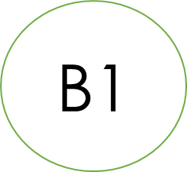
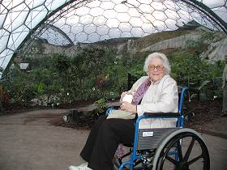
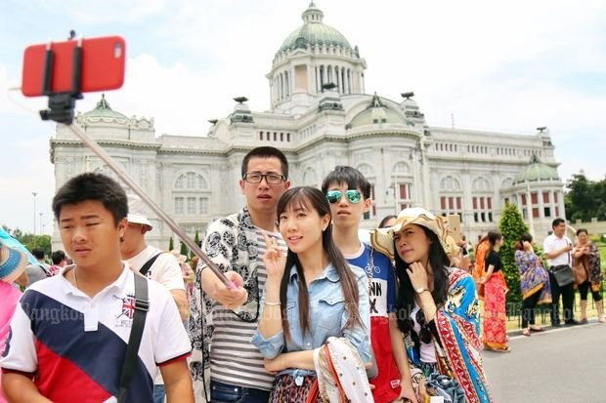
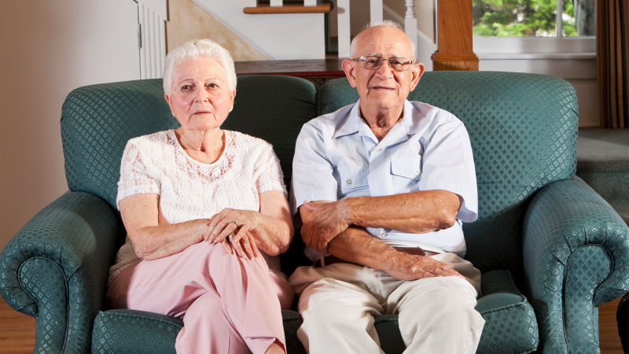
Different types of visitor
What different customer types are there?
What expectations might they have?
Create a spider diagram.
Types

Slide 5
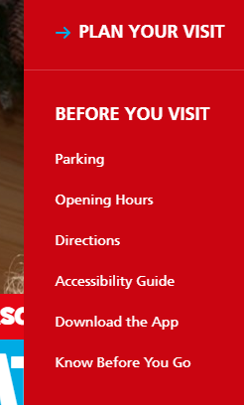
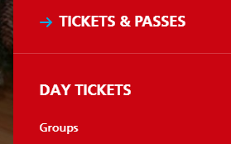
Activity - Visitor Types
Using your smart phone / laptop identify the different types of customers for one of your attractions.....
Where to look? Front page of their website....

Slide 6
Different types of visitors
Most visitor attractions will want to attract different types of visitor, to do so they will need to consider what the needs of different visitors are.
They will also need to consider the expectations of different visitor types, for example a school group may have very different expectations to an elderly couple visiting the same attraction.
It is within the interests of that attraction to meet and exceed the needs of those visitors so that they can continue to attract high numbers of tourists, maintain a good reputation and make good levels or profit.

Slide 7
Different types of visitors
Individuals: Individuals can be solo adults or children. Anyone that is visiting that attraction on their own.
Families: Families can be of any age e.g. Two adults with two children 10. You always need to consider the age of the children as this will change the expectations of the parents.
Groups: This could be school groups, elderly coach tours or a specific tour group.
Overseas Visitors: Not all overseas visitors will speak English so it is important to consider what their needs and expectations are.
People with specific needs: This can be anything from a visible disability to allergies. It is important to consider all needs, even ones that you cannot see.

Slide 8
Individual Needs – match up
Stated Needs
Those products and or services that you think the customer might need.
Unstated Needs
Needs the customer tells you about.
Anticipated Needs
Needs that’s will affect the customer’s choice of product – but which they do not tell you about.

Slide 9
Diverse Expectations
Accessibility
Priority access
Wheelchair ramps
Braille
Hearing aid loops
Lifts
Toilets and changing rooms
Handrails
Guide dogs
Cost and Convenience
Different tickets e.g. family
Pre-booking
Facilities available e.g. café
Queue systems
Discounts
Fast track
Safety and security
Alarm systems etc
Security guards
Lockers
Systems in place for lost children etc
Tannoy systems
CCTV
Automated entry points
Entertainment
Different exhibits
Shows / films
Characters
Rides
Stalls
Arcades
Play areas
Education/Information
Classroom provision
Guides for school groups
Special tours
Booklets/leaflets
Informative maps
Online resources

Slide 10
Specific Needs
Some customers may have specific needs which require additional and sensitive customer service e.g.
Special dietary needs
Mobility problems
Hearing impairment
Visual impairment
Speech difficulties
Medical condition
Learning disabilities

Slide 11
Specific Needs – how can an attraction meet each of these needs?
Special dietary needs
Mobility problems
Hearing impairment
Visual impairment
Speech difficulties
Medical conditions
Learning disabilities

Slide 12
Task: Choose one of your attractions from learning aim A. Complete the table below considering the different types of tourist and what their expectations are.
Name of your attraction | Accessibility | Cost and Convenience | Safety and security | Entertainment | Education/ Information
Individuals e.g. solo traveller
Families
School groups
Overseas visitors
People with specific needs

