Slide 1
Learning Aim B
Examine how visitor attractions meet the diverse expectations of visitors

Slide 2
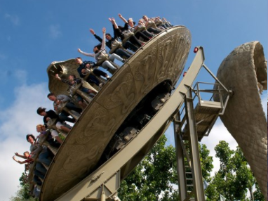
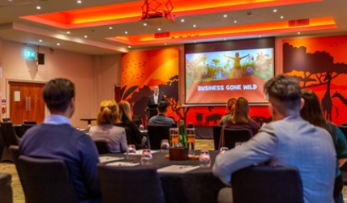
Products and services provided
B2
Different attractions will provide different products and services.
These can include rides, exhibits, landscapes, information centres maps, conference facilities, educational talks etc.
Bigger attractions tend to have a wider variety of products and services – what do Chessington World of Adventures offer?

Slide 3
Activity - CWoA
Using your phone/laptop, identify as many products and services which Chessington supply……

Slide 4
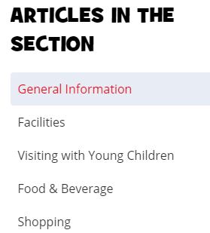
Support Services
Support services are additional services available to support a visitor’s time at that attraction.
This includes:
Visitor information centres
Parking
Park and ride facilities
Transfer shuttles
Toilets and restrooms
First aid
Creche and children’s facilities
Signage
Security
Cleaning
Task:
Research the support services that are available at Chessington.
In your opinion are there enough support services for visitors to this attraction?
Could anything be improved?
If so what?

Slide 5
Primary and Secondary Spend Opportunities
Primary spend is how visitors initially spend their money at the attraction e.g. the admission fee, seats and exhibition tickets.
Secondary spend is other ways in which visitors can spend their money e.g. shops, merchandise, catering and accommodation, guided tours, visitor centres, events, upgrades, annual passes, passes for entry to a range of attractions.
Remember: Some attractions are free and therefore rely on secondary spend!

Slide 6
Products and Services
Task: For your 2 chosen attractions list the products and services that are available
Attraction 1
Attraction 2

Slide 7
Task
For your two attractions consider the primary and secondary spend opportunities. Is there any room for further opportunities?
Attraction 1 | Attraction 2
Primary Spend: | Primary Spend:
Secondary Spend: | Secondary Spend:

