Slide 1
Auteur

Slide 2
Dictionary definition - Auteur
-A film director who influences their films so much that they rank as their author.
-An approach to film analysis and criticism that focuses on the ways in which the personal influence, individual sensibility and artistic vision of a film’s director might be identified in their work.

Slide 3
From the late 1940s a group of cinephiles influenced by the writing of Andre Arstruc and Andre Bazin began looking at cinema through the literary prism of authorship.
In the French film journal ‘Cahiers du Cinema’, writer Francois Truffaut used the phrase politique des auteurs, which is roughly translatable as auteur policy, but commonly rendered in English as- the auteur theory.
This celebrated the film director as an auteur (author)– an artist whose personality or personal creative vision could be read, stylistically and thematically, across their body of work.

Slide 4
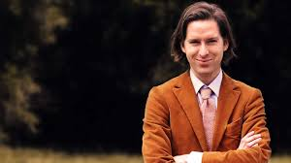
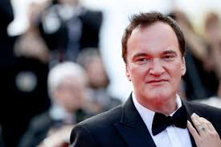
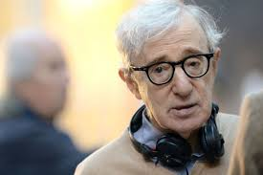
Which film directors can you recall who have a specific style?
Consider three or more films they have made
What similarities can you see across these films to support your view?

Slide 5
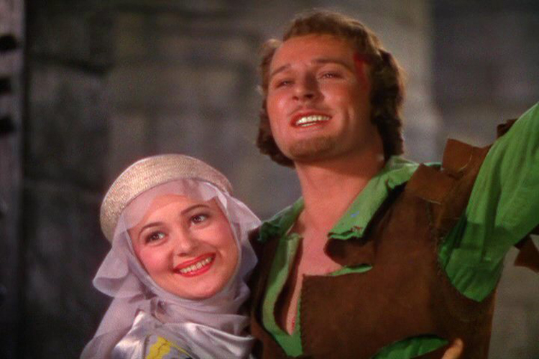
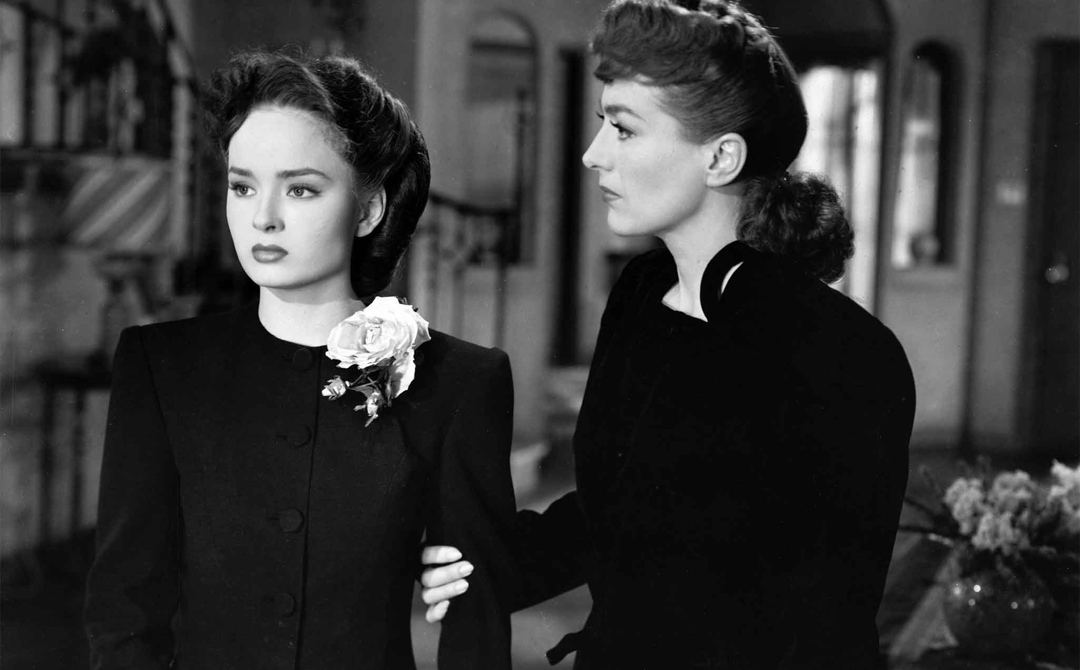
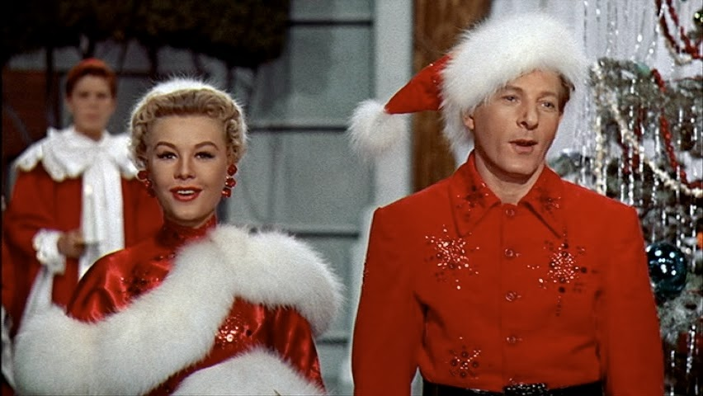
Michael Curtiz
Over the course of his career, Curtiz made almost 100 films for Warner Brothers, including musicals, detective stories, and horror films. Born in Budapest, Hungary, in the late 1800s. He began making films there in 1912, but left Hungary in 1919 because of political unrest. In 1926 he arrived in Hollywood.
Adventures of Robin Hood (1938)
Mildred Pierce (1945)
White Christmas (1954)
Notes:
Wasn’t first choice. Joined production two weeks before shooting began. Worked across multiple genres. Doesn’t adhere to the auteur theory ideas. Anti auteur. Metteur en scene a better description?! But won the Oscar for Best director

Slide 6
Can Curtiz be classed as an auteur?

Slide 7
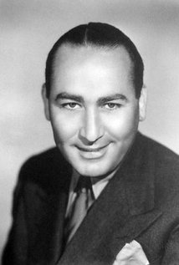
Hal B Wallis
So whose vision and style can Casablanca be attributed to?
Hal B Wallis was a prominent producer working for Warner Bros. between 1931 – 1945. Due to its roots, Warners was a production company that had a reputation for making socially conscious films…
…during his period working there Wallis produced hits such as Little Caesar, The Maltese Falcon, Yankee Doodle Dandy, and not to mention Casablanca.
Notes:
Won the Oscar for Outstanding picture. Jack Warner rushed the stage. Career over with Warner.

Slide 8
Answering an exam question
So, in a auteur exam question, in relation to Casablanca you have a few options:
Argue that you think Curtiz was an auteur
Or instead, put it down to the vision of Hal B. Wallis (producer)
Discuss the film as a collaborative approach and discuss key personnel
Or discuss Warner Bros’ house style and the Classical Hollywood ‘look’.

