Slide 1
International trade
And markets

Slide 2
INTERNATIONAL TRADE AND ACCESS TO MARKETS
Learning Objectives:
Students understand the issues which can result from differential access to trade markets and the impacts on economic and societal well-being.
Students can identify a number of strategies that seek to deal with these issues, in particular:
Fair trade over free trade
Students are able to describe world trade for a food commodity (bananas) and/or manufactured product.
KEY WORDS:
Free trade
Fair trade
Ethical Investment
Banana trade wars

Slide 3
Fair trade and ethical investment
Define the term ‘Fair trade’
Discuss alternative trading organisations:
Cafedirect OR
Traidcraft
Why are these organisations viewed as more ethical?
How does Fairtrade differ to Free trade?

Slide 4
introduction
https://www.youtube.com/watch?v=JoIZWd2q2Ec

Slide 5
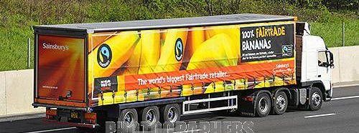
Fair Trade
We source our Fairtrade bananas from farmers in Central & South America, the Caribbean and West Africa.
Fairtrade premiums are crucial to many smallholder farmers and workers who would otherwise see their livelihoods threatened by global competition.
Fairtrade is about better prices, decent working conditions, local sustainability, and fair terms of trade for farmers and workers in the developing world. By requiring companies to pay sustainable prices (which must never fall lower than the market price), Fairtrade addresses the injustices of conventional trade, which traditionally discriminates against the poorest, weakest producers. It enables them to improve their position and have more control over their lives.

Slide 6
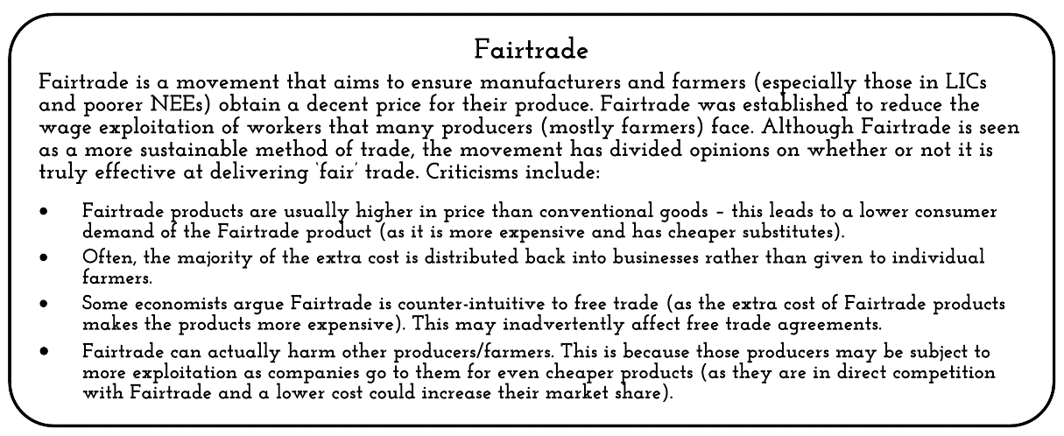
https://www.youtube.com/watch?time_continue=15&v=PLKTGWH398Q&feature=emb_logo

Slide 7
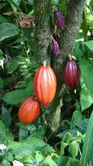
Free Trade or Fair Trade?
Free Trade | Fair Trade
Free Trade is the reduction of regulations and other constraints on businesses to increase international trade. | Fair Trade is about making sure that farmers are paid a fair wage for their produce.
Tariffs and quotas are removed, so countries can respond to market forces. | Fair trade gives farmers a guaranteed price for their products, no matter what the market does. This helps them plan and budget for the future.
It is based on the theory that every country will be better off if it specialises in producing goods which is comparatively more efficient. | Fair trade encourages farmers to cooperate. This allows better conservation of the natural environment. It also encourages investment in local amenities.
Why are many countries against Free Trade?
Research an example of how Fair Trade has helped people in LEDCs

Slide 8
Free TRade or Fair Trade?

Slide 9
Fair TRade – Geofile
Define Fairtrade
Discuss alternative trading organisations:
E.g. Traidcraft (www.traidcraft.co.uk) Traidcraft Tea Story: https://www.youtube.com/watch?v=1Ssz_WtHiQk
What are the aims of Traidcraft?
Summarise the role of Traidcraft in Kenya
Why is an organization like Traidcraft viewed as more ethical?

Slide 10
Geofile Online: Fair TRade No 499
Complete Questions 1-5 on the back of the Geofile

Slide 11
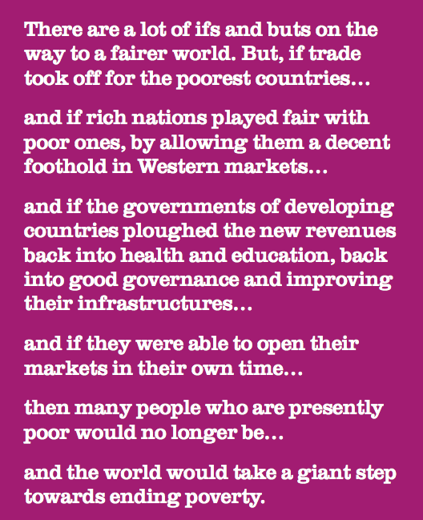

Slide 13
RESEARCH TASK: World trade in one food commodity or one manufacturing product
Build a case study on the global trade of a food commodity or manufactured product. Make sure you consider/answer the following:
Cash crops such as bananas, coffee and cocoa have great discussion potential here due to their production largely focused in LICs.
Make sure you include a map of global trade for your product – trade patterns
Describe world trade for your food commodity and/or manufactured product where does the commodity come from (where is it grown?)and where does it travel to (export to)? (See next slide) Can you draw a diagram or map the chain of production – distribution -consumption
Which countries and/or trade agreements are responsible for and involved in world trade of your food commodity or manufactured product, and why
Are there any barriers to trade or conflicts around trade in your choice of food commodity or manufactured product?
What are trade wars? Are they relevant to your chosen food commodity or manufactured product?
How are companies trying to resolve these issues?
Resources for research: see final section in your booklet for resources. You can research this as a small group.

Slide 14
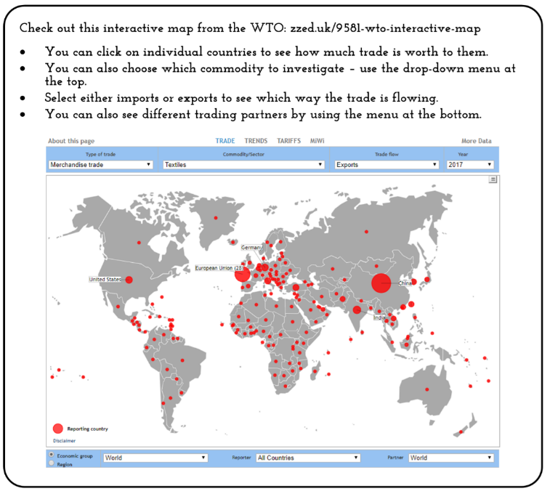
Research
Use the website to investigate trade in your food commodity

Slide 16
review questions
Explain the pattern and processes involved in the world trade of one food commodity or one manufacturing product (6 marks)
Finally, complete the questions on page 33 in the Oxford Textbook

Slide 17
REsources
https://www.fairtrade.org.uk/Buying-Fairtrade for different food commodities

Slide 18
Pre-work/Homework
Using Hodder textbook p306-308 produce a mind map/notes on ‘Nature and role of TNCs’
Reasons for operating in more than one country
Why 21st century TNCs are called ‘globally integrated enterprise’
Spatial organisation and production of primary, secondary and service based TNCs.

