Slide 1

Jerusalem Week 9
Notes:
Introduction. Aims and objectives: to continue through the play to page 70; to read a review for homework, and to analyse the language of the review, producing their own, emulating the same style, but countering it with references to the play to support their points. 5 mins

Slide 2
Your task
Read the two pages allocated to you.
Summarise in one sentence
If you were set this as an extract,
what Must you write about
What should you write about
What could you write about?
Remember: you are always thinking about context, stylistic analysis, dramatic features, discourse etc.
Notes:
Work in pairs to read their two extracts. To fill in the boxes, and to feedback to the class. (20 mins) Read on pp70-72, 78-79, 80-81, 82-84 in preparation for next week.

Slide 3
Page 57
Lexis: use of proper nouns to add veracity ("A14 outside Upavon" etc) – characteristic of Johnny's storytelling
Discourse: use of dialect "bluff" meaning "cliff" – indication of Johnny's origins in the West Country
Dramatic: Litotes used for comedic effect: "we got to chatting"

Slide 4
P 58-9 A1
Must write about the lexical features within the dialogue of this section. Eg archaic lexis, typical of Johnny as he tells a story or delivers a speech (“over yonder”) Also - example of stichomythic exchange, involving repetition and antithesis (“they are. Aren’t they// I Imagine they are…) to suggest unity of the group, echoing one another, asking opinions etc
  Should write about the context of the scene with Johnny's story with the giant building Stonehenge as well as the reaction from Ginger, the Professor, lee, Pea and Tanya. This is the first mention of the drum (“just bang this drum and us, the giants, we’ll hear it, and we’ll come.”) use of direct speech to add variety – characteristic of an aural narrative (Johnny very practised at telling stories)
​
  Could write about the structure and debate around Johnny's story, the story is detailed with Johnny using high frequency lexis whilst sharing it. Leading to others saying short simplistic sentences, reacting to Johnny.

Slide 5
Pages 60-61
pp 60-61
Lexis: contrast of taboo language (“weird shit”), and the subject specific lexis (“runes”) – indicating Lee’s desire to downwardly converge to Ginger, countered by his knowledge.
Stylistic: syntactical repetition of “not unless… not unless… you don’t want to” three warnings – religious echoes, of the significance of the number three. This is also the third time he has produced “proof” of his stories (see p 12, p 50)
Stylistic: Interrogatives repeated 10 times – to create sense of uncertainty.

Slide 6
Pp 62-63 B1
After Lee beats the drum, Marky shows up and Johnny can’t take him to the fair
Johnny speaks repetitively when taking to Marky – “you got a kiss for me?” Repeats this 3 times – “Coke? Pepsi?” Repeats twice – Marky straight up ignores him
Military lexis – Johnny dismissing his troops/followers “on your feet”, “at ease” – echoes pg 50 where Johnny declares himself “your merciless ruler”
The drums bang and Marky, a 6 year old shows up rather than giants – ironic as Marky is significantly smaller than giants – but in a way proves Johnny’s drum works as it brings a presence you don’t want to see

Slide 7
Pages 64-65
Lexis: Wesley’s vocabulary is limited, here his discourse includes repeated platitudes (“How’s things… Please excuse my… I better be off…) to disguise the chaos of the effects of the drugs.
Syntax: imperatives of Johnny (“go and play… Do a best… Mind the step…”), emphasising the adult role that he takes here – responding to his responsibilities.
Lexis: epithets used to describe Johnny (“gyppo”) in a play where naming has great power (the list on the petition, the names of the giants)

Slide 8
Pages 66-67
Motif: of Johnny as a timeless, mythical figure (“The world turns. And it turns. And it moves on and you don’t. You’re still here.”)
Discourse: different register of Dawn to Andy on the phone (“Look, do you mind…”) with positive politeness features, contrasting to the minor sentences with repeated taboo language she uses when speaking to Johnny. (“Fuck off. All right? Fuck off.”)
Context: appealing to the incongruity theory of comedy as he chops out lines on the Trivial Pursuit box: juxtaposing adult and childish worlds.

Slide 9
Pages 68-69 A1
1. Dramatic: "Dawn comes over....walks away": sense of a constant shift between connection and division within these characters' dynamic. In the stage directions we see the power of the stories Johnny uses to calm his audience - or to seduce them. After telling his story, “Dawn comes over”. Though it's clear Johnny is the more static character, he starts the kiss and he actively tries to get closer too her. (Giving her his phone, walking closer to her, going through her bag) through the use of proxemics its clear that Johnny wants to understand Dawn and rebuild the connection between the two of them. But Dawn is more incisive as shown by the stage directions quoted above and the fact that she while is reciprocated the kiss, she was the one to end it. Shift in pronoun use in stage directions (“He kisses her” – suggesting Johnny initiating, “They kiss”, suggesting mutuality. “She pulls away” – Dawn initiates the separation) This shows the unstable nature of their relationship and the fact that in this moment Dawn is the one in power since she is the one ending these interactions and creating a divide that Johnny is unable to fix.
2. Lexis + structure - Johnny attempting to find the name of Dawn’s partner, in a play where naming has great power (the list on the petition, the names of the giants) His excessive listing on page p.69 while he's trying to guess the name of Dawn's partner, gives a sense of Johnny overwhelming Dawn, since she almost unable to get a word in. This shows paired with the fact that Johnny completely dominates this moment (speaks for the longest and leads the conversation almost completely) shows that Johnny, though it is dwindling, is still in a position of power in this relationship.
3. Lexis - Johnny's monologue/story is in the past tense as opposed to the characteristic present tense. Shows the effect Dawn has on Johnny, she's the only one he changes his format for. She throws him off. Has less connection to her? Present tense has a more immediate connection to the audience - without the present tense it gives a sense of divide between these two characters

Slide 10
Jerusalem pages 68
Dramatic features: “Dawn comes over…walks away” sense of a constant shift between the connection and division within the characters dynamic.
Johnny's story about being kidnapped by four Nigerian traffic wardens is another example of Johnny’s (Butterworths) incredible skill for engaging the characters and the audience:
The use of rhyming slang in “I'm having a jimmy riddle” adds comedic tone to his story.
The line “didn’t swallow nothing for a week” shows Johnny's idiom and informal lexis.
Also the sarcastic response of Dawn “you were kidnapped by traffic wardens” suggest that she is used to Johnny's bizarre stories and could represent how their relationship didn’t work out because she doesn’t trust or rely on Johnny.
The use of minor sentences “they walk miles. Long days” creates a conversational effect of him telling Dawn this story.
The only difference about this story is that he has no evidence unlike the previous stories with the mars bar and the drum.
Jerusalem page 69
Lexis and structure: Johnny's excessive listing “Tom? Pete. Lee. John "whilst trying to guess the name of Dawns partner suggests that Johnny is somewhat jealous at the fact that Dawn has been able to move on with her life whilst he has not – also the power of names.
Dramatic features: Though Johnny is more of a static character, he initiates intimacy through the stage directions when “he moves to her - he kisses her – he touches her hair” using proxemics here it clear that Jonny wants to understand Dawn and rebuild the connection they once shared.
However, Dawn is more incisive as shown by the stage directions quoted above and the fact that while she reciprocated the kiss, she was the one to end it “she pulls away”– shows the unstable nature of their relationship and the fact that in that moment Dawn has power by ending these interactions and creating a divide that Johnny is unable to fix.
Johnny refers to Dawn as “Darling” could suggest that he’s still fond of her but could also just highlight his idiom.
Millie W A1

Slide 11
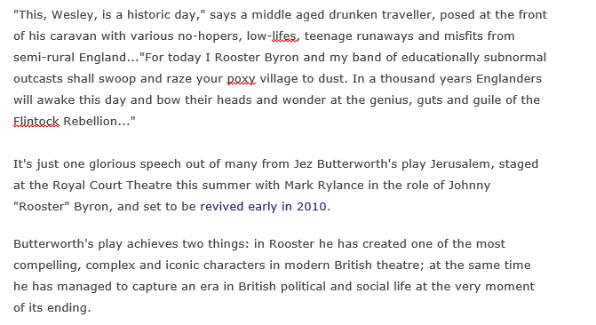
A Review
"Butterworth's
Jerusalem: the
full English"
Paul Mason
Friday, 18 Dec.
2009.
(Blog)

Slide 12
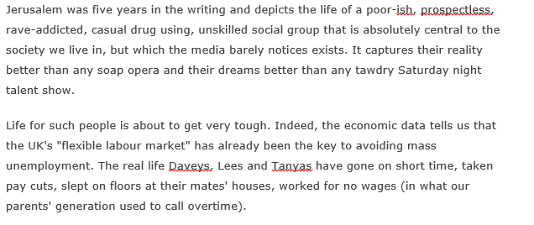

Slide 13
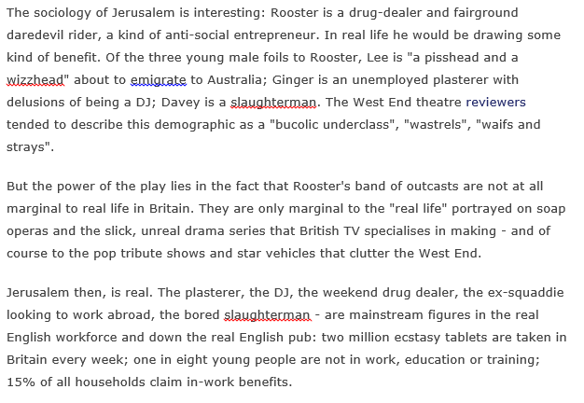

Slide 14
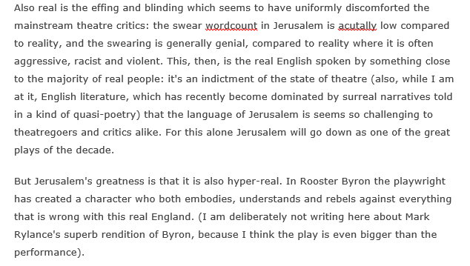

Slide 15
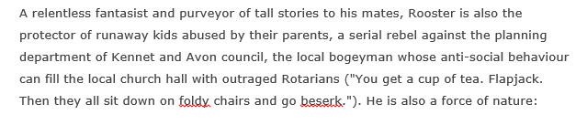
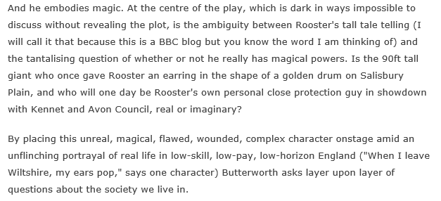

Slide 16
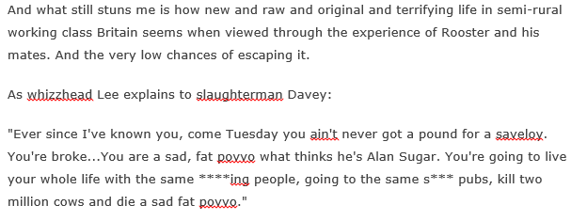


Slide 17
What single quote would you use from this review?
For example…
In Rooster he has created one of the most compelling, complex and iconic characters in modern British theatre
… capturing an era in British political and social life
unflinching portrayal of real life in low-skill, low-pay, low-horizon England

Slide 18
A review
Jerusalem strains very hard for an effect it never manages to achieve, leaving us with the occasional amusing story, but far, far too much time spent with the sort of tedious drugheads whose presence in a play is meant to give us the feeling that what we are watching is 'edgy' and 'daring', but which can't help but be as boring as someone telling us "how out of it I was last night". The attempt to link the main character to the myths of old England never convinces and the play - which also tries very hard to be relevant to the moment by including many references to recent pop culture - will quickly become outdated. " England's green & pleasant Land" may, in many ways be a desperate place today but Butterworth fails to find the cry of its despair. (review from Good Reads)
Notes:
Students have read a review by Paul Mason: discuss what he liked about the play. 10 mins Read this one: discuss the genre, audience and purpose of this review. Write on board. Main criticisms of the play by this writer? 5 mins

Slide 19
Main criticism
Boring
Unconvincing links with myth
Will quickly become outdated
Doesn’t accurately represent England as being a desperate place to live
Notes:
Compare their ideas with those on the slide. 5 mins Hand out guidance, with reference to the following slide.

Slide 20
Write a 138 word review to counter this….
General audience - accessible
Features of spoken discourse and more formal writerly features
Paraphrase from the text, from critical reviews or interviews to support your points
Purpose: to persuade, and inform
Notes:
10 minutes to write a counter review to this, emulating the style of the example. If time: hear example. Take in writing. Next week: working on to Act 3, benchmark assessment.

Slide 21
Some details….
Verb use personifies the text and England – rhetorical flourish
Use of inclusive first person plural pronoun (“us”)
Repetition for persuasion and emphasis (“far, far too much”)
Non-standard grammar (adjective “occasional” replacing adverb “occasionally”) indicating the register of this review
Lexical clusters of boredom (“tedious” “boring”), effort (“tries very hard”, “strains” “attempt”) and failure (“never manages to achieve” “fails to find”) - central message of this review
Antithetical sentence structure, marked by repeated use of subordinating conjunction (“is meant to… but” “England’s green… but Butterworth”): suggesting a balanced, researched argument

Slide 22
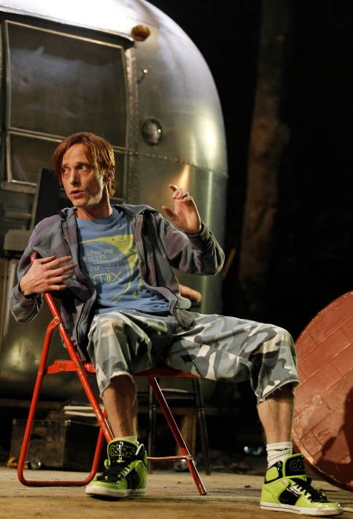
B.K.
Unlike the popular West-End plays that are so censored and idealistic that you wonder if you are watching a brightly-lit dream, Jerusalem is able to present a way of life that is much closer to how proper-English people live in the modern day. Characters are developed and intriguing- capturing ‘mainstream figures in the real English workforce’ but making them fascinating depictions of types we all know. Johnny Byron is anything but boring, with wonderfully constructed monologues so bizarre that you start to wonder if they’re true. It is a play with light and shade, a perfect capsule of modern English life; toying with the relationship between old and young, and challenging anyone’s preconceptions of theatre.
Jerusalem: presenting “proper-English people”?

Slide 23
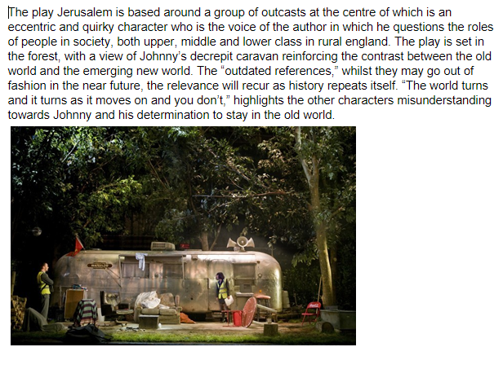
OB TB

Slide 24

DW
Looking at any piece of media builds a representation of life and it is important to understand the variation of this subject. This variation, and the divisions that come with it is something that Butterworth expertly betrays within his play Jerusalem. He beautifully creates a world where everything, from low life drug dealers, wannabe DJs, confused professors and even the setting itself has a unexpected and hidden depth. The supernatural is woven with the mundane. The wise within the foolish and the tragic within the comedic. An unexpectedly complex play filled with wonderfully human characters. And most certainly not edgy. A1
Johnny: the supernatural woven with the mundane

Slide 25
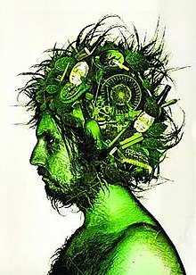
EL CS
Jerusalem conveys are variety of complex characters, each of which bring something new to the play. The story successfully entertains the audience with its mainly light tone but also shocks them by the constant strong swearing. The main character, Johnny Byron, brings the story together through showing the craziness of his dysfunctional world. Whilst being a problematic character, Johnny is depicted as some sort of distorted father figure and is thought of as a safe escape in many young people’s lives. This conveys how incredible his character really is as he brings all other characters together, enhancing their personalities. Another interesting element of the play is how the characters interact with each other differently depending on who is around them. Overall, Jerusalem is an intricate yet compelling play.
Johnny: the green man of Jerusalem

Slide 26
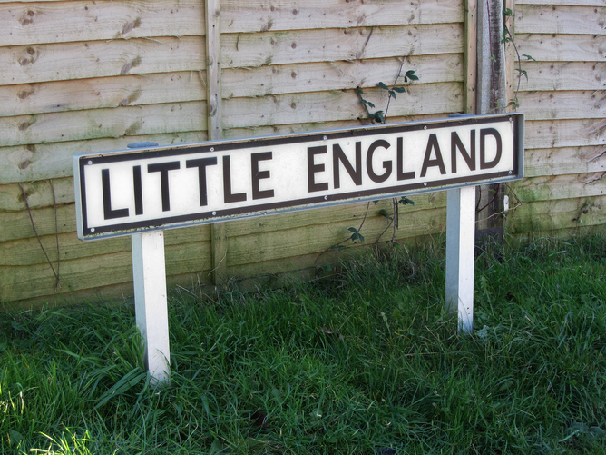
Review of Jerusalem: by Millie W
Jerusalem portrays an accurate representation of Britain from a social class of “various no hopers, low life’s, teenage runaways and misfits in a semi-rural England” led by Johnny Rooster Byron who is an “antisocial entrepreneur” that throughout the play, symbolizes a “force of nature and embodies magic”. Butterworth employs and edgy group of characters to illustrate the struggle of real life from the perspective of “low skilled, low payed, low horizon people”. The use of mythical connections to Old England through Johnny Byron’s recurring stories of giants and werewolves creates an engaging yet comical tone of the unpredictable nature of life in Rural England. Overall, Jerusalem is a very educated play constructed with a contrast between realism and bold mythical elements. A1
A world of the low skilled, low paid, low horizon…

Slide 27
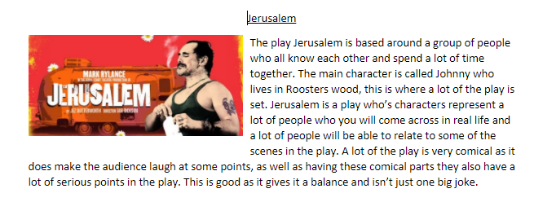
S. P. A1

Slide 28
Your task: Looking at p 67-69
Group One: Dramatic Performance; Eg The volume of the speech. The speed of the speech. The use of paralinguistic elements (gestures, facial expressions) The use of pauses to build suspense, for example. Stage Directions. E.g. Instructions for the actor (delivery, volume, pace) Instructions for the director (lighting, weather, set, sound) The level of detail within the directions Lexical patterns within the directions Stage Effects: Lighting. Sound. Music. Use of props. Set design
Group Two: Stylistics. Eg. Patterns of words (lexis).patterns of sentences (“parallelism”) patterns of sound (“phonetic parallelism”) unusual use of words (“lexical deviation”) unusual use grammar (“syntactical deviation”) unusual ways of presenting the words (“graphological deviation”). Discourse. Eg. instrumental power v influential power. Interruptions. Use of rhetorical devices. agenda setting. use of discourse markers to hold the floor. allocating the next speaker. Adjacency pairs. Terms of address. Turn taking etc. Types of utterances: private conversation v public speech, quoted lines
Group Three: Context – connection to the rest of the play – repeated themes, patterns, imagery, lexis etc. Production and critical reception eg. Set of the original and subsequent productions. Costume of productions – costume changes etc. Directorial decisions: placing of the actors on the stage (proxemics). Directorial decisions: about the delivery of the lines, about timings. Theatrical reviews of the time. Interviews with author/director/actors. Dramatic conventions. Eg. The use of the soliloquy. The use of stichomythia. The use of the chorus. The use of mime. The use of split stage etc. Exits and entrances. Genre: e.g. Does the play neatly fit into the genre of comedy? Does the play neatly fit into the genre of tragedy? If it does fit into a genre, what conventions of that genre do you see? Does the play challenge or subvert that genre?

Slide 29
Your Homework: due this time next week
Examine the presentation of the relationship between Johnny and Dawn, on pp 67 – 69; from "So tell me…" to “Who’s looking after you, John?”
You should consider the use of dramatic and stylistic techniques in the extract, its significance within the play and any other relevant dramatic or other contexts

Slide 30
P70-71
Johnny – series of questions to engage Dawn
Dawn providing identity for Johnny “Spiderman … Supertramp” – sarcasm Reference to the importance of labels and identity within the play as a whole.
Repetition of imperative “come over here” (x3) “Look” (x4) and question “Did you see” (x3) hypnotic effect
“There now” – idiomatic phrase used to a child – power of Johnny.
Repetition of “suit yourself” p 63 adding to a sense that this is a structured vignette – with a beginning and an end.
Stage directions reveal Johnny playing a role: his reassurance disappears when he is alone. (“He eyes the wood nervously”) He anticipates the threat arriving. Suspense builds.

Slide 31
p72
Idea that ley lines have spiritual power or resonate a special psychic or mystical energy. Seen to be sources of power.
Theme of change: central to the play “New horizons” etc
“This is holy land” – by implication this gives Johnny a spiritual dimension
Contrast of the characters’ speech: Lee looking outwards and into the future, Tanya looking back, and at herself and Lee.
Tanya’s language is figurative, but predictable and clichéd in “no strings” – but the euphemism of “Eat my peaches, don’t shake my tree” is metaphorical and humorous in its euphemistic nature

