Slide 1
Liquidity Ratios

Slide 2
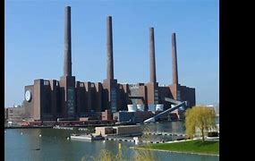
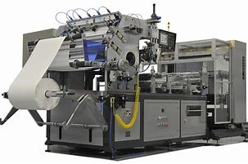
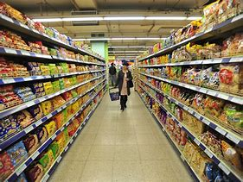
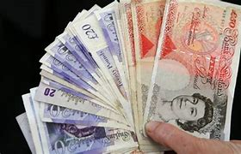
What is LIQUIDITY?
Remember, things the business OWNS are called ASSETS.
The business will intend to keep some assets for years and years. Example: Buildings and machinery.
Other assets will come and go. They don’t stay for long in the business. Example: Inventory and cash.
Liquidity means “THE EASE AT WHICH ASSETS CAN BE SOLD FOR CASH”.

Slide 3
Liquidity
The most liquid of all the assets is ……… CASH. You don’t have to do anything to change that in to cash!
The rest of the CURRENT ASSETS are also quite liquid. They don’t stay in the business for very long.
The NON-CURRENT (Fixed) ASSETS are much less liquid. The business bought those with the intention of keeping them long term. It is a much bigger deal to sell these on for cash.

Slide 4
Why do businesses care about their liquidity?
Remember, things the business OWES are called LIABILITIES.
Businesses need to know if they have enough cash to pay for their URGENT liabilities. The formal term for these ‘urgent liabilities’ is CURRENT LIABILITIES. They will need to be paid very soon. Does the firm have enough cash to do so?
What if it doesn’t?

Slide 5
What if the business doesn’t have enough cash?
The answer is, they will have to get it from somewhere.
First port of call: can they sell their CURRENT ASSETS to raise cash quickly to pay off their CURRENT LIABILITIES?
Remember, the difference between CURRENT ASSETS and CURRENT LIABILITIES is called WORKING CAPITAL
Working Capital = Current Assets – Current Liabilities
If the business has a positive working capital figure, it can probably pay off it’s current liabilities.

Slide 6
here is the top half of a balance sheet for ‘classique’, a ladies clothes shop Questions: What is this firm’s WORKING capital? Should it be concerned about its accounts?
 | £
Non-Current (Fixed) Assets | 500 000
Current Assets:
Inventory (stock) | 50 000
Receivables (debtors) | 1 200
Cash | 5 000
Total Current Assets | 56 200
Current Liabilities:
Payables (creditors) | 41 000
Overdraft | 15 000
Total Current Liabilities | 56 000
WORKING CAPITAL | ?
NET ASSETS | 500 200

Slide 7
here is the top half of ‘classique’s’ balance sheet.
 | £
Non-Current (Fixed) Assets | 500 000
Current Assets:
Inventory (stock) | 50 000
Receivables (debtors) | 1 200
Cash | 5 000
Total Current Assets | 56 200
Current Liabilities:
Payables (creditors) | 41 000
Overdraft | 15 000
Total Current Liabilities | 56 000
WORKING CAPITAL | 200
NET ASSETS | 500 200
Does the firm have enough cash?
Does the firm have enough CURRENT ASSETS?
Look at Classique’s Current Liabilities

Slide 8
YES it does
But only just!!
It only has working capital of £200!!
Surely, to be safe, it would prefer to have a lot more in current assets.
What happens if it has to wait for months for the receivables (debtors) to clear?
What happens if it takes a while to sell the inventory (stock)?
In an ideal world, businesses would like approximately 1.5 the amount of CURRENT ASSETS as they do CURRENT LIABILITIES.

Slide 9
The current ratio
This can easily be calculated using the Current Ratio.
Formula:
CURRENTS ASSETS : 1 CURRENT LIABILITIES
Your answer tells you how much the firm has in current assets in proportion to their current liabilities.
An ideal company would be to have 1.5 times the amount of current assets to current liabilities. This would be shown as
1.5 : 1
The number to the left of the : represents current assets; the number to the right of the : represents current liabilities.
Another way of looking at this would be the business has £1.50 worth of current assets (inventory, receivables and cash) for every £1 of current liabilities.
If all the business’ current liabilities all fell due immediately, they would have lots of ‘inventory, receivables and cash’ (a.k.a. CURRENT ASSETS) to pay it with. 50% more than they need! They’d comfortably cover their URGENT DEBTS.

Slide 10
Let’s work out the current ratio for ‘classique’
Current Ratio = CURRENT ASSETS ÷ CURRENT LIABILITIES : 1 = £56 200 ÷ £56 000 : 1
= 1.00:1 (express your answer to 2 decimal places).
What would you say to the managers of Classique? Would you be happy with this ratio?

Slide 11
Let’s work out the current ratio for ‘classique’
Classique should be worried. They have enough current assets to pay off their current liabilities, BUT ONLY JUST.
Also, most of their current assets are made up of inventory (stock). Ladies clothes, in other words, that need to be sold before they can raise the cash needed to pay the current liabilities. Surely that would take TIME? Not great, if they need CASH urgently.

Slide 12
What if we took stock out of the equation?
Surely, if inventory (stock) is difficult to sell and takes time, it is silly to always include it in the current assets number! What would the ratio look like if we ignore inventory (stock) and just concentrate on the VERY LIQUID ASSETS of RECEIVABLES (debtors) and CASH?
This is what we do when we calculate the LIQUID CAPITAL RATIO:
Formula: CURRENTS ASSETS – INVENTORY (stock) : 1 CURRENT LIABILITIES
Ideally, businesses would want to see a LIQUID CAPITAL RATIO of 1:1.
In other words, they’d like to see JUST ENOUGH receivables and cash to cover their current liabilities.

Slide 13
Let’s work out the liquid capital ratio for ‘classique’
Liquid Capital Ratio = (Current Assets – Inventory) ÷ Current Liabilities :1
= (£56 200 - £50 000) ÷ £56 000 : 1
= £6 200 ÷ £56 000 : 1
= 0.11:1
What a disaster!! The Liquid Capital Ratio really highlights how ILLIQUID this business is. It only has 11p to pay of every £1 worth of current liabilities!!

Slide 14
Conclusion for classique
Classique runs the risk of bankruptcy if it can’t sell all its stock immediately.
Question: What else could it do, to avoid bankruptcy?
Answer: It could try to get FINANCE from elsewhere. A loan from an understanding bank manager perhaps?

Slide 15
Time to practise
Have a go at working out the LIQUIDITY of some businesses for yourself.
Use the worksheet on GOL.

