Slide 1
Break-even
How changes in costs and/or revenue can affect break even

Slide 2
What do you remember?
What is ‘break-even point’?
What is ‘margin of safety’?
What is the formula for:
Contribution per unit
Break-even
Profit
Notes:
Selling price – variable costs

Slide 3
Learning Objectives
Construct and interpret break-even charts, including the margin of safety
Analyse how changes in costs and/or revenue can affect break-even
Evaluate the usefulness of break-even to a business and its stakeholders

Slide 4
Key terms
Break-even: where a business sells just enough to cover its costs
Break-even point: where total revenue and total costs are the same
Margin of safety: the range of output between the break-even level and the current level of output, over which a profit is made (actual output – break even output)

Slide 5
How useful is break-even analysis?
Provides a simple and easy to understand representation of costs, revenue and potential profit.
Cheap to construct
Profit and loss situation can be seen at a glance.
Useful part of a business plan.
Allows for ‘what-if’ analysis and aids decision making
Using ‘what-if’ allows owners to judge impact on profitability

Slide 6
Limitations of break-even analysis
Assumes only one product is produced and sold.
Assumes all goods produced are sold.
Assumes all goods are sold at the same price.
Effectiveness will depend on the quality and accuracy of the data.
Some fixed costs are stepped
When a business increases capacity, cost such as rent may increase.

Slide 7
Changes in variables
Break-even charts can be used to demonstrate the effect of changes in fixed costs, variable costs and price.
Changes in price: affect total revenue line (steepness)
Changes in fixed costs: shift the fixed costs line up or down. Will also affect the TC line.
Changes in variable costs: will affect the gradient of the TC line.
Notes:
Break even charts provide a visual means of analysing changes in output on total cost, total revenue, profits and the margin of safety

Slide 8
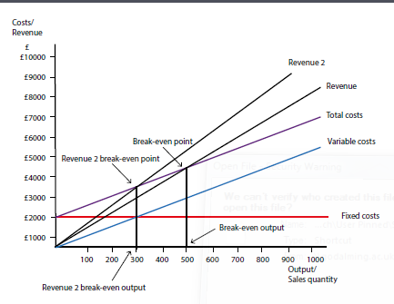
Example of an increase in price
An increase in the price of the boxes from £9 to £11 will change the total revenue line (Revenue 2), it becomes steeper
TR will cut the total cost line sooner, resulting in break-even at a lower level of output.
If the price was reduced then the opposite would happen and the break-even point would be at a higher level of output.

Slide 9
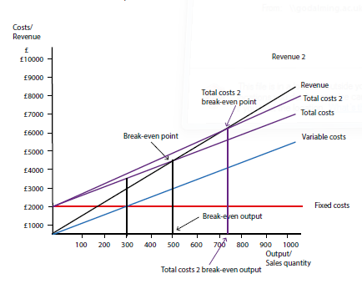
Example of an increase in variable costs
An increase in the variable cost will change the total cost line (Total costs 2).
It becomes slightly steeper and will cut the revenue line at a higher output level, resulting in break-even at a higher level of output.
If the costs were reduced then the opposite would happen.
If variable costs remained the same but fixed costs changed then this would result in a parallel shift in the total cost line.

Slide 10
Activities
Complete Question 1 on page 199 of the text book
30 minutes
Complete the Blue River Kayaks past paper question (answer all questions, in full, using correct technique)
30 minutes
Notes:
More likely 30 minutes and 20 minutes timings wise

Slide 11
Plenary
What would be your judgement for his question?
‘The failings and weaknesses of break-even analysis make it barely useful in the real world.’

Slide 12
Homework – Due Friday 25th October
Complete the BRK past paper question (started in class) in full.
Make sure you follow instructions re: exam technique for question d.
Complete the double sided knowledge recall exercises (try to complete these without looking at any notes – revise topic first, then complete)

