Slide 1
NEWSPAPERS
REPRESENTATION AND IDEOLOGY

Slide 2
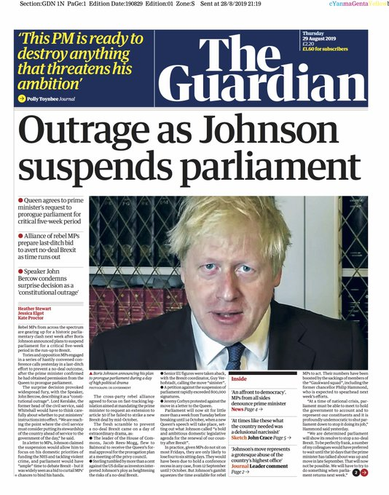
THE GUARDIAN
Newspaper front pages in the UK (and beyond) on Thursday 29 August 2019 were full of Brexit drama – with most of the papers high critical of the Prime Minister’s decision to suspend parliament.
The Guardian called it a ‘constitutional outrage’

Slide 3
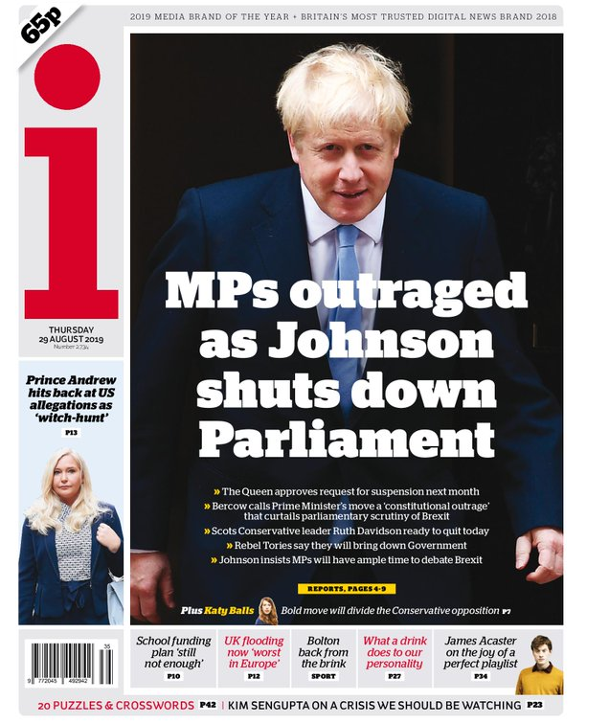
THE i
The i has a similar headline: “MPs outraged as Johnson shuts down Parliament” but also teases an opinion piece on its front page that calls Johnson’s decision a “Bold move [that] will divide the Conservative opposition”.

Slide 4
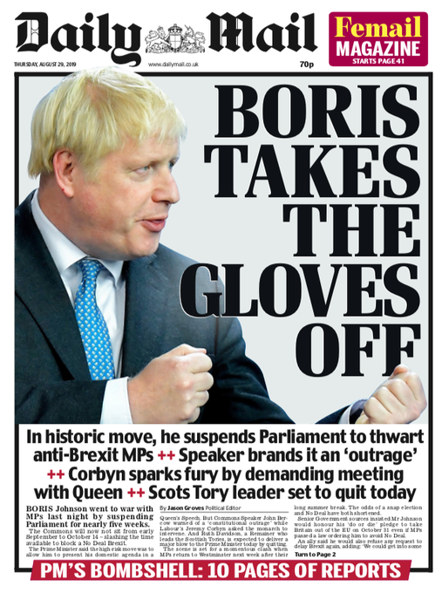
DAILY MAIL
According to the Mail’s telling, it was not the Prime Minister but Jeremy Corbyn who sparked “fury” by demanding a meeting with the Queen. The paper is far more positive about Johnson’s decision, calling it a “historic move … to thwart anti-Brexit MPs”.

Slide 5
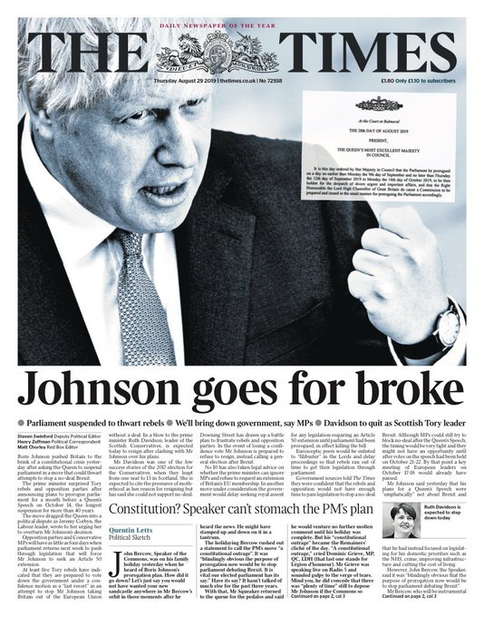
THE TIMES
The Times’ front page features a large, flattering black and white photo of the prime minister under the headline “Johnson goes for broke”. While it leads with the fact that the news has “pushed Britain to the brink of a constitutional crisis”, it also features a front page sketch in which it mocks Speaker John Bercow who challenged the constitutionality of Johnson’s decision. “John Bercow, Speaker of the Commons, was on his family holiday yesterday when he heard of Boris Johnson’s prorogation plans,” writes Quentin Letts. “How did it go down? Let’s just say you would not have wanted your new sandcastle anywhere in Mr Bercow’s orbit in those moments after he heard the news. He might have stamped up and down on it in a tantrum.”

Slide 6
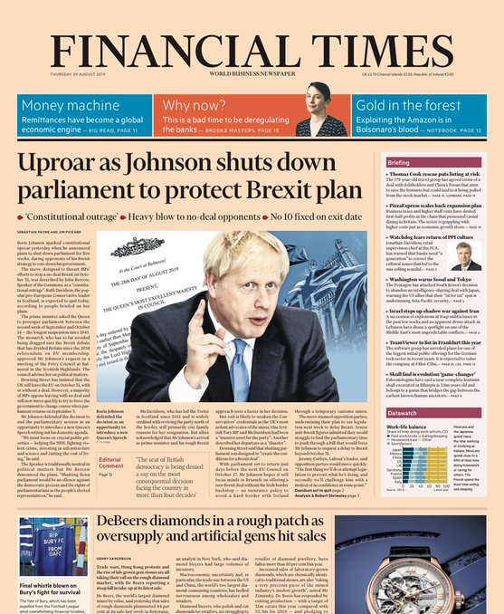
THE FINANCIAL TIMES
The FT focuses in on the implications for the constitution: “Boris Johnson sparked constitutional uproar yesterday”, says the paper. Bercow’s “constitutional outrage” comments are prominently featured.

Slide 7
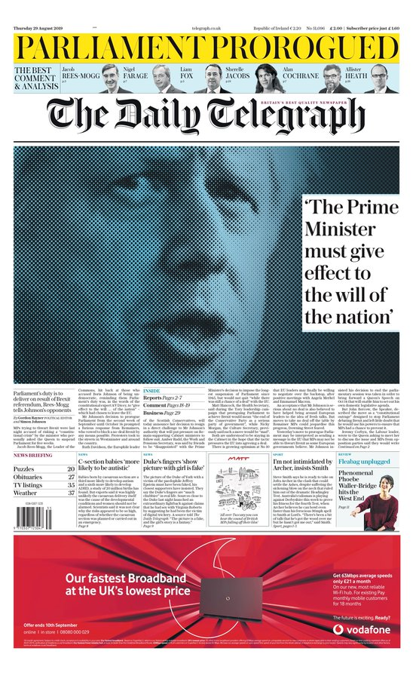
THE DAILY TELEGRAPH
The Telegraph, which employed Boris Johnson as a columnist, is very positive about his decision, leading on Jacob Rees-Mogg’s accusation that it is “MPs trying to thwart Brexit” – and not the proroguing PM –who are risking a “constitutional crisis”.
“Jacob Rees-Mogg, the Leader of the Commons, hit back at those who accused Boris Johnson of being undemocratic, reminding them parliament’s duty was, in the words of the constitutional expert AV Dicey, to ‘give effect to the will … of the nation’ – which had chosen to leave the EU.”

Slide 8
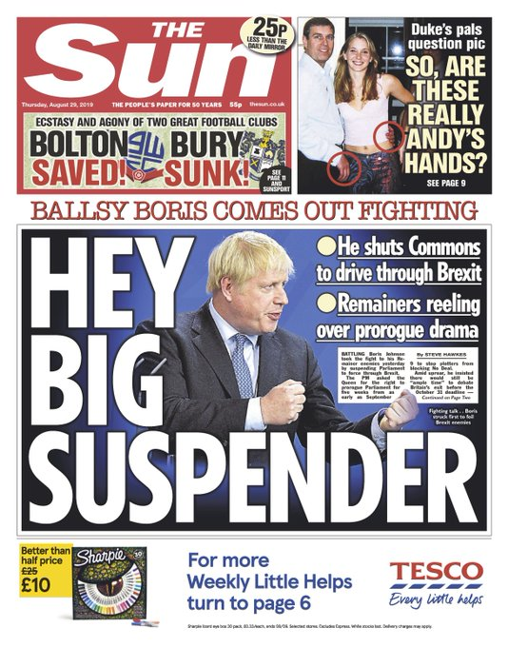
THE SUN
The Sun says “Ballsy Boris” has “come out fighting”: “Battling Boris Johnson took the fight to his Remainer enemies yesterday.” The paper also wins the award for best headline: “Hey big suspender”.

Slide 9
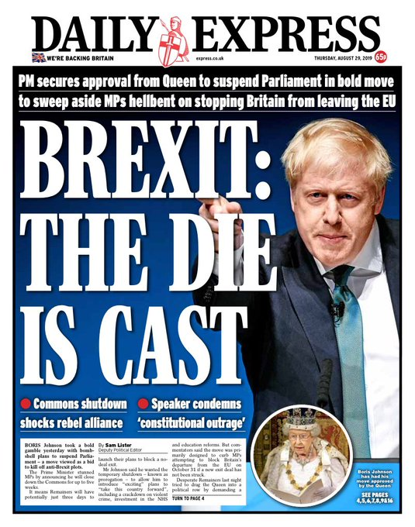
DAILY EXPRESS
The Express is thrilled with the proroguing, writing: “PM secures approval from Queen to suspend Parliament in bold move to sweep aside MPs hellbent on stopping Britain from leaving the EU”. It attempts a bit of a sleight of hand by suggesting that by granting the suspension, the Queen must be in favour of it, with a picture of Her Majesty captioned: “Boris Johnson has had his move approved by the Queen”.

Slide 10
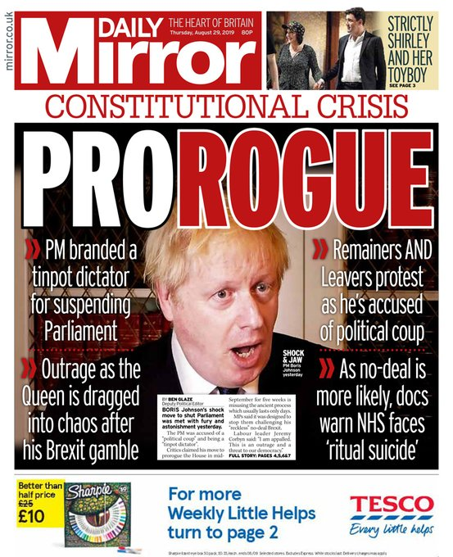
DAILY MIRROR
On the other end of the spectrum, the Mirror is furious, dubbing Johnson a “Prorogue” and saying he has been “branded a tinpot dictator for suspending Parliament” and that a no-deal Brexit could lead the NHS to face “‘ritual suicide’”. The paper also has a very different take on the Queen’s involvement, saying there was “outrage” at her being “dragged into chaos”.

Slide 11
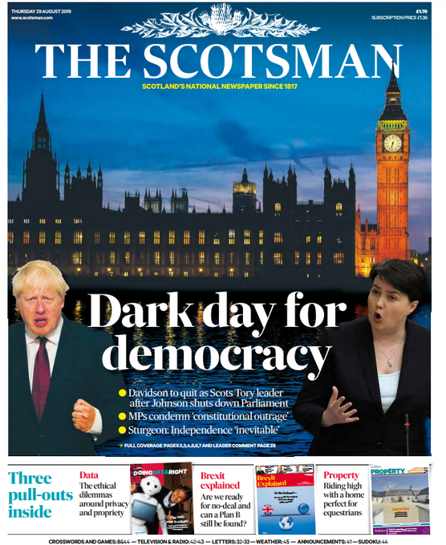
THE SCOTSMAN
The papers in Scotland understandably led on the news that Ruth Davidson, leader of the Scottish Conservative party, was likely to quit over her unhappiness with Johnson. The Daily Record, which called Wednesday “the day democracy died”, reported comments from Nicola Sturgeon, Scotland’s first minister: “If Ruth can’t stand him then why should we?”

