Slide 1
Sources of Finance
The role of the finance department and sources of finance for large firms
Question: which sources of finance are available / will be easier to access for established and large businesses – why?

Slide 2
Learning Objectives
Explain the sources of finance available to established and large businesses and consider their appropriateness for different circumstances.
Understand that sources of finance can be internal and/or external.
Explain the advantages / disadvantages of different sources of finance and the importance of choosing appropriate sources.
Evaluate the different sources of finance available to a business and its stakeholders.

Slide 3
The importance of the finance department
Finance is important to business as they have to know how financially viable it is and need to balance profit and costs.
Responsibilities include:
Preparing and creating financial account (profit and loss accounts and balance sheets)
Keep and maintain financial records: sales and expenditure records
Prepare and plan internal financial information: e.g. budgets
Analyse current financial performance: ratio analysis
Pay creditors (people the business owes money to).
Pay employees wages and salaries

Slide 4
Thinking Activity
Think & Share
Can you think of any businesses that have failed due to financial problems
OR
Businesses that have found themselves in trouble due to financial problems

Slide 5
Recap: Internal sources of finance
Retained Profit: This is profit after tax. 65% of all business finance is sourced in this way.
Working Capital: Money which is has been invested in the organisations and has been used to run it.
Sale of Assets: Machinery, land, buildings (if no longer needed)

Slide 6
Recap: External Short Term
Bank loan: must be repaid, written agreement.
Bank Overdraft: Flexible can be expensive
Hire Purchase and leasing: Normally used to purchase Capital Goods (medium term)
Trade Credit: Purchase of materials or goods normally within 30-90 days
Factoring: normally taken on by banks. Factors will pay 80% of the debt
Credit cards: Day to day expenses of an organisation normally for travel or accommodation.
Government assistance, Business Start up schemes

Slide 7
Recap: External (long-term)
Bank Loan : this can be secured from a range of sources
Commercial Mortgages: property is used as security against the loan.
Sale and leaseback: involves the business selling assets to a finance company and the leasing the asset back
Venture capitalists(Venture Capitalists eg 3i)
Share Capital: Only for Limited companies. Types of shares are, ordinary, Preference, Deferred.

Slide 8
Sources of finance for companies: Shares (Shareholders are part owners of a company)
Ordinary Shares (Equities):
Ordinary shareholders have voting rights
Dividend can vary
Last to be paid back in event of collapse
Share price varies with trade on stock exchange
Preference Shares:
Paid before ordinary shareholders
Fixed rate of return
Cumulative preference shareholders – have right to dividend carried over to next year in event of non-payment
New Share Issues – arranged by merchant or investment banks
Rights Issue – existing shareholders given right to buy new shares at discounted rate

Slide 9
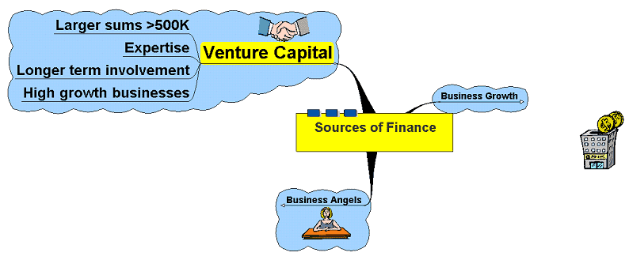
Sources of finance for companies: Venture Capital

Slide 10
Venture Capital
Pooling of capital in the form of limited companies – Venture Capital Companies
Looking for investment opportunities in fast growing businesses or businesses with highly rated prospects
May also buy out firms in administration who are going concerns
May also provide advice, contacts and experience
In the UK, venture capitalists have invested £50 billion since 1983

Slide 11
Which sources of finance are available / will be easier to access for established and large businesses?
Share capital
Venture capitalist
Factoring
Long term sources
Retained profit / working capital

Slide 12
Activities
Read pages 8 and 9 of the Sources of Finance workbook started last lesson
Complete the rest of the table on pages 6 and 7 (from sale of assets)
Complete the scenarios on pages 10 and 11. Remember, you must choose the most suitable source of finance. You should justify your choice.
30 minutes

Slide 13
Plenary

Slide 14
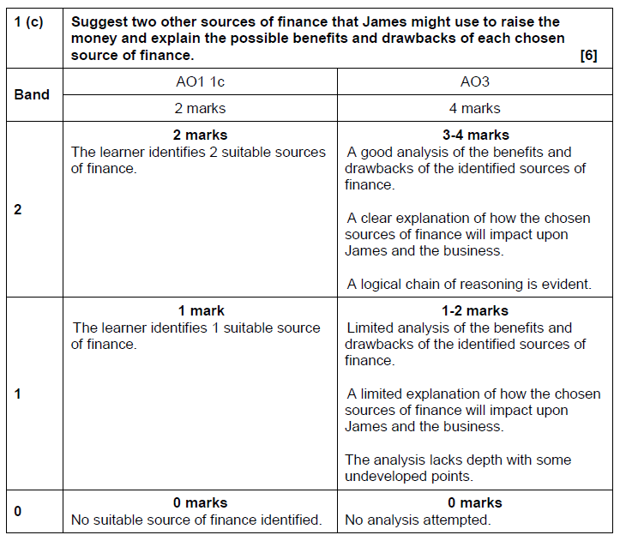

Slide 15
Homework - due Wednesday 2nd December
Fully complete the scenarios on pages 8 and 9 of workbook started in class
Answer the past paper question (Bobo Buddies on page 12) using full exam technique
Upload your sources of finance workbook to The Teams Assignment before our lesson on Wednesday 2nd December

