Slide 1
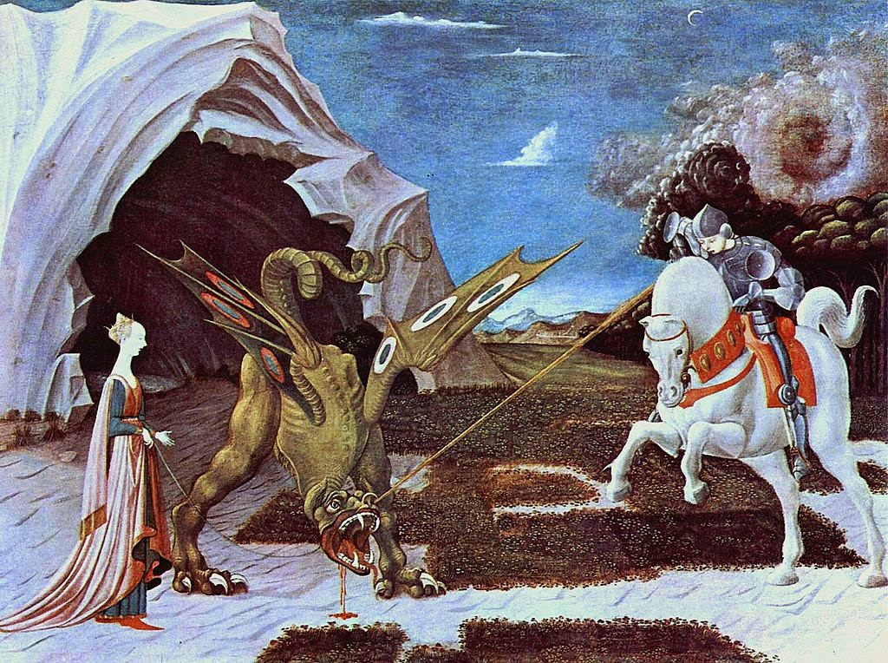
Jerusalem Week 10
Reading on to Act 3 – foolish comedy

Slide 2
P70-71
Johnny – series of questions to engage Dawn
Dawn providing identity for Johnny “Spiderman … Supertramp” – sarcasm Reference to the importance of labels and identity within the play as a whole.
Repetition of imperative “come over here” (x3) “Look” (x4) and question “Did you see” (x3) hypnotic effect
“There now” – idiomatic phrase used to a child – power of Johnny.
Repetition of “suit yourself” p 63 adding to a sense that this is a structured vignette – with a beginning and an end.
Stage directions reveal Johnny playing a role: his reassurance disappears when he is alone. (“He eyes the wood nervously”) He anticipates the threat arriving. Suspense builds.

Slide 3
Reading On…
Each group has one area on which to focus: p 72, 78-79, 80-81, 82-84
In your group answer the questions, making sure that EVERYONE in the group is taking notes.
Your job is then to teach the extract you have been given. Everyone else will take notes, and should ask if anything is unclear.

Slide 4
Your Guidance – p72
How does the language of Lee contrast with that of Tanya?
What other contrasts are evident in this extract? Are the contrasts used for comic effect, and if so, how?
What is comic about the language that is being used here?
What relevance has this extract got to the rest of the play?
Why does Butterworth include it?
REMEMBER: STYLISTIC, DRAMATIC, CONTEXT
SOME EXTRA RESEARCH…
Ley Lines – Theories about the alignments of monuments and natural landscape features, leading to ideas that ley lines have spiritual power or resonate a special psychic energy.
A FEW NOTES:
Theme of change: central to the play “New horizons” etc
“This is holy land” – by implication this gives Johnny a spiritual dimension
Contrast of the characters’ speech: Lee looking outwards and into the future, Tanya looking back, and at herself and Lee.
Tanya’s language is figurative, but predictable and clichéd in “no strings” – but the euphemism of “Eat my peaches, don’t shake my tree” is metaphorical and humorous in its euphemistic nature

Slide 5
Your Guidance – p 78-9
What relevance has this extract got to the rest of the play?
Are there any motifs that are repeated from elsewhere in the play?
What events precede it? Is there a contrast?
Do we sympathise with Johnny?
What do you notice about the use of names in this extract?
What type of language do the characters use? (questions/taboo/statements) What does the language they use reveal about their character?
Why has Butterworth included this extract in the play?
REMEMBER: STYLISTIC, DRAMATIC, CONTEXT
A FEW NOTES:
“spiderman” – ref. p 70 – Johnny has taken Dawn’s words and echoes them – indicating a connection between them
Apparently unable to answer the question about “Jerusalem” draws attention to the word: stops the play on that word - metatheatrical
Humour of rhyming: “Bucolic Alocholic Frolic” – high register, low frequency words – indicating a character who works and manipulates language
Johnny parodies the host- welcoming Troy in language that is full of questions, and self-consciously suggests respect in the term of address: “Mr Whitworth”
Contrasts of terms of address: “Mr Whitworth” “Troy” “gyppo” “Byron” refers to teenagers as “rats” – ref to the girls first appearing from under the trailer, perhaps.

Slide 6
Your Guidance – p 80-1
What relevance has this extract got to the rest of the play?
Are there any motifs that are repeated from elsewhere in the play?
What events precede it? Is there a contrast?
Do we sympathise with Johnny?
What type of language do the characters use? (questions/taboo/statements) What does the language they use reveal about their character?
Can you comment on the use of the names in this extract?
Why has Butterworth included this extract in the play?
REMEMBER: STYLISTIC, DRAMATIC, CONTEXT…..
A FEW NOTES
Troy uses imperatives: “Get rid of them. Now.” To assert power
Contrast of terms of address: Johnny uses “mate” (x2) v “pikey” “snake” etc. used by Troy – disintegration from insults relating to humans, to those relating to creatures.
P 81 Johnny goads Troy: trapping him in implication – the unanswered questions – “She your treasure?” etc Notice the shift of power – Johnny refers to him as “boy” (x4)
Speech about Troy and the cards: change of tone: figurative language “in the dead of night” and evocative adjectives “pitch dark” “silver” “blood-red”
Loss: “Got lost? Can’t find your way home?” – characters finding an identity and a direction. Time of change.

Slide 7
Your Guidance – pp 82-84
What relevance has this extract got to the rest of the play?
Are there any motifs that are repeated from elsewhere in the play?
What events precede it? Is there a contrast?
Do we sympathise with Johnny?
What type of language do the characters use? (questions/taboo/statements) What does the language they use reveal about their character?
What contrasts are there in terms of the way in which the characters speak?
Why has Butterworth included this extract in the play?
What relevance has the George and the Dragon story got to the play? Who is St George? Who is the dragon?
REMEMBER: STYLISTIC, DRAMATIC, CONTEXT
SOME EXTRA RESEARCH:
St George and The Dragon: S. George was a knight and born in Cappadocia. On a time he came in to the province of Libya, to a city which is said Silene. And by this city was a stagne or a pond like a sea, wherein was a dragon which envenomed all the country. And on a time the people were assembled for to slay him, and when they saw him they fled. And when he came nigh the city he venomed the people with his breath, and therefore the people of the city gave to him every day two sheep for to feed him, because he should do no harm to the people, and when the sheep failed there was taken a man and a sheep. Then was an ordinance made in the town that there should be taken the children and young people of them of the town by lot, and every each one as it fell, were he gentle or poor, should be delivered when the lot fell on him or her. ….When she was there S. George passed by, …. And said to them: Ne doubt ye no thing, without more, believe ye in God, Jesu Christ, and do ye to be baptized and I shall slay the dragon. Then the king was baptized and all his people, and S. George slew the dragon and smote off his head, and commanded that he should be thrown in the fields, and they took four carts with oxen that drew him out of the city. Extracts Taken from The Golden Legend compiled by Jacobus de Voragine, 1275
A FEW NOTES
Troy’s story: move from the third person narrator to the second person narrator – he knows that this is personal, this will hurt Johnny and addresses him directly. Short syntax to shock: “All overs you. On your face. In your hair. In your mouth.” – like punches. Troy and Johnny attack one another with words here – foreshadowing the physical violence. Ginger’s story about Troy’s eczema is a weak attempt to fight back.
Scene is peppered with pauses and silence: indication of the breaking down on this green world. The clearing is “empty” apart from the Professor.
The characters shift the blame: suggestion that Dawn was right that they don’t care about Johnny: focused on Ginger’s drug trip and Davey’s payment.
Prolepsis: “I’ll come back. I’ll iron this out” – repeated word for word – to create sense of resolution in the future – engaging the audience
Stage directions: indication of change, of uncertainty – we are denied the end of a sentence – we hold our breath with Phaedra

Slide 8
Visual Comedy

Slide 9
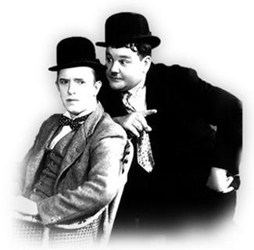
Visual Comedy (one Element of Slapstick)
harmless violence and horseplay
comedic timing and a controlled physical performance
ill-fitting clothes
funny faces
looking ridiculous, accompanied by incongruous objects
incongruous actions
falling over, tripping up.

Slide 11
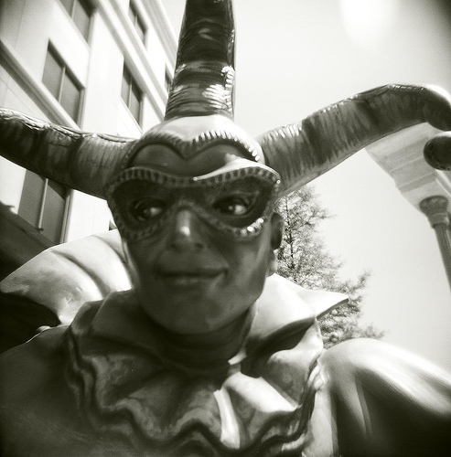
The fool as a comic convention:
two types:
the licensed fool paid to entertain, (the jester, the stand-up comedian)
the natural fool (simple, often lower-class characters in Shakespeare, who lack common sense or intelligence, but sometimes provide insights.)

Slide 12
pp 85-87 - Spot the comedic feature: tick list
harmless violence and horseplay
comedic timing and a controlled physical performance
ill-fitting clothes
funny faces
looking ridiculous, accompanied by incongruous objects
incongruous actions
falling over, tripping up.
Paronomasia
Parody of language
Natural fool
Visual/Physical comedy (other)

Slide 13
Comedy Features
Paronomasia – “corporal”
Parody of language – “Permission to take hat off”
Natural fool – “What? What hat?”
Visual/Physical comedy – hat and coconut/confusion of actions

