Slide 1
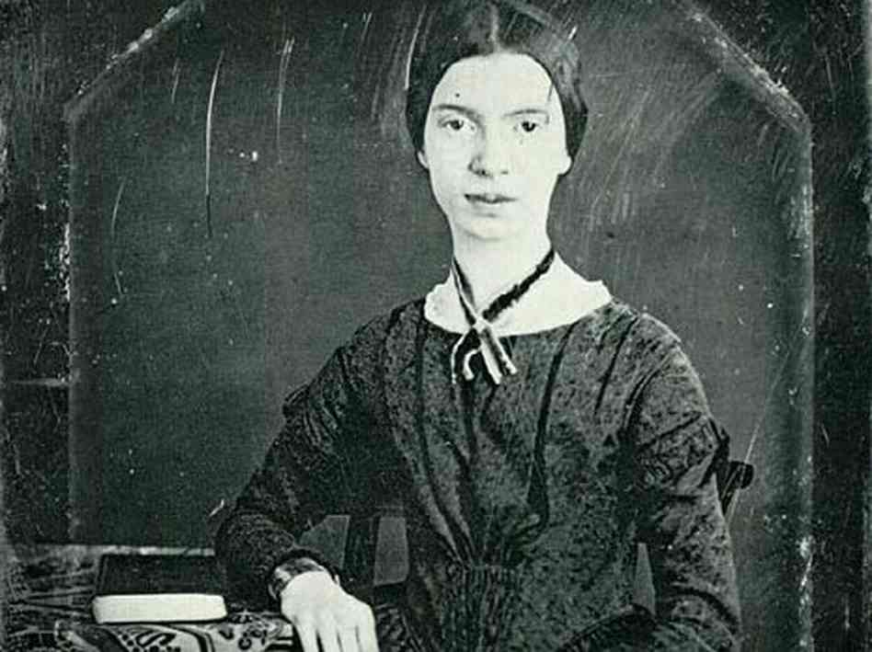
The Author
Week 2

Slide 2
Where we left it last week:
Politics is pervasive
Language is constitutive
Truth is provisional
Meaning is contingent
Human nature is a myth

Slide 3
Aims:
to examine how to find the author and how valid it is to look for him/her
to introduce some terms for the author as a function
to look at a seminal essay on the concept of the author
to think about how important we think the author is

Slide 4
Your task
Look at the painting you have in front of you.
Note down what you think the painting means, and whether it contains any symbolism within it.

Slide 5
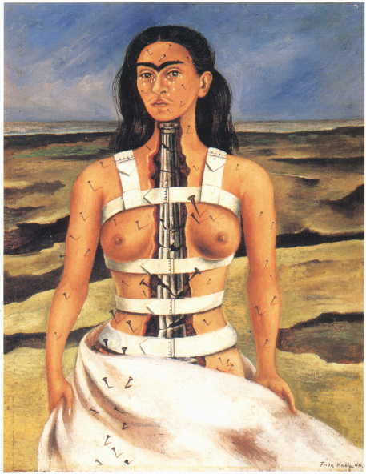

Slide 7
Who is?
Jane Austen
How do you know?
"Jane Austen" is a historical figure.
"Jane Austen" is a set of traits associated with our expectations of her (the Austen industry).
"Jane Austen" is a set of traits that the reader "finds" in the text.

Slide 8
Some terms….
Textual or implied author is one built up as a picture from reading a work. A textual author is a virtual image of the author's attitudes, as presented by the text.
Composite author is one built up from reading a range of works.
Worth thinking about … the idea that the textual, implied or composite author may be very different from the "real-life" individual. We could have a sense of a person and personality to which we could give the name "Jane Austen" even without reading any biographical evidence.

Slide 9
What if …
"To attribute work to a single author is to imprison it in the imagined self of its individual producer."

Slide 10
Your task:
You have been given a section of Barthes' essay.
You are responsible for reducing your section to a sentence.
Who thinks the author is important? Why? Who thinks he/she is not? Why not?

Slide 11
According to Barthes:
The birth of the reader must be at the cost of the death of the author.

