Slide 1
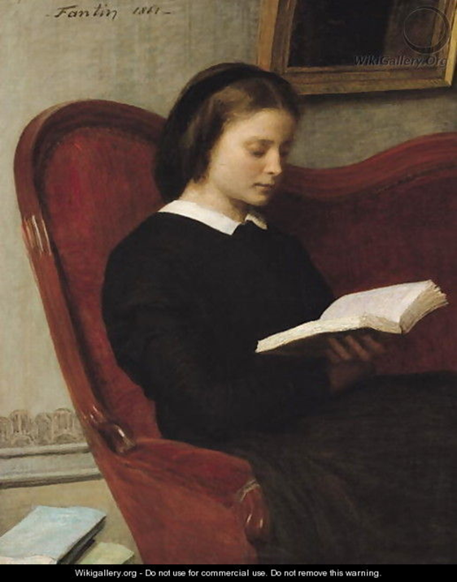
The Reader
Week 3

Slide 2
Aims:
to revise the intentionalist fallacy
to examine what determines meaning
to introduce some theory about "the reader" and some terms for the different types of readers
to question the role of the reader.

Slide 3
Look at the poem below:
_ _ _ _ _ _ _ _ _ _ _ _ _ _ _ _ _ _ _ _ _ _ _
The apparition of these faces in a crowd;
Petals on a wet, black bough.
_ _ _ _ _ _ _ _ _ _ _ _ _ _ _ _ _ _ _ _ _ _ _
Your task is to add a third or a first line to create a three line poem that contains some sort of symbolic meaning.
Then, summarise the meaning of your three line poem on a separate piece of paper in no more than 10 words.
Notes:
Ezra Pound 1913 an imagist poem – nb no verbs. "In a Station of the Metro" – he reduced it from 30 to 2 lines…. imagist poetry is (in part) about reduction…

Slide 4
What determines meaning?
Intention?
Reader?
Text?
Context?
Notes:
Discussion about which is most important.

Slide 5
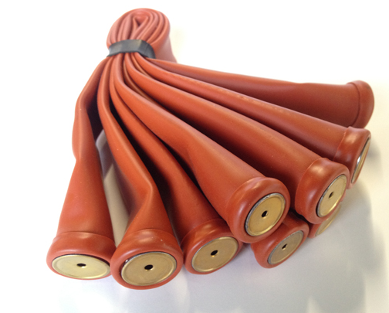
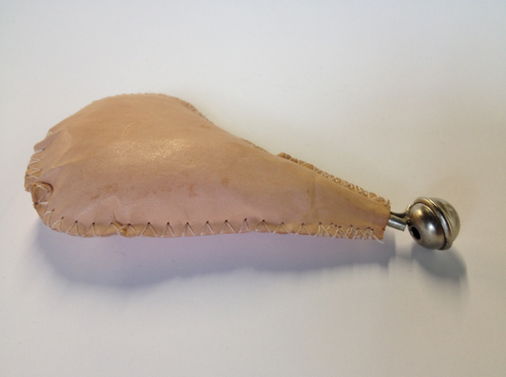
What is the story that connects these three things?
Notes:
They are all instruments that make bird calls: the starling, the house sparrow, an aubudon (an instrument that can make a multitude of bird calls) How do they create the stories? On what are they drawing (their experiences/knowledge/bias/intention)? On white board: What determines meaning? Intention? Reader? Text? Context? Discussion about the way in which we make sense of things. The need to create a story, but that the story is always created from a context, of our understanding of words, of concepts, from our gender, class, race bias. All immersed in an ideology of which we are unaware

Slide 6
What the Reader Response Theorists would surmise….
Meaning is both what we understand, and what in the text we try to understand.
It is context bound in the sense that context includes the rules of language, the situation of the author and that of the reader.
Stories are the way we make sense of things. We create a narrative, and our narrative depends on context.

Slide 7
Influential Critics …
Stanley Fish in 1980 started talking about "the reader" and was the primary mover behind the Reader Response theory: "Twenty years ago one of the things that literary critics didn't do was talk about the reader, at least in a way that made his experience the focus of the critical act." (Is there a Text in this Class? The Authority of Interpretive Communities, Cambridge, MA and London, Harvard University Press)
Jacques Derrida in 1981 argued that all reading is "transformational", and warned against reading "according to a … method which would seek out a finished signified beneath a textual surface." (Positions, Bass, Alan (trans.), London: Athlone Press)
Notes:
There was a subtle move of critics from talking about "we" to saying "I".
Increasing awareness of bias (gender and class, for example) Also worth looking at Umberto Eco (1981) The Role of The Reader: Explorations in the Semiotics of Texts London, Hutchinson

Slide 8
Some terms….
Intended reader:
written with a particular reader in mind.
Implied or inscribed reader:
the reader who is written into the text.
Intended/informed/ideal/optimal/super reader:
one who is a competent speaker of the language, is in full possession of idioms etc and has literary competence.
Umberto Eco (1981) The Role of The Reader: Explorations in the Semiotics of Texts, London: Hutchinson
Micheal Riffaterre (1978) Semiotics of Poetry, London: Methuen.

Slide 9
What does this mean?
Thus Roman Ingarden confronts the structure of the literary text with the ways in which it can be konkretisiert. The text as such offers different "schematised views" through which the subject matter of the work can come to light, but the actual bringing to light is an action of Konkretisation. If this is so, then the literary work has two poles, which we might call the artistic, and the aesthetic ...
Wolfgang Iser "The Reading Process: A Phenomenological Approach" (1972)
Notes:
We can't understand it – because we are not the "optimal reader". We lack the vocabulary/the knowledge to understand it.

Slide 10
Milton, Sonnet XX: what do these two lines mean?
He who of those delights can judge, and spare
To interpose them oft, is not unwise.
it is either a recommendation for the delights: either he who can leave time for them is not unwise
or a warning: he who knows when to refrain from them is not unwise.
Notes:
Explain how over decades and decades critics have failed to agree on the meaning of the word "spare" No matter what primary evidence they have drawn on, they cannot agree. The question should not surely be on what the word means, but on why no one can agree. There are clearly meanings that cannot be pinned down by intention, context, author or text, and the meaning ultimately lies with the (empirical) reader. The responsibility lies with him/her.

Slide 11
Reader Response Theory…
What sort of procedures do readers follow in responding to works as they do? What sort of assumptions must be in place to account for their reactions and interpretations? The meaning of the text is the experience of the reader (an experience that includes hesitations, conjectures, and self-corrections) Meaning is created in negotiation between reader and text emphasis on personal response to literature. If a literary work is conceived as a succession of actions upon the understanding of a reader, then an interpretation of the work can be a story of that encounter: various conventions or expectations are brought into play, connections are posited, and expectations defeated or confirmed. The work is the experience of the reader.

Slide 12
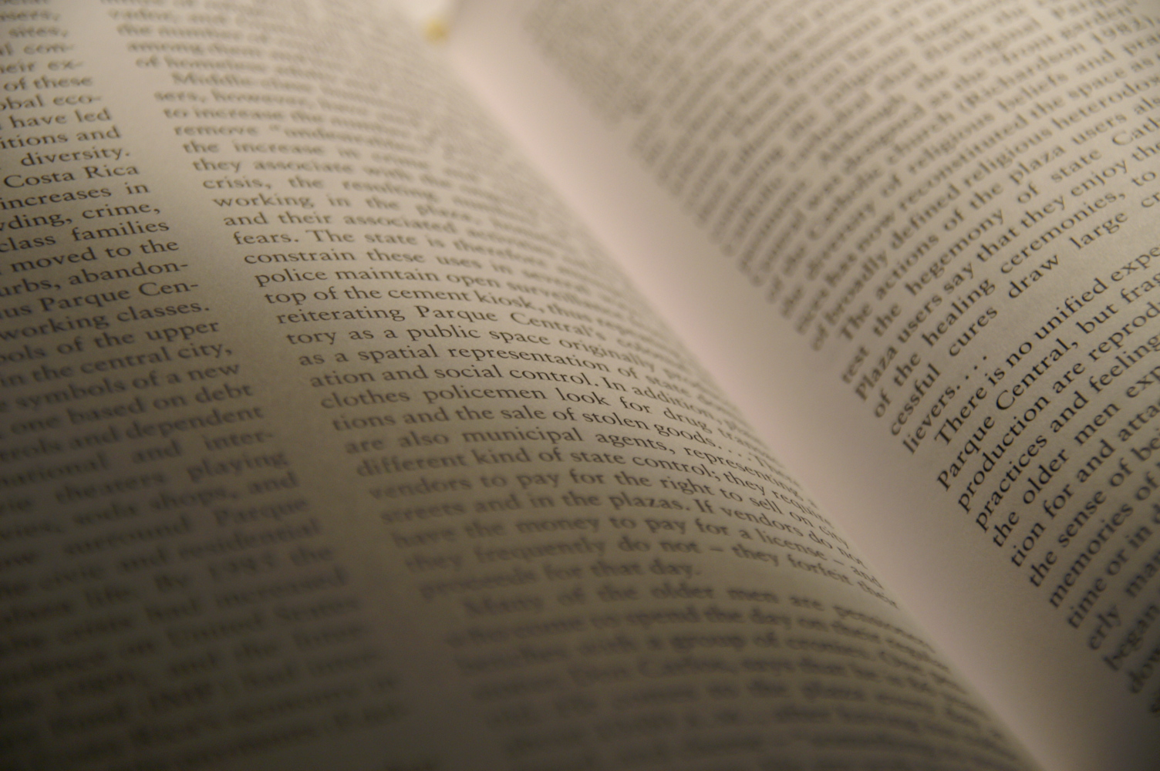
Next Week:
The Text

