Slide 1
Narratology (Gerard Genette)
Week 7
noun \ner-ə-tä-lə-jē / n. L.20 [Fr. narratologie, f. as NARRATIVE: see –OLOGY.]
Notes:
Aims of the session are to look at one aspect of narratology, which is a huge subject. Many, many books have been written on a subject that has been around since the 1970s. There are several theorists, but the focus here is on Genette, who provides accessible classifications. 5 mins

Slide 2

Pull it apart – what does it mean?
f. gnarus knowing
Gk logikē (tekhnē) of reason, f. logos reasoning, discourse
Notes:
Ask the students to think about the word “narratology” in a post-structuralist way. Given the information on the slide, what do they think that it means? Discussion as a class.
Stress that this is a flavour of narratology: not responding to the word as a whole, but breaking it down to find patterns, etymological sources, derivations. Link to next slide …. 5 mins

Slide 3

History
The past (Liberal Humanists) = thinking about a work as being unique and bound to the author
The present (Structuralists/Post-Structuralists) = thinking about a work as a series of patterns
Notes:
Tendency to focus on the authorial intentions, on bibliography etc – move to a new way of thinking about the text as being de-contextualised. This is the structuralist/post-structuralist tendency. 2 mins

Slide 4



Three words … what’s the difference?
The story
The plot
The narrative
Notes:
Students to discuss the difference. Teacher to outline the fact that narratology became very popular in the structuralist movement in France in the 1970s, but Propp (in 1938) was already making the distinction between the “fabula” (the story) and the “sjuzhet” (the form that the story takes, and the way that it is told). Link to next slide… This leads us to the essence of “narratology”… 5 mins

Slide 5
So … what’s the difference?
Propp (in 1938) made the distinction between the "fabula" (the story), which is the content of a text
and the "sjuzhet" (the plot) which is the form the story takes, and the way that it is told
Notes:
Students to discuss the difference. Teacher to outline the fact that narratology became very popular in the structuralist movement in France in the 1970s, but Propp (in 1938) was already making the distinction between the “fabula” (the story) and the “sjuzhet” (the form that the story takes, and the way that it is told). Link to next slide… This leads us to the essence of “narratology”… 3 mins

Slide 6
Narratology: what is it, then?
It is the study of the function and structure of narrative.
It examines the form taken by the text.
It focuses on the positions of the narrators, and how their positions affects our understanding of what they tell us.
It classifies the conventions, and the patterns of words and themes in a text.
Notes:
5 mins

Slide 7
“how”, not “what”.
The essence is that …
you no longer look at WHAT is being narrated.
you look at HOW something is being narrated.

Slide 8
Gerard Genette (1930-2018)
Four main categorisations:
Narrative Levels
Narrative Mood
Narrative Distance
Narrative Time
Notes:
French theorist – in the wake of structuralists, Levi Strauss, Todorov, Propp etc. 5 mins

Slide 9
LEVELS of narration – or diegetic levels: the levels at which the narrating act and the narratee are situated in relation to the narrated story.
Main plot – also called extradiegetic (the primary narrative, often told from outside the fictional world)
Event story – also called intradiegetic (a story that exists within the story world of a text)
Second level narrative act – also called intradiagetic
Embedded narrative – also called metadiegetic – often also metaleptic (where the narrator intrudes on the narrative)
Notes:
Genette subdivides his taxonomy of narratology into many categories. We are going to focus on four of them. The first of those is what he terms “level” of narration. Discuss in pairs what they think each mean. Come up with their own explanation (or example) for each. Share with another pair. Discuss as a class. Link to next slide – the theory into practice

Slide 10
Theory into Practice
Main plot (narration of story): “’T’was…”
Event story “a dark and stormy night and three men sat in a cave and one of them said…”
Second level narrative act “Listen, I am going to tell you a story….
Embedded narrative “’T’was a dark and stormy night and three men sat in a cave…”
Notes:
5 mins

Slide 11
E.g. Applied to The Great Gatsby
These are in not in order. Order and classify according to Main plot (narration), Event Story, Second Level Narrative Act, Embedded Narration.
Gatsby’s first love affair with Daisy back in her hometown
Gatsby asking Daisy over to Nick’s to recapture her attentions
Jordan, in the Plaza hotel, telling Nick about Gatsby and Daisy in the past
Nick, telling us about the previous summer
Notes:
5 mins

Slide 12
Eg Applied to The Great Gatsby
These are in not in order. Order and classify according to Main plot (narration), Event Story, Second Level Narrative Act, Embedded Narration.
Main plot (narration): Nick, telling us about the previous summer
Event Story: Gatsby asking Daisy over to Nick’s to recapture her attentions
Second Level Narrative: Jordan, in the Plaza hotel, telling Nick about Gatsby and Daisy in the past
Embedded Narrative: Gatsby’s first love affair with Daisy back in her hometown
Notes:
5 mins

Slide 13
Putting it into Practice ...
Today, we are in a lesson. During this lesson my teacher will say, “Think of narratives as independent linguistic objects, detached from their context of production, that reveal an underlying structure. My teacher will also tell us that Gerard Genette said, “Narrative does not ‘represent’ a (real or fictive) story, it recounts it...”
Your turn: write a mini story illustrating Genette's Narrative Levels.
Notes:
Today (main plot) during the lesson my teacher (event story) “think of narratives” (2nd level narrative act) “Narrative does not...” (embedded narrative) 20 mins

Slide 14
Terms: worth considering …
These terms can be applied to narrators:
A homodiegetic narrator is also a character in the story.
An extradiegetic narrator is outside the narrative.
An intradiegetic narrator: when a character of the extradiegetic narrative relates another character's story, he or she becomes an intradiegetic narrator.

Slide 15
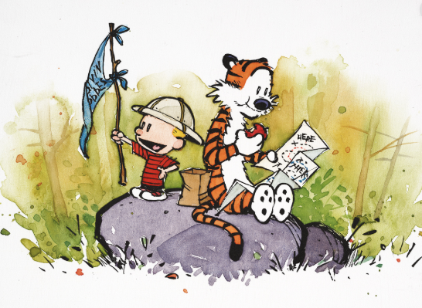
Next Week

