Slide 1
Business Functions
Business Finance

Slide 2
Cash Flow Forecasting
Cash is King!
Discuss......
Business Finance

Slide 3
Starter
Think & Share
How would you define ‘cash flow’?
Come up with two examples of ‘inflows’ and two examples of ‘outflows’?

Slide 4
Learning Objectives
Explain what is meant by cash flow
Explain what is meant by a cash flow forecast
Construct, calculate and interpret cash flow forecasts

Slide 5
Key Terms
Cash flow: the continuous movement of cash in and out of the business
Cash flow forecast: showing the expected flows of cash in and out of a business
Cash flow statement: shows an historic view, showing the actual flows of cash in and out of the business

Slide 6
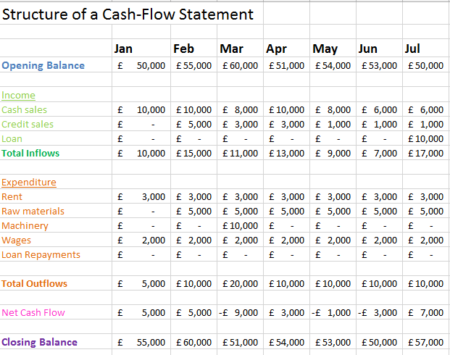
Cash Flow Forecast Structure

Slide 7
Purpose of cash flow forecasting
To anticipate potential shortages of cash
To examine and possibly adjust the timings of receipts and payments in order to avoid problems
To arrange financial support

Slide 8
Benefits of cash flow forecasting
An accurate cash flow forecast will allow a firm to get a clear idea of how the business is doing - and how it is likely to perform in the future
Allows managers to be able to specify times when the business may need additional funding, such as when cash outflow exceeds inflow
Inconsistencies in performance can be identified, predicted and remedied
Changes in inflows and outflows resulting from major new investments can be accurately assessed

Slide 9
Problems of cash flow forecasting
Inaccurate market research (e.g. sampling errors or interviewer bias)
Changing tastes (fashion and tech)
Competitors (actions cannot be predicted)
Economic changes (changes to inflation, economic growth, unemployment)
Uncertainty (estimation of costs, the longer the time scale the less accurate the forecast is likely to be)
Drawing up the cash flow forecast takes up managers time

Slide 10
Activity 1
Using what you have learnt by completing the Andrew Nut Cash Flow Forecast as a class, independently complete the CFF for Albert Spanner
Carefully read the case study, enter the data into the cash flow forecast and carry out the calculation
20-30 minutes
Notes:
5 minutes going through answers for Activity 1 – 5 minutes for activity 2
Extension: knowledge questions on page 210 of HJR

Slide 11
Activity 2
Read the Cash Flow Forecasting notes (at the very top of the CFF GOL page):
1. Summarise the benefits and limitations of cash flow forecasting
2. Answer the following questions:
What is the difference between a cash flow statement and cash flow forecast
Explain why cash flow forecasts can sometimes be a rough estimate
Explain three reasons for cash flow problems
Describe at least three methods of solving cash flow problems. Are there any disadvantages to these methods?
How can a business improve its cash flow problems in the longer term.

Slide 12
Plenary
Explain what is meant by cash flow
Explain what is meant by a cash flow forecast
Why is cash king?

