Slide 1
Jerusalem Week 11
“It’s over…”
Notes:
Introduction. Aims and objectives: to finish the play, to bring together the strands of this text, to produce a piece of non-fiction writing guiding a first year A Level student on how to answer the exam question.

Slide 2
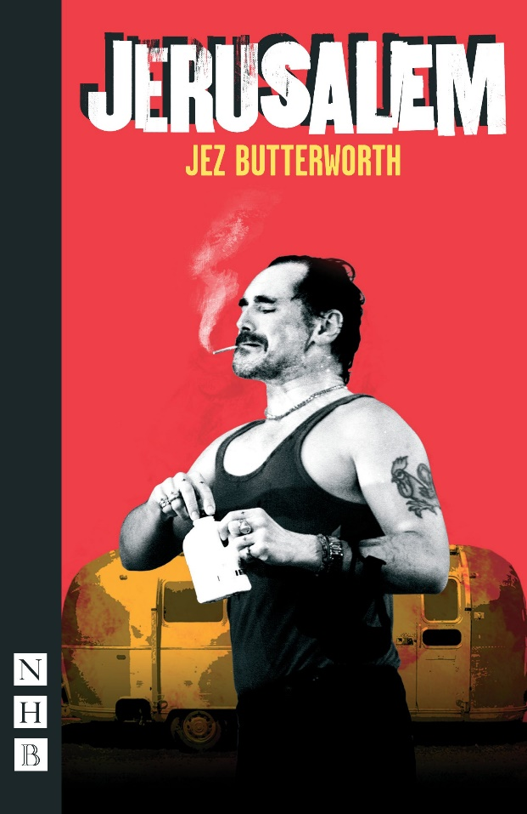
Running Commentary…. You each have one quote. Offer a sentence of stylistic/dramatic/contextual analysis.
“Hear ye…. Hear ye!” p 98
“Enter the Professor garlanded with flowers” p 99
“I feel suddenly light …. Like pure light." p 99
“Wild garlic and the May blossom” p 99
“With the merry ring” p 100
“Hurry up. Time’s running out.” p 101
“I’ve seen a lot of strange things in this wood.” p101
“I can’t believe that’s one year ago… Now I’ve only got five minutes”: p102
“Johnny stretches his arms wide, smiling” p 104
“Away, I said, I ain’t fooling, boy. Get away.” p 106
“I give ‘em a pint of my blood. And they give me six hundred pound” p 107
“A spitfire flies over…” p 108
I, Rooster John Byron…” p 108
“Relentlessly, he beats the drum….” p 109
Notes:
Each student has a piece of paper – they need to find their pair, and explain why they have made the connection.

Slide 3
Analysis
“Hear ye…. Hear ye!” contrasting worlds of the lexical clusters of the official (gavels, leaflets, warrants) and the anarchic and wild (wind, babes, blood, chalk) p 98
“Enter the Professor garlanded with flowers” Stage directions foreground the contrast between the power of warrants, enforced by the outside world (Fawcett and Parsons exit) and the natural (flowers, crown of blossom): professor assuming the costume of a king p 99
“I feel suddenly light …. Like pure light. “ Epiphanic moment as the Professor is released from his delusion. He is also released from Johnny – he does not need him any more. Sense of change (the winter is over.) p 99
“Wild garlic and the May blossom”: characters breathe the air (ref. p 91) – taking in something undefinable – the “true” ancient England? P 99
“With the merry ring”: refrain repeated three times in the play (p 45 Act 1, Act 3 p 9, p100): symbolising celebration and unity. P 100

Slide 4
“Hurry up. Time’s running out.” symbolic reference to Byron’s waning power (repeated references to time – it’s five to six, till six o’clock etc) p 101
“I’ve seen a lot of strange things in this wood.” lyrical poetic language, echoing the green man of the woods archetype – mythical and timeless p 102
“I can’t believe that’s one year ago… Now I’ve only got five minutes”: moving from the past to the present: both characters have been avoiding talking about the present – or the future. p103
“Johnny stretches his arms wide, smiling” stage directions suggest a Christ-like pose – supported by proxemics in the original production. Ginger also turns from him – rejecting him. P 104

Slide 5
“Away, I said, I ain’t fooling, boy. Get away.”: sacrificing his friendship with Ginger: Johnny has to finish alone. P 106
“I give ‘em a pint of my blood. And they give me six hundred pound”: to the end of the play, we are left questioning the truth of Johnny’s stories. Is it possible that this is where he gets his money, rather than from drug dealing? p107
“Lie. Cheat. Steal. Fight to the death. Don’t give up. Show me your teeth”: rhetorical style of speech here, seen in the use of triples. p107

Slide 6
“A spitfire flies over…” the official, empirical history of Britain, merging with the ancient, mythic history. p108
I, Rooster John Byron…” repetition from Act 1, p 50 – the power of language, here used to curse – the power of repetition (never, never, and may, and may etc”) p 108
“Relentlessly, he beats the drum….” The echoes of the drum have been heard throughout the play (“beat”) – natural culmination and climax – in the production you hear the sound of the giants – in the text, it is left ambiguous (ellipses). P 109

Slide 7
Benchmark Cohort A: Explore how Butterworth presents the story about Johnny Rooster Byron in this extract from Jerusalem. Ginger: weren’t always like that… keep the change love – and downs it in one. Walks out. Walks it off. pp 30-32
POSSIBLE STRUCTURE FOR YOUR JERUSALEM ESSAY:
One Hour – 32 Marks
Explore how Butterworth presents the story about Johnny Rooster Byron in this extract from Jerusalem. Ginger: weren’t always like that… keep the change love – and downs it in one. Walks out. Walks it off. pp 30-32
You should consider the use of dramatic and stylistic techniques in the extract, its significance within the play and any other relevant dramatic or other contexts
Open: with setting the scene in context: where does it appear in the play? What function does it have? What is it doing in terms of structure? Explain your conceptualised response to the theme/focus named in the question, and its relevance to the play as a whole.
First Section: give an analysis that is focused on dramatic features- the use of a prop to symbolise a theme, for example; the detailed analysis of stage directions and what they reveal about theme/character etc: each time giving specific examples, and analysing their use with reference to the theme/focus named in the exam question. Link your analysis to the wider context – another point in the play (the characteristic use of this feature by Butterworth) – an observation about the original production – a link to a reviewer’s comment, or one made by Butterworth/Rylance etc. Return to the question and hook into the next paragraph.
Section Section: add to your argument with a stylistic analysis, looking at syntactical parallelism, lexical repetitions/oppositions/clusters. Each time give a specific example, and analyse it. Consider the syntactical use in the extract: the choice of sentence types and moods and how they might shape the meaning of the play, in terms of the theme/focus named in the exam question. Link your analysis to the wider context – another point in the play (the characteristic use of this feature by Butterworth) – an observation about the original production – a link to a reviewer’s comment, or one made by Butterworth/Rylance etc. Return to the question and hook into the next paragraph.
Third Section: focus on discourse – on the features of power in terms of the language; on the supportive or combatative communication; on how the discourse features shape the character, or the theme. Link your analysis to the wider context – another point in the play (the characteristic use of this feature by Butterworth) – an observation about the original production – a link to a reviewer’s comment, or one made by Butterworth/Rylance etc. Return to the question and hook into the next paragraph.
Conclusion: give a conceptualised analysis of the focus of the question: an overview of way in which the lexical/syntactical use; the dramatic features shapes our understanding of this extract and of the play as a whole.

Slide 8
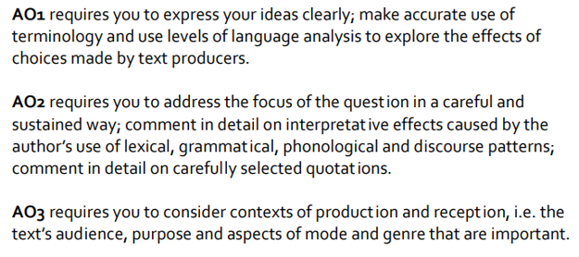
Cohort B: Write your own guidance
Your task is to complete an advice sheet on which you are advising first year A Level English Language and Literature students on how to approach the drama paper.
Consider:
What aspects you need to tackle (Stylistic, dramatic, contextual) and what each mean
What you should do
What you shouldn't do
What the examiners want. eg:
Notes:
Stress that this will be used next year for the up-coming cohort. Preparation for next week: the setting of the benchmark.

