Slide 1
Cash Flow Forecasting
Business Finance

Slide 2
Starter
Identify the typical reasons for variations between actual and forecast cash flows?
Explain 2 benefits and 2 limitations of preparing a cash flow forecast.

Slide 3
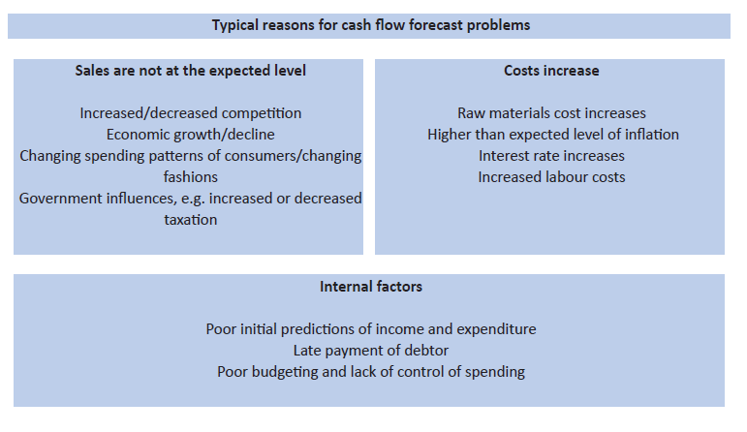

Slide 5
Learning Objectives
Explain the causes of cash flow problems and strategies to improve cash flow
Explain the benefits and limitations of cash flow forecasts
Evaluate the strategies a business uses to improve cash flow problems
Evaluate the impact of a cash flow forecast on a business and its stakeholders

Slide 6
Benefits of cash flow forecasting
An accurate cash flow forecast will allow a firm to get a clear idea of how the business is doing - and how it is likely to perform in the future
Allows managers to be able to specify times when the business may need additional funding, such as when cash outflow exceeds inflow
Inconsistencies in performance can be identified, predicted and remedied
Changes in inflows and outflows resulting from major new investments can be accurately assessed

Slide 7
Problems of cash flow forecasting
Inaccurate market research (e.g. sampling errors or interviewer bias)
Changing tastes (fashion and tech)
Competitors (actions cannot be predicted)
Economic changes (changes to inflation, economic growth, unemployment)
Uncertainty (estimation of costs, the longer the time scale the less accurate the forecast is likely to be)
Drawing up the cash flow forecast takes up managers time

Slide 8
Reducing cash flow problems
Short term
Long term
Chase debtors: people who owe the business money
Reduce trade credit period
Use of debt factoring
Delaying payments to creditors
Reducing stock levels
Increased financial capital (owners investment)
Increased long term borrowing
Sale and leaseback
Leasing rather than buying

Slide 9
Activity
Create a table of the different strategies for improving cash flow. For each strategy identify advantages and disadvantages. Use the scanned text book pages on GOL and the exam board notes to help you.
At least 3 short-term and 3 long-term strategies
15 - 20 minutes
Strategy | Advantage | Disadvantage
Overdraft | Quick way to increase cash. Easy to arrange | If you have reached overdraft limit, bank may be reluctant to increase lending as will have concerns about cash flow. Good solution for short term only
Sell off or reduce stock
Notes:
Should take approx. 1 hour.

Slide 10
Activity
Timed exercise: Complete the Spring Furnishings Past Paper questions a(i) and (ii) ONLY.
To do this you should:
Revise your CFF notes.
Put all notes away and set a timer for 21 minutes or 26 minutes 30 seconds if you have extra time
Answer all questions using full exam technique.
If you are not finished your answer when the time is up – make a note of where you were up to when the time ended and continue to finish your answer.
(this is good practice for your benchmark next week)

Slide 11
Plenary
Which stakeholders would be interested in / impacted by a firm’s cash flow forecast and why?

Slide 12
Homework
You should be revising your Business Opportunities content and practicing past paper questions (all available on Godalming Online) for your benchmark next week which will take place in lesson on Tuesday 8th December.

