Slide 1
Ending Never Let Me Go and Starting Frankenstein
Week 1/0

Slide 2
Consequences on Chapter 22
Miss Emily begins speaking to the clones, telling them that Madame, or “Marie-Claude” as she calls her, is now somewhat disillusioned with the idea of Hailsham—that Madame now wonders whether the school “did any good at all.” But Miss Emily, who created the school, always believed in its mission, which she details slowly for Kathy and Tommy. Emily first notes that school like Hailsham did not exist for decades after the development of clones, because, once organ donation and cloning technologies were created, people preferred to think that “their donated organs simply came from nowhere.” The idea was prevalent, before Hailsham, that clones were not people and should not be treated as such. Hailsham, and a small number of other institutions like it, were started in the 1960s as a reform movement designed to show that clones could be raised in humane conditions and accorded human dignity, even if clone and organ programs continued operating.
She then addresses the rumour of deferral and of the gallery. Although the deferral rumour is not true and “never was”—though many students have heard of it over time, and Emily and Madame believe that the rumour springs up organically among different classes of students— the gallery rumour “is” true, to an extent. When Tommy asks why—since the art is not used to determine whether people are truly in love—Emily responds that the art was used to show that clones “had souls at all,” since so many in post-war England believed, as above, that clones were “sub-human.”
But she notes that all this came to an end once the Morningdale Scandal struck. Kathy asks what this scandal was, and Emily responds that, in Scotland, a rogue scientist named Morningdale began experimenting on clones whose attributes could be “selected” when the clone was created. These clones cause people to fear that Morningdale could create something like a “super-race” of clones. This caused an uproar across the country, and made it more difficult to argue for the ethical treatment of those clones that already existed. This negative tide caused financial support for institutions like Hailsham to “dry up,” and by the 1990s, Hailsham and other places like it had run out of money, and were forced to close.

Slide 3
Consequences on Chapter 22
Miss Emily says that she now must go, since her assistant is arranging for the sale of a piece of furniture. Miss Emily and Madame seem to understand how difficult it must be for the clones to learn this, and they apologise that there’s nothing else they can do—that Kathy and Tommy must simply “let their lives run their course.”
Miss Emily vaguely remembers Miss Lucy, and states that Lucy opposed the way that the school elided over certain facts of clone life until the clones were older. Emily goes on to defend her firing of Lucy, saying that things were better the way they went at Hailsham, and that Lucy’s method would have been no better for the clones in the long run. When Kathy complains that Madame always found the clones “repulsive,” Emily defends her, saying Madame “gave her life” for the clones, and that she (Emily) was also “repulsed” by the students—it took all her efforts to repress her distaste for them, even as she wanted dearly to help them—since cloning seemed unnatural to all non-cloned humans, no matter how sympathetic they were.

Slide 4
Consequences on Chapter 22
Madame and Kathy have a final conversation about Kathy dancing. She marvels that Kathy remembers so vividly, and that Kathy seemed even then to understand what was going through Madame’s mind as she wept while watching Kathy dance.
Kathy explains her fantasy regarding the child in her arms, and Madame counters that, although she didn’t necessarily she that version of the fantasy, she (Madame) nevertheless detected that Kathy was trying to cling to an “old kind world” with her slow dance, a world that no longer existed—and that the song seemed to reference. This is what made her weep. At this, Madame calls Tommy and Kathy “poor creatures,” gets choked up again, and touches Kathy on the cheek, saying “she wishes she could help. But now they are by themselves.” Madame then goes back inside, and Kathy and Tommy return to Kingsfield.
On the drive back, Tommy asks Kathy to stop the car. Tommy gets out into the dark, and then Kathy hears “three screams.” She rushes into the field to find Tommy having one of his tantrums, just like he did when he was in Hailsham. Kathy this time manages to grab hold of Tommy and calm him down, and Tommy apologizes for his outburst, and gets back into the car covered in mud from his flailing and kicking.
But this time, Kathy’s response to Tommy and his tantrum is different. Kathy tells Tommy that, “back at Hailsham” when Tommy would have tantrums, perhaps it wasn’t because he was immature, but because “he knew something that the other students didn’t” about the unfairness of the world into which they would soon be released.

Slide 5
What Makes Us Human?
Presence of a soul
Writing, creativity, culture
Self-awareness
Abstract thinking
Thinking laterally/making connections
Morality
Empathy
Ability to love
Understanding of the consequences/ the future
Notes:
Ideas on board, compared to this slide. 10 mins. Half the class to find evidence that the clones are “less than human” (limited vocabulary, limited sense of causality; limited memory; limited emotional intelligence) – half to find evidence that they embody the characteristics on the board. Run a down-the-table debate. 15 mins

Slide 6
Two Sets of Words: Which ones are taken from Never Let Me Go?
Fierce wind reason fury clouds
blackness
insanity powerful gust moon
horizon moonlight fury village night cottage
reflection moon
raging shouting face
Notes:
Discussion in small groups or pairs – sorting these into the two novels. Context discussion. 15 mins

Slide 7
Look at these two extracts: what relationship do they have with one another?
I was in a field that slope down steeply not far in front of me, and I could see the lights of some village way below in the valley. The wind here was really powerful, and a gust pulled at me so hard, I had to reach for the fence post. The moon wasn’t quite full, but it was bright enough, and I could make out in the mid-distance, near where the field began to fall away, Tommy’s figure, raging, shouting, flinging his fists and kicking out…. He slipped and fell out of view in the blackness. … I caught a glimpse of his face in the moonlight, caked in mud and distorted with fury…”
“As the night advanced, a fierce wind arose from the woods, and quickly dispersed the clouds that had loitered in the heavens: the blast tore along like a mighty avalanche, and produced a kind of insanity in my spirits that burst all bounds of reason and reflection. I lighted the dry branch of a tree, and danced with fury around the devoted cottage, my eyes still fixed on the western horizon, the edge of which the moon nearly touched. A part of its orb was at length hid, and I waved my brand; it sunk, and, with a loud scream, I fired the straw, and heath, and bushes, which I had collected.”
Notes:
Three similarities between them – what has happened prior to this? What is the setting? What symbols are featured? Discuss. Compare to slide. 20 mins

Slide 8
Some Ideas….
The vulnerability of the characters against a more powerful, dangerous force (the wind, the image of the avalanche etc) symbolic function of the weather and setting
The rejection of both characters by a surrogate parent figure, and the relinquishing of any hope
The moment when both characters finally reject any positive connection with wider society (Tommy embraces the identity of a donor and therefore his death, the creature seeks isolation and revenge)
The analogical function of the weather: the fury of both characters captured in the wind
The sense of civilisation (the village/cottage) visible but inaccessible to the characters etc.
Notes:
If time: purple card exercise. 20 mins

Slide 9
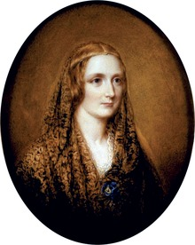
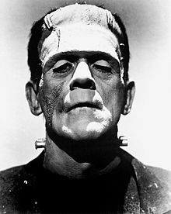
Frankenstein
Week one: overview.

Slide 10
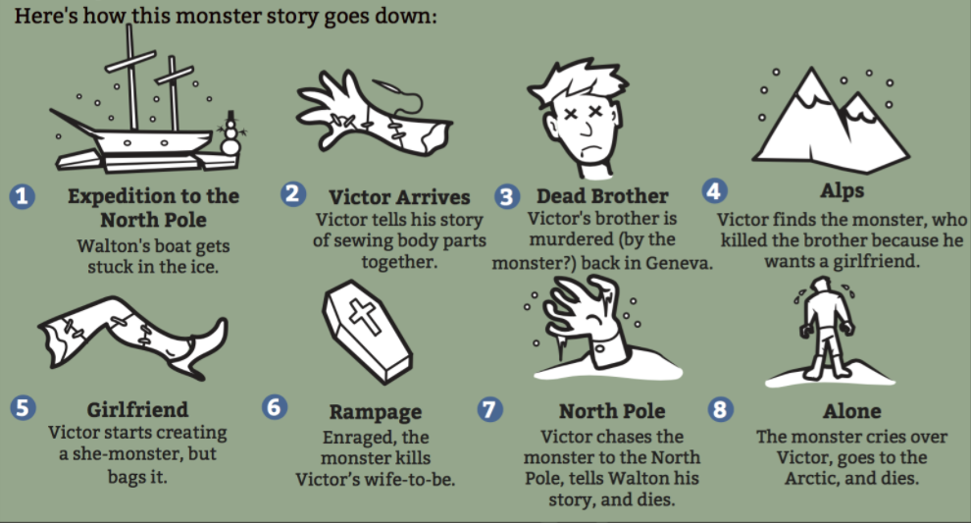
Ordering the story
On the following slides are the main events from Frankenstein.
Your task is to work
Out what has been
Moved out of order
Notes:
Each student has a piece of paper on which is written one event from Frankenstein; the students should negotiate and discuss in order to revise the structure and story of this novel

Slide 11
There are three events out of place… what are they?
Walton writes to his sister, describing his early life.
Walton writes of his progress to Archangel, describing the crew.
Walton expresses confidence in his quest; he cannot bear to think of failure
Walton catches a glimpse of the monster. The crew take Victor on board, and Walton believes he has a found a friend in whom he can confide.
Victor gives an account of his parents and early upbringing, introducing Elizabeth
Victor describes his early interest in science. Clerval is introduced.
Victor discovers the secret of life and relates how he has constructed the creature.
The creature comes to life and Victor breaks down and then recovers.
A letter from Elizabeth about Justine Moritz arrives. Victor gets better.
Victor leaves for the Orkneys and begins to create the female mate for the creature.
William (Victor’s brother) is murdered, and Victor sees the creature on his journey home.
Justine is tried for the murder of William; she is found guilty and is executed.
Victor isolates himself from his family, and he is full of remorse and guilt
Victor is now in the Alps, when the creature appears and they argue.
The creature describes his early life, introducing the De Laceys.
Elizabeth is murdered by the creature on her wedding night, and Victor swears to take revenge
The creature learns language from the De Laceys and his shocked to see his own reflection in a pool.
Safie (an Arabian woman with whom Felix De Lacey has been in love) arrives. The creature learns more about society and human nature.
The creature describes the history of the De Lacey family, and the story of Safie and her father.
The creature discovers three books and learns more about the identity of his creator. He approaches the De Laceys and is rejected by them.
Caroline (his mother) dies and Victor goes to university
It is clear that the creature was responsible for William’s murder. The creature demands that Frankenstein makes a mate for him.
Victor agrees to make a female and returns to Geneva
Victor’s father suggests that Victor should marry Elizabeth, and Victor leaves for Britain with Clerval.
Victor has second thoughts, the monster appears and Victor rips the female creature apart. The creature threatens Victor, saying that he will be with him on his wedding night. Victor sets off in a boat, is washed ashore in Ireland and arrested for murder.
Victor is imprisoned for the murder of Clerval. Victor’s father arrives and he is released.
Victor returns to Geneva to marry Elizabeth, and they travel to Lake Como.
Walton continues the story, describing how Victor pursues the creature, how the sailors want to return home; how Victor dies and the creature mourns his death. Walton talks with the creature, and the creature disappears across the ice in search of death.

Slide 12
Any surprises?
Letter 1: Walton writes to his sister, describing his early life.
Letter 2: Walton writes of his progress to Archangel, describing the crew.
Letter 3: Walton expresses confidence in his quest; he cannot bear to think of failure
Letter 4: Walton catches a glimpse of the monster. The crew take Victor on board, and Walton believes he has a found a friend in whom he can confide.
Chapter 1: Victor gives an account of his parents and early upbringing, introducing Elizabeth
Chapter 2: Victor describes his early interest in science. Clerval is introduced.
Chapter 3: Caroline (his mother) dies and Victor goes to university
Chapter 4: Victor discovers the secret of life and relates how he has constructed the creature.
Chapter 5: The creature comes to life and Victor breaks down and then recovers.
Chapter 6: A letter from Elizabeth about Justine Moritz arrives. Victor gets better.
Chapter 7: William (Victor’s brother) is murdered, and Victor sees the creature on his journey home.
Chapter 8: Justine is tried for the murder of William; she is found guilty and is executed.
Chapter 9: Victor isolates himself from his family, and he is full of remorse and guilt
Chapter 10: Victor is now in the Alps, when the creature appears and they argue.
Chapter 11: The creature describes his early life, introducing the De Laceys.
Chapter 12: The creature learns language from the De Laceys and his shocked to see his own reflection in a pool.
Chapter 13: Safie (an Arabian woman with whom Felix De Lacey has been in love) arrives. The creature learns more about society and human nature.
Chapter 14: The creature describes the history of the De Lacey family, and the story of Safie and her father.
Chapter 15: The creature discovers three books and learns more about the identity of his creator. He approaches the De Laceys and is rejected by them.
Chapter 16: It is clear that the creature was responsible for William’s murder. The creature demands that Frankenstein makes a mate for him.
Chapter 17. Victor agrees to make a female and returns to Geneva
Chapter 18: Victor’s father suggests that Victor should marry Elizabeth, and Victor leaves for Britain with Clerval.
Chapter 19: Victor leaves for the Orkneys and begins to create the female mate for the creature.
Chapter 20: Victor has second thoughts, the monster appears and Victor rips the female creature apart. The creature threatens Victor, saying that he will be with him on his wedding night. Victor sets off in a boat, is washed ashore in Ireland and arrested for murder.
Chapter 21: Victor is imprisoned for the murder of Clerval. Victor’s father arrives and he is released.
Chapter 22: Victor returns to Geneva to marry Elizabeth, and they travel to Lake Como.
Chapter 23: Elizabeth is murdered by the creature on her wedding night, and Victor swears to take revenge
Chapter 24: Walton continues the story, describing how Victor pursues the creature, how the sailors want to return home; how Victor dies and the creature mourns his death. Walton talks with the creature, and the creature disappears across the ice in search of death.

Slide 13
What is going on?

Slide 14
What has happened?

Slide 15
The story of Prometheus
According to Greek mythology: Prometheus and his brother were asked by Zeus the king of the gods to create mankind.
Clever, thoughtful, Prometheus shaped some earth in the image of the gods' image and named his creation Man. His brother, the foolish, thoughtless one, gave little thought to his work when creating the animals and squandered many of the powerful gifts on the animals. He gave powerful teeth and claws to animals such as lions and bears, he gave wings to birds giving them the power of flight, and swift legs to horses. No gifts remained to give to man. However, Prometheus invented a new gift that he gave it to the human race. It was intelligence and it gave men superiority over the animals. He also gave them the gift of fire, which he stole from Zeus, arming mortals against wild animals. Fire then enabled man to make fire, to craft metal etc.
When Zeus discovered this, he sentenced Prometheus to be eternally punished by fixing him to a rock of Caucasus, where each day an eagle would peck out his liver, only for the liver to regrow the next day because of his immortality as a god. He was intended to suffer alone for eternity, but eventually Heracles (Hercules) released him.

Slide 16
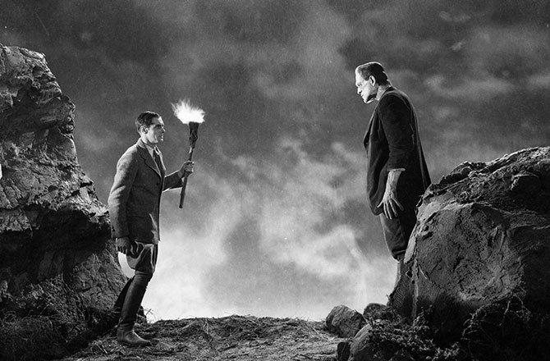
What are the links?

Slide 17
Possible links:
Victor is Mary Shelley’s modern incarnation of Prometheus.
Victor fascinated by the power of electricity (lightning), Prometheus by fire.
It is the power that will result in the torture that each will suffer.
Victor is ill with disgust following the creation of the creature; his torture mirrors that of Prometheus; undying and eternal.
This suffering pervades the entire novel, from when Victor warns Walton of the consequences of his quest, to the conclusion when Victor again reiterates the misfortunes he has suffered as a result of his curiosity.

