Slide 1
Unit 8 – The Recruitment and Selection Process
Introduction

Slide 2
What will you learn in this unit?
That successful recruitment is key to maintaining the success of a business.
You will learn about the different stages in the recruitment and selection process (both for the business and the candidate)
You will explore the various selection tools and technologies used by businesses in the process.
You will also have the opportunity, through role play, to take part in interviews. This will give you the foundation for progression to employment (e.g. in a human resources role), or to higher education.
Notes:
Ask students – does anyone have a part time job?

Slide 3
Introduction
What do you already know about recruitment and selection?
Recruitment and Selection = The process of finding and hiring the best-qualified candidate (from within or outside of an organisation) for a job opening, in a timely and cost effective manner.
Source: BusinessDictionary.com
Which functional area of a business is responsible for recruitment and selection?
Human Resources (HR)
Notes:
Ask students – does anyone have a part time job?
Define what is meant by functional areas. Outline the main functional areas

Slide 4
Methods of RECRUITING staff | Methods of SELECTING staff
Job adverts (online, in store, newspapers, industry journals) | Assessment centres
Job description | Psychometric tests
Person specification | Individual interviews
Job Centres | Group or team activity interviews
Recruitment agencies / Headhunters | Panel interviews
CV or application form | Telephone interviews
Letter of application | Presentations and tests at interviews
Note: Businesses can recruit internally or externally… what does this mean?
Note: Online can include the business’ own website or websites such as reed.co.uk or even newspapers websites.
Notes:
Introduce the concept of internal vs external.
Briefly introduce methods of recruitment and selection to enable students to carry out research task. Explain that these will be discussed in more detail next week,

Slide 5
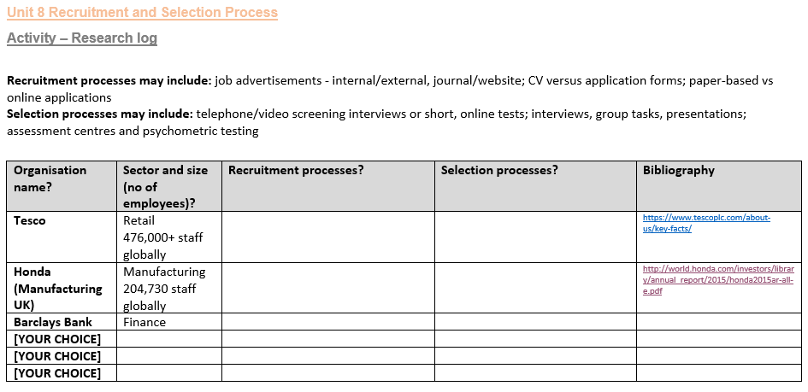
Introduction: Research Task

Slide 6
Today’s task
Complete the Research log activity
You should show on screen evidence of your completed log in the lesson on Monday 21st January
You need to finish the work BEFORE the lesson (not during)

