Slide 1
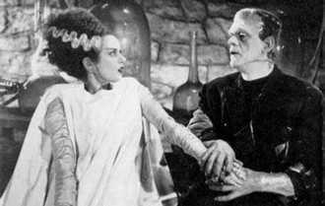
Frankenstein Week 2
Narrative and Women: Letters and Chapter 1

Slide 2
The purpose of the letters:
To provide a reliable voice: one that is not filtered through another character
To add a sense of veracity: these letters have recognisable forms, dates and place names
Expository function: introducing Walton’s early life; his current ambition; the creature and Victor
Expository function: introducing themes of loneliness, acquisition of knowledge, ambition

Slide 3
Male or female: are these quotes referring to male or female characters? You decide….

Slide 4
What do you deduce about the patterns you see in terms of the depiction of male and female characters?

Slide 5
Male v Female
Women: | Men:
restricted to the private sphere of domesticity | in the public sphere
imagery of religion associated with them | Possessing money
Nurturing | In pursuit of and in possession of knowledge
imagery of child (Child, helpless) | freedom to move
simple work (plaiting straw) | Possessing a profession
imagery of tender plants (exotic, rose) | Power (over women, money etc)
to be possessed by men (mine, mine, present)

Slide 6
Reading on: Chapter 1 p 33
P 33 Use of the first person narrator – unnamed, but introduced by Walton. Establishing his social position ("my family is one of the most distinguished…"
P 33 Worth noting how the father's role is very public and influential ("filled several public situations…"), contrasting with the female roles. Beaufort cannot bear to "live in poverty and oblivion" – as, indeed, the majority of the women and the creature do.
P33 setting up of nurturing evident throughout the early part of this novel ("loved Beaufort with the truest friendship") – contrasting to Victor's care for the creature.

Slide 7
Chapter 1 p 34
P 34 Contrast of female role here – Caroline Beaufort "attended him" "plaited straw" – nurturing, private activities.
P 34 First instance of the death of a family member "leaving her an orphan and a beggar" – echoed throughout this novel, about the way in which Victor fails to care for the creature. Seen again on p 36 ("her mother … had died on giving her birth…" "his child became an orphan and a beggar")

Slide 8
Chapter 1 p 35
P 35 – wife as the vulnerable plant "fair exotic" – with the husband as the gardener (the protector).
P 35 – duties are repeated throughout ("they fulfilled their duties towards me"…) as Victor is to fail to do.
P 35 - Reference to the "silken cord" that binds Victor to his family – sense of entrapment

Slide 9
Chapter 1 p 36
P 35-36 focus on the idealisation of femininity – the importance of physical beauty ("fairer than a pictured cherub… who seemed to shed radiance from her looks…") Repeated imagery of the spiritual and heavenly – foregrounding the contrasting appearance of the creature.
P 36 – Darker tone at the close with the lexical repetition of "mine" (x3) – a possession to be owned.

Slide 10
Your paragraph: 5 minutes discussion, 5 minutes, planning, 5 minutes writing: what does the opening of each novel reveal about the society depicted within it?
What does the choice of narrative voice tell us about the depiction of society in each text?
How does Kathy’s voice shape the meaning of the novel? (What clues are we given and how are we given them?)
Quote and analyse.
How does the use of letters shape the meaning of the novel? (What clues are we given and how are we given them?)
Quote and analyse
Conclusion about how the voice creates an unsettling depiction of society; adds a sense of veracity; serves to introduce certain themes; serves to introduce certain characters or terms that are important in the society of the novel.

Slide 11
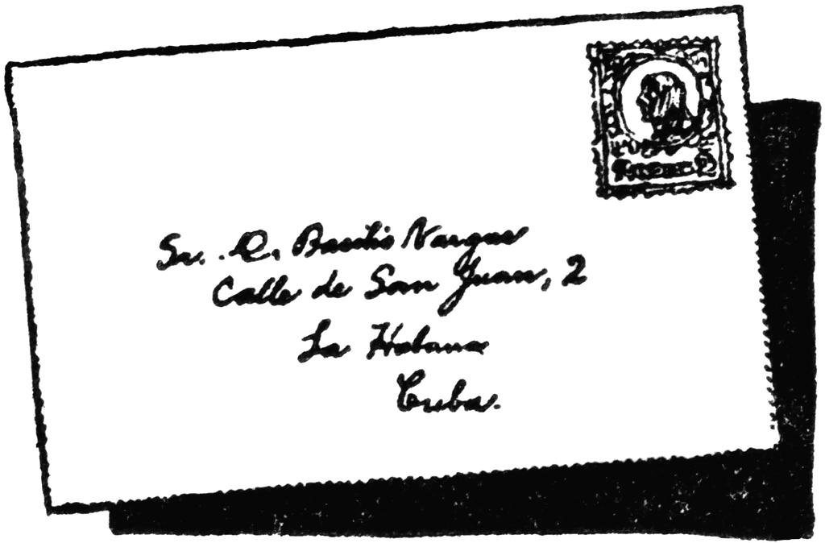
Some Narrative Terms
Epistolary:
An epistolary novel is a novel written as a series of documents. The usual form is letters, although diary entries, newspaper clippings and other documents are sometimes used.
Frame narrative:
A frame narrative is a literary technique that sometimes serves as a companion piece to a story within a story, whereby an introductory or main narrative is presented, at least in part, for the purpose of setting the stage either for a second narrative

Slide 12
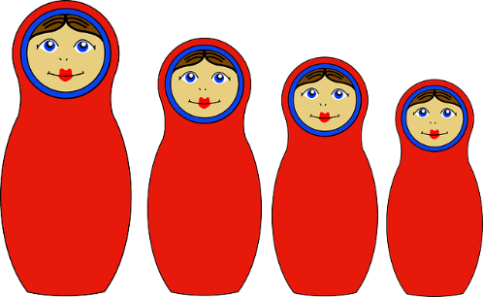
And some more….
Embedded narrative
Contained within a frame narrative, an embedded narrative hinges contextually on the framing narrative, while typically becoming the bulk of the story itself. In other words, the embedded narrative usually comprises the majority of the text, while the framing narrative occupies just the first and last few pages.
Chinese box structure:
refers to a novel where one narrative is told inside another, inside another (and so on), giving views from different perspectives.

Slide 13
Choose your diagram – or create your own

Slide 14
Now place these on your diagram
Walton’s letters (dated December 11th-August 19th)
frame narrative
epistolary narrative
Victor’s story related by Walton (Chapters 1-10)
the creature’s story related by Victor, related by Walton
Safie’s story, related by the creature, related by Victor, related by Victor (Chapters 11-16)
Victor’s story related by Walton (Chapters 17-23)
Walton’s letters – dated August 26th- September 12th (Chapter 24.)

Slide 15
For example: a completed version

