Slide 1
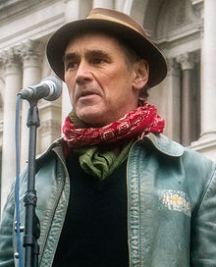
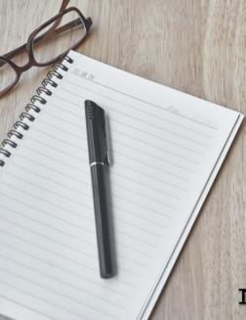
Week 13
Finishing Jerusalem – Introduction to Non-Fiction Creative Writing Coursework

Slide 2
In Pairs: you are given one statement. Argue your case
Either…. | Or….
This extract portrays Phaedra as being in control | This extract portrays Johnny as being in control
This extract includes the introduction of Phaedra’s voice, thus representing a sense of change and hope | This extract represents the final stages of the play – sense of resolution
In this extract the declarative sentence form indicates Johnny’s certainty | In this extract the Johnny’s vaguer, quieter tone suggesting uncertainty
In this extract the goldfish is simply a powerful, physical object on the stage | In this extract the goldfish has a highly charged symbolic significance
This extract portrays equality in the discourse (examples of co-operative principles in action) | This extract portrays a child-adult relationship (power imbalance)
Notes:
Contrasting ideas are handed out to students – they should find quotes and evidence to support their point. 10 mins Run the debate across the class. The rest of the class should vote on which side wins. 10 mins

Slide 3
Three quotes – your analysis in one sentence
“Just swimming back and forth”
“Time’s running out.”
“Everything needs a name.”
Notes:
Each pair has a white board and stand. They each write their analysis on the white board, as the sentences are revealed. The most popular is displayed at the front of the class. 15 mins

Slide 4
Some ideas to start you off…
Context: position in the play; first spoken words of Phaedra; first interaction between Phaedra and Johnny; “moving on” comments from Rylance interview; “escaping” comments in Paul Mason review; breaking from structure of comic genre in the sense of foreboding etc
Stylistics: repeated interrogatives (Phaedra); Johnny’s declarative, often simple sentences; shifting verb use from “given” to “left”; lexical clusters of stasis; lexical repetition of “name” etc
Dramatic: different register for Johnny; use of adjacency pairs; parody of official language; repetition of verb “shivers” in stage directions; goldfish imbued with physical and symbolic significance (revealing an aspect of Johnny’s character); sense of foreboding – nearing the end of the play, sense of reaching a climax/resolution; connection between stage directions and Phaedra’s “What you stick here for, anyway?” etc
Notes:
Three groups: one are the stylistics experts, one the dramatic experts, one the context experts – the rest of the students can ask them questions about what they could include. 20 mins Read on to the end.

Slide 5
Non-fiction writing
Assessment, choices
Notes:
What do they know about it? Compare to next slide.

Slide 6
Independent study: analysing and producing texts (04)
Your task: to produce a piece of original non-fiction writing.
Non examined assessment of both tasks: 40 marks 20% of total A level

Slide 7
What?
approximately 1000–1200 words with a 150-word introduction.
could take the form of travel writing, memoir, speeches, digital texts, multi-modal texts or any other text in a non-fiction genre. Suggestion – draw on the anthology
Notes:
What non-fiction might be possible? All suggestions on board – wipe off those that would not enable them to reach the higher grades (posters, advice sheets)

Slide 8
Your commentary
You need to identify some key elements of their original writing, showing the way in which their writing reveals understanding of their chosen genre and use of literary and linguistic techniques.
Learners should be able to:
use a range of techniques to produce and evaluate texts for different audiences and purposes, informed by wide reading
use English appropriately, accurately and creatively
synthesise and reflect on their knowledge and understanding of some elements of linguistic and literary methods and concepts
demonstrate knowledge and understanding of how language choices shape meanings in text.

Slide 9
Examiners will be looking to see if you…
use a range of techniques to produce and evaluate texts for different audiences and purposes, informed by wide reading
use English appropriately, accurately and creatively
synthesise and reflect on your knowledge and understanding of some elements of linguistic and literary methods and concepts
demonstrate knowledge and understanding of how language choices shape meanings in text.

Slide 10
The “boring” details
AO weightings for Original writing non-fiction. AO2 – 2%, AO5 – 6%, Total – 8%
The dominant assessment objective is AO5: Demonstrate expertise and creativity in the use of English to communicate in different ways.
Answers should also demonstrate understanding of how meanings are shaped in their original writing (AO2).

Slide 11
Start writing over the Christmas holidays – for example….
Travel writing
Essay
Speech (satirical or not)
Diary (perhaps a parody, or in the style of a celebrity, for example)
Parody (article/speech)
Article
Horrible Histories style piece to educate a young audience
Script for education purposes
Blog/journal
Any more?

Slide 12
Read Madonna’s Diary
Who has written/delivered/presented this text? Evidence
What genre is it?
When was it produced? Evidence
Who is the audience? How do you know? Are there examples of subject-specific lexis, for example? What does this tell you about the audience?
Remember: Context, Lexis and syntax, Interactional and Phonological features, Overview
Notes:
Ask the students to respond to these questions. Discussion about what attitudes the reader has towards Madonna. Is this a diary? Or a diary being used to achieve something else?

Slide 13
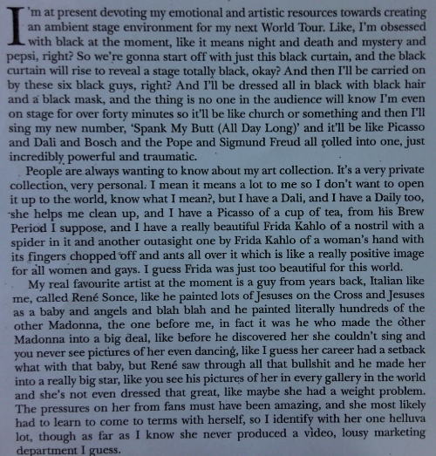

Slide 14
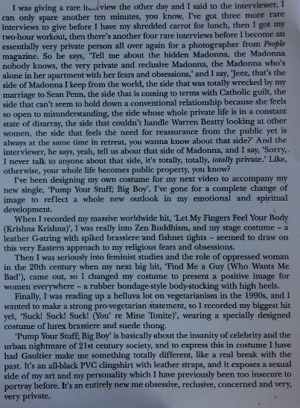

Slide 15
Lexis
Are there repetitions of particular words? If so, why?
Are there particular words that you would only expect to find in a spoken text? Words that you would expect to find in a written text?
Are there examples of figurative language? Are they metaphors/similes/clichés?
Are there any examples of lexical contrasts? If so, why?
Notes:
Aspects they might analyse: lexis being used to entertain (repetition, hyperbole, litotes, etc etc)

Slide 16
Syntax
What kind of sentences are most often used? (simple/compound/complex/minor), where and why?
Are the sentences mainly statements (declarative), questions (interrogative) or exclamations (exclamatory)? Why?
Are there examples of changing the order of the words in a sentence to create a particular effect? If so where and why?
Are there any punctuation marks that are used more than others, if so, why?
Notes:
Move to think about syntax

Slide 17
Interactional and phonological features
How does the text interact with the audience?
Does it address the audience using the second person pronoun?
Does it use “deictic language”? If so, where, and why?
Are there any sound effects utilised by the text? If so, where and why? (Non-verbal sounds, alliteration, consonance, onomatopoeia, phonetic spelling, assonance?)
Notes:
And finally… the students add to their notes as these slides are shown

Slide 18
Parody – written by Craig Brown, from Private Eye Rear Columns Collected Diaries of the Famous, 1992
Parody is mimicry of someone’s style in a humorous or satirical way.
Look again at the lexis and syntax, and see if you can find evidence for the way in which Madonna’s way of speaking, subjects she discusses, her lyrics, her publicity strategies.
Think of the features of comedic language (repetition, hyperbole, litotes, repetition etc etc)
Notes:
Reveal of parody genre – work in pairs to find evidence of the idea that this is a parody

Slide 19
Now try your own
Write the first paragraph of a parody of a diary of a close friend or relative.

