Slide 1
8.2 INTRO AND OVERVIEW
P3-D3

Slide 2
What are you going to be doing for this assignment?
You are going to prepare all the documents for a job that you could genuinely apply for (P3) and you will participate in a series of mock interviews (P4/M2) as interviewee and interviewer
You will then analyse your experience of the role play (M3), evaluate the documents used (D2) and finally evaluate how well the recruitment and selection process complied with best practice (D3)

Slide 3
Initial research task (P3)
Research a range of job roles from Tesco
Keep a portfolio of the information you find about the various jobs and consider the experience, skills, qualities and qualifications required for each the role.
Research 6-8 different roles from various areas of the business

Slide 4
P3: Prepare appropriate documentation for use in recruitment and selection activities
Choose an actual job (e.g. Customer Assistant or similar) that you could apply for now or in the near future. For this job you need to produce the following documents:
Job description
Person specification
Completed application form
Job advert
C.V.
Covering letter
List of question for interview
Interview feedback form (to be completed when interviewing candidates)

Slide 5
1. Write a Job Description
Title of the job
Department and location
Broad terms (rough idea of what’s involved in the post)
Responsible to whom
Responsibilities
Scope of post (whether or not there is a possibility to supervise others or make management changes)
Education and qualification
Name of compiler and approver (who designed and agreed the job)
Date of issue

Slide 6
2. Write a Person specification
Title of the job and reference number
Location in management line (how senior the post holder will be)
Essential characteristics
Desirable characteristics
Attainments, qualification and general intelligence
Previous experience
Special aptitudes (special skills e.g IT or typing speed)
Temperament and personality
Any other relevant information

Slide 7
3. Create a Job advert
Company – name, logo, what they do.
Job title
Pay
Place
Work
Contact Type
How to apply
Deadline

Slide 8
4. Write your own cv
Personal details
Education
Academic qualifications
Work experience
Personal statement
Referee (reference – usually 2)

Slide 9
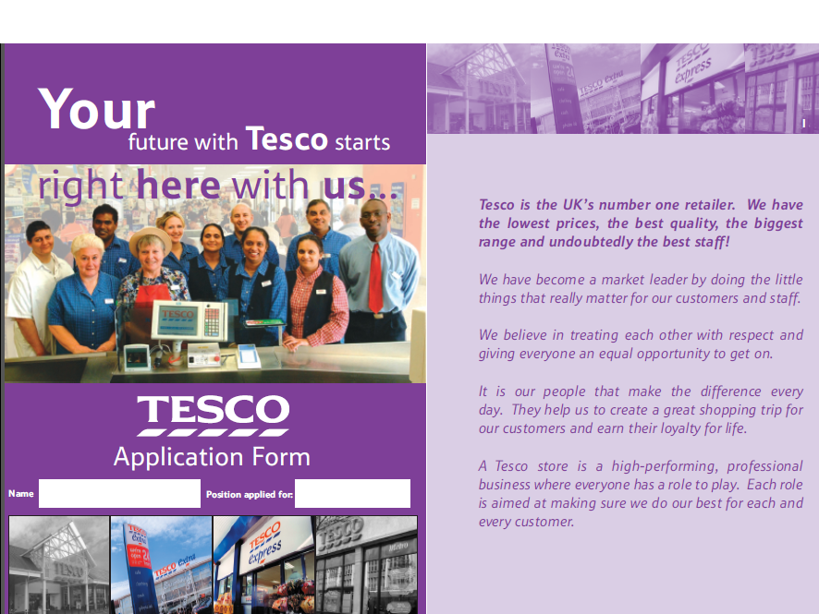
5. Fill in the tesco application form
Go onto Godalming Online and print off the Application Form for Tesco.
Complete by hand in Black or Blue Ink .

Slide 10
participate in the interview
P4,P5,M2

Slide 11
P4/m2: participate in the interview
You will undertake a mock interview for the post that you have applied for. You will need to participate in the interviews as interviewee and interviewer. Your performance at interview in both roles will be observed by your peers and teacher.
P4 is taking part in the interview process
M2 is awarded for demonstrating analytical responses and questioning in the interview to allow assessment of skills and knowledge. (Consider the questions that you will ask your interview candidates)

Slide 12
P5: swot analysis
You will need to create 2 x SWOT analyses
1) In your role as an interviewee (the candidate)
2) In your role as an interviewer
Also
Complete the 2 performance tables on Godalming Online analysing your performance as an interviewee and as an interviewer

Slide 13
P5: swot as interviewee
Consider – Strength or weakness?
Posture, body language, facial expression
Nervous? Well prepared?
Ability to respond to every answer
Quality of language – polite, clear, formal/appropriate?
How much detail you could provide
How relevant your answers were
Did you have experience to refer to?
Did you make sure that your answers were relevant to Tesco?

Slide 14
P5: swot as interviewer
Consider – Strength or weakness?
Were all the recruitment documents appropriate?
At interview, how was your posture, body language, facial expression – general manner?
Did you put the candidate at ease? Greeting?
Nervous? Well prepared? How well you did you work with the other panel member
Quality, clarity and detail of questions– appropriate? Repetitive?
How relevant your questions were - linked to Tesco job description and person specification?
How quickly did you respond to the candidate’s answer? Did you rush them/keep them waiting?
How well did you respond to the candidate’s question?

Slide 15
Review and evaluate the interview
P6,M3,D2,D3

Slide 16
P6/m3: personal skills development plan
Date | Personal skill to be developed | How will it be developed? | What will the outcome be? | By whom and when? | Resources and help I need? | Review and monitoring
Example: 24 November 2016 | Time management | Complete an online training course in time management | Course completed | Joe Bloggs 30 March 2017 | Access online Registration online
You will need to create a Personal Development Plan, complete with SMART targets (P6)
Write an analysis of how your experience in the role play and your personal development plan might improve your future success and improvement of your employability skills (M3)

Slide 17
D2: evaluation
Evaluate your documents and your performance at interview (as an interviewer and as an interviewee
Consider the strengths and weaknesses of each (see D2 Guidance Sheet) and conclude what you could do to improve if you were to do it again.

Slide 18
D3: evaluation
Evaluate how well the recruitment and selection process complied with best practice.
Include reasoned conclusions as to how this will support your future career.
Finally, don’t forget your bibliography.

