Slide 1
Preparing for interview
Assignment 8.2

Slide 2
What will you need to do?
Write 10 interview questions
Prepare a shortlist proforma
Prepare an interview feedback form
Submit your portfolio to the members of your group for their review.
Practice your interview technique

Slide 3
Interview questions
Questions should be asked in ways that help the applicant to do their best. They should be:
Clearly communicated and allow time for the interview to have a short pause before they answer
Repeated if necessary
Short enough for the interviewee to understand the questions but long enough for them to be able to give a good answer.
Asked in a way that supports the interviewee to give their best answer

Slide 4
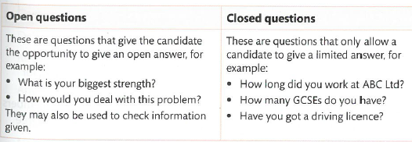
Writing interview questions
Start with general questions about the person (e.g. why they want the job and any other background information)
Then ask questions that relate to specific aspects of the job
Conclude with any other relevant information that might be needed (i.e. when and how the applicant will hear if they have been successful)
Applicants should be given a chance to ask questions at the end of the interview

Slide 5
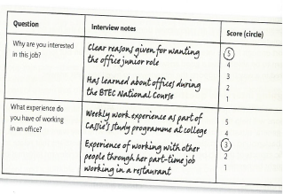
Interview feedback form
During the interview, detailed records need to made so that candidates can be compared.
Each interviewer will complete their own form and then compare with the other panel members after the interviews have finished.

Slide 6
Peer review of recruitment portfolio
On a new page at the end of your electronic portfolio add the title ‘Peer review of documents’
Each member of your group should come and read through all of the documents you have prepared and provide feedback regarding the quality and suitability of the documents you have created and suggestions for improvement.
Are the documents fit for purpose? (HR and Applicant docs) Strengths/weaknesses? Can any of them be improved?
Are the interview questions suitable? If yes, why? If no, how can they be improved?
Is the feedback form suitable? How could it be improved?
The members of the group should type their name and then type their comments into you portfolio. You should therefore end up with 3 good sized paragraphs providing feedback on the all the recruitment documentation you have provided.

Slide 7
Interviews and skills
Communication – its not just what you say, but how you say it.
Body language and listening skills
Firm handshake
Active listening e.g. nodding head
Open body language
Good eye contact
Don’t fidget
Smile!
Professional approach – it is important that you act in a way that shows you are serious about the job and that you can act in a way that the profession requires.
Formal language – use clear speech, no slang!
Appropriate dress
Watch the videos on GOL to help you prepare your technique

