Slide 1
Learning Aim C: Reflect on the recruitment and selection process and your individual performance.

Slide 2
P5: Complete a SWOT analysis on your performance in the interviewing activities STEP 1: Complete a self critique
You now need to self-critique; evaluating what went well, where there is room for improvement, how this can be achieved and why it is important to do so.
You will document this in a reflective report that measures your individual performance against best practice.
Add the title “Review and evaluation of the role play activity”
TASK: Set up the following tables;
Title: Feedback from peers – create the table on page 281
Title: review of communication skills – create the table on page 282
Title: review of organisational skills – create the table on page 283.

Slide 3
P5: Complete a SWOT analysis on your performance in the interviewing activities STEP 2: Identification of employability skills
TASK: Using the feedback from your performance as both interviewer and as an interviewee, identify the employability skills shown in your performance and describe how you demonstrated these skills (using examples).
Type of skills | Examples
Cognitive and problem solving | Using critical thinking, solving problems with interesting and creating solutions, using systems and technology
Intrapersonal skills | Communicating with others, working collaboratively, negotiation and influencing other people, presenting yourself well.
Interpersonal skill's | Self management, being able to adapt to different situations, being able to reflect on your behaviour and change it as necessary
Continued on next slide

Slide 4
P5: Complete a SWOT analysis on your performance in the interviewing activities STEP 2: Identification of employability skills
TASK: Why do you think you have gaps in your skills? The UK Commission for Employment and Skills suggests the most common gaps in skills for young people are:
Lack of life experience
Poor attitude or motivation
Lack of skills or competencies
Lack of common sense
Poor literacy/numeracy skills
Poor results from education
TASK: Looking at the employability skills, consider which ones you have and which ones you can improve:
What can you do to improve these skills?
Who do you need to ask for help?
Think about how you could gain skills or competencies in a voluntary or work experience capacity.
How can you make sure that you get the best results from your business course?

Slide 5
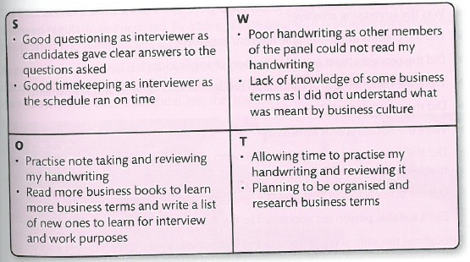
P5: Complete a SWOT analysis on your performance in the interviewing activities STEP 3: Complete SWOT Analysis
A SWOT analysis is a good way of summarising your performance into an easy format that can help you identify what you need to improve on in future. SWOT
Strengths = what are you really good at?
Weaknesses = which areas do you not perform so well at?
Opportunities = what could you do to improve your performance, especially in areas where you did not do so well.
Threats = what is stopping you getting better?
Continued over page
Notes:
Use judgement words (i.e. the words with boxes around) and then explain.

Slide 6
P5: Complete a SWOT analysis on your performance in the interviewing activities STEP 3: Complete SWOT Analysis
You should complete a series of SWOT grids for the following:
Your role as interviewer
Your role as interviewee
Planning and preparation, this should address:
Timings during interview, smooth running of interviews, presentation of your documents, level of detail in documents, spelling and grammar in documents, professionalism of documents.
4. Overall effectiveness of the recruitment and selection process, this should include:
Was the advert effective?
Were the notes/records sufficient?
Did the process given enough information to make a decision about the best person to appoint?
Did the process follow best practice for legal and ethical considerations?

